Slide 1
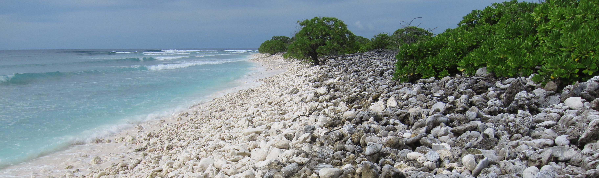
An ensemble approach to reconstructing mid-20th century climate using young fossil corals:
pitfalls and opportunities
Nicholas T. Hitt
Environmental Data Analysis

Slide 2
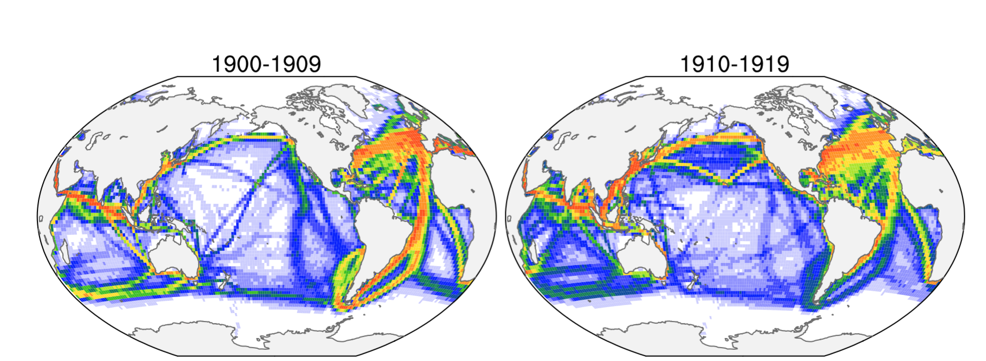
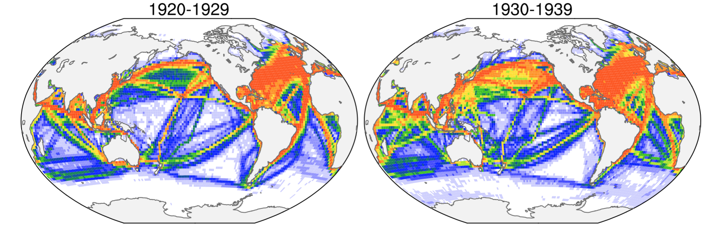
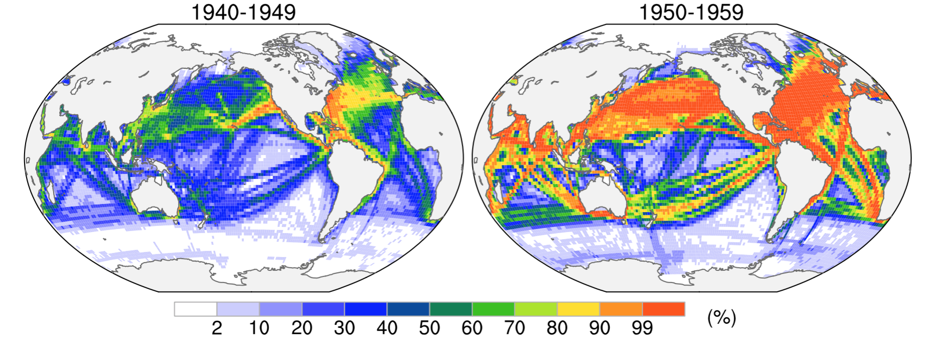
Few direct SST observations in the tropical Pacific prior to 1950
(Deser et al. 2010)

Slide 3
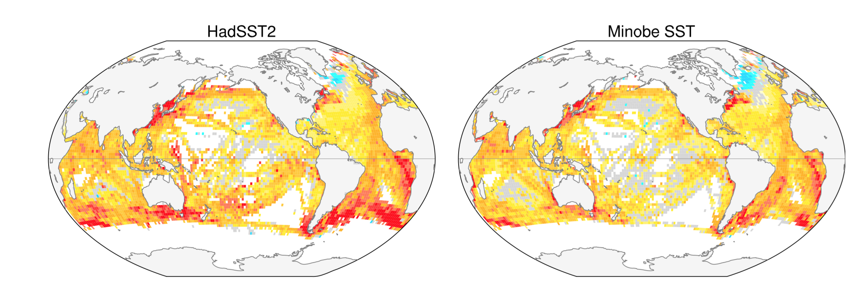
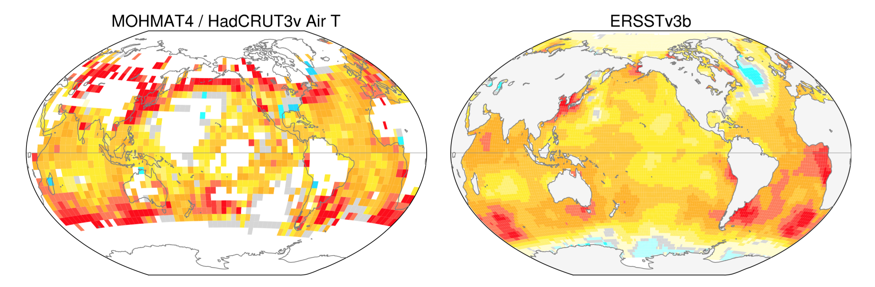
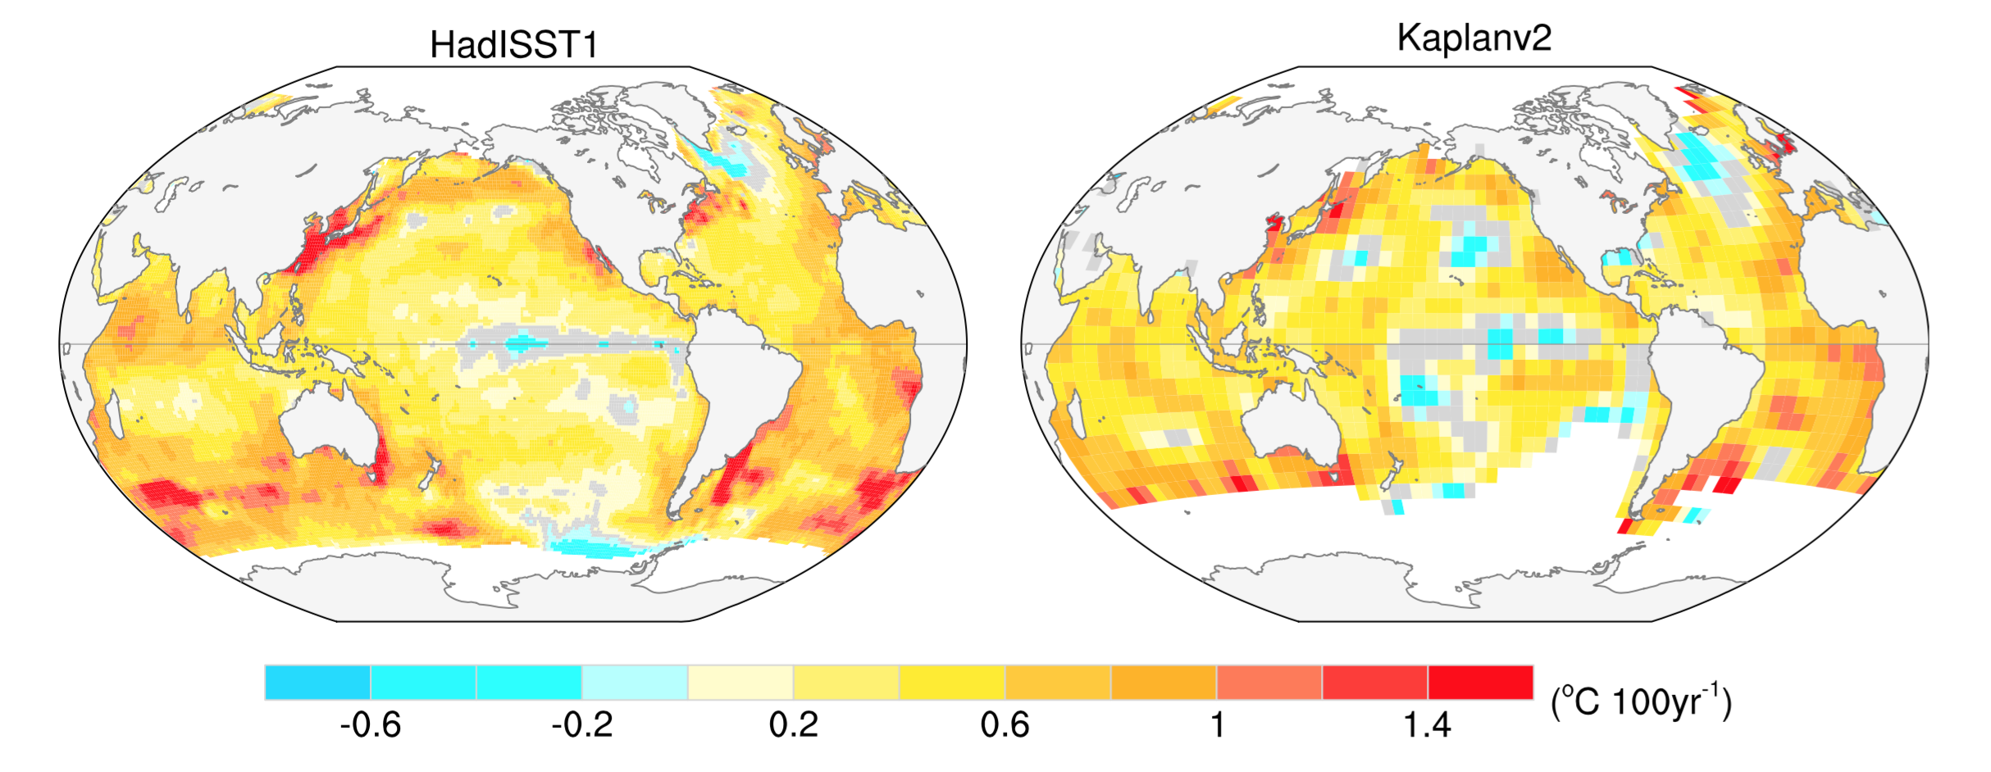
Tropical Pacific SST trends are inconsistent over the 20th century
(Deser et al. 2010)

Slide 4
Christmas Island
Tropical Pacific SST trends are inconsistent over the 20th century
(Deser et al. 2010)

Slide 5
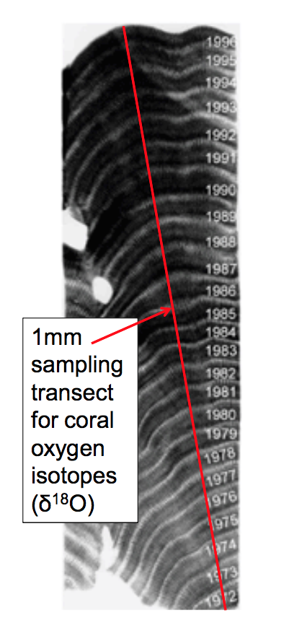
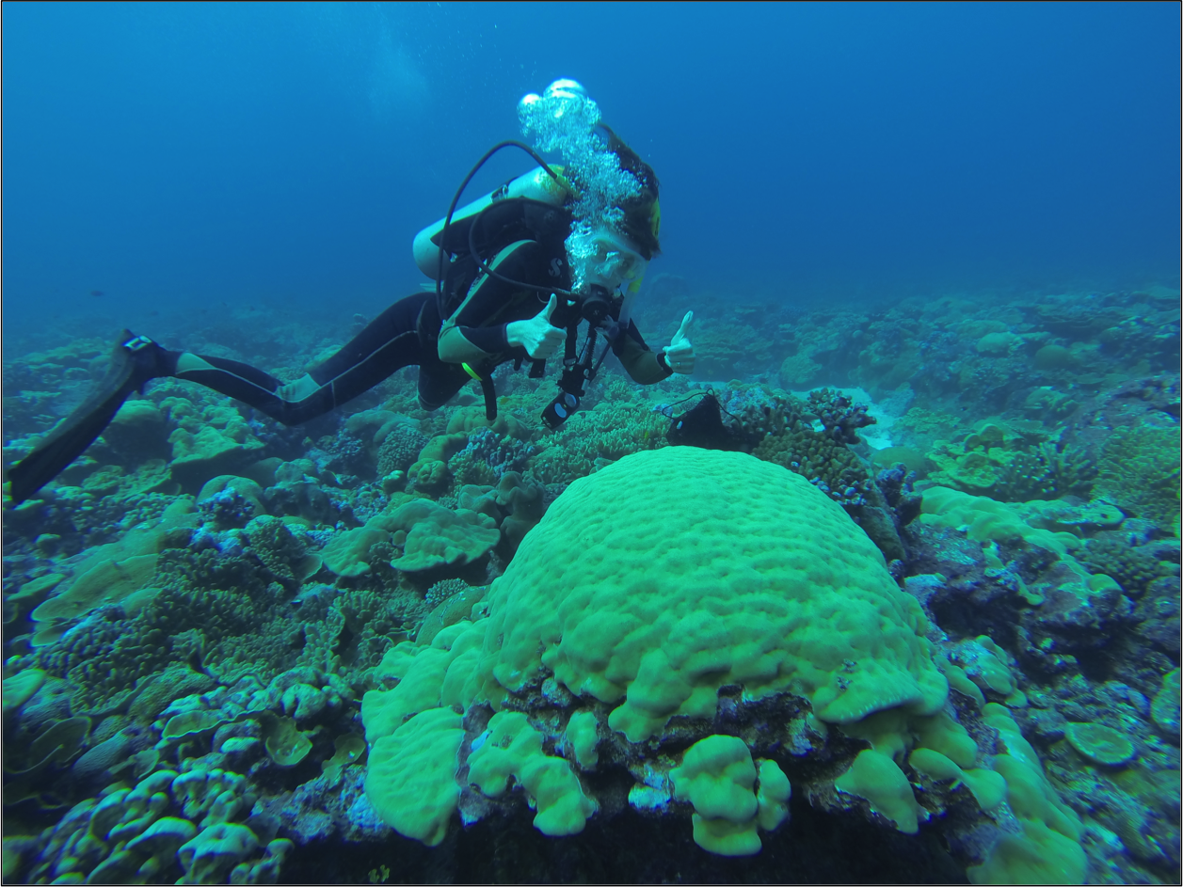
Corals are in situ recorders of past ocean conditions
Photo Credit: P. Grothe
Widely distributed throughout the tropics
Rapid growth rates allow for monthly resolved records
Seasonal banding represented in x-rays

Slide 6
Oxygen isotopes in modern corals from Christmas Island
Evans et al., 1998
Nurhati et al., 2009
Grothe et al., in press
Tianran et. al in rep
δ¹⁸O is well reproduced among modern corals and tracks SST

Slide 7
Oxygen isotopes in modern corals from Christmas Island
Evans et al., 1998
Nurhati et al., 2009
Grothe et al., in press
Tianran et. al in rep
δ¹⁸O records are systematically offset from one another
Offsets range from 0.27 per mil or ~1C

Slide 8
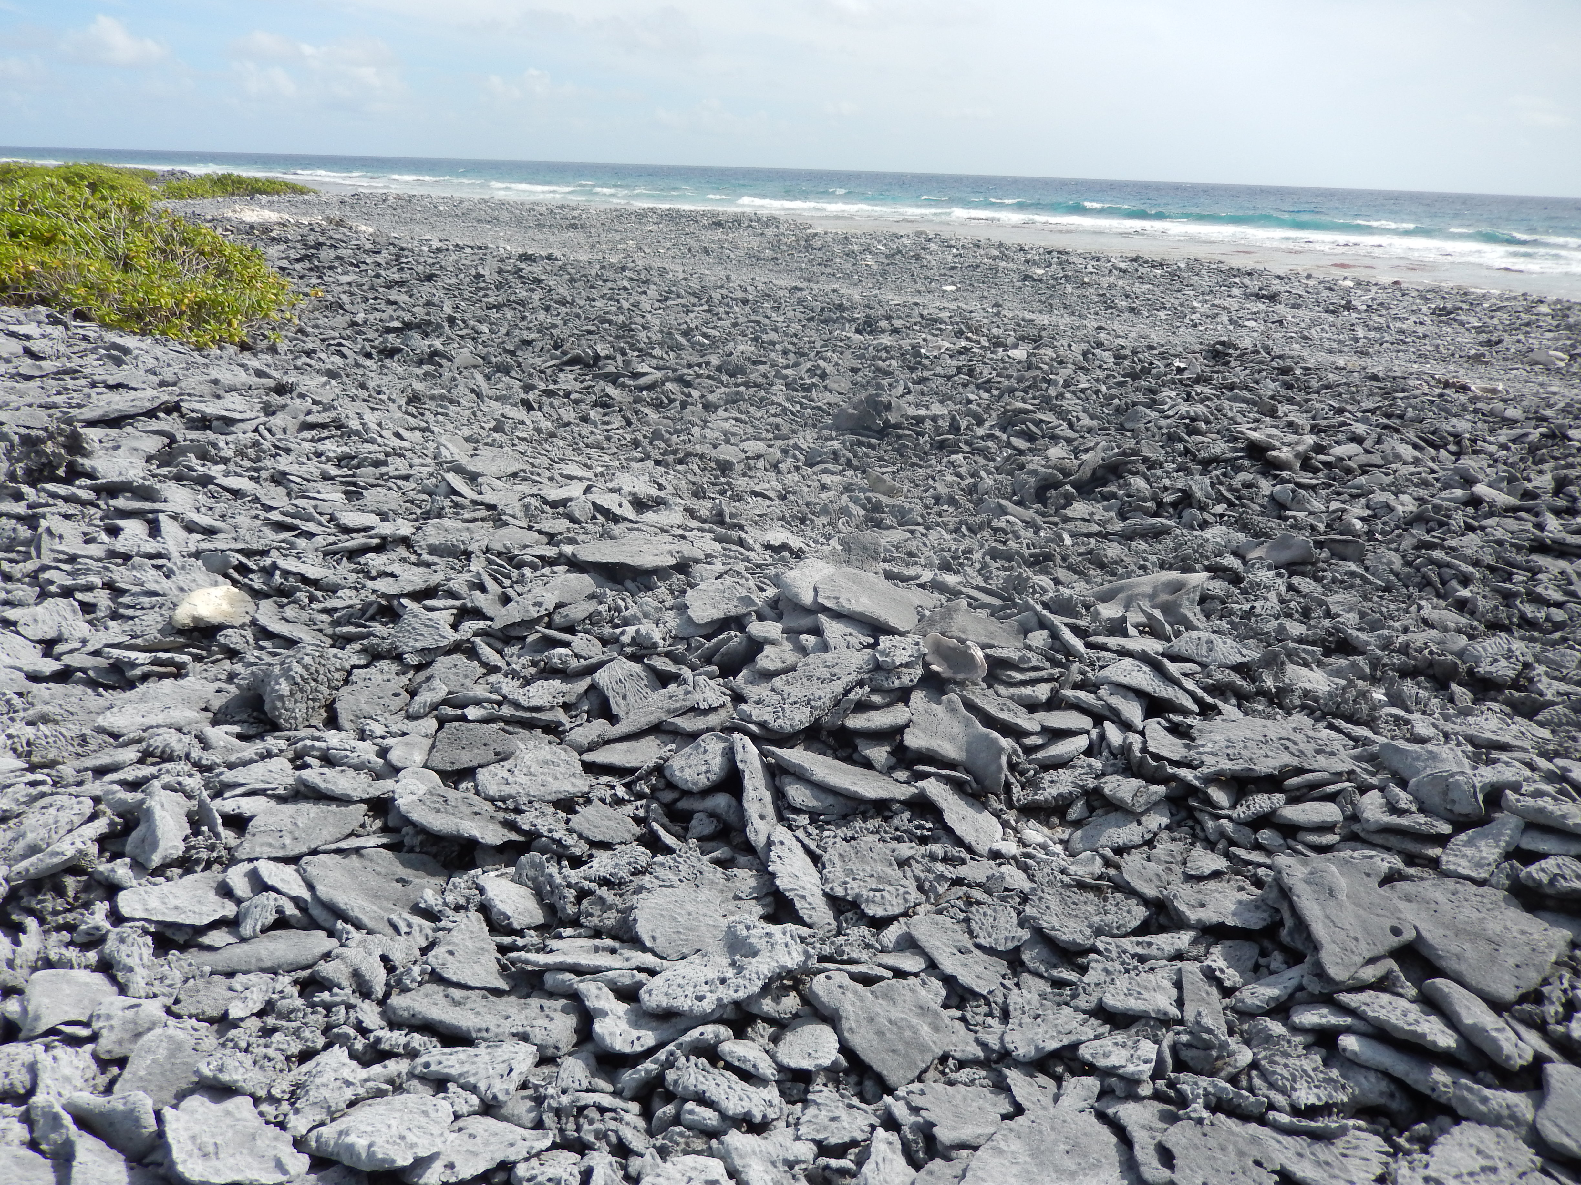
Coral rubble fields on Christmas Island
Photo Credit: Pamela Grothe

Slide 9
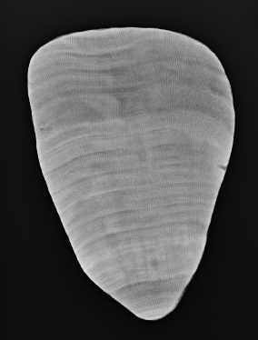
Research Objectives
Test rubble corals as a tool for reconstructing mean climate
Approach:
measure δ¹⁸O in U/Th-dated rubble corals from 1978-2006
Transect length = 14.3 cm
~13 years of climate data

Slide 10
Rubble Approach
  short record lengths
  expensive U/Th dates
  time consuming SEM/XRD
  susceptibility to diagenesis?
  need large number of samples
Cons
  unlimited number of samples
  high degree of replication
  constrain uncertainties from offsets
Pros
Notes:
Converging multiple records through multiple offsets affords more accurate mean climate reconstructions

Slide 11
Rubble Approach
  short record lengths
  expensive U/Th dates
  time consuming SEM/XRD
  susceptibility to diagenesis?
  need large number of samples
Cons
  unlimited number of samples
  high degree of replication
  constrain uncertainties from offsets
Pros
high potential for robust climate reconstructions
Notes:
Converging multiple records through multiple offsets affords more accurate mean climate reconstructions

Slide 12
Results
δ¹⁸O
Year
Notes:
Corals match up well with SST, shows the same variations as SST, highly correlates

Slide 13
Results
Notes:
Corals match up well with SST, shows the same variations as SST, highly correlates

Slide 14
Results
Notes:
Corals match up well with SST, shows the same variations as SST, highly correlates

Slide 15
Results
δ¹⁸O
Year
Notes:
Corals match up well with SST, shows the same variations as SST, highly correlates

Slide 16
Results
δ¹⁸O
Year
Diagenesis produces anomalously high δ¹⁸O values
Notes:
Corals match up well with SST, shows the same variations as SST, highly correlates

Slide 17
Results
Notes:
Corals match up well with SST, shows the same variations as SST, highly correlates

Slide 18
Results
Notes:
Corals match up well with SST, shows the same variations as SST, highly correlates

Slide 19
Results
δ¹⁸O
Year
Notes:
Corals match up well with SST, shows the same variations as SST, highly correlates

Slide 20
Results
Notes:
Corals match up well with SST, shows the same variations as SST, highly correlates

Slide 21
Results
Notes:
Corals match up well with SST, shows the same variations as SST, highly correlates

Slide 22
Results
 | SST | Modern Coral
X12-D6-1 | 0.7804 | 0.7515
X12-FS9-5 | 0.5226 | 0.3708
X12-FS15-7 | 0.6341 | 0.4508
Number of Occurrences
Number of Occurrences
Number of Occurrences
Notes:
Corals match up well with SST, shows the same variations as SST, highly correlates

Slide 23
Results
δ¹⁸O
Notes:
Corals match up well with SST, shows the same variations as SST, highly correlates

Slide 24
Rubble Coral Stack
δ¹⁸O is well reproduced among rubble coral pieces
and is consistent with modern coral δ¹⁸O

Slide 25
Summary
  Tested a coral rubble approach to reconstruct mean climate
  Rubble pieces reproduce δ¹⁸O from modern corals and tracks SST
  This approach has potential for robust climate reconstructions

Slide 26
Summary
  Tested a coral rubble approach to reconstruct mean climate
  Rubble pieces reproduce δ¹⁸O from modern corals and tracks SST
  This approach has potential for robust climate reconstructions
  Provide a modern benchmark for climate reconstructions using rubble approach

