Slide 1
Can Weather Influence Homicide Rates?
Kaitlin Gardner

Slide 2
Motivation
Criminal Minds!!!
Oakland County Child Killer
Occurred during winter months and bodies dumped after snowfall
Suicide Correlation
During Spring and Summer suicide rates jump
Temperature and Rainfall
Studies have shown a correlation between higher temperature and rainfall and aggressive behavior

Slide 3
Questions for Analysis
Is there a correlation between rainfall data and homicides that indicates that the former causes the later?
Is there a trend in the two data sets?

Slide 4
Datasets
Rainfall Data
NOAA Weather Station in Boston
Range 1988-2008
Monthly totals
Homicide Data
20 Year Homicide Report from Boston Mass.
Range 1988-2008
Monthly totals
Benefits
Equal number of data points so no interpolation of any kind

Slide 5
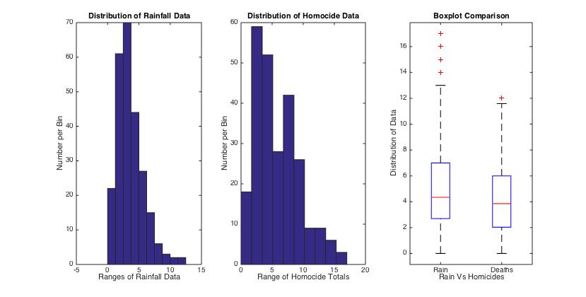
Histogram and Boxplots of Data

Slide 6
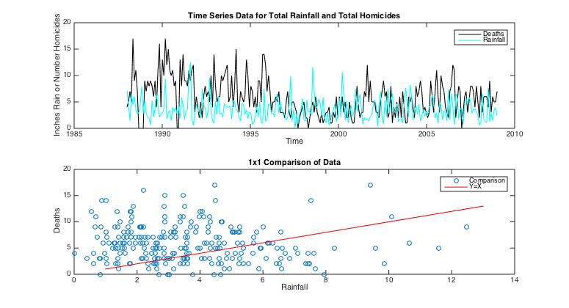

Slide 7
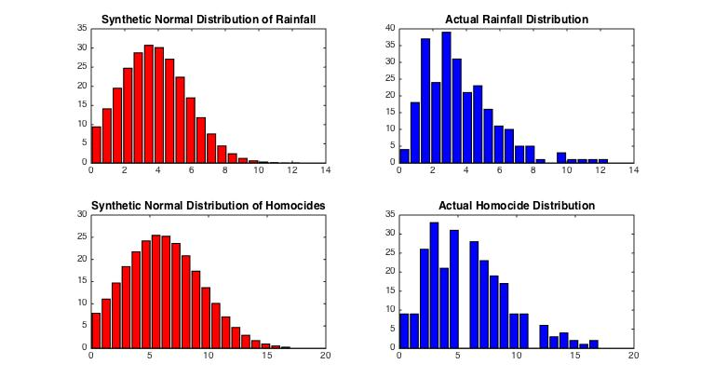

Slide 8
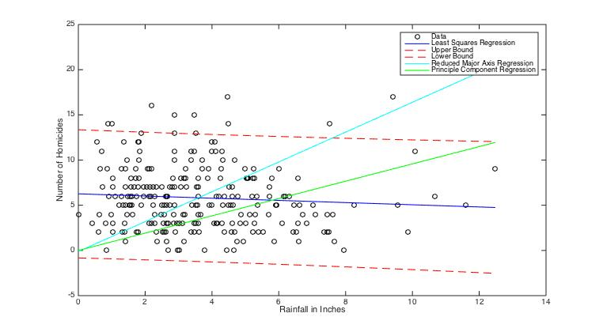
Regression Analysis and Correlation Coefficient
Regression Analysis
Least Squares
Reduced Major Axis
Principle Component Regression
Visually Least Squares looks the best
Correlation Coefficient
R = -0.0733
P = 0.246
The correlation is not strong and it is not significant

Slide 9
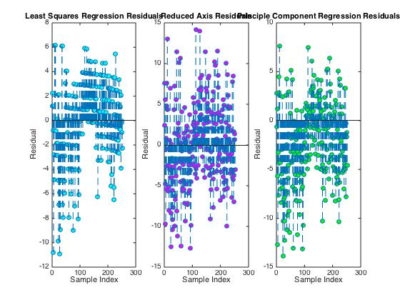
Residual Analysis
Least Squares Regression has the best fit because the residual analysis shows the least amount of difference between actual and fitted values

Slide 10
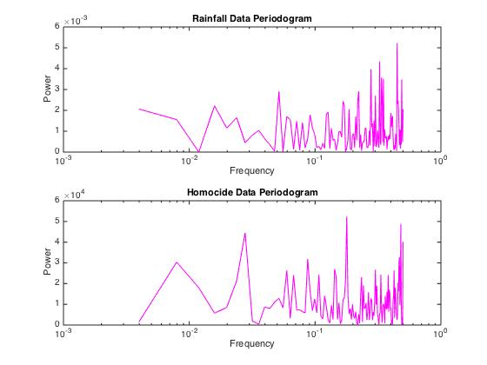
Periodogram of Rainfall and homicide Data
Expected to see trends that matched if there are high correlations
Since there are not it does not surprise me that are trends that aren’t matching
There are lots of peaks so it does not seem that there is one trend that really stands out

Slide 11
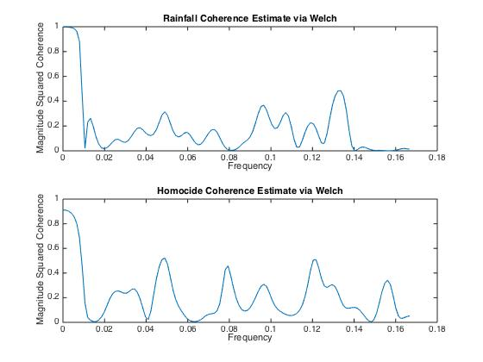
Coherence of Rainfall and homicide Data
Low coherence at every point except for the very beginning on both series
Indicates that there is a lot of noise

Slide 12
Conclusion
There is no correlation in this specific city however this only took into account one very specific population and area in the United States.

