Slide 1
THE EFFECT OF EXISTING GEOLOGIC FEATURES ON THE FORMATION OF EUROPA’S CHAOTIC TERRAINS.
J. E. Hedgepeth¹ and B. E. Schmidt¹,
¹Georgia Institute of Technology
(jhedgepeth3@gatech.edu)

Slide 2
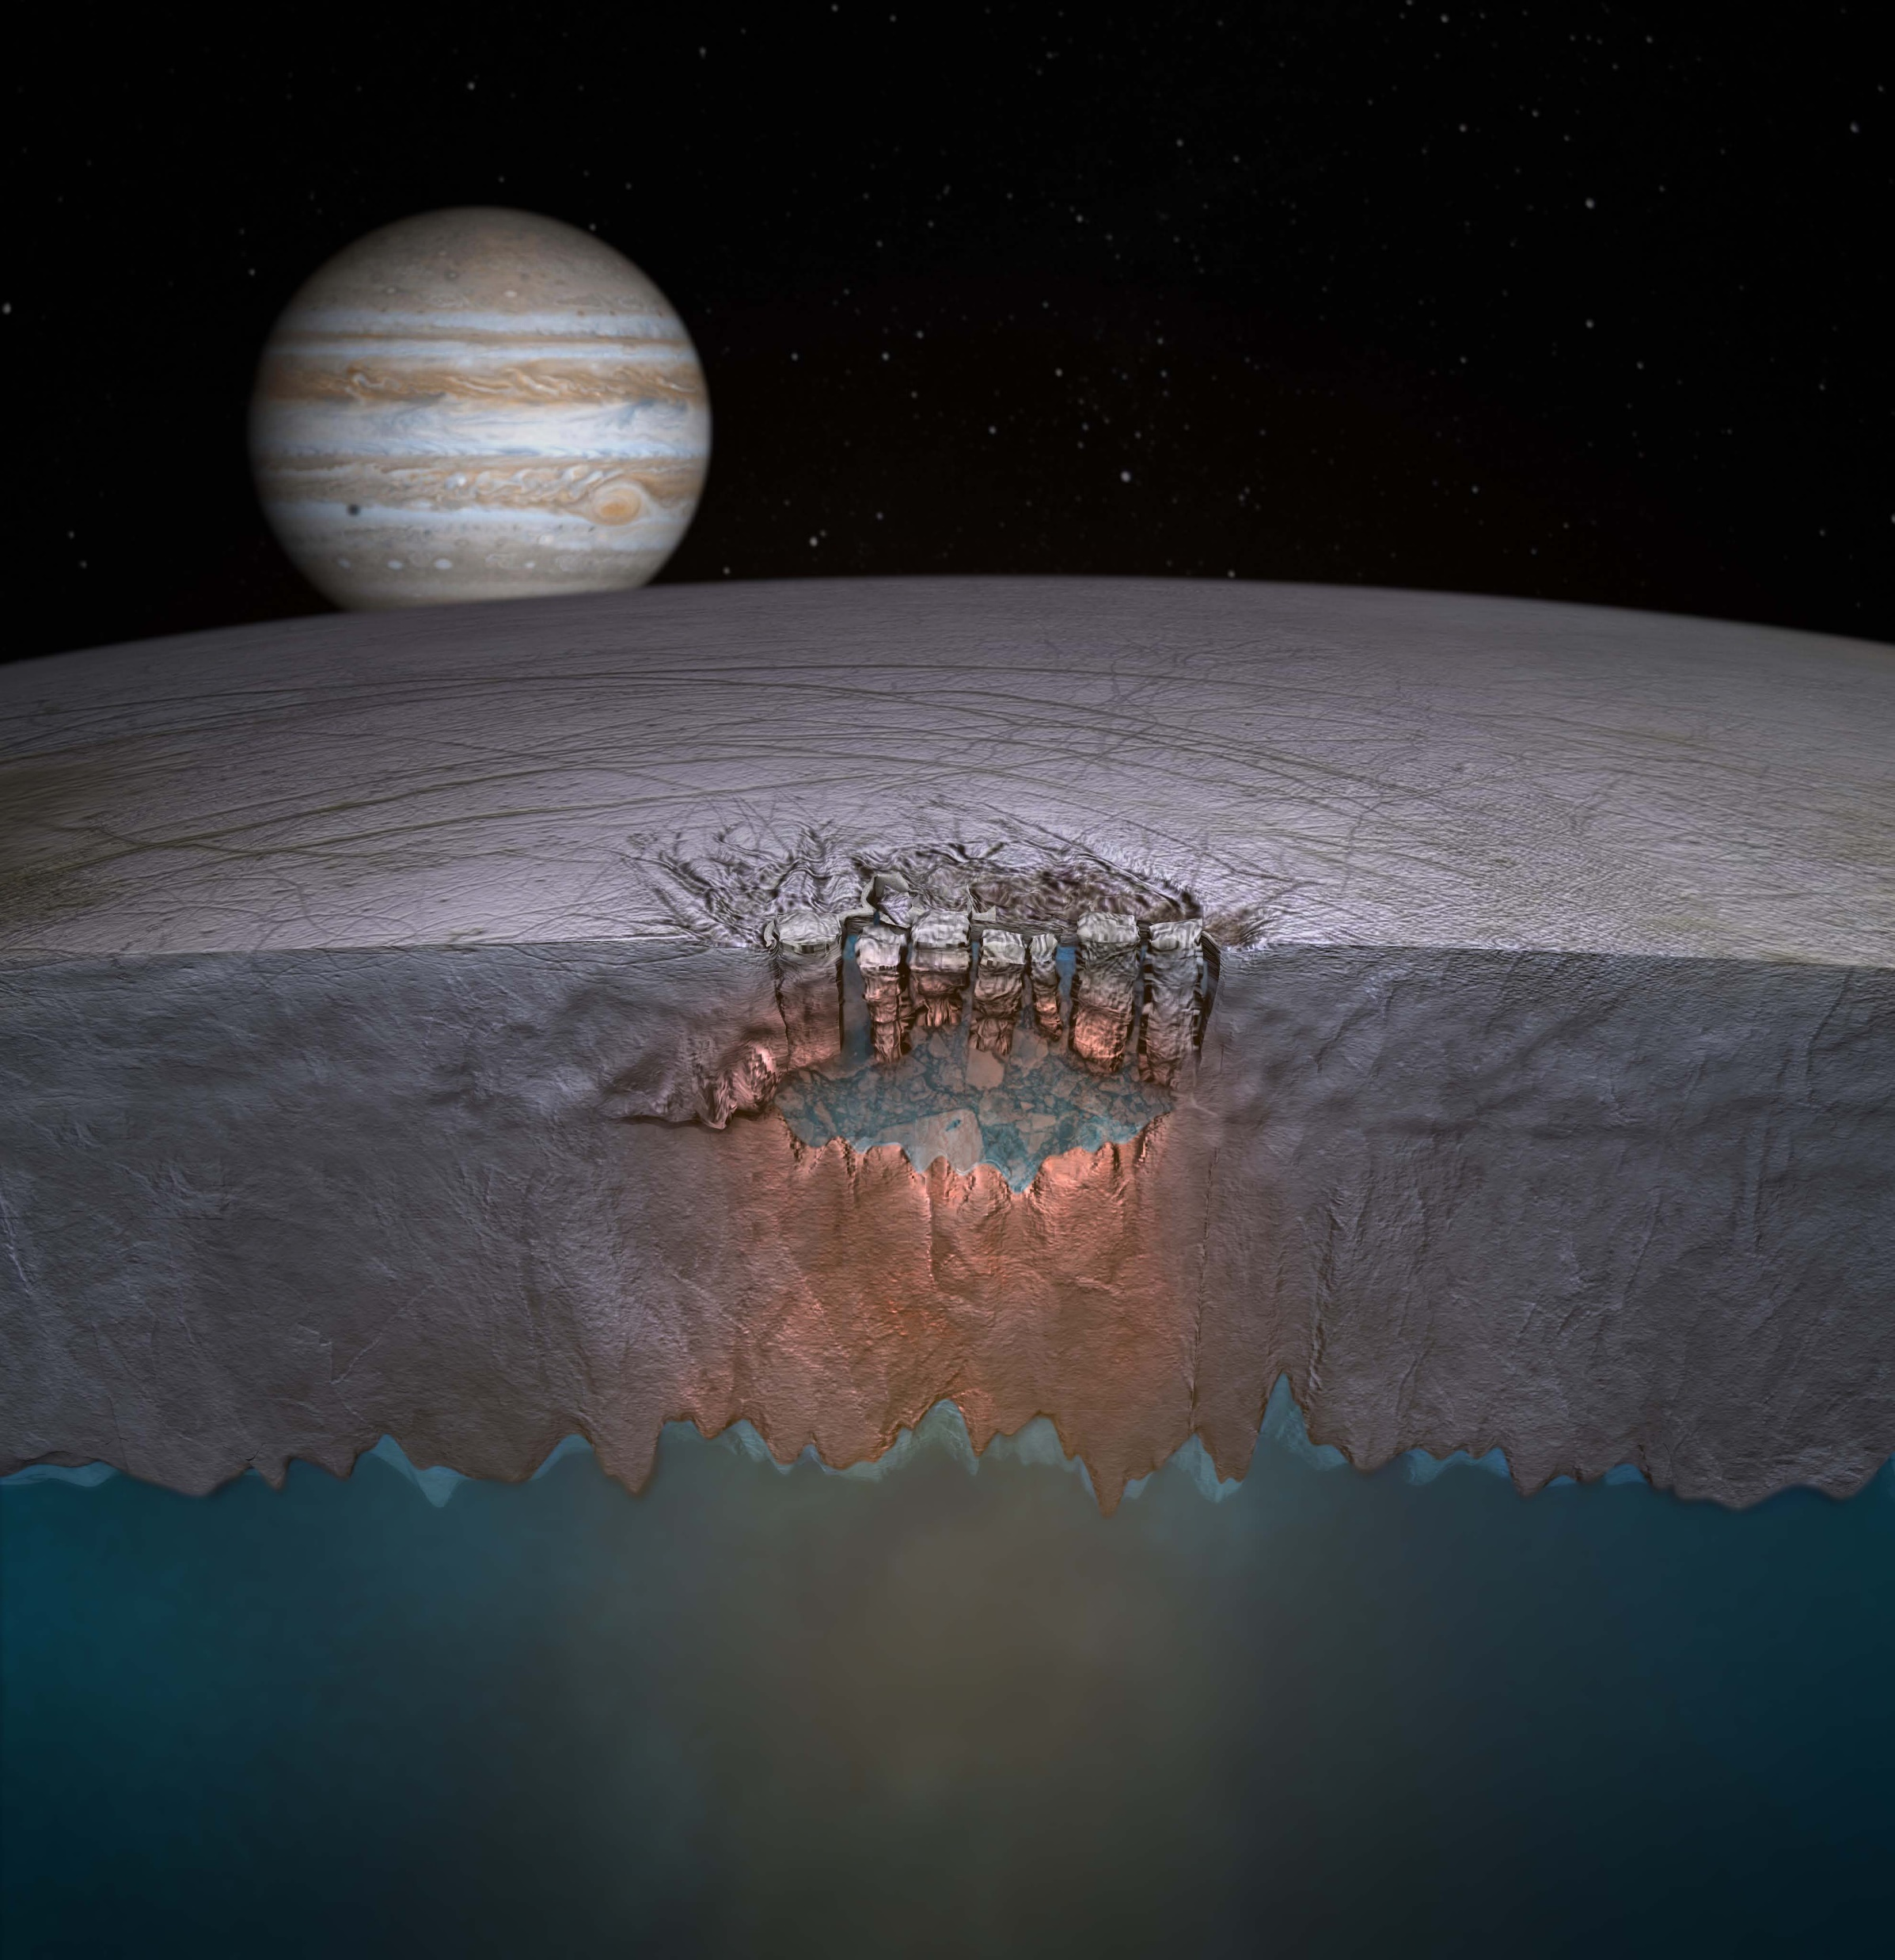
Introduction
Water ~ Life, hence the love for icy moons
Chaos terrains may be evidence of subsurface activity
Surface-ocean mixing
Possible resource for Europian life [1,3]
Chaotic terrain are lumpy, disrupted matrix material
Formed from preexisting surface by endogenic process [3-5]
Models explain formation but not diversity of types
Schmidt et al. (2011) Chaos Formation [1]

Slide 3
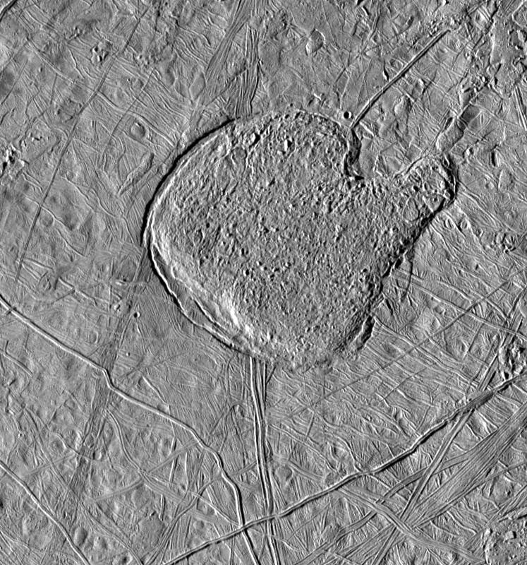
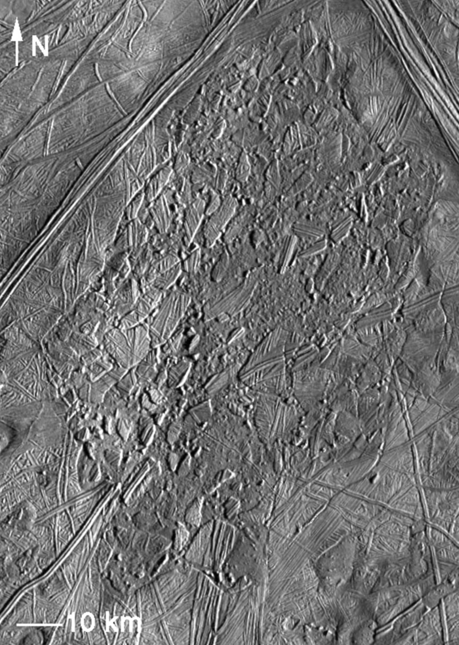
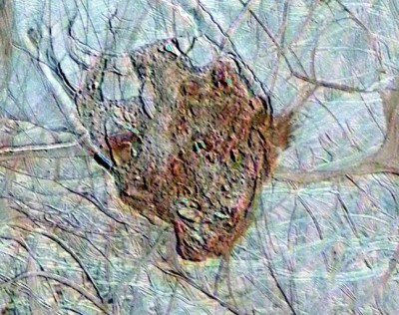
Europa Chaos Map [2]

Slide 4
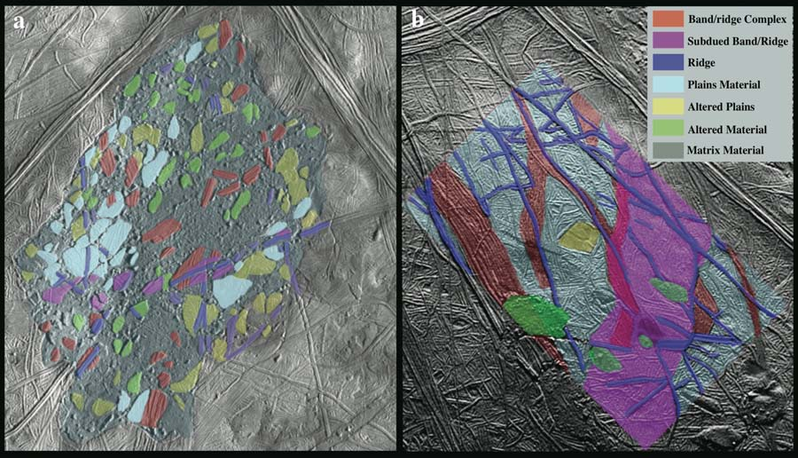
Objectives
Identify current surface features
Infer paleo-features
Correlate features to existence of icebergs
Ratio area measurements
Schmidt et al. (2011) use analogous terrain to infer the what iceberg material exists in Conamara Chaos [1] .
Hypothesis:
Plains are weaker than ridges. Stronger material is more resistant to breaking up and will leave behind more icebergs (unbroken ice).

Slide 5
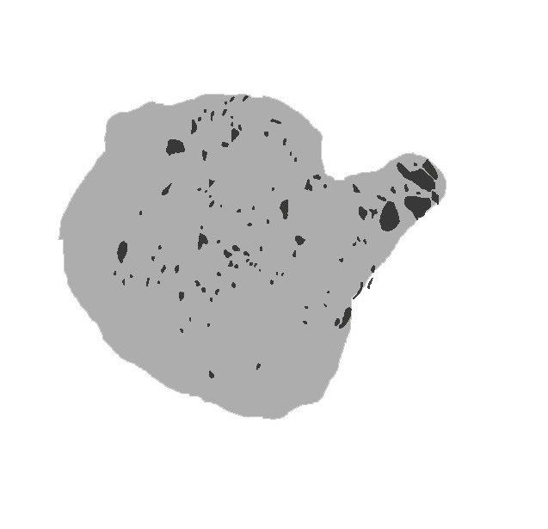
Data Collection
21 Chaos terrains
(~230m/px)
Identified chaos and icebergs
Identified surface features
Plains (blue)
Bands (red)
Plains (green)

Slide 6
Methods
Data Collection
Convert maps to data matrix
Area ~ Pixel count
Normalize
Linear Regression
Correlation Coefficient
Multi-Variable Regression (mvregress)
$A_{iceberg}=β_{1}∙A_{ridge}+β_{2}∙A_{band}+β_{3}∙A_{plain}$
Correlate modeled and observed iceberg areas
Weigh significance of ridges, bands, and plains

Slide 7
Results, Linear Regression
Probabilities $≤$ 5%
Correlation Coefficients

Slide 8
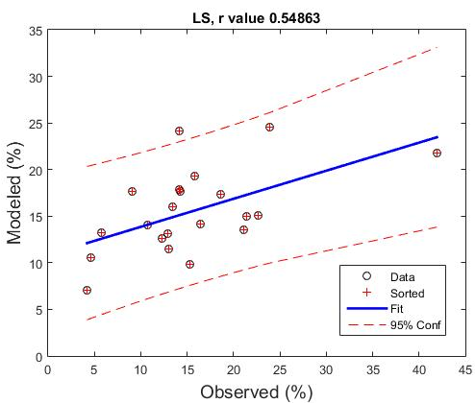
Results, Multivariable Reg.
Beta Values
$β_{0}=0$
$β_{1,ridge}=0.40132$
$β_{2,band}=0.13159$
$β_{3,plain}=0.05315$
Correlation >50%
Probability $≅1\%$
Does not fit to origin
i.e. $f(0)≠0$
$$A_{i,modeled}=β_{1}∙A_{r}+β_{2}∙A_{b}+β_{3}∙A_{p}$$

Slide 9
Multivariable Regression
Best fit for all betas
2nd best fit for only ridges
Closest to fit to origin
1 ridges, 2 bands, 3 plains
Beta | r-Values | p-Values
β₁, β₂ & β₃ | 0.5486 | 0.0100
β₂ & β₃ | -0.1627 | 0.4810
β₁ & β₃ | 0.3925 | 0.0784
β₁ & β₂ | 0.5247 | 0.0146
β₁ | 0.4688 | 0.0320
β₂ | -0.0582 | 0.8020
β₃ | -0.1770 | 0.4429

Slide 10
Multivariable Regression, Cont.
Running regression for fewer variables (calculating new beta each time)
 | No Bands | No Ridges | No Plains
r-Value | 0.41331/0.3925 | -0.5474/-0.1627 | 0.54491/0.5247
P-Value | 0.062559 | 0.010216 | 0.010637

Slide 11
Conclusions
Correlation not definitive but suggestive
Ridges play larger role (i.e. more icebergs for more ridges)
Effect, if any, of plains, negative (i.e. produces fewer icebergs)
Impact
Sets foundation for understanding chaos formation
Future Work
Increase data set (more locations and variety)
Identify iceberg feature types, rotation and movement of icebergs during formation [5].
Identify models that fit the formation studied.

Slide 12
Reference
[1] Schmidt, B. E., Blankenship, D. D., Patterson, G. W. & Schenk, P. M (2011) “Active formation of ‘chaos terrain’ over shallow subsurface water on Europa.” Nature 479, 502-505.
[2] Greenberg R., Hoppa G.V., Tufts B.R., Geissler P., Riley J., Kadel S. (1999) “Chaos on Europa.” Icarus, Volume 141, Issue 2, 263-286.
[3] Kereszturi A., Keszthelyi Z. (2013) “Astrobiological implications of chaos terrains on Europa to help targeting future missions.” Planetary and Space Science, Volume 77, 74-90.
[4] Collins G., and Nimmo F. (2009) "Chaotic terrain on Europa." Europa, The University of Arizona space science series. University of Arizona Press, 259-281.
[5] Figueredo, P.H., Greeley, R. (2004) “Resurfacing history of Europa from poleto-pole geological mapping.” Icarus 167, 287-312
[6] Khan S.A., Kjeldsen K.K., Kjær K.H., Bevan S., Luckman A., Aschwanden A., Bjørk A.A., Korsgaard N.J., Box J.E., Broeke M., van Dam T.M., and Fitzner A. (2014) “Glacier dynamics at Helheim and Kangerdlugssuaq glaciers, southeast Greenland, since the Little Ice Age.” The Cryosphere, 8, 1497-1507.

Slide 13
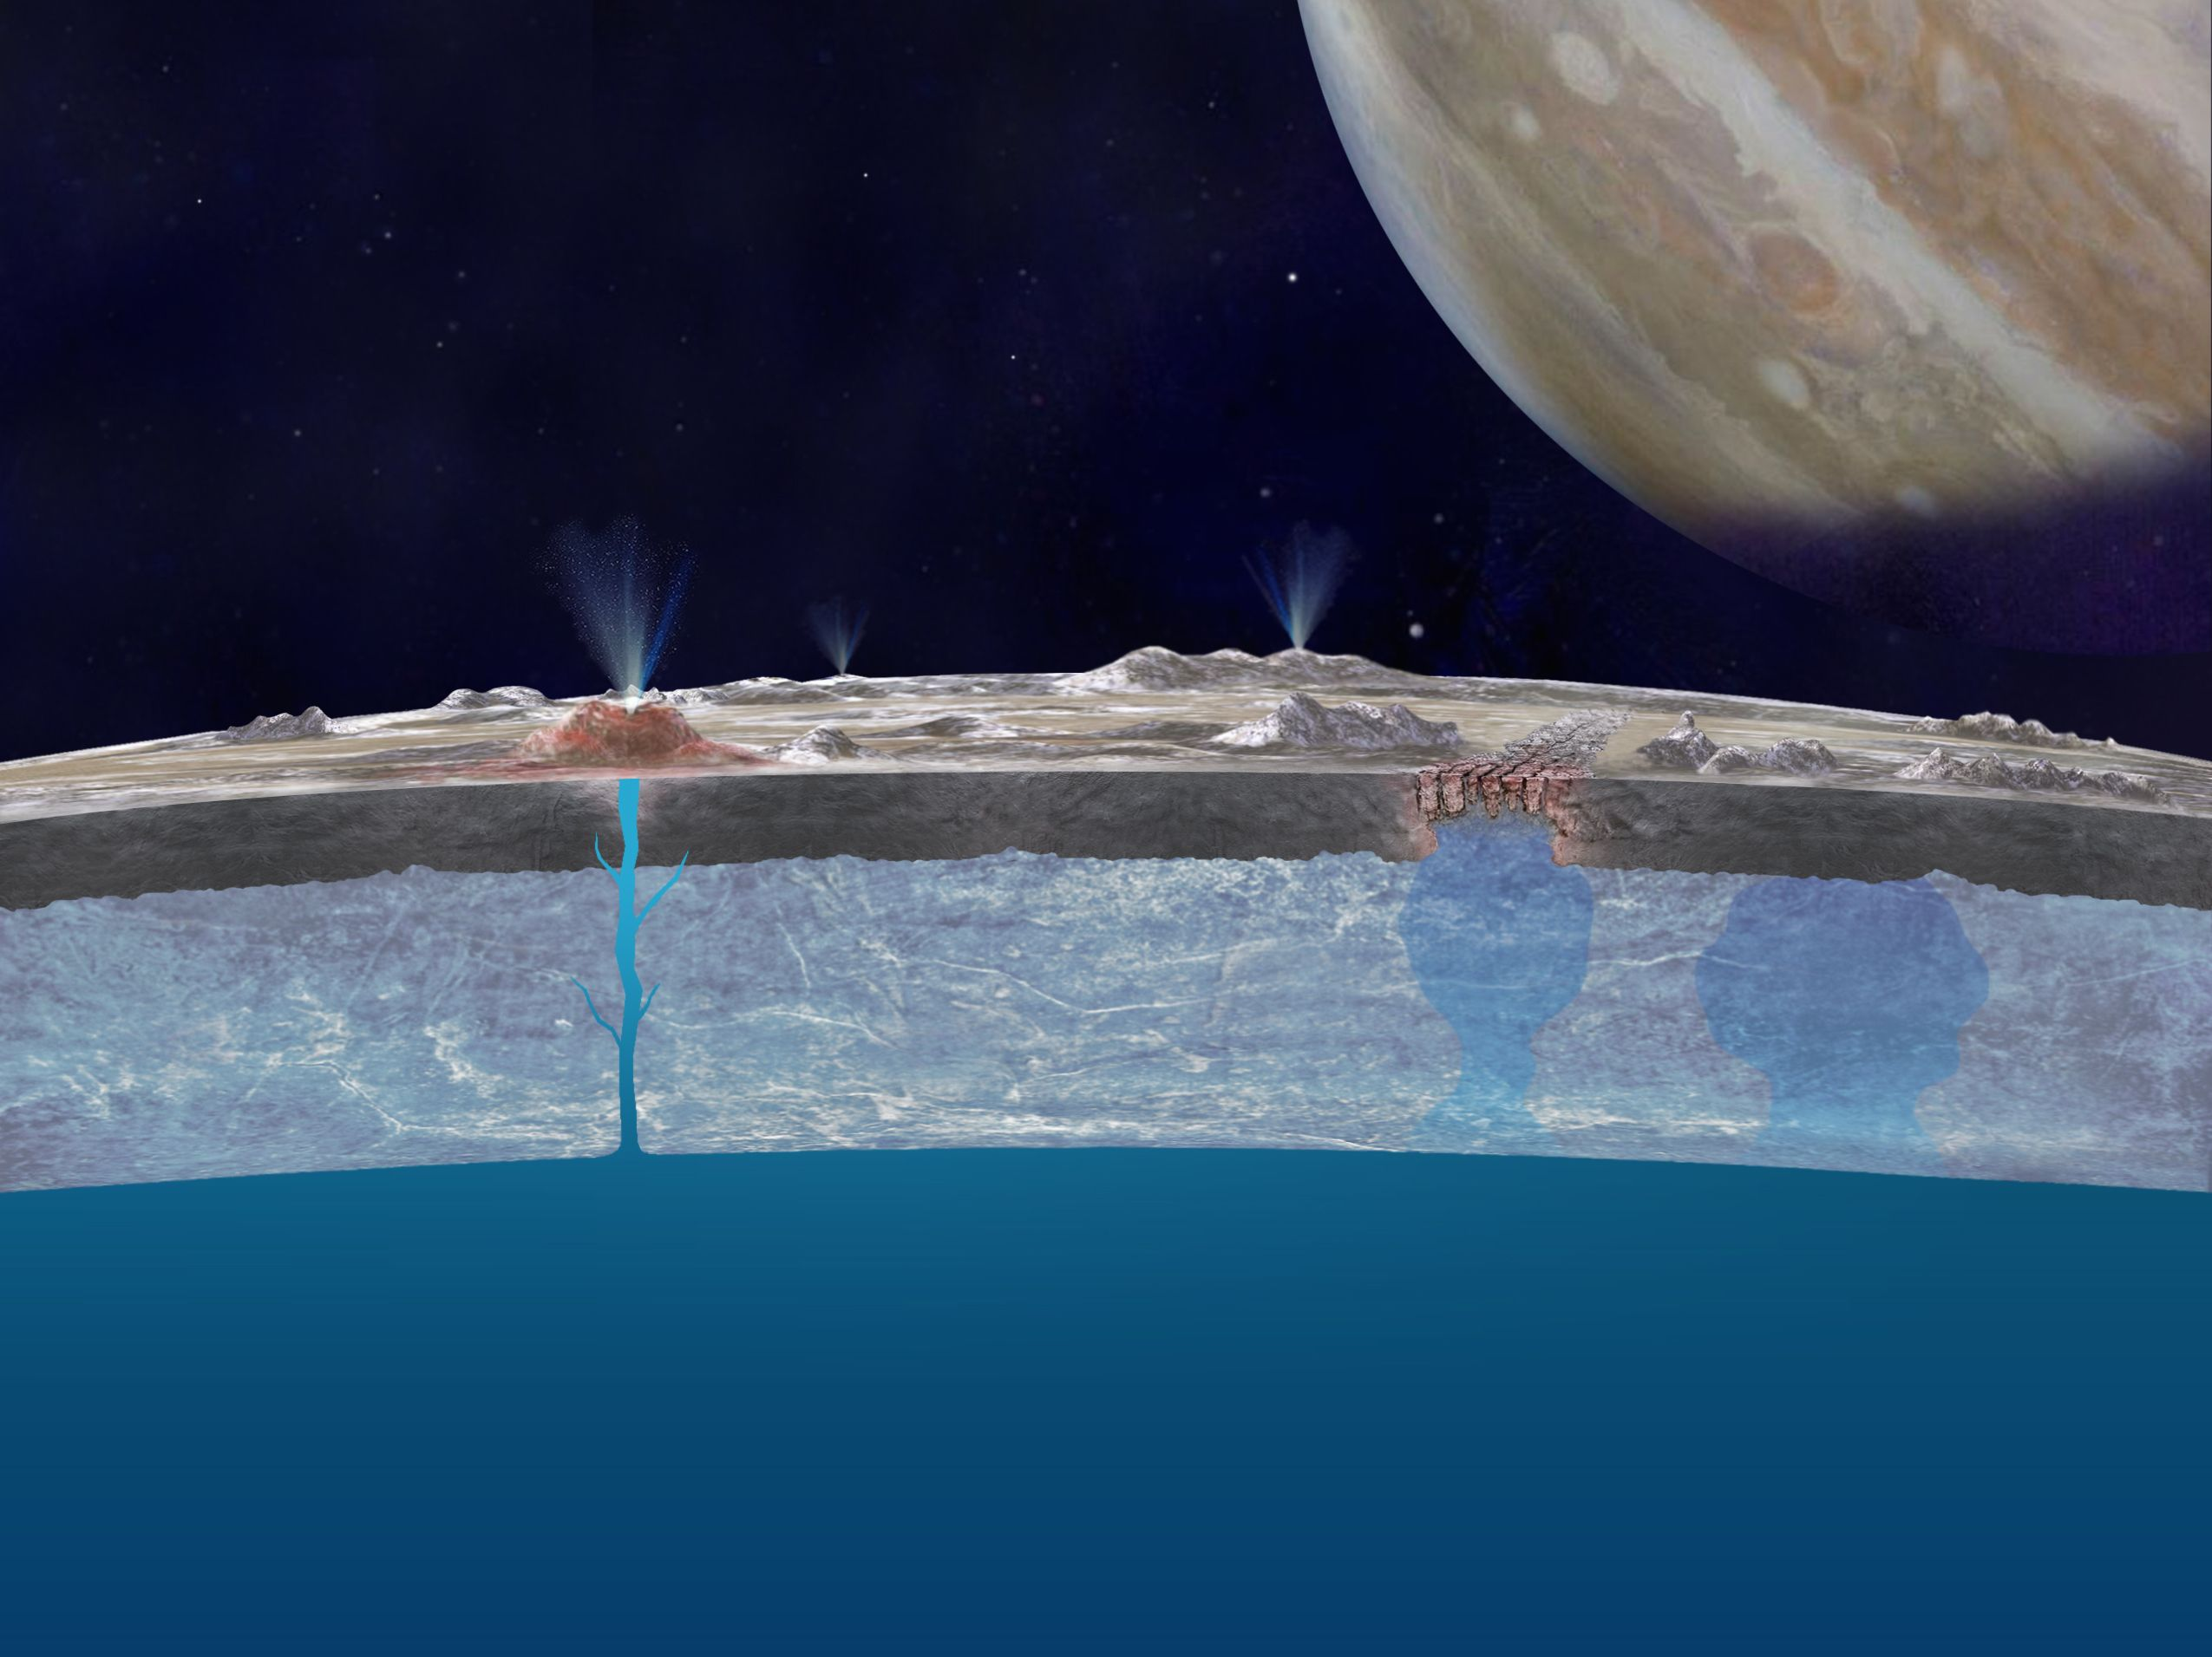
Questions

