Slide 1
NROT Values and Tornado Warning Polygon Area
Jenn Varian
EAS 4480
21 April 2016

Slide 2
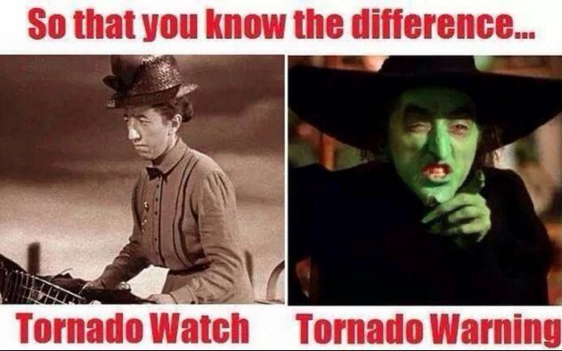
Tornado Watch vs. Tornado Warning
Tornado Watches are issued by Storm Prediction Center in Norman, OK.
BE PREPARED
CONDITIONS ARE FAVORABLE
Tornado Warnings are issued by local Weather Forecasting Office (WFO).
TAKE ACTION
SIGHTING ON GROUND OR ON RADAR
False Alarm Warning Rate (TOR FAR)
~ 0.73 FFC

Slide 3
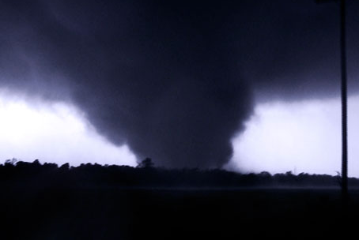
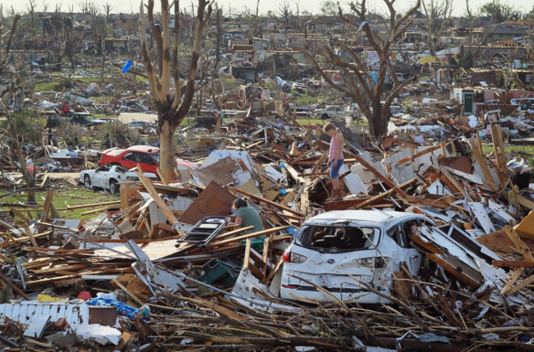
Motivation for Study
2011 Joplin Tornado -- Joplin, Missouri
161 fatalities
Sirens tested weekly
TOR FAR ~ 0.92

Slide 4
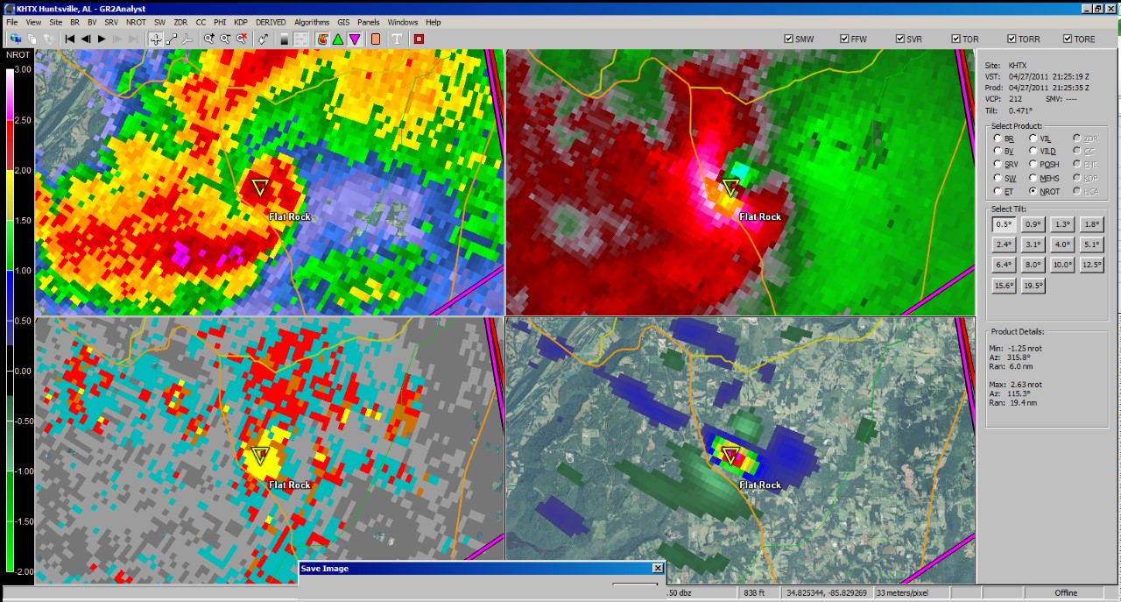
NROT and GR2Analyst

Slide 5
NROT
Derived from rotational velocity into arbitrary (-5, 5).

Slide 6
NROT Study
What sort of things factor into False Alarms?
EMOTIONS!
Population density, size of warning polygon, FEAR OF A MISS.
If there is a larger NROT, does the forecaster tend to make a larger warning polygon to CYA?
Is there a correlation between polygon area and NROT?

Slide 7
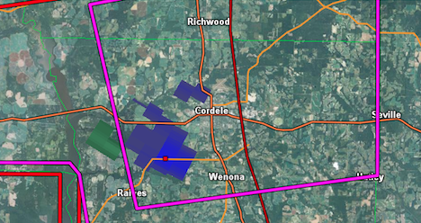
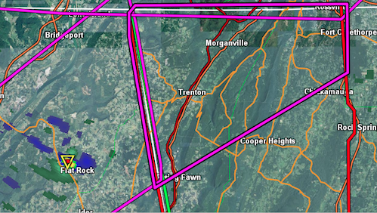
NROT

Slide 8
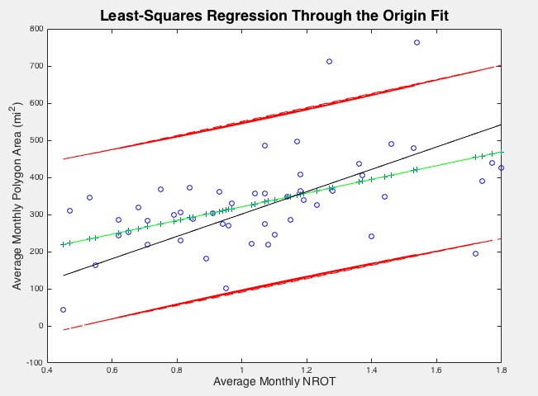
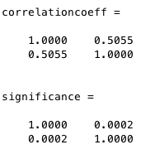
Least-Squares Regression Through the Origin

Slide 9
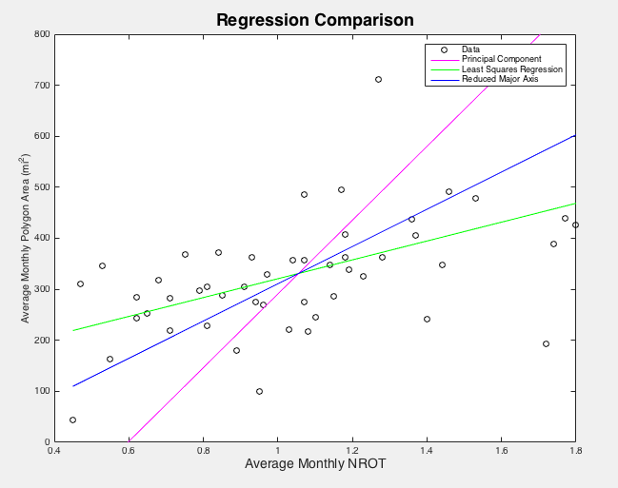
Linear Regression Comparison
Least Squares has the least
amount of change in slope
when introduced to an outlier.

Slide 10
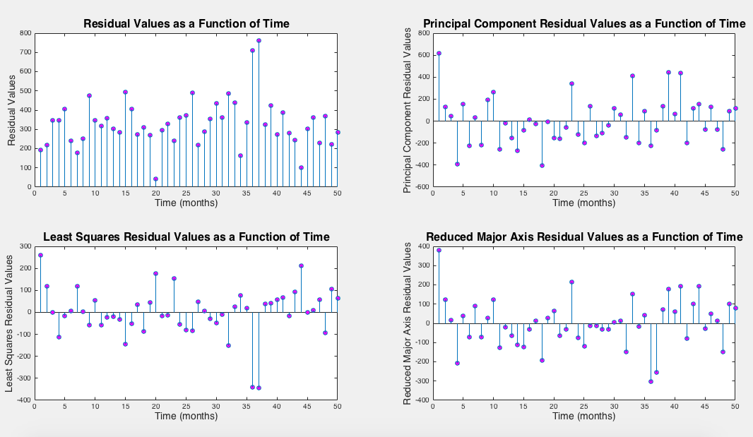
Residual Analysis as a Function of Time
Least-Squares
is the only one that rejects
the null hypothesis.
Chi2Value: 21.9266
Chi2Princp.Comp: 5.8036
Chi2LeastSq: 12.0601
Chi2ReducedMA: 1.4045

Slide 11
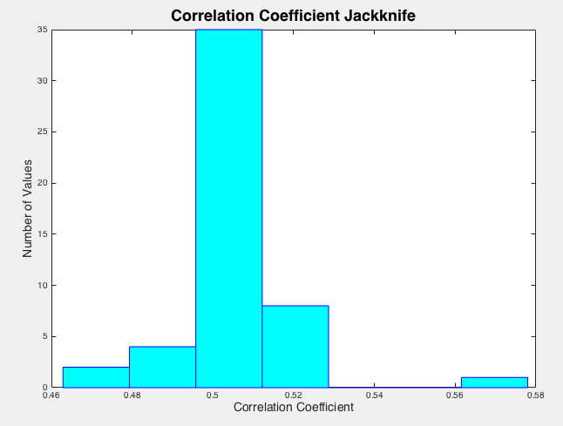
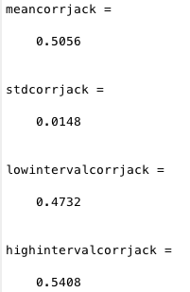
Resampling -- Jackknife
95% Confidence

Slide 12
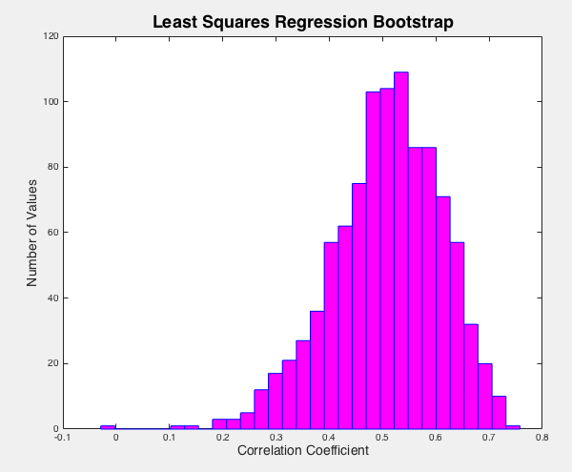
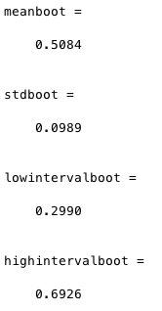
Resampling -- Bootstrap
95% Confidence

Slide 13
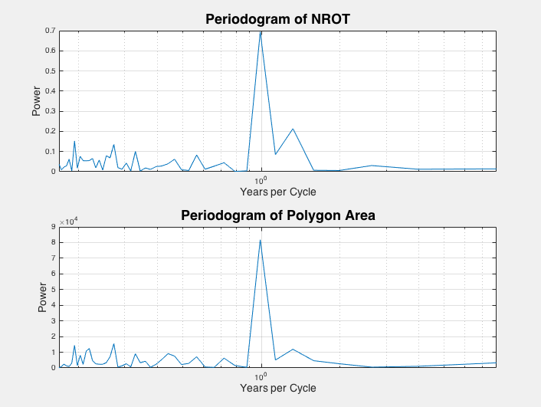
Periodogram of NROT and Polygon Area
1 year/cycle

Slide 14
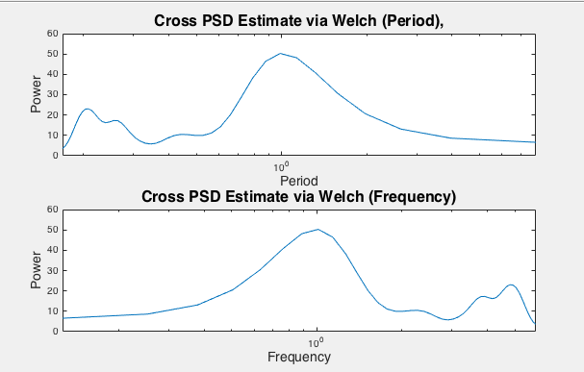
Cross-PSD of NROT and Polygon Area
Take the frequency
at the highest power.
Then look at coherence.
Frequency = 1

Slide 15
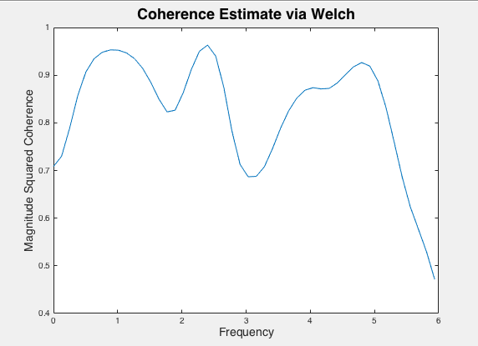
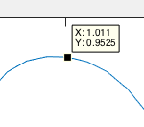
Coherence of NROT and Polygon Area
Coherence at 1
is 0.95, so the data is
coherent.

Slide 16
References
https://s-media-cache-ak0.pinimg.com/736x/79/a4/ac/79a4ac67953d7435590ddcda10b3a1f5.jpg
http://esq.h-cdn.co/assets/cm/15/07/54daf60d130bc_-_esq-joplin-tornado-1011-lg-19010429.jpg
http://nvlpubs.nist.gov/nistpubs/NCSTAR/NIST.NCSTAR.3.pdf

Slide 17
Questions?

