Slide 1
Effects of Temperature and Precipitation on Pollen Count
Zeeshan Rasheed

Slide 2
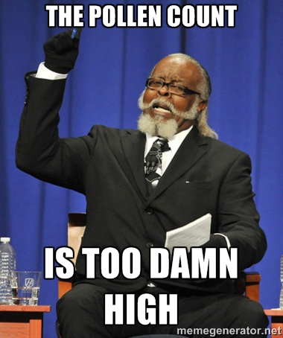
Pollen and Weather
Weather plays a direct role on pollen count
Rain removes pollen from air
Winter weather can impact flowering season

Slide 3
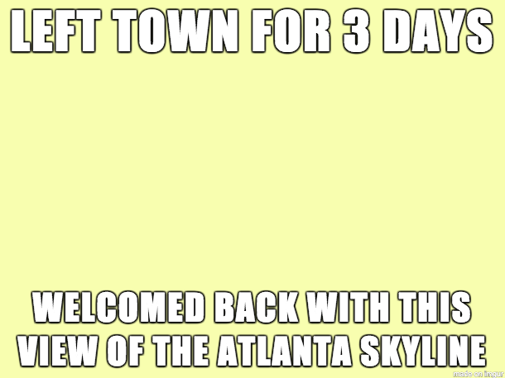
Hypothesis
Pollen counts will be higher on days with warmer temperatures
Pollen counts will decrease on days with rain

Slide 4
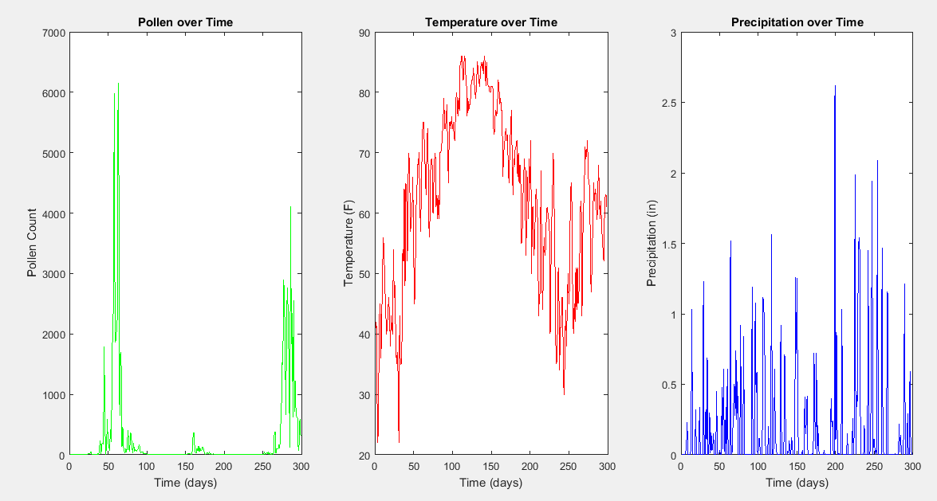

Slide 5
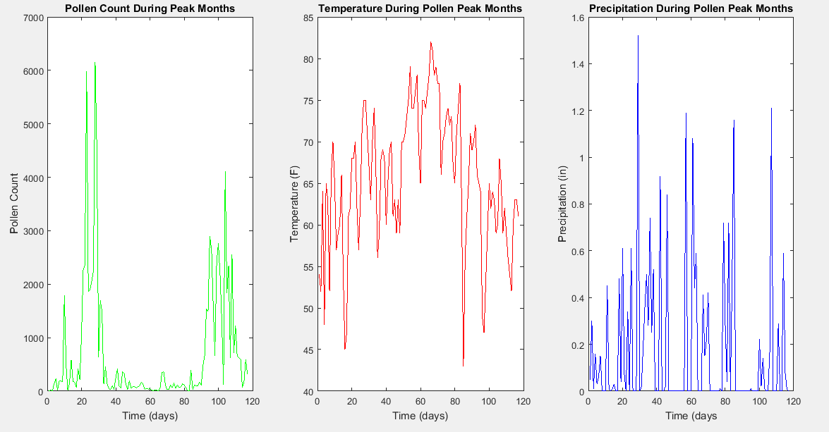

Slide 6
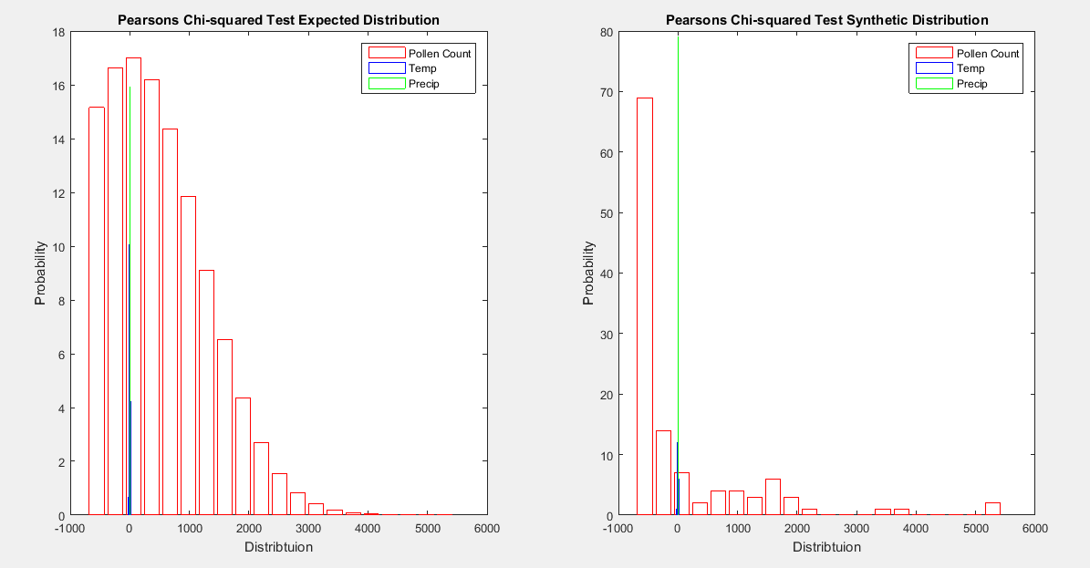

Slide 7
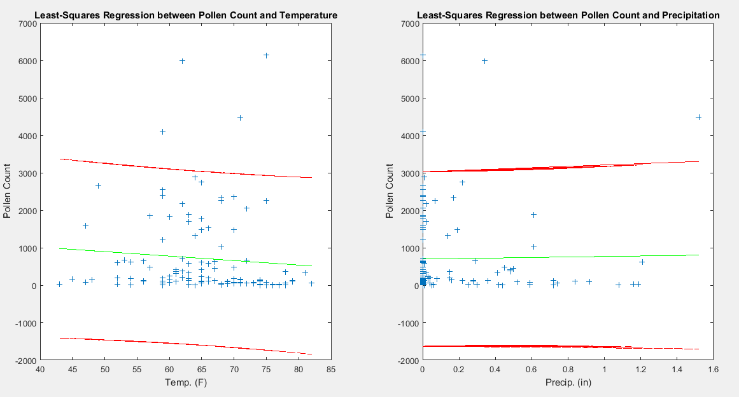

Slide 8
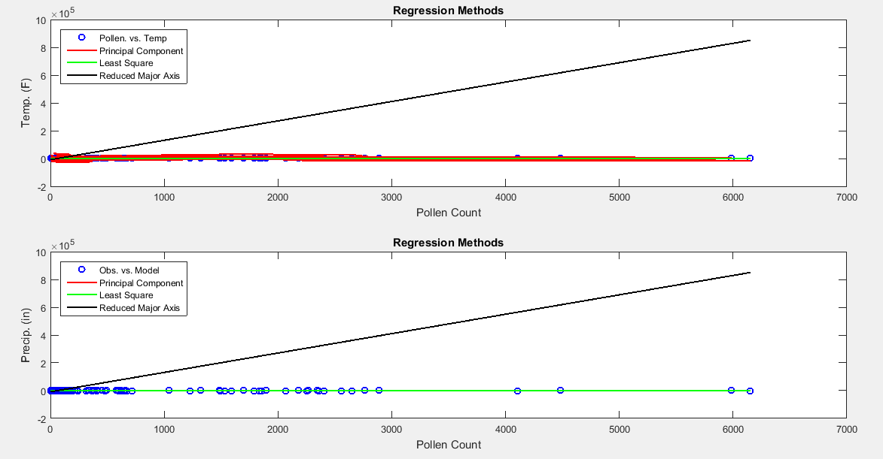

Slide 9
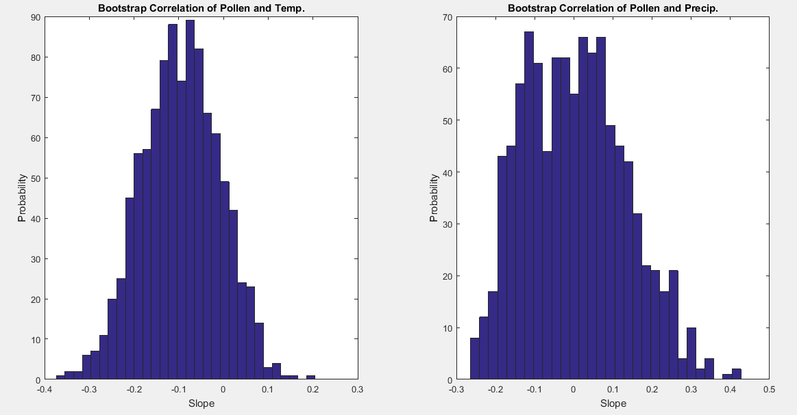

Slide 10
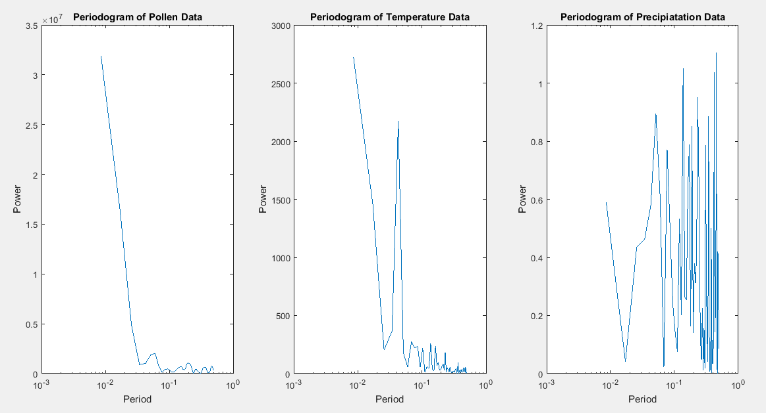

Slide 11
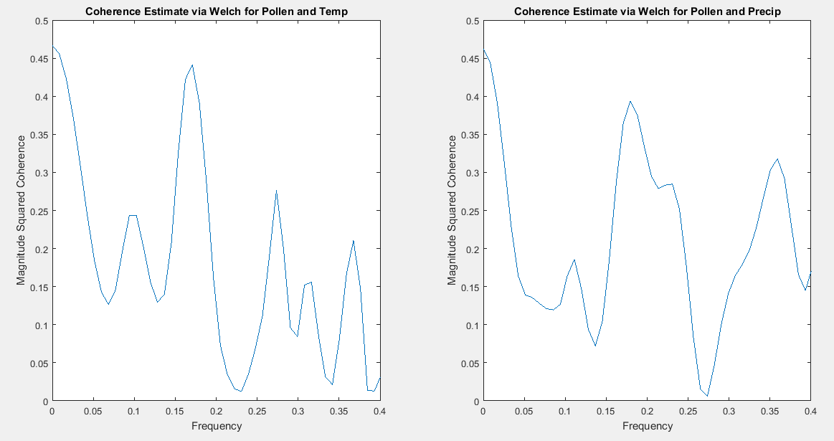

Slide 12
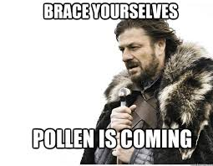
Conclusion
No correlation found
Data set too small and too many zeros in
Need larger pollen data and to account for no precip days
Look at other seasonal effects on pollen

Slide 13
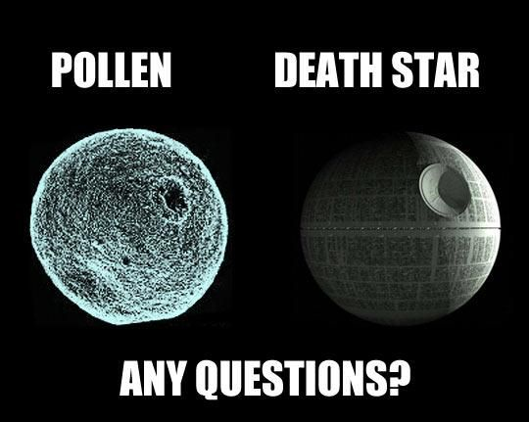
Questions?

