Slide 1
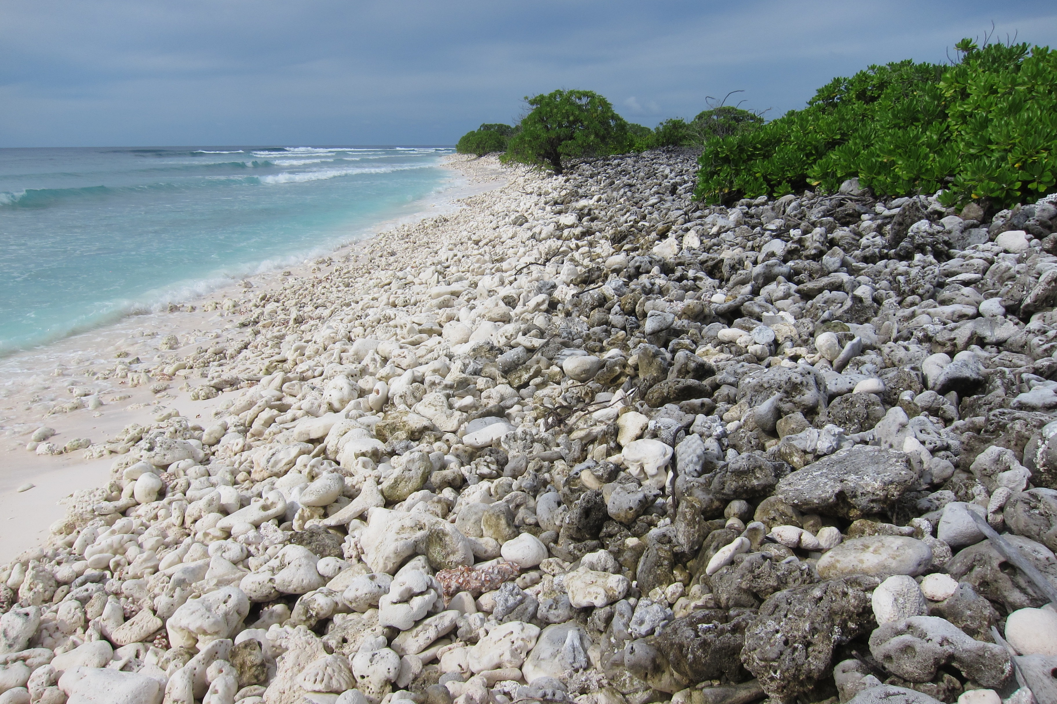

Favia Coral:
A New Paleoclimate Archive
Shellby J. Miller
Environmental Data Analysis
April 19th, 2016

Slide 2
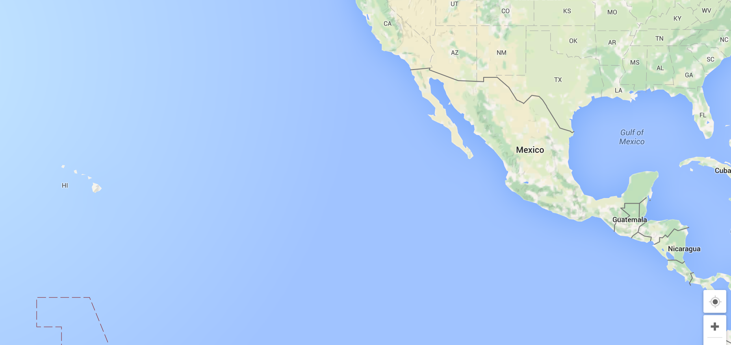

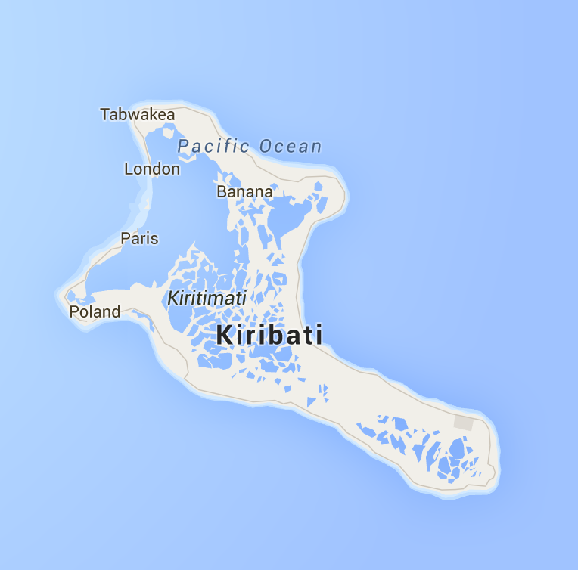
Research Site
Republic of Kiribati
Kiritimati Island
(1.8721°N, 157.4278°W)
Notes:
Since this coral is very abundant in the fossil realm of this region, we believe we can produce a more robust paleoclimate reconstruction.
Longest x-mas island record only dates to 1938.
Palmyra gap 1703-1186

Slide 3
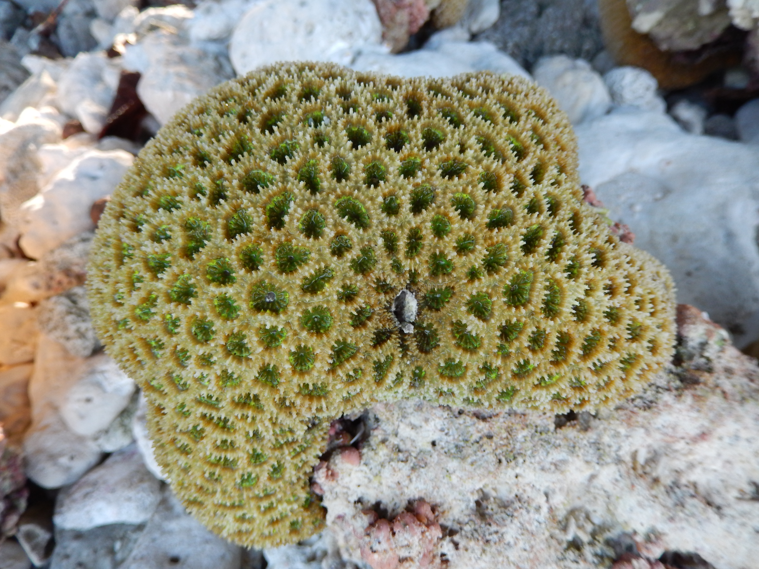
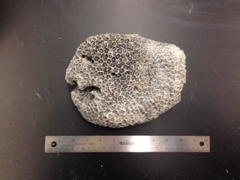
Why Favia?
Favia coral:
(left) above water photo of modern Favia after collected off the reef in 2014; (right) fossil Favia
Notes:
Since this coral is very abundant in the fossil realm of this region, we believe we can produce a more robust paleoclimate reconstruction.
Longest x-mas island record only dates to 1938.
Palmyra gap 1703-1186

Slide 4
Research Questions
How well do modern Favia corals track changes in temperature and salinity at our research site?
Do these modern coral colonies reproduce the same climate signal?
Is it possible to achieve accurate reconstructions of El Niño Southern Oscillation (ENSO) using fossil Favia?
Notes:
Since this coral is very abundant in the fossil realm of this region, we believe we can produce a more robust paleoclimate reconstruction.
Longest x-mas island record only dates to 1938.
Palmyra gap 1703-1186

Slide 5
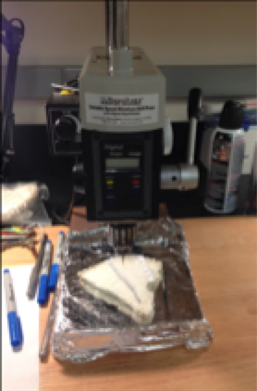
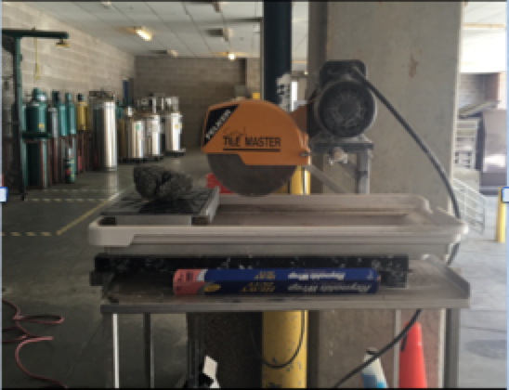
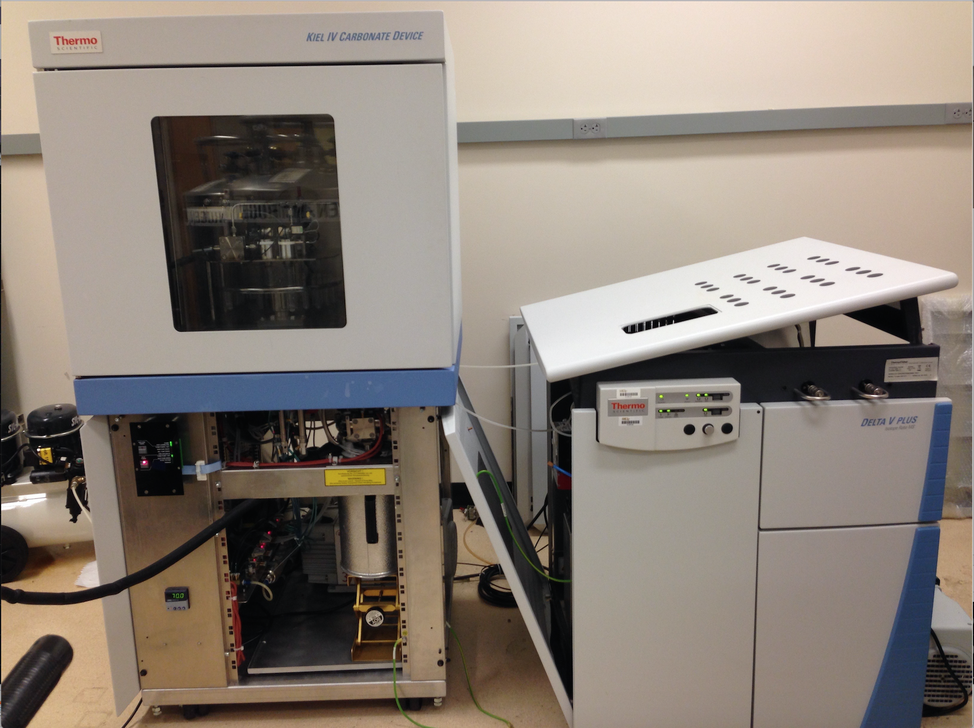
Methods
Notes:
Since this coral is very abundant in the fossil realm of this region, we believe we can produce a more robust paleoclimate reconstruction.
Longest x-mas island record only dates to 1938.
Palmyra gap 1703-1186

Slide 6
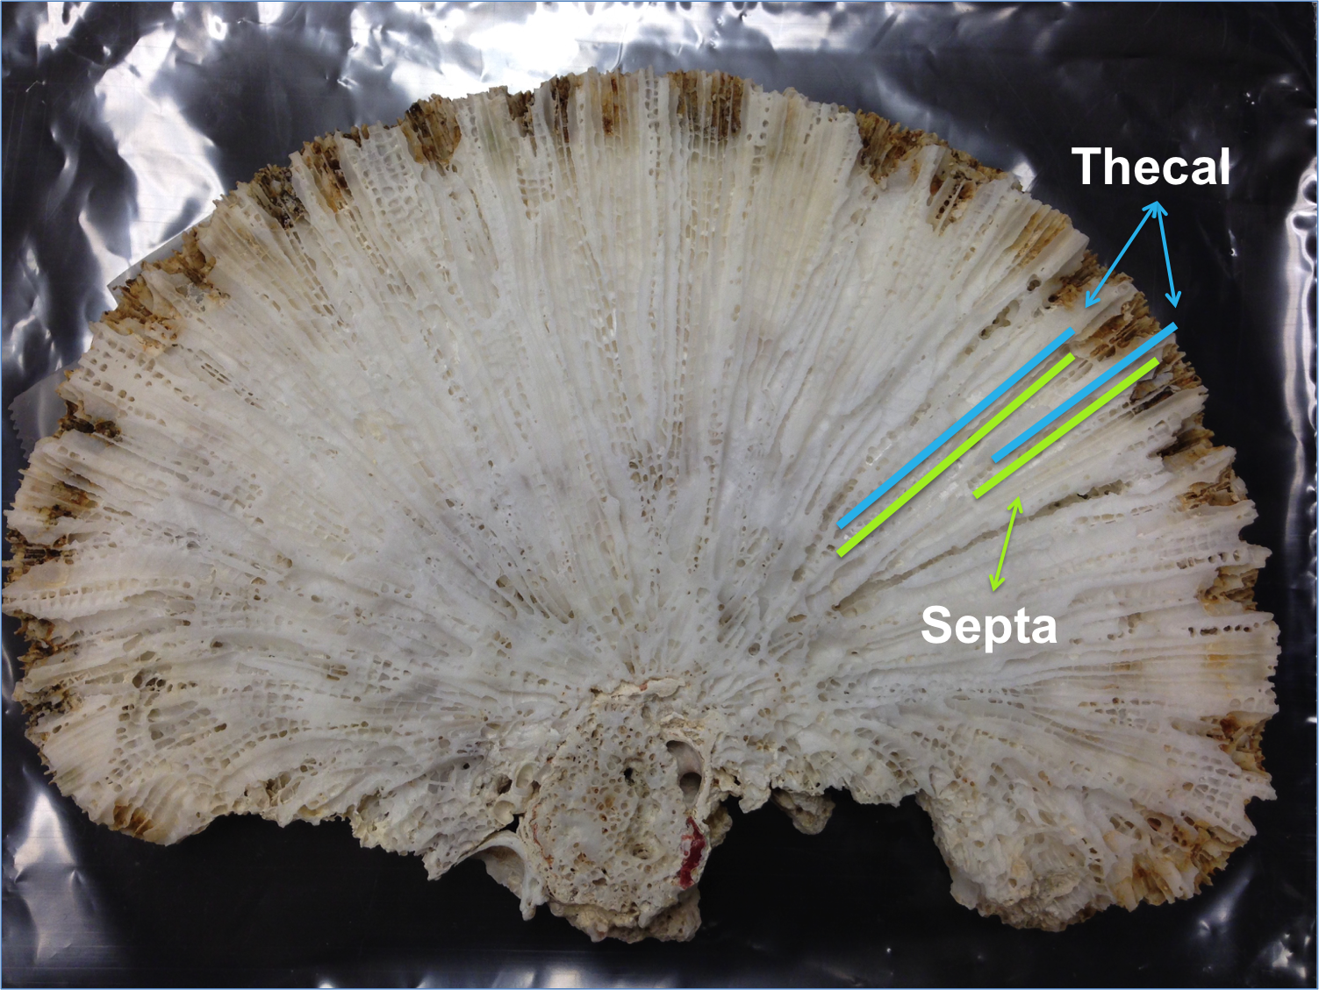
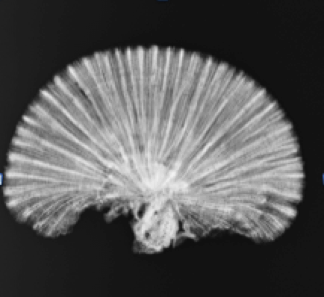
Methods
Skeletal Structure of Favia
Favia skeleton slab with labeled thecal wall and septa
X-ray of Favia skeleton slab
Notes:
Since this coral is very abundant in the fossil realm of this region, we believe we can produce a more robust paleoclimate reconstruction.
Longest x-mas island record only dates to 1938.
Palmyra gap 1703-1186

Slide 7
Methods
Statistical Analyses
Linear Regression, Correlation Coefficient, and Residual Analysis
  d18O and SST in single colony
  d18O and SST across multiple colonies
  d18O in Favia and d18O in Porites
Bootstrap resampling
  d18O and SST across multiple colonies
  d18O in Favia and d18O in Porites
Cross Spectral Analysis
    d18O in Favia and d18O in Porites
Notes:
Since this coral is very abundant in the fossil realm of this region, we believe we can produce a more robust paleoclimate reconstruction.
Longest x-mas island record only dates to 1938.
Palmyra gap 1703-1186

Slide 8
Results
Best Sampling Approach
Comparison plots of δ¹⁸O along different transects in the same coral colony. (A) two transects along septa only, (B) two transects along thecal walls only, (C) Septa T2 versus Thecal T2, (D) comparison of Mixed T3 and Thecal T2, Offsets have been removed for each transect.
Notes:
Since this coral is very abundant in the fossil realm of this region, we believe we can produce a more robust paleoclimate reconstruction.
Longest x-mas island record only dates to 1938.
Palmyra gap 1703-1186

Slide 9
Results
Reproducibility of a climate signal within a single colony
Three transects from modern Favia coral X13-4 plotted against each other and SST
(R = -0.71 to R = -0.87)
Notes:
Since this coral is very abundant in the fossil realm of this region, we believe we can produce a more robust paleoclimate reconstruction.
Longest x-mas island record only dates to 1938.
Palmyra gap 1703-1186

Slide 10
Results
Reproducibility of a climate signal within a single colony:
Linear Regression Analysis
Transect | Correlation Coefficient
Thecal T1 | -0.8668
Thecal T2 | -0. 7099
Mixed T3 | -0.8238
Notes:
Since this coral is very abundant in the fossil realm of this region, we believe we can produce a more robust paleoclimate reconstruction.
Longest x-mas island record only dates to 1938.
Palmyra gap 1703-1186

Slide 11
Results
Reproducibility of a climate signal within a single colony:
Residual Analysis
Notes:
Since this coral is very abundant in the fossil realm of this region, we believe we can produce a more robust paleoclimate reconstruction.
Longest x-mas island record only dates to 1938.
Palmyra gap 1703-1186

Slide 12
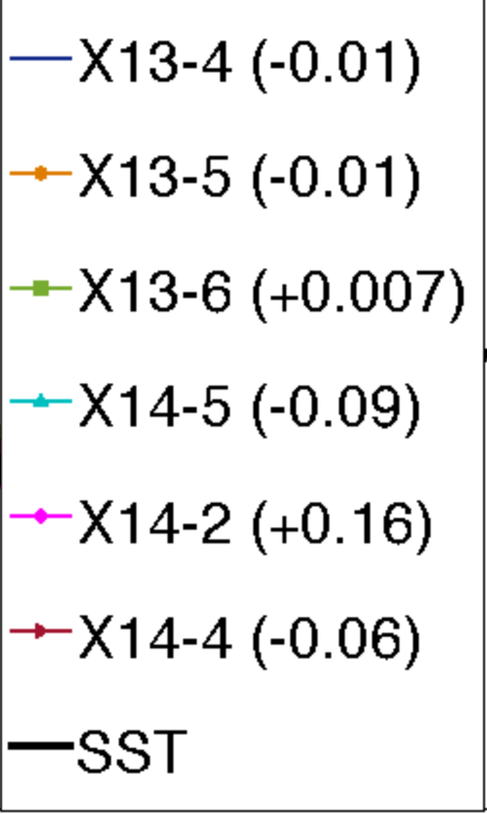
Results
Reproducibility of a climate signal among multiple colonies
δ¹⁸O profiles from six Favia colonies plotted against each other and SST
(R = -0.72 to R = -0.87)
Notes:
Since this coral is very abundant in the fossil realm of this region, we believe we can produce a more robust paleoclimate reconstruction.
Longest x-mas island record only dates to 1938.
Palmyra gap 1703-1186

Slide 13
Results
Reproducibility of a climate signal among multiple colonies:
Linear Regression Analysis
Coral | Correlation Coefficient
X13-4 | -0.7632
X13-5 | -0.8575
X13-6 | -0.8586
X14-5 | -0.8661
X14-2 | -0.8475
X14-4 | -0.7202
Notes:
Since this coral is very abundant in the fossil realm of this region, we believe we can produce a more robust paleoclimate reconstruction.
Longest x-mas island record only dates to 1938.
Palmyra gap 1703-1186

Slide 14
Results
Reproducibility of a climate signal among multiple colonies:
Residual Analysis
Notes:
Since this coral is very abundant in the fossil realm of this region, we believe we can produce a more robust paleoclimate reconstruction.
Longest x-mas island record only dates to 1938.
Palmyra gap 1703-1186

Slide 15
Results
Reproducibility of a climate signal among multiple colonies:
Bootstrap Estimates
Notes:
Since this coral is very abundant in the fossil realm of this region, we believe we can produce a more robust paleoclimate reconstruction.
Longest x-mas island record only dates to 1938.
Palmyra gap 1703-1186

Slide 16
Results
Inter-species comparison:
Porites δ18O vs Favia δ18O
Notes:
Since this coral is very abundant in the fossil realm of this region, we believe we can produce a more robust paleoclimate reconstruction.
Longest x-mas island record only dates to 1938.
Palmyra gap 1703-1186

Slide 17
Results
Inter-species comparison:
Linear Regression Analysis
Coral | Correlation Coefficient
X13-4 | -0.7632
X13-5 | -0.8575
X13-6 | -0.8586
X14-5 | -0.8661
X14-2 | -0.8475
X14-4 | -0.7202
Notes:
Since this coral is very abundant in the fossil realm of this region, we believe we can produce a more robust paleoclimate reconstruction.
Longest x-mas island record only dates to 1938.
Palmyra gap 1703-1186

Slide 18
Results
Inter-species comparison:
Residual Analysis
Notes:
Since this coral is very abundant in the fossil realm of this region, we believe we can produce a more robust paleoclimate reconstruction.
Longest x-mas island record only dates to 1938.
Palmyra gap 1703-1186

Slide 19
Results
Inter-species comparison:
Bootstrap Estimates
Notes:
Since this coral is very abundant in the fossil realm of this region, we believe we can produce a more robust paleoclimate reconstruction.
Longest x-mas island record only dates to 1938.
Palmyra gap 1703-1186

Slide 20
Results
Inter-species comparison:
Periodogram
Notes:
Since this coral is very abundant in the fossil realm of this region, we believe we can produce a more robust paleoclimate reconstruction.
Longest x-mas island record only dates to 1938.
Palmyra gap 1703-1186

Slide 21
Results
Inter-species comparison:
Cross-Spectral Analysis
Notes:
Since this coral is very abundant in the fossil realm of this region, we believe we can produce a more robust paleoclimate reconstruction.
Longest x-mas island record only dates to 1938.
Palmyra gap 1703-1186

Slide 22
Conclusions
δ18O in the thecal wall is more reproducible and more coherent with
SST than δ18O in septa. However, the climate signal is not lost in the δ18O profile of the combined thecal and septa.
It is possible to reproduce the same climate signal in a single Favia
coral colony, as well as among multiple Favia coral colonies
Notes:
Since this coral is very abundant in the fossil realm of this region, we believe we can produce a more robust paleoclimate reconstruction.
Longest x-mas island record only dates to 1938.
Palmyra gap 1703-1186

Slide 23
Future Work
Apply same sampling protocol to fossil Favia U/Th dated for 1968, and compare δ18O values to Niño3.4
Notes:
Since this coral is very abundant in the fossil realm of this region, we believe we can produce a more robust paleoclimate reconstruction.
Longest x-mas island record only dates to 1938.
Palmyra gap 1703-1186

Slide 24
Thank You!
Notes:
Since this coral is very abundant in the fossil realm of this region, we believe we can produce a more robust paleoclimate reconstruction.
Longest x-mas island record only dates to 1938.
Palmyra gap 1703-1186

