Slide 1
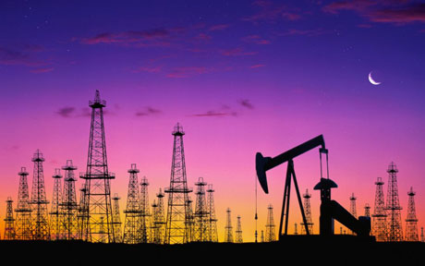
CAN ENERGY BE INTERESTING?
ANSWERING THE MOST IMPORTANT QUESTIONS
JOURNEY INTO THE DEPTHS OF OUR ENERGY INDUSTRY COURTESY OF BRUNO RODRIGUEZ QUEIRAZZA

Slide 2
Why try to recreate ENSO variability using national energy consumption trends?
BECAUSE IT WOULD BE COOL IF I FOUND SOMETHING

Slide 3
DATA
March 2016
Monthly Energy Review
Our beloved EIA – Energy Information Administration
“ SENSATIONAL” – Entertainment Weekly
Our future employer– NOAA (Climate Prediction Center)
“ IDEAL 5 AM READ” – NY Times
Federal Election Commission

Slide 4
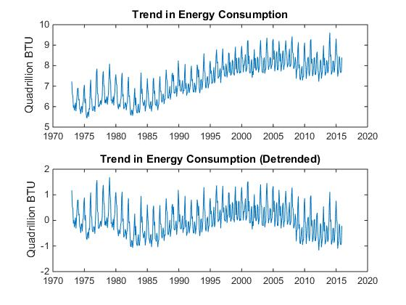
DATA & METHODOLOGY
Step 1: Get rid of the despised trend

Slide 5
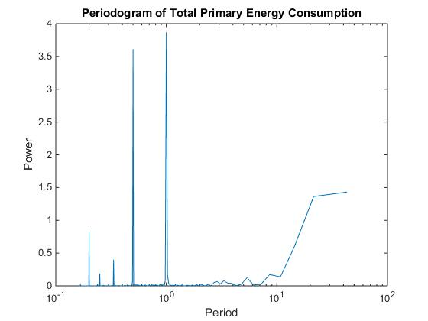
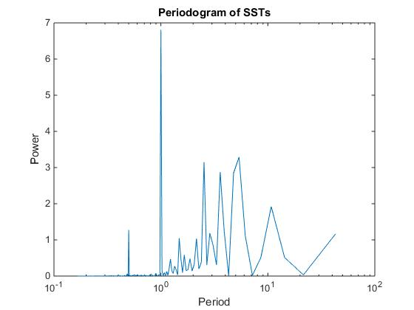
ANALYSIS
ANNUAL CYCLE AND 3-MONTH PEAK
LACK OF SIGNALS AT LONGER TIME SCALES – INDICATIVE OF INEXISTANT ENSO EFFECTS
SST’s SHOW PEAKS AT 2, 3, AND 5 YEAR PERIODS – ENSO IMPACTS ARE EVIDENT
CONFIRMS VALIDITY OF CALCULATIONS

Slide 6
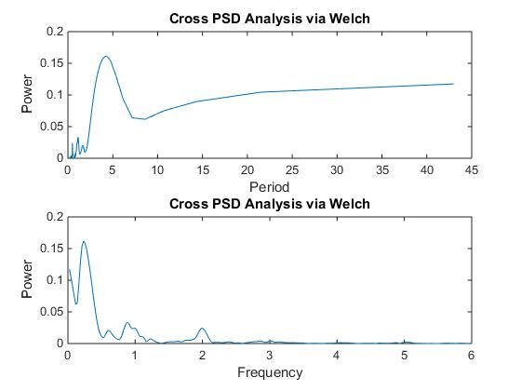
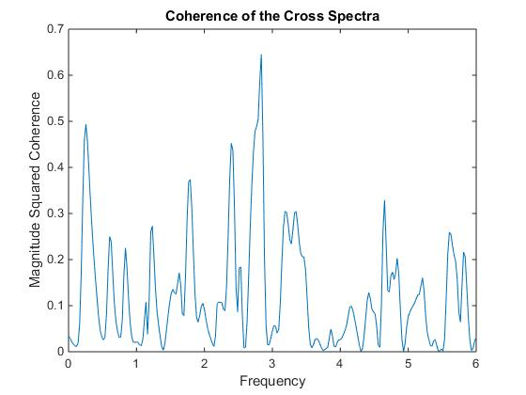
ANALYSIS
HIGH VARIANCE IN COHERENCE CONFIRMS LACK OF RELATIONSHIP
CPSD ANALYSIS USING TOTAL ENERGY CONSUMPTION SHOWS NO CO-VARIANCE BEYOND SEASONAL/ANNUAL CYCLES

Slide 7
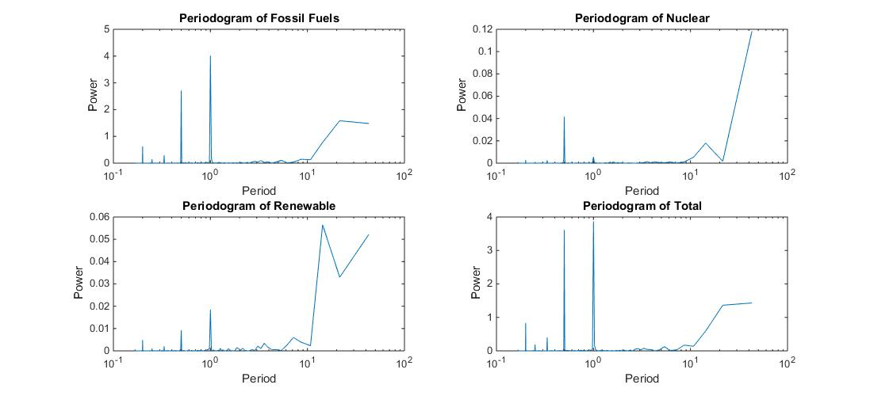
ANALYSIS
Could a particular energy sector better represent ENSO variations?

Slide 8
ANALYSIS
Could a particular energy sector better represent ENSO variations?
NOPE

Slide 9
ANALYSIS
Could a particular energy sector better represent ENSO variations?
COULD NUCLEAR ENERGY BE THE PREDOMINANT ENERGY SOURCE FOR INDUSTRY AS OPPOSED TO RESIDENTIAL USE?

Slide 10
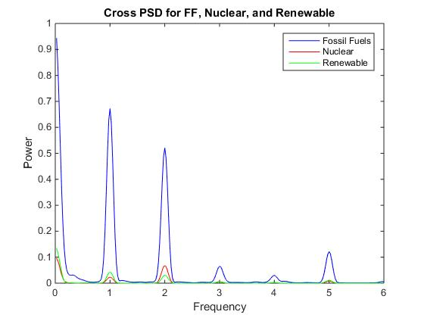
ANALYSIS
VARIABILITY OF TOTAL NATIONAL ENERGY CONSUMPTION IS CLEARLY DRIVEN BY FOSSIL FUELS
SOMEWHAT SURPRISINGLY, RENEWABLE ENERGY STILL MANAGES TO PICK UP SEASONAL/ANNUAL VARIABILITIES

Slide 11
UNDETERRED BY THE LACKLUSTER RESULTS, I DECIDE TO MARCH ON IN MY SEARCH FOR A MEANINGFUL RESULT RELATED TO THE ENERGY INDUSTRY…

Slide 12
IS RED AMERICA LESS LIKELY TO GO RENEWABLE?
DOES BLUE AMERICA HAVE A RENEWABLE ENERGY LOVE AFFAIR?

Slide 13
SHARE OF RENEWABLE ENERGY PRODUCTION (%) BY STATE (2013)
% DEMOCRATIC VOTE BY STATE IN 2012 GENERAL ELECTIONS

Slide 14
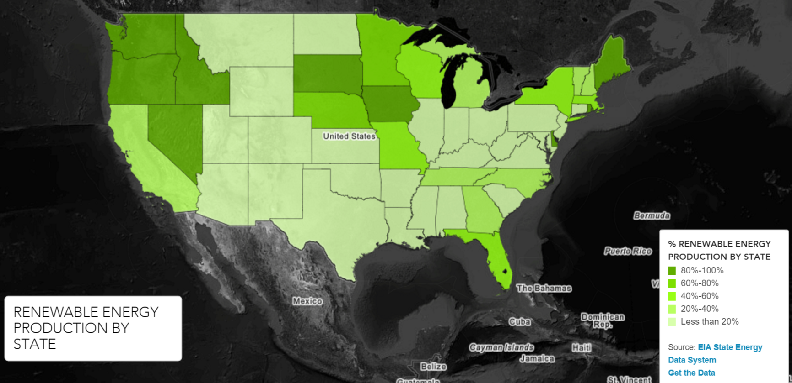
ENERGY.GOV

Slide 15
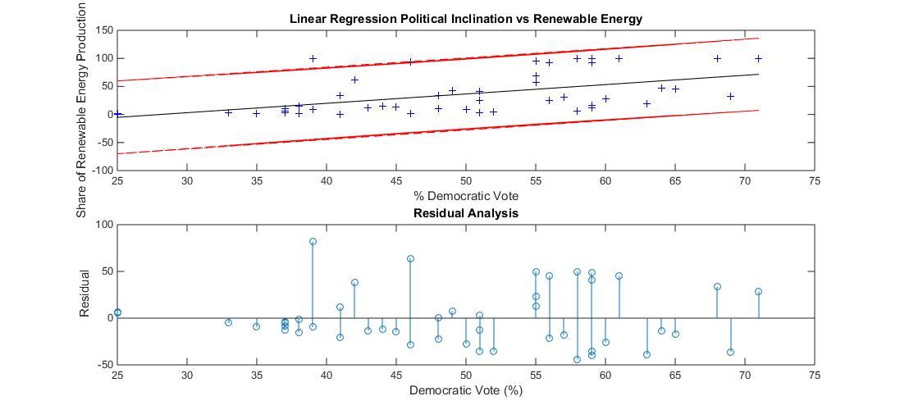
LEAST-SQUARES REGRESSION
CORRELATION COEFFICIENT = 0.5223 (BETWEEN MODERATE AND HIGH)

Slide 16
RESIDUAL ANALYSIS – Test of Normality
CHI-SQUARED TEST
GENERATE NORMAL DISTRIBUTION
SCALE NORMAL DISTRIBUTION TO MEAN
CALCULATE CRITICAL CHI2 VALUE
A picture of mouth-watering Matlab script
Calculated Chi-squared value: 10.3153
Critical Chi-squared value: 11.0705

Slide 17
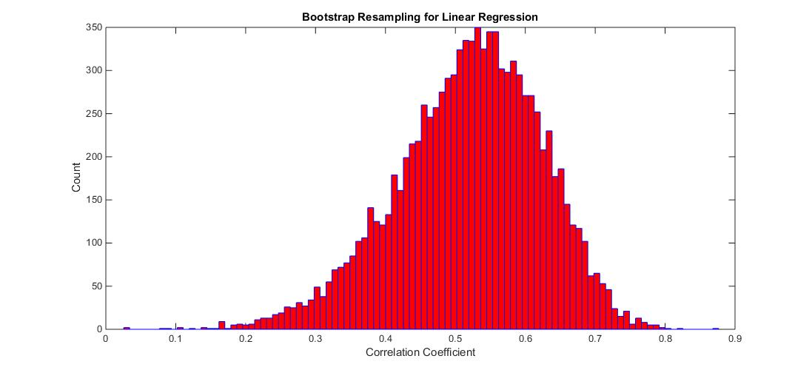
Bootstrap Recycling

Slide 18
Future Work
REDUCED MAJOR AXIS REGRESSION
PRINCIPAL COMPONENT REGRESSION
TRY TO INCORPORATE RENEWABLE ENERGY PRODUCTION POTENTIAL BY STATE

Slide 19
References
“March 2016 Monthly Energy Review” – Energy Information Administration
2013 Primary Energy Production Report – Energy Information Administration
http://www.eia.gov/state/seds/data.cfm?incfile=/state/seds/sep_sum/html/sum_btu_totcb.html&sid=US
ENSO 34 Data – Climate Prediction Center, National Oceanic and Atmospheric Administration
http://www.cpc.ncep.noaa.gov/products/analysis_monitoring/ensostuff/detrend.nino34.ascii.txt
2012 Federal Election Commission Report
http://www.fec.gov/pubrec/fe2012/federalelections2012.pdf

Slide 20
QUESTIONS?

