Slide 1
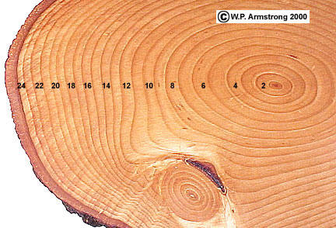
Tree Rings vs. Annual Precipitation
Johnna Floyd

Slide 2
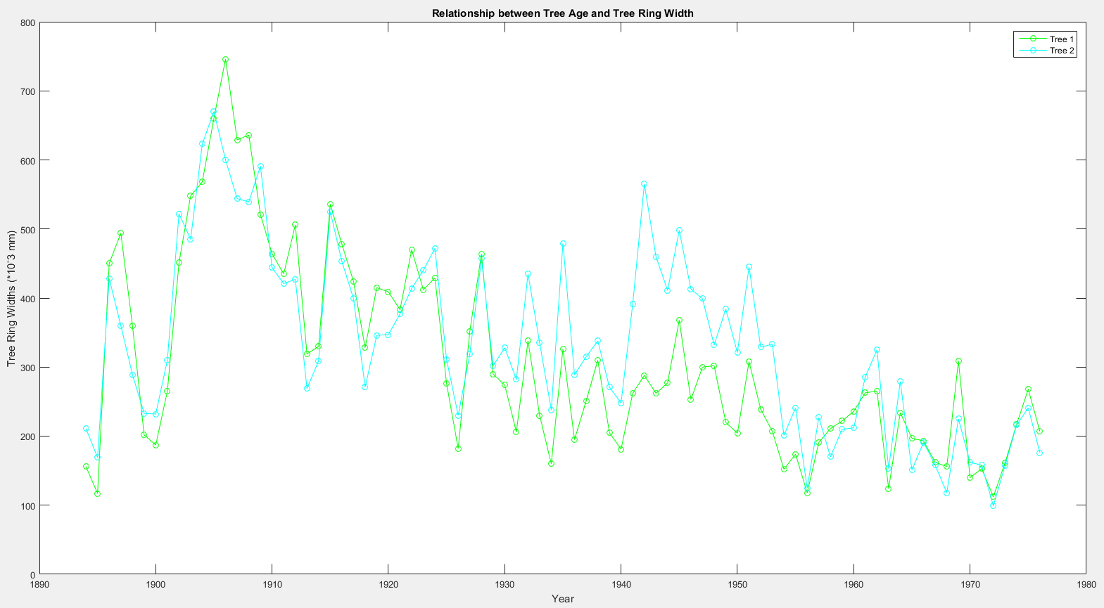
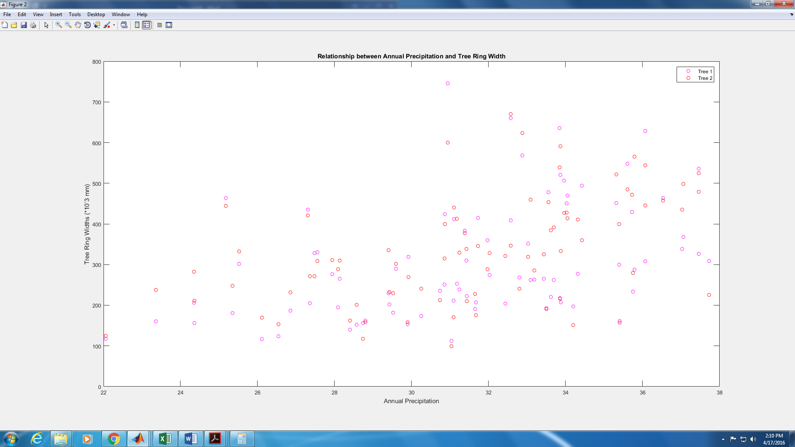
Raw Data

Slide 3
Time Series

Slide 4
Boxplot

Slide 5
Least Squares Regression
Regression | Slope | Intercept | Confidence Interval | Correlation Coefficient | 95% Confidence Interval for Corr. Coeff.
Tree 1 vs. Precip. | 0.011 | 28.1086 | [-0.0348, 0.0568] | [1, 0.4331; 0.4331, 1] | [0.2398, 0.5933]
Tree 2 vs. Precip. | 0.0134 | 27.0311 | [-0.0345, 0.0613] | [1, 0.4880; 0.4880, 1] | [0.3043, 0.6367]
Tree 1 vs. Tree 2 | 0.7872 | 91.17 | [-0.1891, 1.7653] | [1, 0.8501; 0.8501, 1] | [0.7768, 0.9006]

Slide 6
Tree 1 vs. Tree 2: Three Regression Methods
- General least-squares regression
Slope: 0.7872
Intercept: 91.17
- Reduced major axis regression
Slope: 0.926
Intercept: 48.4811
- Principle component regression
Slope: 0.9136
Intercept: 52.3046

Slide 7
Tree 1 vs. Annual Precipitation: Three Regression Methods
- General least-squares regression
Slope: 0.011
Intercept: 28.1086
- Reduced major axis regression
Slope: 0.0254
Intercept: 23.6823
- Principle component regression
Slope: 0.011
Intercept: 28.1069

Slide 8
Tree 2 vs. Annual Precipitation: Three Regression Methods
- General least-squares regression
Slope: 0.0134
Intercept: 27.0311
- Reduced major axis regression
Slope: 0.0274
Intercept: 23.6823
- Principle component regression
Slope: 0.0134
Intercept: 27.0286

Slide 9
Least Squares Regression Using De-trended Data

Slide 10
Least Squares Regression Showing Correlations between Datasets

Slide 11
Bootstrap Trend Distributions using first Original Data and then De-Trended Data
Sample | Boot Slope Mean of Original | Boot Slope STD of Original | Boot Slope Mean of De-trended | Boot Slope STD of De-trended | Confidence Interval Original | Confidence Interval De-trended
Tree 1 | -3.6586 | 0.6134 | -0.0283 | 0.6465 | [-4.8625, -2.4939] | [-1.3164, 1.2003]
Tree 2 | -3.037 | 0.5794 | -0.002 | 0.5551 | [-4.1685, -1.8933] | [-1.1012, 1.0667]
Annual Precipitation | 0.0107 | 0.0154 | -2.1036*10^-4 | 0.0157 | [-0.0196, 0.0389] | [-0.0296, 0.0316]

Slide 12
Possible Future Work
Cross Spectral Analysis
Periodogram

