Slide 1
Quality Control at a Local Brewery
Data analysis of in-house sensory panel to measure batch-to-batch consistency of an American IPA brew

Slide 2
Sensory Evaluation
Quantitative Descriptive Analysis® (QDR)
A behavioral sensory evaluation approach
Widely used in Food & Beverage Sciences
Term coined in 1974 by Herbert Stone and Joel Sidel at Stanford Research Institute

Slide 3
Components to QDA
Considered at 3 Taverns:
Experienced subjects (tasters)
Small panel size
Screened for sensitivity
Descriptors or classes are given
Subjects rate on a scale
Conducted individually without discussion
Quantitative results considered only
Replication of results
Production staff, marketing team
6-8 per tasting
Not taken into account
13 different sight, flavor, and aroma profiles given
Rated on a 9 point scale
Same brew not repeated
Brew tasted again after 30 and 60 days
Different combination of tasters

Slide 4
Sensory analysis at 3 Taverns
13 descriptors or profiles
Aroma: pine, citrus, tropical fruit (measured separately)
Color
Foam
Clarity
Mouthfeel
Carbonation
Hops
Sweetness
Resin
Alcohol
Lingering bitterness
Each variable scored on a scale of 1-9
5 is ideal and is considered “true to style”
<5 means too little is perceived
>5 means too much is perceived

Slide 5
Focus and goals of study
Analyze the tasting panel results of multiple batches of one brew
Combinations of different tasters rated the brews after 0, 30, & 60 days
Identify outlier batches
Identify outlier profiles
Identify outlier tasters
Make recommendations for improved tasting panel performance

Slide 6
Problem: Plots of averages of each profile after 0, 30, & 60 days are not meaningful
No noticeable change over time
Not useful

Slide 7
Solution: Principal Component Analysis
Pairwise correlations are made to quantify relationships
Multivariate analysis – 13 dimensions for this project (# profiles)
Reduces dimensions to 2 or 3
Variances are plotted on 2 or 3 axes
Clustering indicates related samples
Powerful visual representation of data with multiple variables
Outliers can be identified

Slide 8
MATLAB’s pca() function
[coeff score latent tsquared] = pca(X)
X: an m x n matrix, where m are observations and n are variables
Coeff: loadings or principal component (PC) coefficients. Give magnitude and direction for eigenvectors in “p” space
Score: values of PC for observations. Represent coordinates of original data in PC space
Latent: the eigenvalues – gives variance of each eigenvector.
Tsquared: Hotelling t-squared statistic. Gives distance of observation to center of data.
Input m x n data matrix, X
Generate eigenvector coefficients
Generate scores
Rollins et al., 2011

Slide 9
Issue: PCA is sensitive to outliers
PCA centers data but does not scale
PCA is best when:
data is scaled
variables follow normal distribution
To visualize data and gain insight, normal distribution of individual variables is not required
For hypothesis testing, normality is required
Fix: use zscore()
Centers data about zero
Scales so that the standard deviation is 1

Slide 10
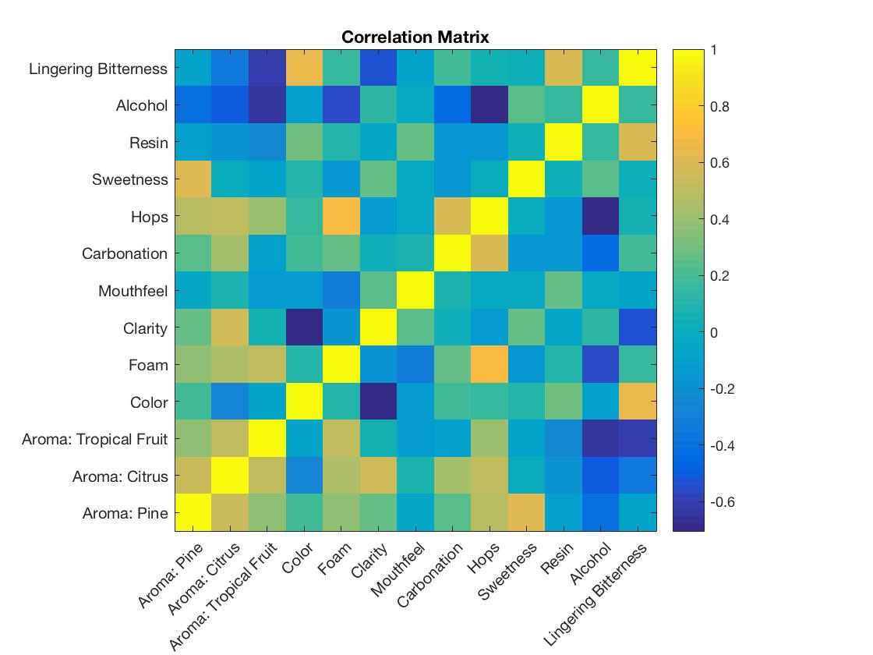
PCA of Descriptors after 0 days

Slide 11
PCA of Descriptors after 0, 30, and 60 days
Some variables group together as expected
Becomes more spread-out after 30 days. Higher complexity of beer?
Suggests beer flavors and aromas may homogenize with time

Slide 12
PCA of Batches – spread of batches over time
Visually, 160022, 160024, & 160039 appear to be possible outliers
Hotelling t-square shows similar distance from center of data
(problem?) – need to correct

Slide 13
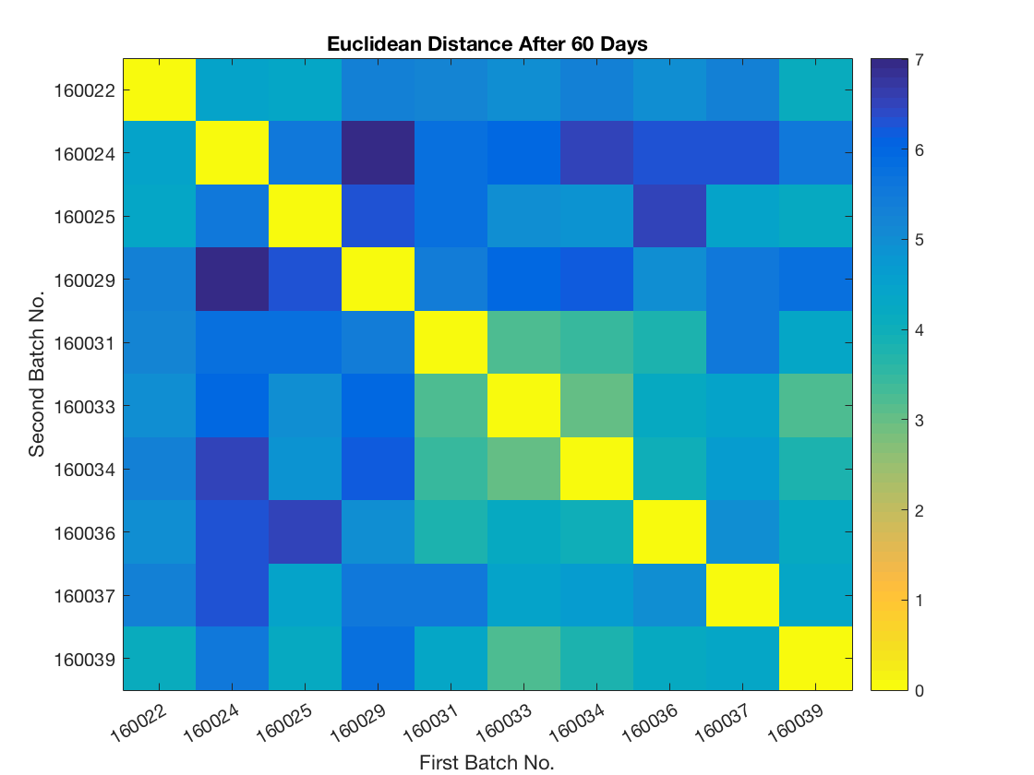
Distance Matrix – pdist()
Calculates Euclidean distance (straight line) between pairs of observations
Try other distance metrics?
Manhattan?

Slide 14
Cluster Analysis of Batches
In MATLAB:
Use linkage() and dendrogram() for tree
Find cluster correlation with cophenet()

Slide 15
Next Steps
Improve batch analysis
Hotelling T² values
Distance metric for high dimensionality
Analyze taster performance
Find outlier tasters
Overall:
Summarize findings and make recommendations, e.g.
Identify which descriptors tasters struggle with
Add or remove descriptors
Replication of results: introduce “blind” batches for replication

Slide 16
Questions

