Slide 1
Correlation of oxygen isotope data taken from two proxies with different locations
Shelby Ellis EAS 4480

Slide 2
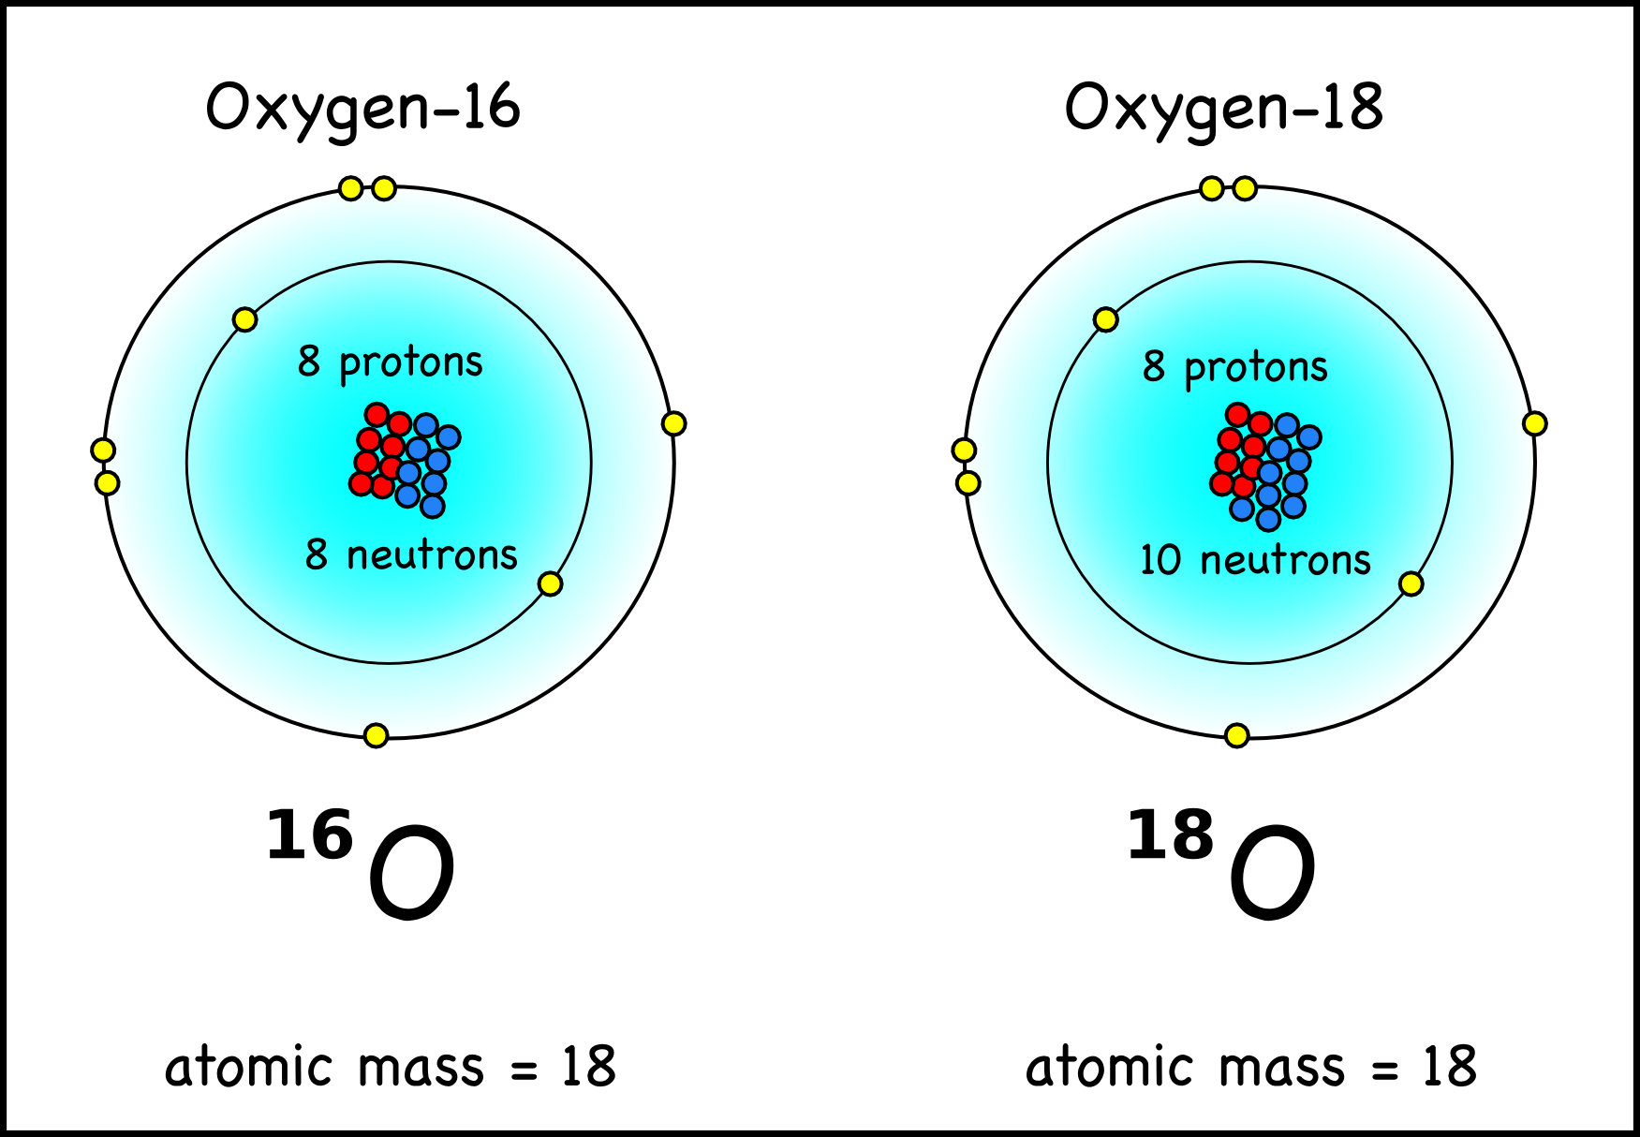
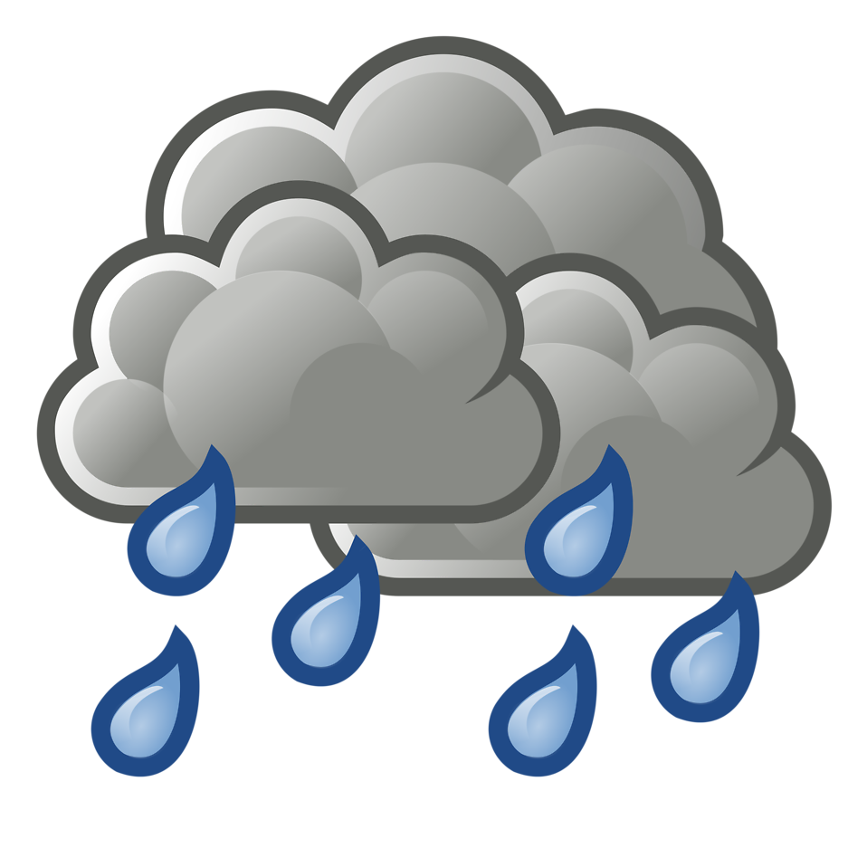
Paleoclimate Proxies
Paleoclimatology: Study of Past Climates
Not possible to go back in time to see what climate was like
Rely on chemical imprints that alter geological materials or organisms
Geological Materials or Organisms = ’Paleoclimate Proxies’
Can reconstruct past climate using a combination or different types of proxy records!
Examples of climatic events that can chemically alter proxies:
Temperature
Precipitation
Chemical changes = changes in Isotope ratios (such as 18O/16O)
OR
Notes:
Changes in ice affect the measured value of oxygen 18 or oxygen 16 in the ocean
Lighter 16O’s are ‘locked’ into ice; Heavier 18O’s are ‘left behind’ in the ocean
Leaves the ocean enriched in d18O/16O (how data is expressed in both proxies)

Slide 3
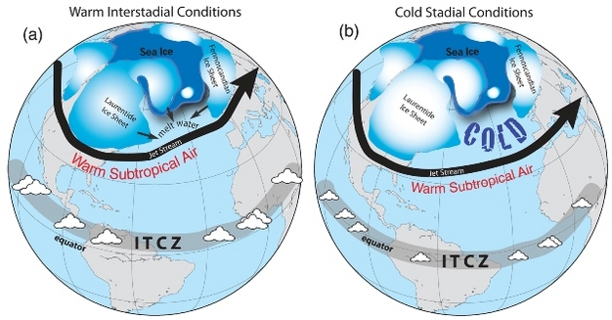
Motivation for study
65 Degrees North: Vulnerable to Ice Accumulation & Ablation
Atmospheric reorganization of deep convection → global precipitation patterns
Will this show up in two different paleoclimate proxies?
Ice Core vs. Stalagmite
Difference of ~ 41◦ latitude
Notes:
Laurentide ice sheets = LGM

Slide 4
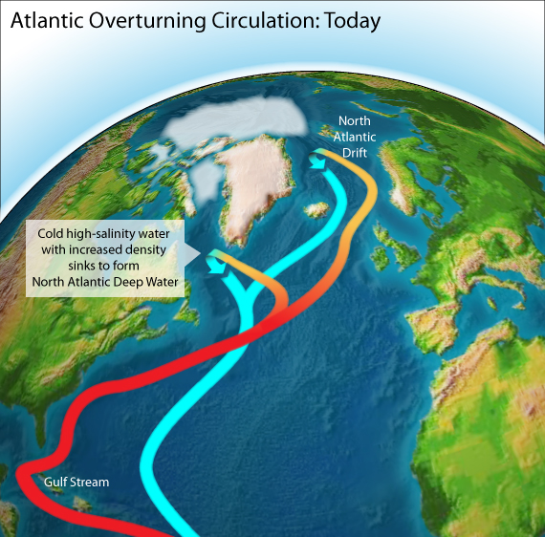
Targeting a specific area: Younger Dryas
Occurred 11.6 kyr
Was a cold period that occurred during the glacial termination after the Last Glacial Maximum
Followed by rapid warming
Important to study because: could have caused a weakening or collapse of Atlantic Meridional Overturning Circulation (AMOC)
Hoping to see this abrupt climate change event in d18O more negative in ice core data
More precipitation → more snow (more depleted oxygen 18 signal)

Slide 5
Stalagmite: -10 to -7 Ice Core: -32 to -42
More negative isotope composition with:
(1) Decreasing temperature
(2) Increasing Height
(3) Increasing Latitude
(4) Increasing distance from Oceanic source

Slide 6
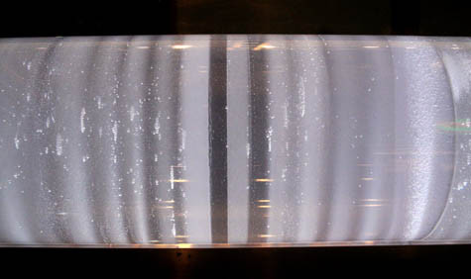
Younger Dryas?
Younger Dryas?

Slide 7
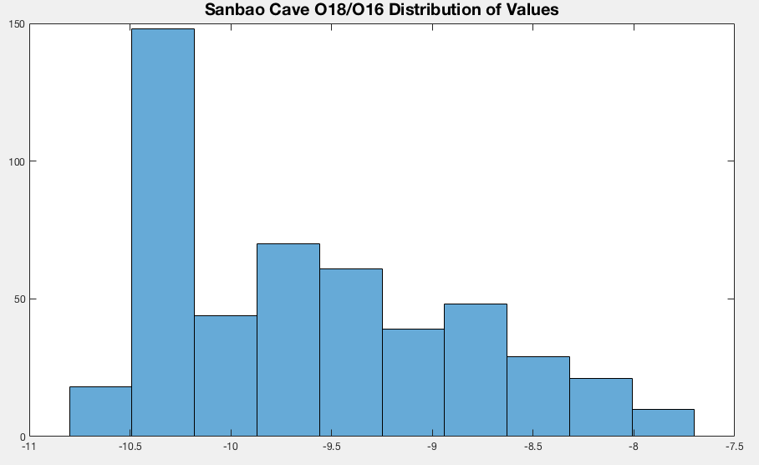
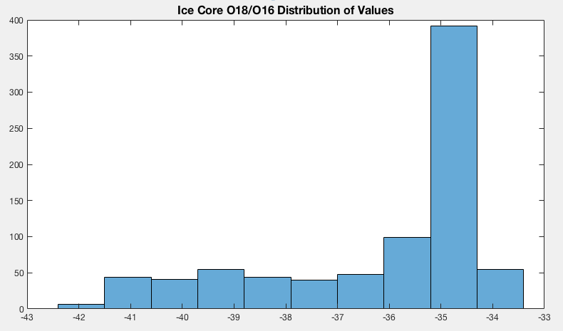
Histogram
Are measured values normally distributed?
Result: Stalagmite and Ice Core d18O is not normally distributed
Number of Data Points
Measured Values 18O/16O
Measured Values 18O/16O

Slide 8
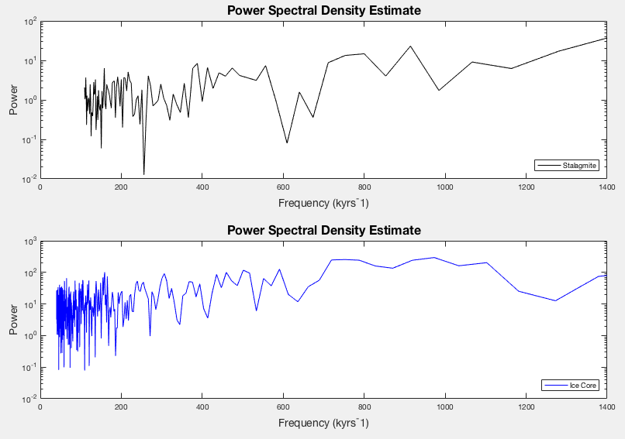
Power Spectral Density Estimate: semilogy vs. PSD estimate (Pxx)
Estimate spectral density of a random signal from a sequence of time samples
Spectral density characterizes the frequency content of the signal
Helps detect any periodicities in data
Observe peaks at the frequencies corresponding to these periodicities

Slide 9
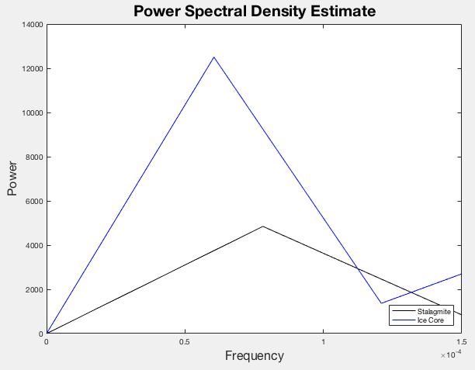
F (frequency vector for PSD values) vs. Pxx (PSD estimate)
Result: Ice core has higher power and two frequency signals; stalagmite only has one significant frequency signal

Slide 10
Estimates power of a signal at different frequencies
Improvement on the standard periodogram spectrum method
Reduces noise in the estimated power spectra in exchange for reducing the frequency resolution
Result: Default appears to be the best overlap window

Slide 11
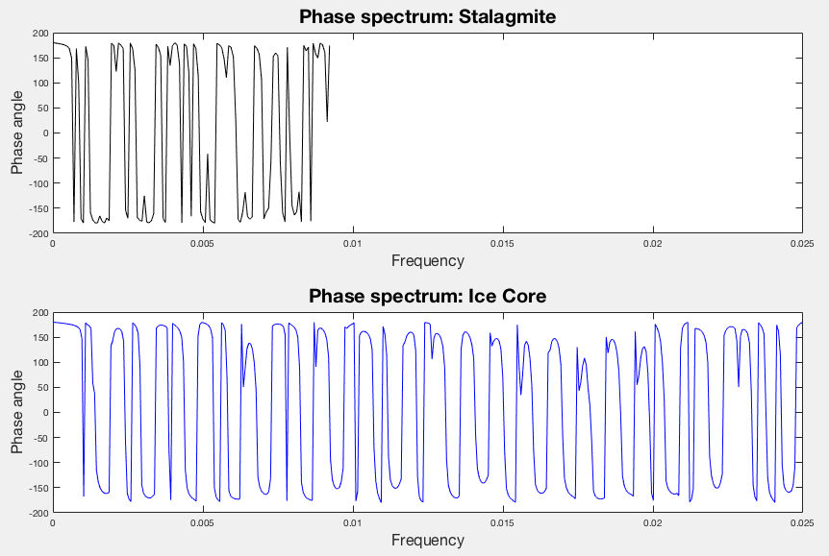
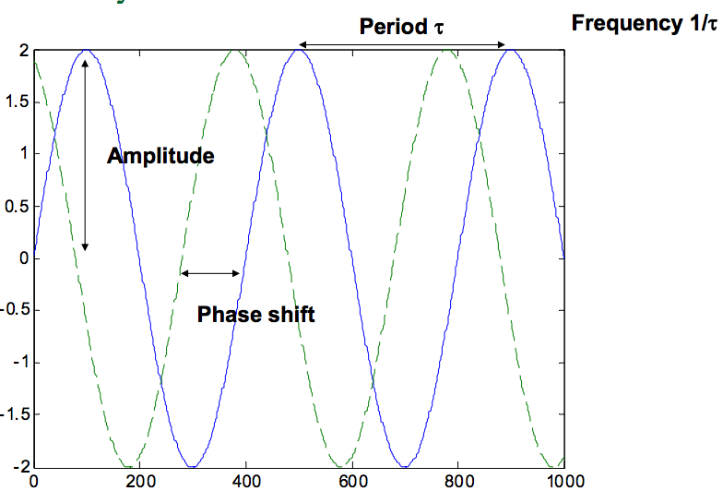

Slide 12
Wavelet

Slide 14
Conclusions
Plot of d18O vs. time: Both stalagmite + ice core proxies show a significant change in signal around the Younger Dryas abrupt climate change event
Histogram: Data not evenly distributed
PSD
Ice Core Data has a higher power and two significant frequency signals; stalagmite d18O has one significant frequency that overlaps
CPSD
Default appears to be the best overlap window to chose
Phase Spectrum
Wavelet

