Slide 1
Predictability of Significant Volcanic Eruptions
Sage Kemmerlin

Slide 2
Volcanic Explosivity Index (VEI)
Classification scheme developed by Newhall and Self (1982)
based on erupted mass and volume
Reference: Newhall, C.G. and Self, S (1982). The volcanic explosivity index (VEI): an estimate of explosive magnitude for historical volcanism.
Jour Geophys Res (Oceans & Atmospheres), 87:1231-1238.

Slide 3
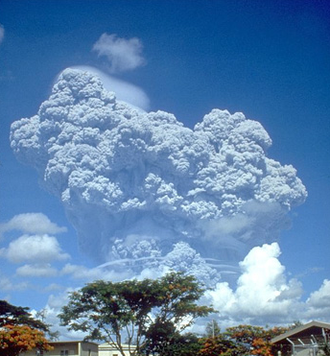
Significant volcanic eruptions
Significant volcanic eruptions pose great hazards to populated areas as they have the potential to do things such as kill, damage buildings, and cause tsunamis.
They are classified as volcanic eruptions that have either caused fatalities, moderate damage ($1 million or more), with a VEI of 6 or larger, caused a tsunami, or been associated with a major earthquake.
For this study I will focus on a the predictability of eruptions with a VEI of 6
My data come from NOAAs Significant Volcanic Eruption Database, which has a global listing of more than 500 eruptions for eruptions during the last 10,000 years
Mount Pinatubo, three days before it
erupted on June 15, 1995. It had a
VEI of 6

Slide 4
Excluding data due to bias
Only the largest VEI eruptions were recorded/ have significant evidence, as well as there used to be
smaller populations, so eruptions may not have been observed. This leads to a bias in the data

Slide 5
Determining useable data
Eruptions with a VEI less than two significantly diverges from the log trend, and is therefore removed

Slide 6
Slope: -7.4996e-4
Intercept: 4.2186
Confidence Interval: [-0.0224, 0.0209]

Slide 7
Resampling
Mean: -0.0008
Standard deviation: 0.0005

Slide 8
FFT

