Slide 1
Vulnerability of Low Income Neighborhoods to Environmental Pollution
Melat Hagos
EAS 4480
April 19, 2017

Slide 2
Introduction
On EPA’s 2020 Action Agenda is a strategic plan to advance environmental justice
“The idea that no group of people should bear a disproportionate share of the negative environmental consequences resulting from industrial, governmental and commercial operations or policies.”
Connection between socioeconomic status and increased exposure to environmental issues
Project Goal : to explore claim that poor and minority communities are
exposed to higher concentrations of air pollution
located closer to dangerous and polluting facilities
Notes:
After attending several serve-learn-sustain events and reading an article in the Scientific American, I wanted to do my project on the connection between socioeconomic status and exposure to environmental pollution. I wanted to explore the claim that poor and minority communities tend to be exposed to higher concentrations of air pollution and that they also have facilities using toxic substances and Hazardous waste treatment, storage, and disposal plants located closer to them.
showing that the biggest polluters in the U.S.-- factories, warehouse and other facilities using toxic substances -- are overwhelmingly located in poor, non-white neighborhoods
disproportionately located in areas near high volume roads or where mobile source air pollution emissions are higher.

Slide 3
Data Sources
2015 data of United States by Census Block Groups; 4767 Data Points
Demographic data from Census Bureau's American Community Survey
Percent low-income: fraction of a block group’s population in households where income is less than/equal to twice the federal poverty level which as of 2015 was $24,250 annual income for a 4 person household ³
Environmental data from EJSCREEN/ EPA Office of Air and Radiation
Ozone level in air: summer seasonal avg of daily concentration (ppb)
PM2.5 level in air: annual avg of particulate matter 2.5 levels (µg/m3)
Proximity to Major Direct Dischargers to Water: count of facilities that discharge pollutants into water within 5 km/distance
Proximity to Risk Management Plan (RMP) Facilities: count of facilities that use extremely hazardous substances within 5 km/distance
Notes:
acilities within 5 km (or nearest one beyond 5 km), each divided by distance in km

Slide 4
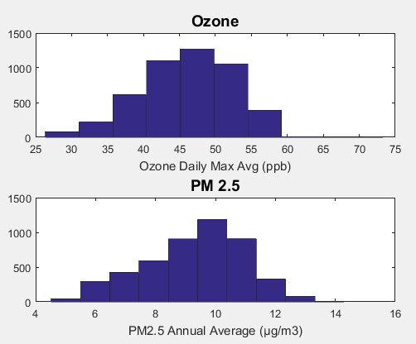
Air Quality
95% Confidence Intervals
Ozone: [45.9429, 46.31176]
PM2.5: [0.3356, 0.3470]
Notes:
On the other hand, narrow confidence intervals in relation to the point estimate tell you that the estimated value is relatively stable; that repeated polls would give approximately the same results.
The width of the confidence interval for an individual study depends to a large extent on the sample size. Larger studies tend to give more precise estimates of effects (and hence have narrower confidence intervals) than smaller studies.

Slide 5
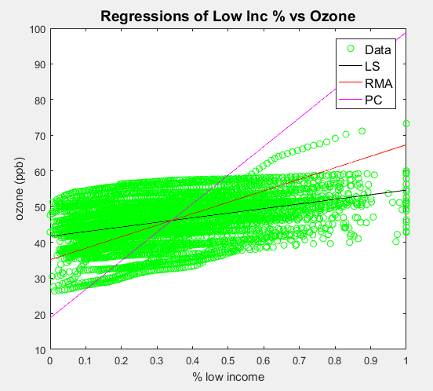
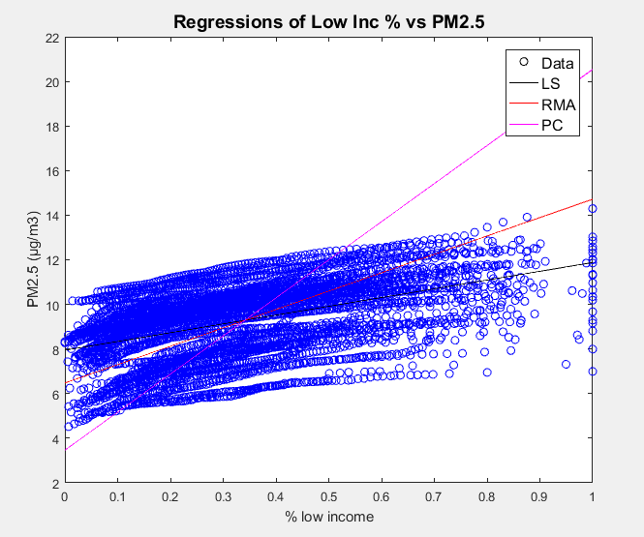
Regression | Slope | R²
LS | 0.1293 | 0.1613
PC | 0.8015 | 0.6190
RMA | 0.3221 | 1.0000
Regression | Slope | R²
LS | 0.3931 | 0.2276
PC | 0.1707 | 0.4294
RMA | 0.8241 | 1.0000
Notes:
The most appropriate regression method depends on the problem. If we treat observed and modeled data equally and want to intercompare the two datasets, PC-regression (and to a lesser extent RMA-regression) is the best. If we treat the observed values are ground-truth and want to understand how the modeled values deviate from the observations, the regular LS regression is the best. If you experiment with the location of the outlier data, you will find that its effect on the regularLS regression depends on how close the data is to the mean of observed data (x-axis). The closer it is, the smaller is the effect. PC and RMA regressions are not affected as much by the xlocation of the outlier point.
The Chi-squared test results here appear to suggest that the RMA fit is the “best” fit, considering that it has the smallest t-value (it has the “most normal” residuals). However, the PC fit takes into account variance in the predictor (x-values) that is not reflected in the analysis of the fitting residuals here. Also, choice of #bins to do the analysis impacts the comparative values of the tvalue (as discussed above).
R-squared is a statistical measure of how close the data are to the fitted regression line. It is also known as the coefficient of determination, or the coefficient of multiple determination for multiple regression.

Slide 6
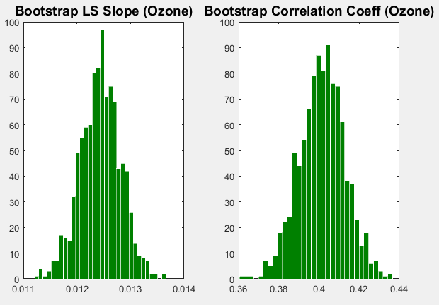
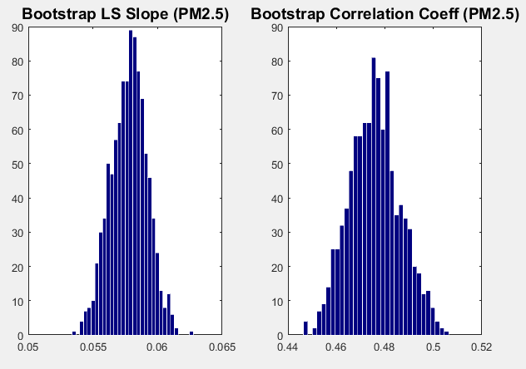
 | LS Slope | CorrCoeff
Mean | 0.012 | 0.402
Std Dev | 0.000 | 0.000
CI | [0.0117, 0.0131] | [0.4013, 0.4020]
 | LS Slope | CorrCoeff
Mean | 0.058 | 0.476
Std Dev | 0.001 | 0.000
CI | [0.0550, 0.0606] | [0.4760, 0.4767]
Notes:
The bootstrap can be used to construct confidence intervals for Pearson's correlation coefficient. In the "non-parametric" bootstrap, n pairs (x_{i}, y_{i}) are resampled "with replacement" from the observed set of n pairs, and the correlation coefficient r is calculated based on the resampled data. This process is repeated a large number of times, and the empirical distribution of the resampled r values are used to approximate the sampling distribution of the statistic. A 95% confidence interval for ρ can be defined as the interval spanning from the 2.5th to the 97.5th percentile of the resampled r values.

Slide 7
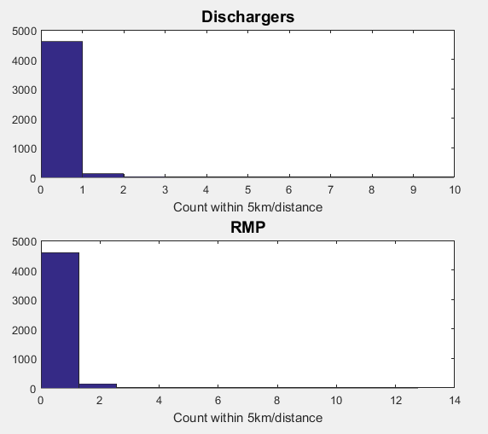
Facilities
95% Confidence Intervals
Dischargers: [0.2321, 0.2572]
RMP: [0.2743, 0.3065]
Notes:
The most notable difference between the two datasets is the difference between their mean values (Modeled > Observed). All four figures also illustrate this difference: the shift of the distribution in Fig. 1 & 2, blue values consistently higher than black values in Fig. 3, and most values falling above the line y = x in Fig. 4. The consistency of model values being higher (save for four measurements, Fig. 4) than observations suggests a systematic cause
The model appears to consistently over-predict the actual O3 value. This may cause a higher incidence of false positive high-ozone day warnings, which is better than the alternative of an non-forecasted poor air quality day.

Slide 8
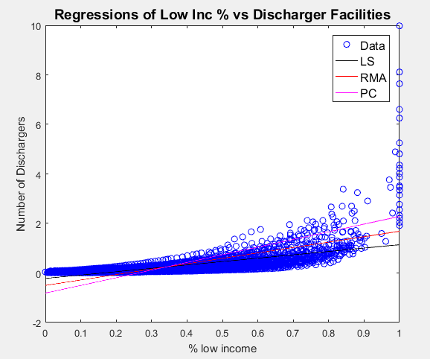
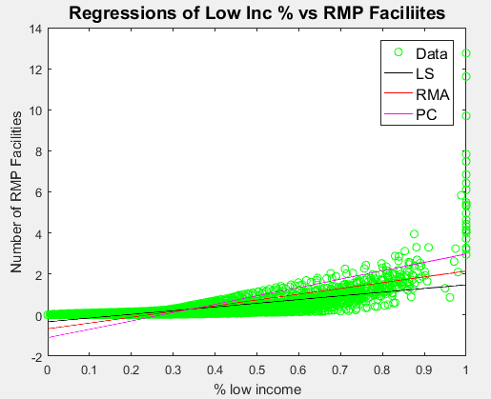
Regression | Slope | R²
LS | 0.1363 | 0.3886
PC | 0.3096 | 0.2055
RMA | 0.2186 | 1.0000
Regression | Slope | R²
LS | 0.1800 | 0.4104
PC | 0.4076 | 0.2104
RMA | 0.2281 | 1.0000
Notes:
The square of the sample correlation coefficient is typically denoted r² and is a special case of the coefficient of determination. In this case, it estimates the fraction of the variance in Y that is explained by X in a simple linear regression. So if we have the observed dataset {y₁,...,y_{n}} and the fitted dataset {f₁,...,f_{n}}, and we denote the fitted dataset {f₁,...,f_{n}} with {ŷ₁,...,ŷ_{n}}, then as a starting point the total variation in the Y_{i} around their average value can be decomposed as follows
{\displaystyle \sum _{i}(Y_{i}-{\bar {Y}})^{2}=\sum _{i}(Y_{i}-{\hat {Y}}_{i})^{2}+\sum _{i}({\hat {Y}}_{i}-{\bar {Y}})^{2},}where the {\displaystyle {\hat {Y}}_{i}} are the fitted values from the regression analysis. This can be rearranged to give
{\displaystyle 1={\frac {\sum _{i}(Y_{i}-{\hat {Y}}_{i})^{2}}{\sum _{i}(Y_{i}-{\bar {Y}})^{2}}}+{\frac {\sum _{i}({\hat {Y}}_{i}-{\bar {Y}})^{2}}{\sum _{i}(Y_{i}-{\bar {Y}})^{2}}}.}The two summands above are the fraction of variance in Y that is explained by X (right) and that is unexplained by X (left).
Next, we apply a property of least square regression models, that the sample covariance between {\displaystyle {\hat {Y}}_{i}} and {\displaystyle Y_{i}-{\hat {Y}}_{i}} is zero. Thus, the sample correlation coefficient between the observed and fitted response values in the regression can be written (calculation is under expectation, assumes Gaussian statistics)

Slide 9
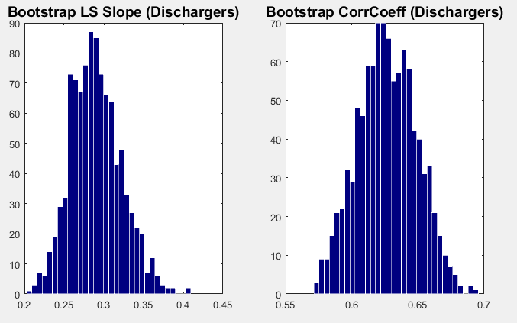
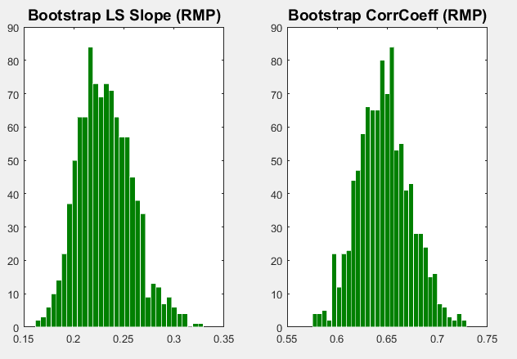
 | LS Slope | CorrCoeff
Mean | 0.290 | 0.623
Std Dev | 0.032 | 0.000
CI | [0.2330, 0.3593] | [0.6231, 0.6235]
 | LS Slope | CorrCoeff
Mean | 0.232 | 0.641
Std Dev | 0.027 | 0.000
CI | [0.1835, 0.2926] | [0.6404, 0.6408]
Notes:
The most appropriate regression method depends on the problem. If we treat observed and modeled data equally and want to intercompare the two datasets, PC-regression (and to a lesser extent RMA-regression) is the best. If we treat the observed values are ground-truth and want to understand how the modeled values deviate from the observations, the regular LS regression is the best. If you experiment with the location of the outlier data, you will find that its effect on the regularLS regression depends on how close the data is to the mean of observed data (x-axis). The closer it is, the smaller is the effect. PC and RMA regressions are not affected as much by the xlocation of the outlier point.
The Chi-squared test results here appear to suggest that the RMA fit is the “best” fit, considering that it has the smallest t-value (it has the “most normal” residuals). However, the PC fit takes into account variance in the predictor (x-values) that is not reflected in the analysis of the fitting residuals here. Also, choice of #bins to do the analysis impacts the comparative values of the tvalue (as discussed above).

Slide 10
Correlation and Significance
Ozone
Correlation Coefficient (r) : 0.4016
Corrcoef 95% confidence interval: 0.4251 to 0.3775
Corrcoef Significance (p) : 2.3239e-184
PM2.5
Correlation Coefficient (r) : 0. 4764
Corrcoef 95% confidence interval: 0.4980 to 0.4541
Corrcoef Significance (p) : 1.201e-268
Proximity to facilities discharging pollutants
Correlation Coefficient (r) : 0.6234
Corrcoef 95% confidence interval: 0.6405 to 0.6058
Corrcoef Significance (p) : 0
Proximity to facilities using extremely hazardous substances
Correlation Coefficient (r) : 0.6407
Corrcoef 95% confidence interval: 0.65709 to 0.62361
Corrcoef Significance (p) : 0
Notes:
The correlation coefficient calculated for these two distributions was ~0.4 with a range from ~0.2 to ~0.6. The significance (p-value) for this correlation was calculated to be 0.0011 (1.1%) which is less than 5%, indicating that the correlation is significant. Thus, the null hypothesis must be rejected – the two datasets are significantly correlated, but the extent of their correlation (how well they correlate) is uncertain.
A coefficient of ~0.4 with such a wide range does not indicate that they are necessarily 1:1 related. This is also reflected in the confidence interval calculated for the slope of the LS linear regression. The range of slopes within the 95% confidence interval includes negative values which would suggest a reverse relationship to the one observed from this sample.
%correlation is significant if p<0.05 (95% confidence)

Slide 11
Conclusion
Positive correlation between low income and ozone/pm2.5
Strong positive correlation between low income and proximity to facilities discharging pollutants/proximity to facilities using extremely hazardous substances
Low income neighborhoods disproportionately located in areas near high volume roads or where mobile source air pollution emissions are higher
Also lack political power over decisions on waste siting and pollution prevention
Notes:
Biggest polluters like factories, warehouse and hazardous waste treatment and storage plants located in poorer areas

Slide 12
References
https://www.census.gov/2010census/popmap/ipmtext.php?fl=13
ftp://newftp.epa.gov/EJSCREEN/2015/
https://aspe.hhs.gov/2015-poverty-guidelines
ftp://newftp.epa.gov/EJSCREEN/2015/EJSCREEN_Technical_Document_20150505.pdf
http://www.ase.tufts.edu/gdae/education_materials/modules/Environmental_Justice.pdf

