Slide 1

Global Access to Improved Drinking Water and Childhood Mortality
Hannah Greenwald
EAS 4480 Spring 2017

Slide 2
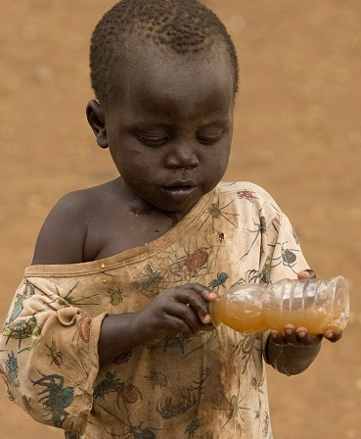
Motivation: Childhood Mortality
5.9 million children under the age of 5 died in 2015
Globally, ~2,000 children under the age of five die every day from diarrheal diseases (1,800 deaths are linked to water, sanitation and hygiene)
~1/2 of under-five deaths occur in India, Nigeria, Democratic Republic of the Congo (DRC), Pakistan and China.
783 million people worldwide without improved drinking water:
  119 million in China;
  97 million in India;
  66 million in Nigeria;
  36 million in DRC;
  15 million in Pakistan

Slide 3
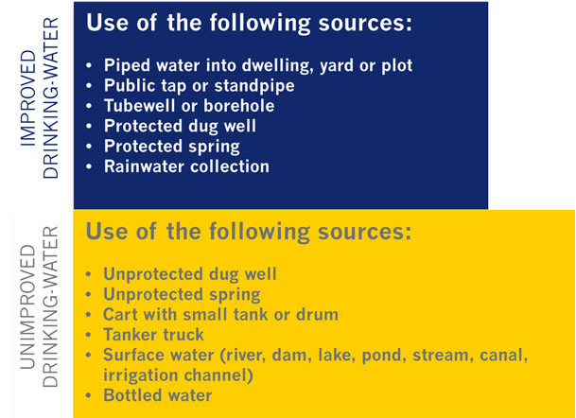
Motivation: Improved Water Source
WHO/UNICEF JMP for Water Supply and Sanitation:
  “An ‘improved’ drinking-water source is one that, by the nature of its construction and when properly used, adequately protects the source from outside contamination, particularly faecal matter. ”
UN Millennium Development Goal 7, Target 7c, calls on countries to: "Halve, by 2015, the proportion of (1990) population without sustainable access to safe drinking-water and basic sanitation".

Slide 4
Data Sources
World Bank: Percent of Population with Access to an Improved Drinking Water Source by Country (1990-2015)
World Bank: Childhood Mortality (deaths under 5 years of age per 1000 live births) (1960-2015)
Notes:
Both data sets have holes and have regional data that were weeded out

Slide 5
Global Water Access Trends
Slope= 0.4367 %/yr
95% regression slope CI = [0.4042, 0.4710]
1990:
Mean=78.75
Skewness=-0.9544
Kurtosis=2.913
2015:
Mean=89.16
Skewness=-1.553
Kurtosis=4.414
*Met Millennium Development goal of ½ reduction, not target of 2/3 reduction
Notes:
Negative so left skew; kurtosis greater than 3 is a wide distribution
out of 170 countries studied, 105 have met Millennium Development goal
(1990: globally 21.25% did not have access; 2015: 10.84% did not have access)
→ Met goal of ½ reduction, not target of 2/3 reduction
6 countries with neg slopes: Afghanistan, CaboVerde, Cayman Islands, Equatorial Guinea, Moldova, Montenegro
Large distribution of access (large error bars) but distribution is getting smaller over time
(164 countries with positive slopes,
6 countries with negative slopes)

Slide 6
Global Child Mortality Trends
1990:
Mean=156.1
Skewness= 0.227
Kurtosis=1.99
2015:
Mean= 33.1
Skewness= 1.29
Kurtosis=4.17
Slope= -2.4 (1/1000)/yr = -0.24 %/yr
95% regression slope CI = [-3.1141, -1.6781]
Notes:
Large distribution of access (large error bars) but distribution is getting smaller over time
(117 countries with positive slopes,
122 countries with negative slopes)

Slide 7
Water Access & Childhood Mortality in 2015
Mean= 88.67
Standard Dev.=14.66
Skewness= -1.473
Kurtosis=4.414
Mean= 32.87
Standard Dev.= 33.37
Skewness= 1.376
Kurtosis=4.17
Notes:
170 countries comparison

Slide 8
2015 Water Access vs. Childhood Mortality
Least Squares Regression
Least Squares Regression:
y=-1.7888x+191.5
Slope 95% CI= [-4.85, 1]
*not statistically decreasing
Slope Bootstrap Analysis
Mean= -1.7934
Std= 0.1792
95% slope CI: [-2.1694, -1.4670]
Correlation Coefficient:
r= -0.7855
p=0.0000
95% CI= [ -.8392, -.7166]
*statistically significant
Bootstrap CorrCoef
Mean= -.7864
95% CI= [ -.8492, -.7132]

Slide 9
2015 Water Access vs. Childhood Mortality
Fitting and Residuals Analysis
residuals not normally distributed for any regression
Residuals not independent (autocovariance analysis)
Regression | Slope | R² | Chi²
LS | -1.7888 | 0.6170 | 134
RMA | 2.2772 | 1 | 256
PC | -2.7091 | 1.4153 | 73
*Normality test Chisquared threshold =18.3 (for n=13)
Notes:
R^2 can be greater than 1???

Slide 10
Bolivia
m=.876
m= -4.71
Correlation Coefficient: r=-.9972, p=0.0000, rlow= -.9988, rhigh= -.9937
1st order LSR slope error bound: [-0.4710, -0.3428]

Slide 11
Bolivia
Regression | Slope | R² | Chi²
LS (1st order) | -0.4069 | 0.9944 | 7.1604
LS (2nd order) | 0.0040, -1.0401 | .9978 | 13.8756
PC | 65.1986 | .996 | 11.7248

Slide 12
India
m=.9728
m= -3.82
Correlation Coefficient: r=-.9993, p=0.0000, rlow= -.9997, rhigh= -.9984
95% CI on 1st order LSR slope: [-0.3543, -0.3025]

Slide 13
India
Regression | Slope | Intercept | R² | Chi² | Bootstrap Slope Mean | Bootstrap Slope Std
1st Order LSR | -0.3284 | 35.6517 | .9986 | 6.035 | -0.3285 | 0.0029
2nd Order LSR | 0.0016 -0.5928 | 46.4994 | .9996 | .7401 | 0.0016 -0.6002 | 3.2031e-04 0.0529
PCR | -0.3285 | 35.6554 | .9989 | 6.0342 | - | -

Slide 14
Nigeria
m= 1.15
m= -3.53
Correlation Coefficient: r=-.9869, p=0.0000, rlow= -.9942, rhigh= -.9706
1st order LSR slope error: [-0.5441 -0.2653]

Slide 15
Nigeria
Regression | Slope | R² | Chi² | Bootstrap Slope Mean | Bootstrap Slope Std
LS (1st order) | -0.4047 | 0.9739 | 7.8026 | -.4062 | .1077
LS (2nd order) | -0.0074 0.4019 | .9928 | 7.3981 | -0.0073 0.3887 | .0015 .1664
PC | -.4062 | .9813 | 7.5201 | - | -
Notes:
Bootstrap: 1st order LSR: -.4062(std .1077) / 39.088 (std= 1.0445)
2nd order LSR: -0.0073 (std .0015) / 0.3887 (std .1664) / 18.0493 (std 4.4885)

Slide 16
United States
m=.032
m= -.43
Correlation Coefficient: r=-.9824, p=0.0000, rlow= -.9922, rhigh= -.9606
Choose 1st Order LSR: Slope error 95% CI= [-0.7019, -0.3006]

Slide 17
United States
Regression | Slope | R² | Chi²
LS (1st order) | -0.50128 | 0.9651 | 1.847
LS (2nd order) | 0.215295, -43.0499 | .9745 | 3.225
PC | -.5049 | .9793 | 5.111
*Threshold Chi² value = 9.488

Slide 18
Conclusions
Global access to improved drinking water sources is increasing over time
Global child mortality is decreasing over time
Developing countries improving faster than developed
2015 child mortality v. water access has significant negative correlation
Very strong negative correlation between Water Access and Child Mort in all countries examined
Rate of Incr. in Water Access: Nigeria>India>Bolivia>US
Rate of Decr. in Child Mort.: Bolivia>India>Nigeria>US
Mag. Of slope of Water v. Mort: Bolivia>Nigeria>India>US
(changing water access in Bolivia has biggest impact on mort)
Need to look at other variables and perform other studies to determine causation

Slide 19
Questions?

Slide 20
References
http://data.worldbank.org/indicator/SH.H2O.SAFE.ZS
http://data.worldbank.org/indicator/SH.DYN.MORT
https://www.wssinfo.org/definitions-methods/
https://www.unicef.org/media/media_68359.html

Slide 21
EAS-4480 Project Report Rubric (90 points + 10 from presentation)
(10) The student clearly identifies the goal of the project – the question being answered. This is accompanied by some motivation of the underlying physical phenomena.
(5) The student identifies data sources and explains (if necessary) how the data were arranged for use in the statistical analysis.
(20) Appropriate statistical techniques that address the goal of the project are employed to analyze the data. The techniques should be used correctly. Error/uncertainty estimates should be made where necessary.
(10) The student should identify why analysis techniques were chosen. Describing the steps of hypothesis testing would be ideal.
(10) The student demonstrates either their in-depth understanding of a particular analysis technique (sophisticated method) or their breadth in multiple relevant techniques. For instance, the analysis should not be limited to calculating the correlation coefficient between different variables.
(15) The student demonstrates clear understand of errors/uncertainties in the analysis and discusses the underlying physical phenomena in light of the analysis results and error estimates.
(20) The written report should be free of major grammatical errors, have a coherent structure (logical procession of ideas), and include abstract, introduction, analysis, conclusions, and a list of references (bibliography). Any figures should be clearly legible with proper labels, lines, fonts, and captions.
Suggested report length: 8-12 pages (double spaced (not counting figures and references), Times New Roman, 12pt). The report must be your own work and writing. Plagiarism will not be tolerated. Please check out these web instructions if you are unsure how to properly credit published and unpublished sources: http://isites.harvard.edu/icb/icb.do?keyword=k70847&tabgroupid=icb.tabgroup106849.

Slide 22
Bangladesh
r=-.9935, p=0.0000, rlow= -.9971, rhigh= -.9853

Slide 23
India

