Slide 1
Hurricanes & Cruise Passengers in the Caribbean
Manon Magill

Slide 2
Goal
Determine a relationship (if any) between the number of cruise ship passengers and hurricane activity in the Atlantic Ocean

Slide 3
Motivation
Hurricanes are destructive events, especially when they make landfall
2004 hurricane season in Florida
Cruise ships often enter warm, hurricane friendly waters over the summer
Potential for impact on sales

Slide 4
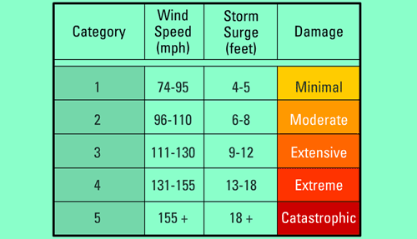
Background

Slide 5
Hypothesis
There is a correlation between the number of cruise ship passengers and the number of hurricanes per season.

Slide 6
Data Sources
NOAA for Hurricane Data
U.S. DOT – Maritime Administration for Cruise Data
Analyzed data per quartile for Bahamas and Caribbean destinations
Number of passengers

Slide 7
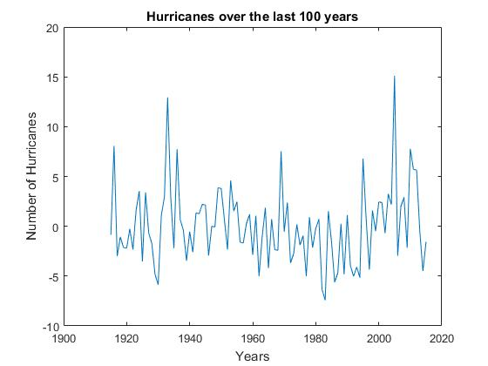
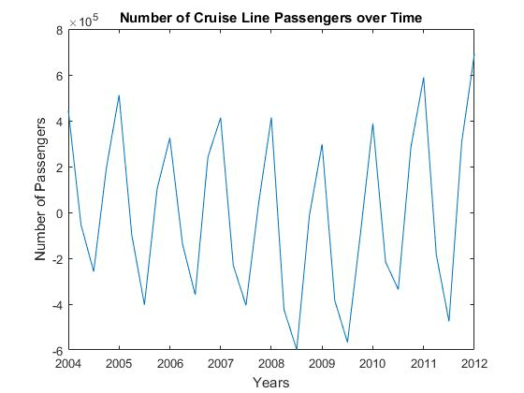
First Glance

Slide 8
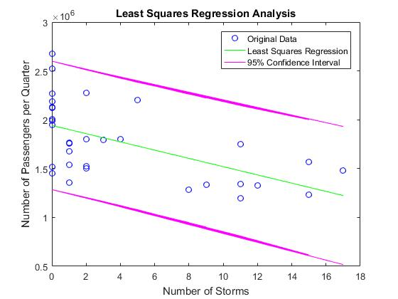
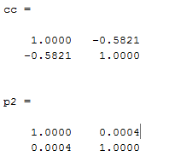
Methods: Least Squares Regression
Notes:
Least squares is influenced the least by outliers out of all of the regression analysis methods
For correlation coefficient:
P-value of cc is 0.004, indicating that the correlation coeff is significant.

Slide 9
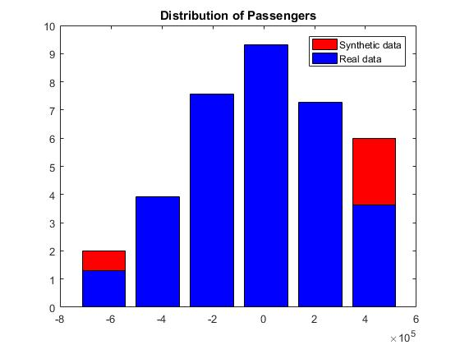
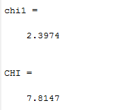
Methods: Residual Analysis
Notes:
-Chi squared test
Since chi1 is less than CHI, data is considered normally distributed

Slide 10
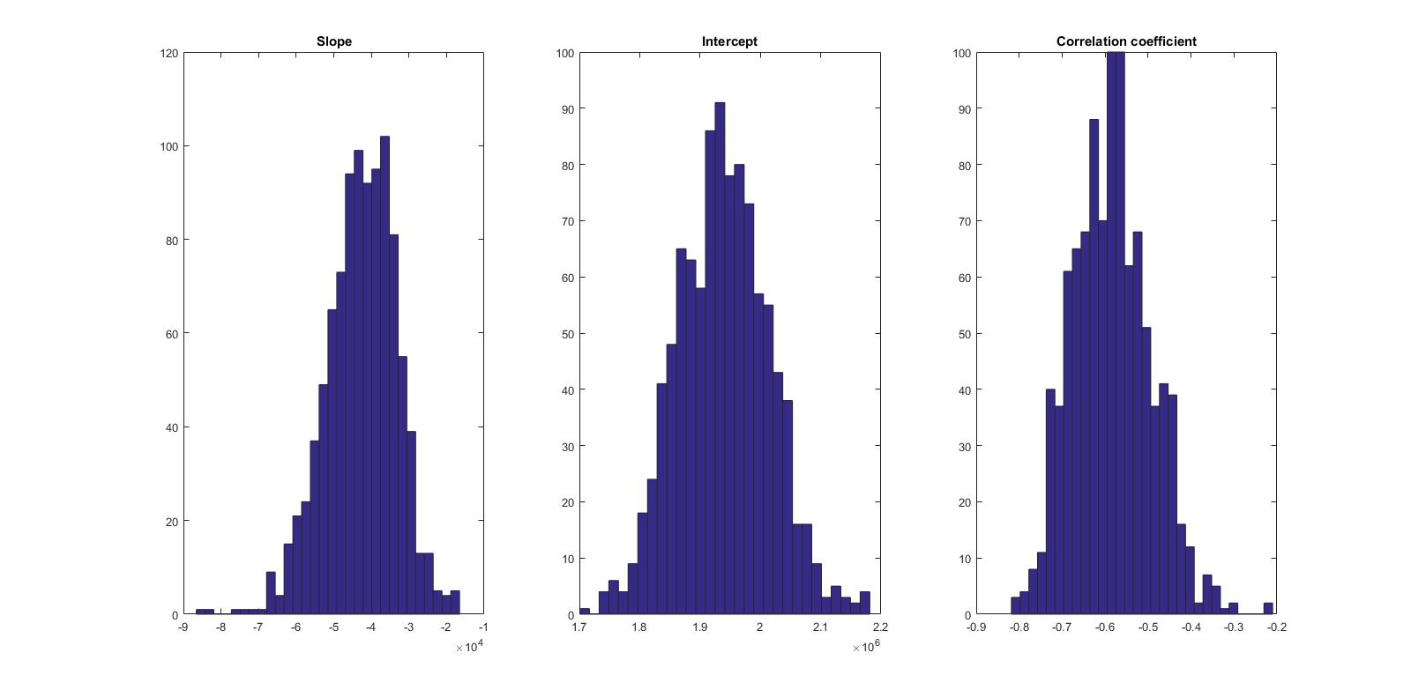
Methods: Bootstrap

Slide 11
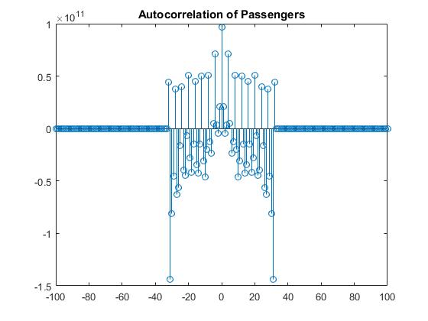
Method: Autocorrelation

Slide 12
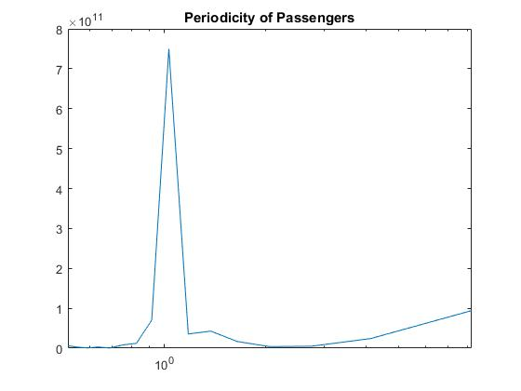
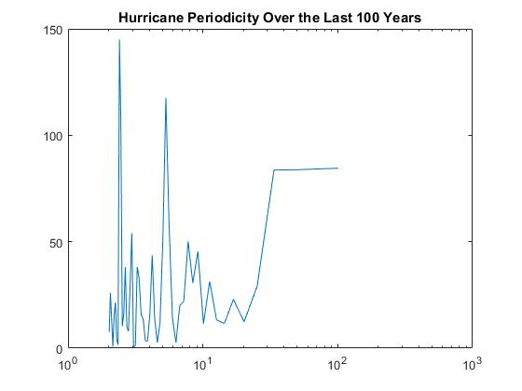
Method: Periodogram

Slide 13
Analysis
Correlation between the number cruise passengers and hurricanes exists
Correlation coefficient is only .58, so not necessarily strong evidence for this phenomenon
No strong periodicity

Slide 14
Sources
http://www.nhc.noaa.gov/aboutsshws.php
http://www.aoml.noaa.gov/hrd/hurdat/DataByYearandStorm.html
https://www.marad.dot.gov/wp-content/uploads/pdf/North_American_Cruise_Statistics_Quarterly_Snapshot.pdf

