Slide 1
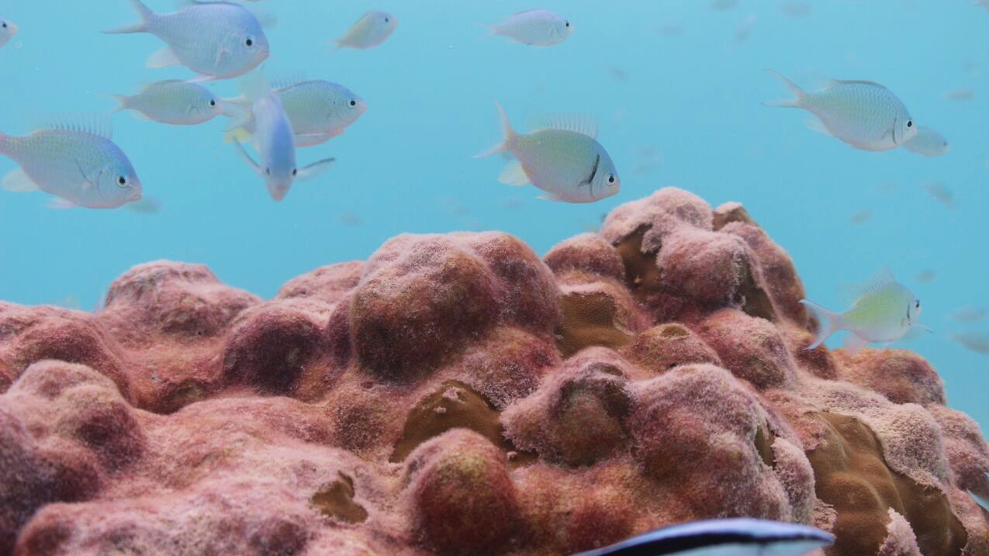
How well did corals from the Central Tropical Pacific record SST during the 2015/16 El Niño Event?
Gemma O’Connor
EAS 4480
April 25, 2017

Slide 2
Motivation
2015/16 El Niño event was one of the strongest on record
Heavy flooding an droughts harming lots of people and economies
We want to understand how El Niño events are changing over time
Instrumental data doesn’t allow us to understand long-term ENSO trends so we use coral oxygen isotopes as proxies for tracking SST

Slide 3
Motivation
“One of the strongest 3 El Niño events on record since 1950” -NOAA
SE Asia experienced heavy drought conditions and damaged crops
South America experienced heavy floods causing hundreds of thousands to evacuate
It’s relevant to reconstruct recent paleoclimate records because we can directly compare them to instrumental records and better understand how the proxy works
Notes:
Pic 1 http://interaksyon.com/article/127313/el-nino-damage-to-agriculture-reaches-p7-013b-in-jan--may-16
Quote https://www.climate.gov/news-features/blogs/enso/february-2016-el-ni%C3%B1o-update-q-a%E2%80%A6and-some-thursday-morning-quarterbacking
Pic 2 http://www.bbc.com/news/world-latin-america-35179103

Slide 4
How does coral δ¹⁸O track SST?
δ¹⁸O_{coral} = a(SST) + b(δ¹⁸O_{sw})
δ¹⁸O_{sw} tracks changes in salinity
relative contribution of these properties vary by location and time
Seawater δ¹⁸O
SST
(m = 0.2‰ / °C)
Coral δ¹⁸O

Slide 5
Project Questions
By analyzing both instrumental and proxy data, how strong was the 2015/16 El Niño event?
How well did coral oxygen isotopes capture SST during 2015/16 El Niño event?

Slide 6
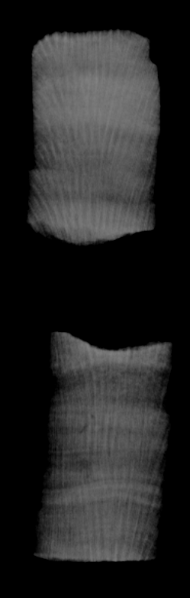
Data Collection
Coral data collection:
Get corals from the middle of the Pacific Ocean
Run hundreds of coral samples on the mass spec (pic of xray coral with line of sampling drawn)
SST data collection:
Download IGOSS (integrated global ocean services system) SST from internet. Represents combined data from ship, buoy, and satellite. https://iridl.ldeo.columbia.edu/SOURCES/.IGOSS/.nmc/.Reyn_SmithOIv2/.monthly/.sst/index.html?Set-Language=en

Slide 7
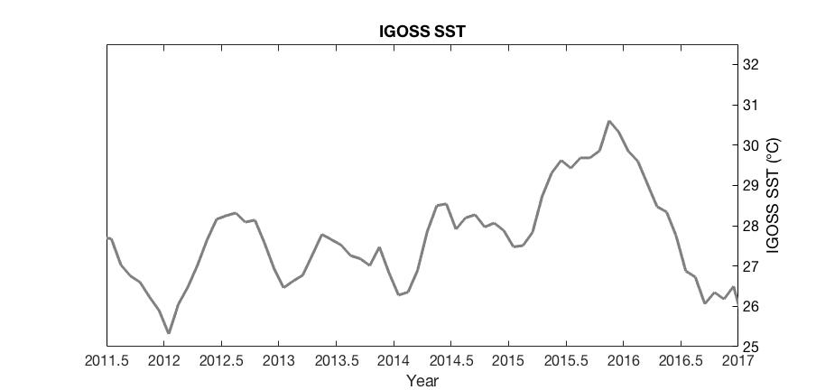
Event Magnitude: Instrumental SST
Peak: 30.61°C
3-month mean: 30.26°C

Slide 8
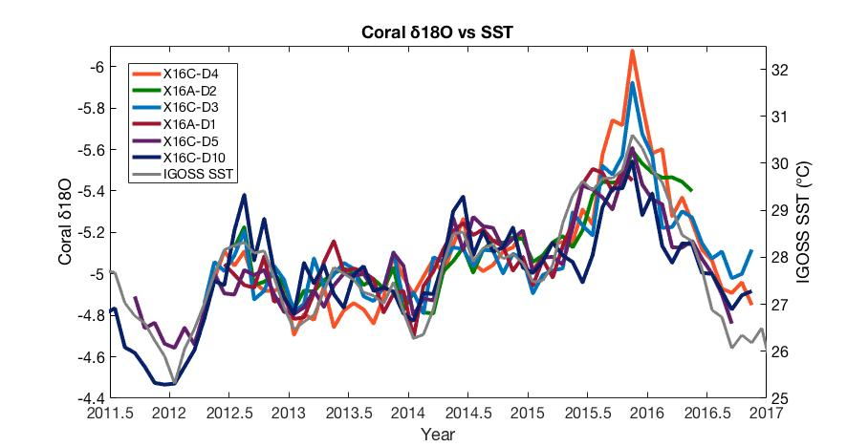
Event Magnitude: Coral δ¹⁸O
Peak: -6.078 ‰
3-month mean: -5.585 ‰

Slide 9
Event Magnitude: Coral δ¹⁸O
My analysis: January 2014 to August 2016

Slide 10
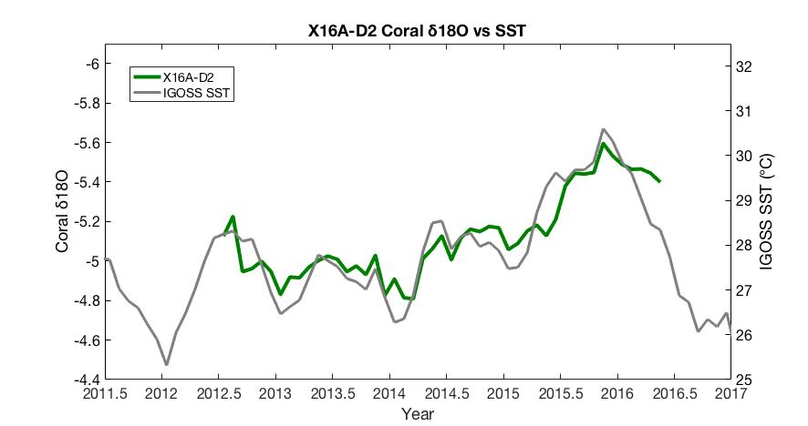
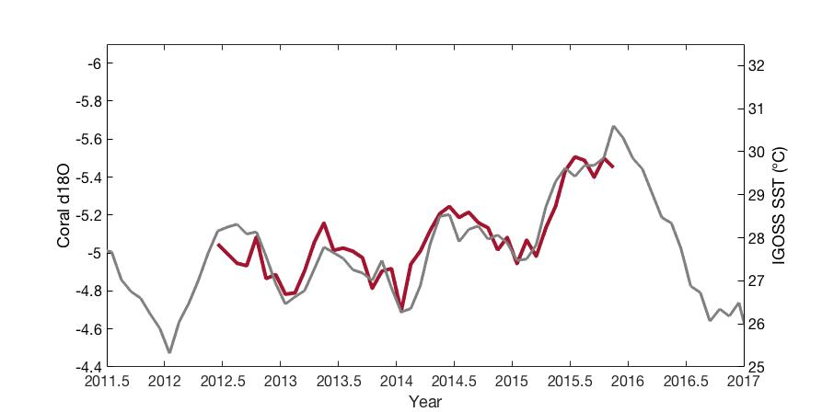
Coral X16A-D1
1

Slide 11
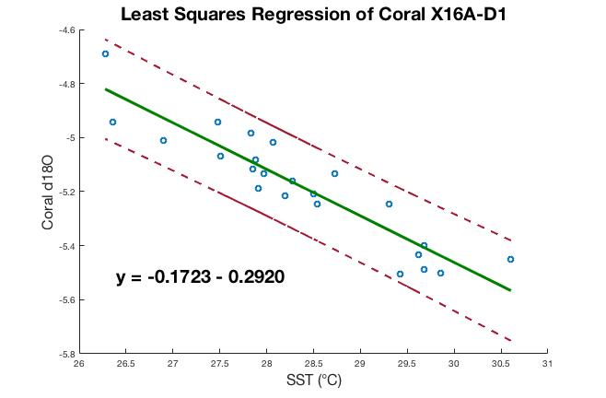
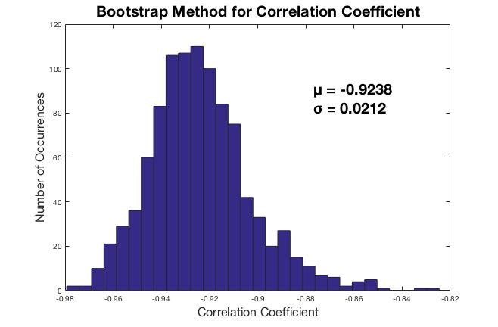

Coral X16A-D1
95% CI for r: [ -0.921, -0.8203]. p-value: 4.6516 e-10

Slide 12
Coral X16A-D2

Slide 13
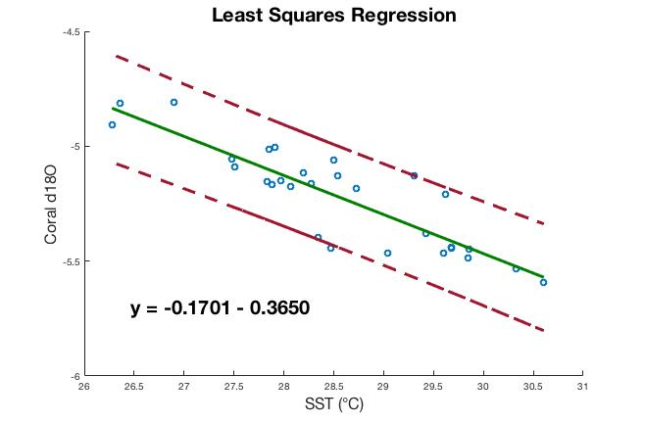
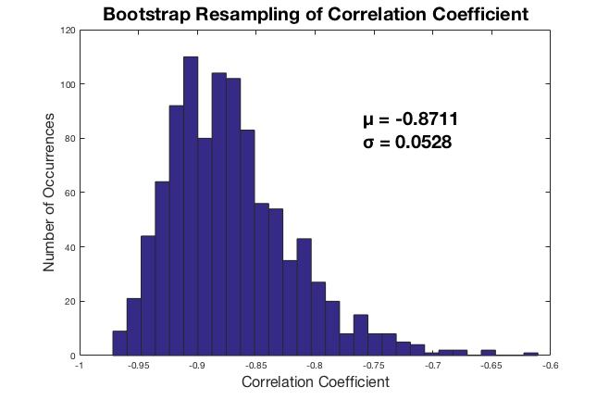
Coral X16A-D2
95% CI for r: [ -0.9389, -0.7443] p-value: 6.7470 e-10

Slide 14
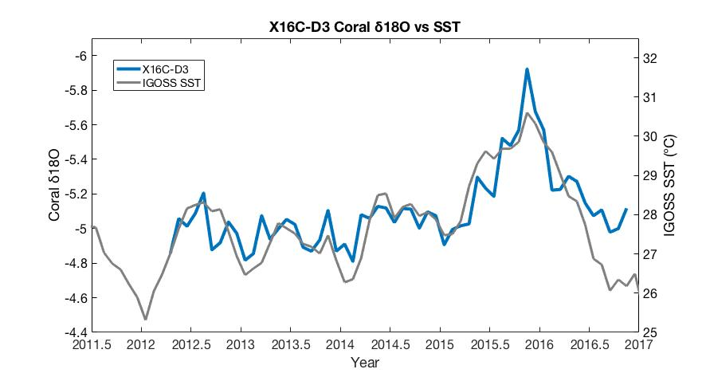
Coral X16C-D3

Slide 15
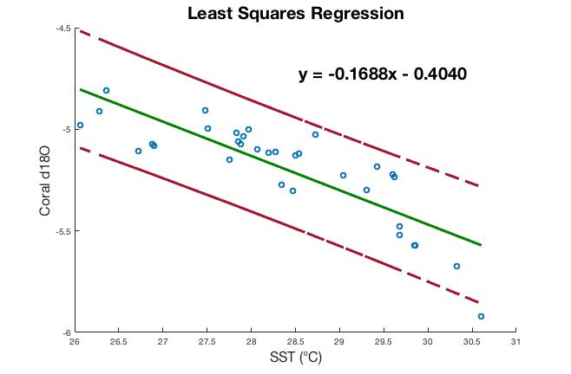
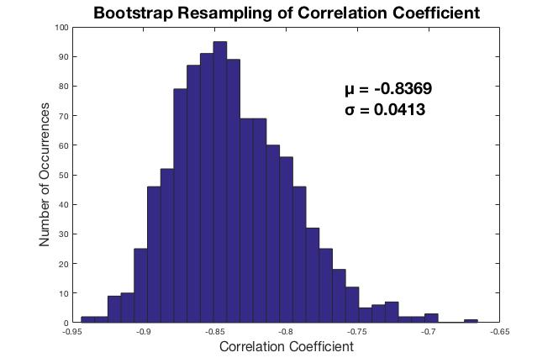
Coral X16C-D3
95% CI for r: [ -0.9174, -0.6945]. p-value: 1.1715 e-9

Slide 16
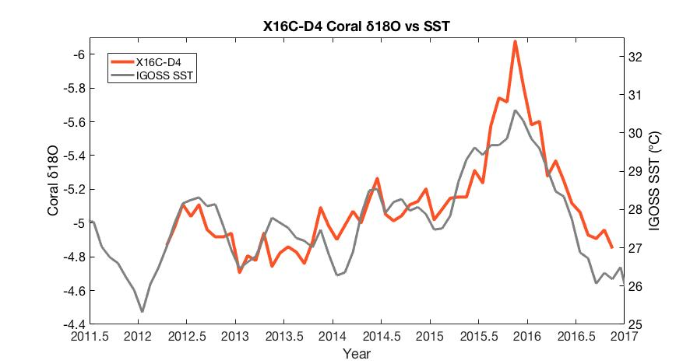
Coral X16C-D4

Slide 17
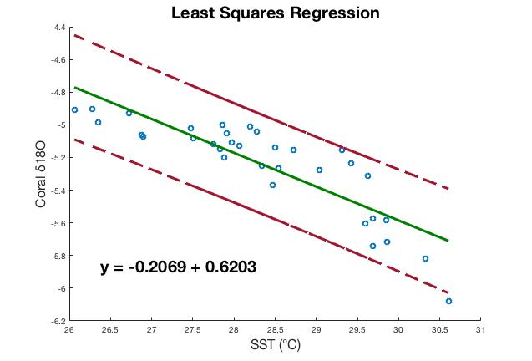
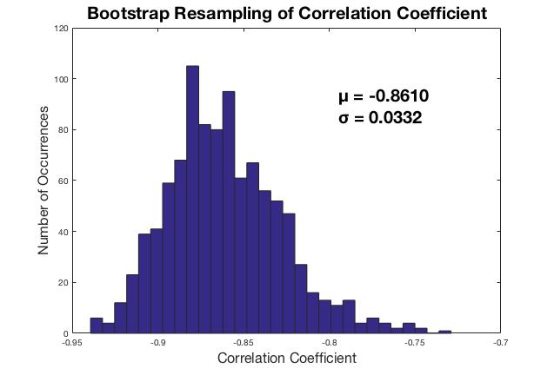

Coral X16C-D4
95% CI for r: [ -0.9298, -0.7357]. p-value: 1.2338 e-10

Slide 18
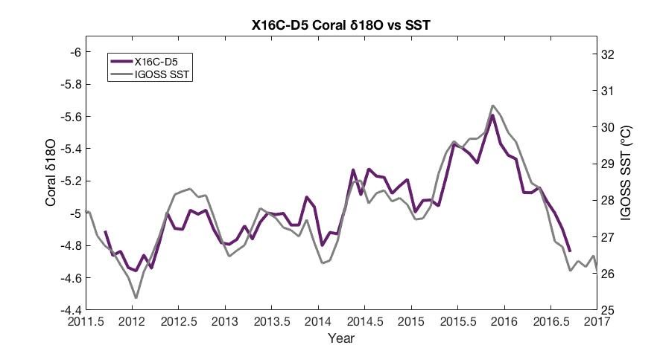
Coral X16C-D5

Slide 19
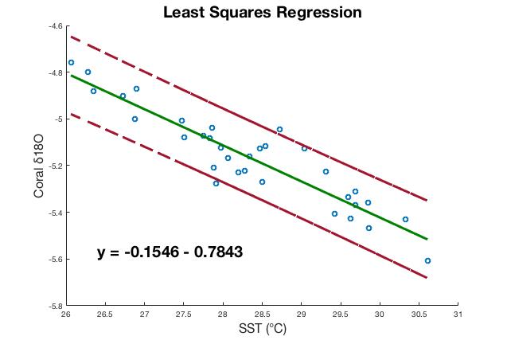
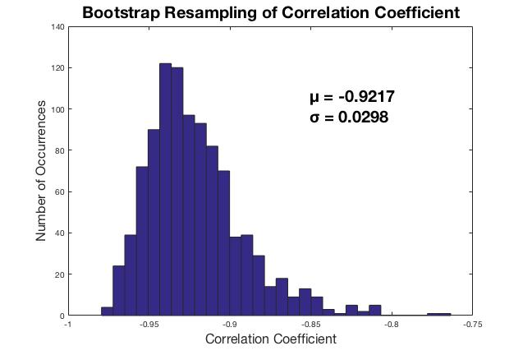

Coral X16C-D5
95% CI for r: [ -0.9628, -0.8529]. p-value: 1.2338 e-10

Slide 20
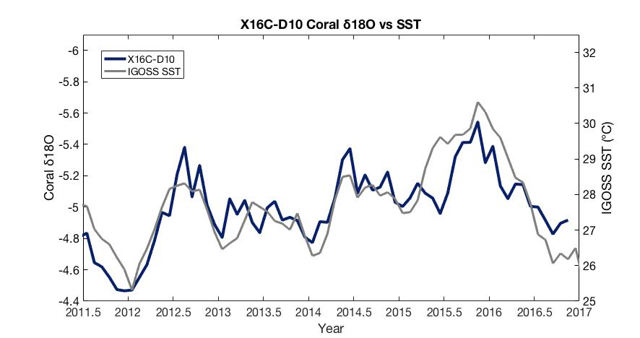
Coral X16C-D10

Slide 21
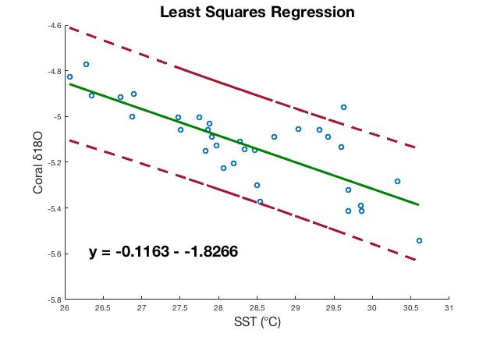
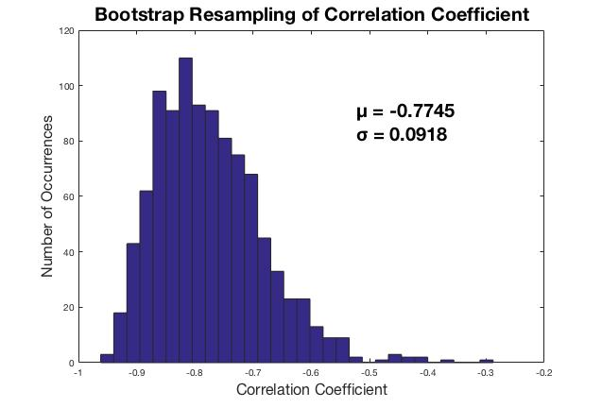

Coral X16C-D10
95% CI for r: [ -0.8847, -0.5923]. p-value: 1.0206 e-7

Slide 22
Summary of Results
Coral | Peak δ¹⁸O | Correlation | P-value
X16A-D1 | -5.500 ‰ | -0.9238 | 4.65 e-10
X16A-D2 | -5.595 ‰ | -0.8711 | 6.75 e-10
X16C-D3 | -5.923 ‰ | -0.8369 | 1.17 e-9
X16C-D4 | -6.078 ‰ | -0.8610 | 1.23 e-10
X16C-D5 | -5.608 ‰ | -0.9217 | 1.24 e-10
X16C-D10 | -5.543 ‰ | -0.7745 | 1.02 e-7
Mean correlation: -0.865

Slide 23
Concluding Remarks
The 2015/16 El Niño reached a peak SST of 30.61°C and a peak δ¹⁸O of – 5.708 ‰ (by averaging the peak values for 6 corals)
With 95% confidence and a sample size of 6 corals, there is a significant correlation (~-0.87) between SST and coral δ¹⁸O during this event

