Slide 1
The role of weather conditions on PM2.5 concentrations in Beijing
Qi Wang

Slide 2
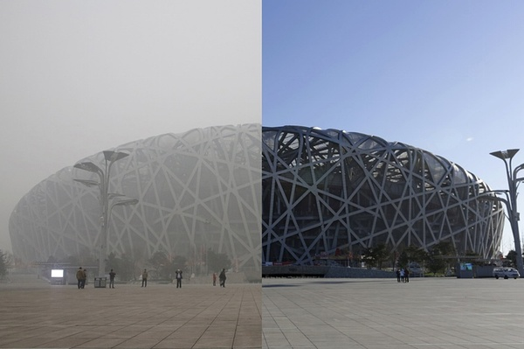
PM2.5
Particles with aerodynamic diameter less than 2.5 μm
A key contributor to the smog in Beijing

Slide 3
Data
Daily average of hourly PM2.5 concentrations (μg/m³)
Daily weather historical data--Beijing Capital International Airport
Temperature (ºC)
Relative humidity (%)
Wind speed (km/h)
Precipitation (mm)
01/01/2011-01/31/2017 (no precipitation data in 2011)

Slide 5
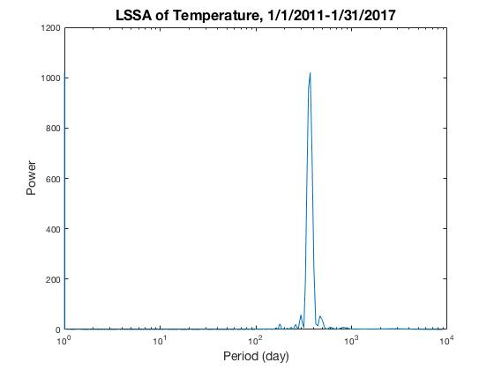
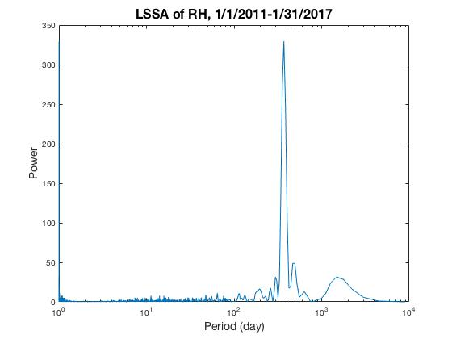
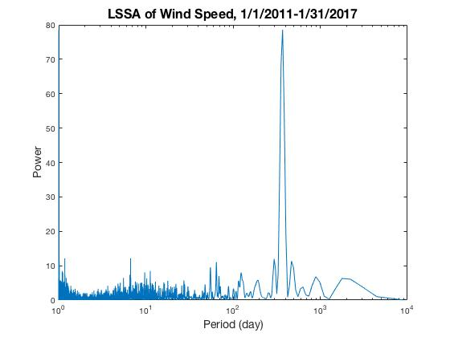
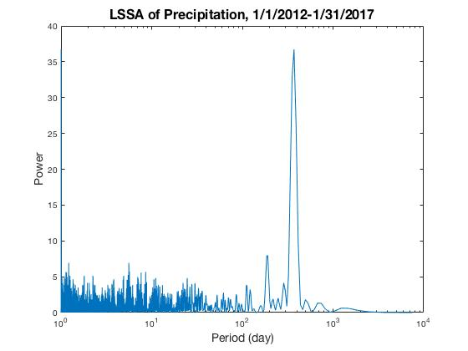
LSSA

Slide 6
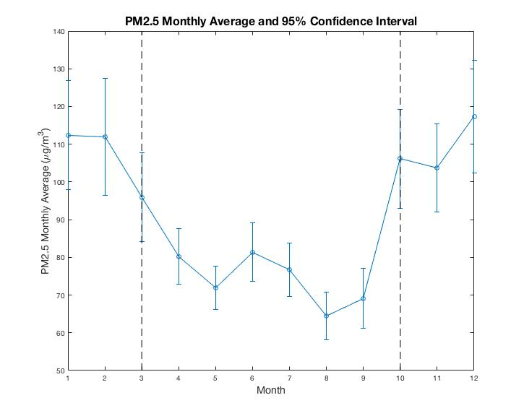
Monthly Average of PM2.5 Concentration
Data were divided into 2 groups based on the PM2.5 monthly average.
Jan to Mar & Oct to Dec
Apr to Sep

Slide 7
Two-sample Kolmogorov–Smirnov test
Jan to Mar & Oct to Dec vs. Apr to Sep
Null hypothesis: Two samples are from the same continuous distribution.
For all variables, the null hypotheses are rejected at the 5% significance level.
Variables | PM2.5 | Temperature | RH | Wind Speed | Precipitation
p-value | 2.5610e-19 | 0 | 2.4529e-29 | 2.5154e-14 | 1.3105e-16

Slide 8
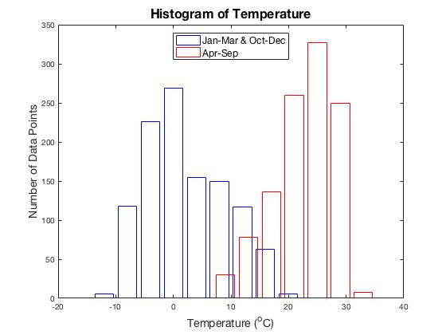
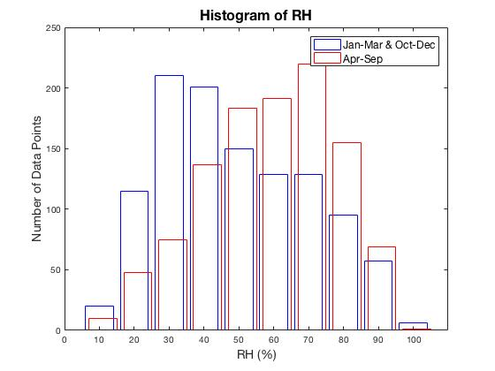
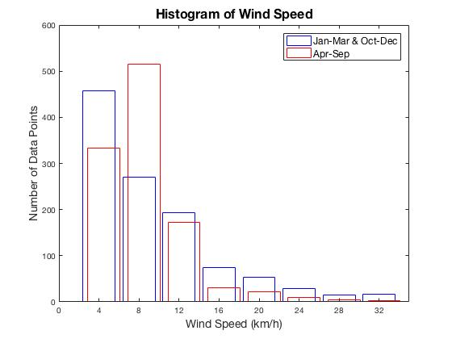
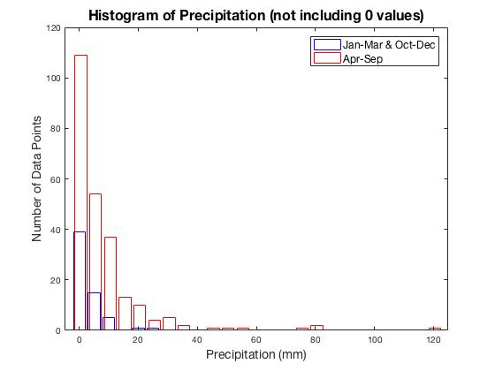
Histograms

Slide 9
Correlation Coefficients and Regression

Slide 10
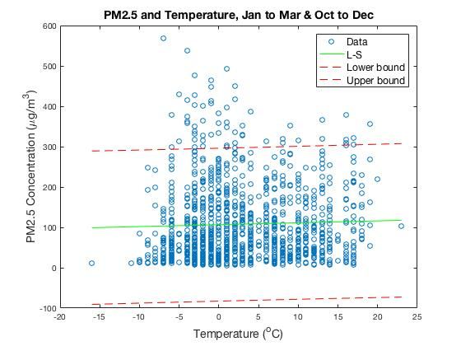
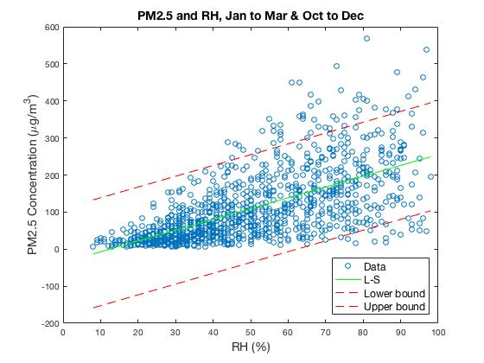
r | p-value | 95% Confidence Interval
0.0341 | 0.2565 | (-0.0248, 0.0927)
r | p-value | 95% Confidence Interval
0.6411 | 1.0161e-129 | (0.6051, 0.6744)

Slide 11
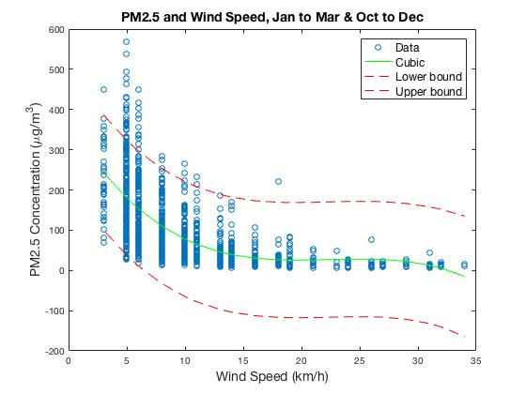
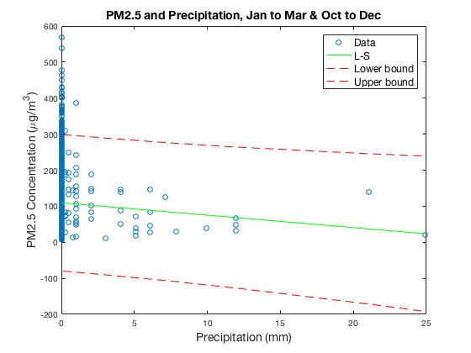
r | p-value | 95% Confidence Interval
-0.5674 | 9.1746e-96 | (-0.6060, -0.5262)
r | p-value | 95% Confidence Interval
-0.0539 | 0.0993 | (-0.1175, 0.0102)
-0.3102 | 0.0150 | (-0.5213, -0.0633)
Without 0 values:

Slide 12
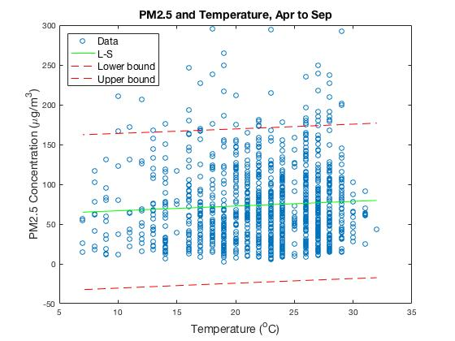
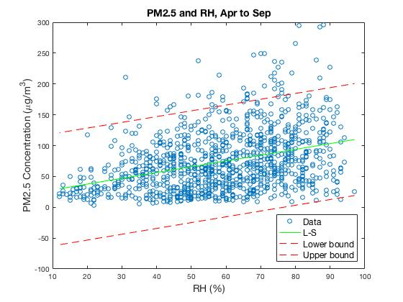
r | p-value | 95% Confidence Interval
0.0616 | 0.0423 | (0.0022, 0.1205)
r | p-value | 95% Confidence Interval
0.3599 | 1.1998e-34 | (0.3071, 0.4105)

Slide 13
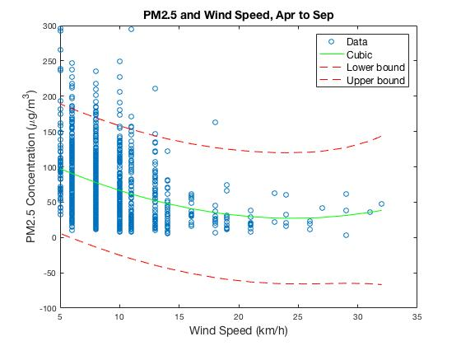
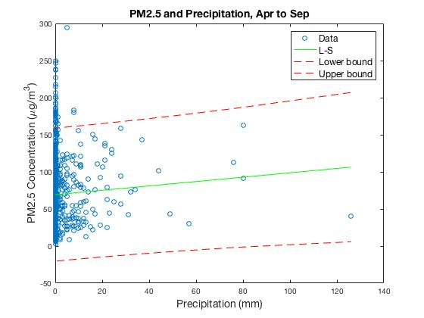
r | p-value | 95% Confidence Interval
-0.3206 | 1.9136e-27 | (-0.3729, -0.2662)
r | p-value | 95% Confidence Interval
0.0530 | 0.1100 | (-0.0120, 0.1176)
0.0897 | 0.1650 | (-0.0371, 0.2137)
Without 0 values:

Slide 14
Cross-correlation

Slide 15
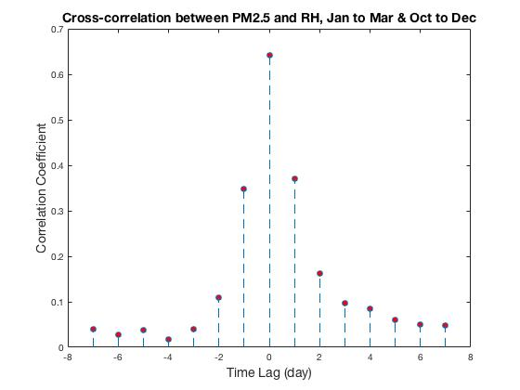
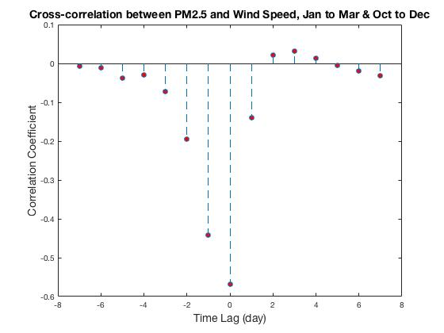
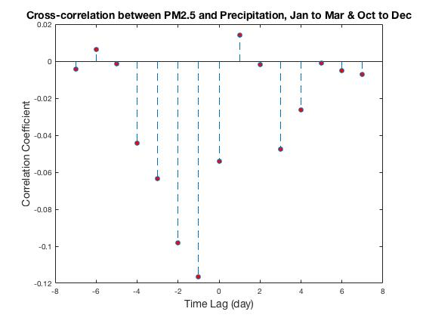
Comparing precipitation
on one day with PM2.5
concentration on the
next day:
r | p-value | 95% Confidence Interval
-0.1167 | 3.4603e -04 | (-0.1794, -0.0530)

Slide 16
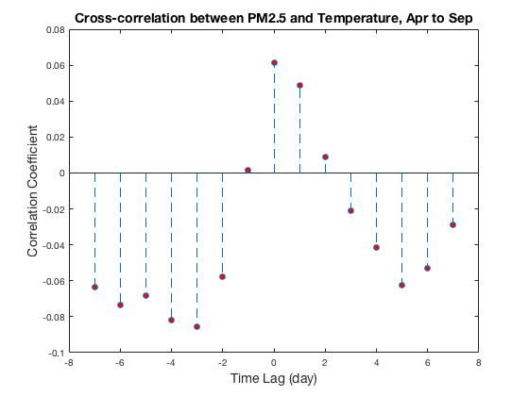
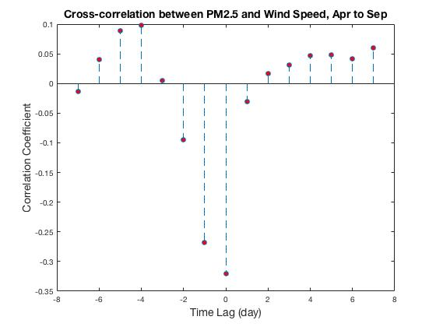
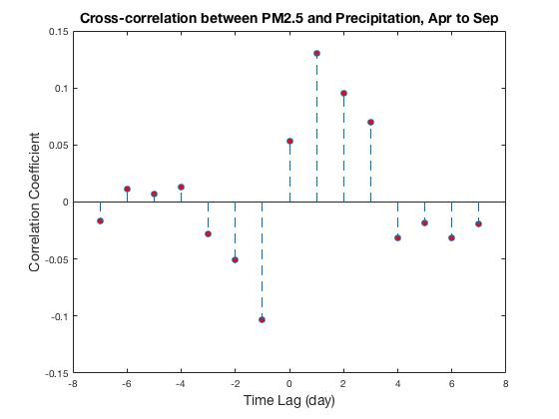
Comparing precipitation
on one day with PM2.5
concentration on the
next day:
r | p-value | 95% Confidence Interval
-0.1030 | 0.0019 | (-0.1669, -0.0382)

Slide 17
Conclusion
PM2.5 concentration, temperature, RH, wind speed and precipitation show yearly cycles.
These variables in the two groups (Jan to Mar & Oct to Dec vs. Apr to Sep) are not from the same distribution.
Jan to Mar & Oct to Dec: PM2.5 has significant correlations with RH, wind speed and precipitation (excluding 0 values).
Apr to Sep: PM2.5 has significant correlations with temperature, RH and wind speed, although the correlation with temperature is weak.
Significant correlation between PM2.5 concentration and precipitation on the previous day.

Slide 18
References
U.S. Department of State Air Quality Monitoring Program: http://www.stateair.net
Weather Underground: https://www.wunderground.com

