Slide 1
El Nino Upwelling and Ocean Productivity
By Sonia Muhammad

Slide 2
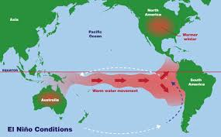
Motivation
Show that upwelling during El Nino affects the ocean productivity on the coasts of Southern Peru/Northern Chile and Southern California

Slide 3
Upwelling
Sea Surface Temperature
During El Nino, warm current appears on the coast, and upwelling diminishes
Sea Surface Height Anomaly
We can determine if upwelling is diminished by observing the sea surface height, which tells us if a warm current is present. (Depression of thermocline leads to a higher SSH)
Warm Current
Upwelling Diminishes
Less Nutrients at Surface
Productivity Decreases
Warm Current Displaces Colder Water in Upper Layer
Sea Surface Height Increases
Elevation of Thermocline
Upwelling Diminished
Productivity Decreases

Slide 4
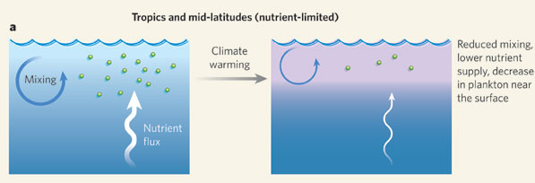
Data
HadISST for Sea Surface Temperature
AVISO for Sea Surface Height Anomaly
SeaWiFS for Chlorophyll Concentration
Chlorophyll concentration data can be used to observe ocean productivity aka amount of phytoplankton

Slide 5
Least Squares Regression Analysis

Slide 6
Peru: SST vs Chlorophyll

Slide 7
Peru: SST vs Chlorophyll
 | Correlation Coefficient | LS Slope
Value | -0.07 | -0.0061
95 % Confidence Interval | -0.23 to 0.09 | -0.18 to 0.17
Significance | 0.38
Very weak negative correlation and small confidence interval, however the correlation value has little significance as the p value is much greater than 5 %.

Slide 8
Peru: SSH vs Chlorophyll

Slide 9
Peru: SSH vs Chlorophyll
 | Correlation Coefficient | LS Slope
Value | -0.10 | -0.1968
95 % Confidence Interval | -0.25 to 0.06 | -4.24 to 3.85
Significance | 0.24
Weak negative correlation, small confidence interval, however the correlation value has little significance as the p value is much greater than 5 %.

Slide 10

SoCal: Chlorophyll vs SST

Slide 11
SoCal: Chlorophyll vs SST
 | Correlation Coefficient | LS Slope
Value | -0.33 | -0.07
95 % Confidence Interval | -0.46 to -0.18 | -0.47 to 0.33
Significance | 0.00002
Weak negative correlation and small confidence interval, and the correlation value has high significance as the p value is much less than 5 %.

Slide 12
SoCal: Chlorophyll vs SSH

Slide 13
SoCal: Chlorophyll vs SSH
 | Correlation Coefficient | LS Slope
Value | 0.40 | 4.3554
95 % Confidence Interval | -0.26 to 0.52 | -15.50 to 24.22
Significance | 3.04 e-7
Weak positive correlation, small confidence interval for the correlation coefficient, and the correlation value has very high significance as the p value is much greater than 5 %.
As for the LS slope, the confidence interval is very large, and shows a large positive slope.

Slide 14
Peru: Periodicity

Slide 15
SoCal: Periodicity

Slide 16
Peru: Cross Spectral Analysis (SSH)
f = .0795
Period =12.5833 months
Lag = 0.1221
Δt = 0.0017 years = .20 months = .6 days

Slide 17
SoCal: Cross Spectral Analysis (SSH)
f = .0779
Period =12.833
Lag = 0.5467
Δt = 0.0076 years = .09 months = 2.7 days

Slide 18
Peru: Cross Spectral Analysis (SST)
f = .0795
Period =12.583
Lag = .1588
Δt = 0.0022 years = .0264 months = .8days

Slide 19
SoCal: Cross Spectral Analysis (SST)
f = .0779
Period =12.833
Lag = 0.6605
Δt = 0.0092 years = .11 months = 3 days

