Slide 1
The Effect of Various Environments on Pitcher Spin Rates
Scott Rapponotti
EAS 4480 Data Analysis

Slide 2
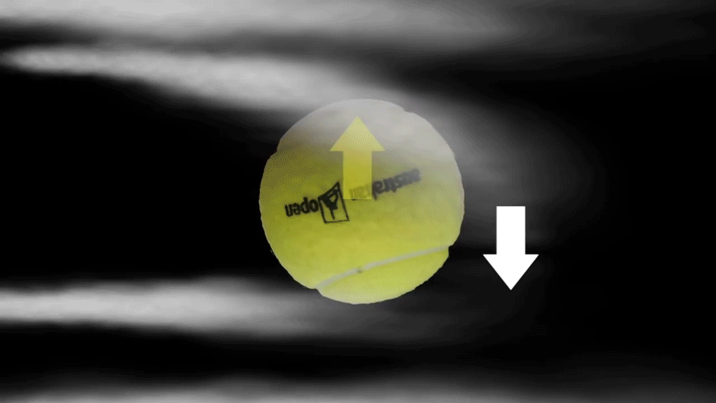
What is Spin Rate

Slide 3
What is the Purpose
Project focuses on determining what environmental variables have a significant effect pitcher spin rate differences for two pitches: 4-seam fastball and curveball
Individual Pitch data was scraped for six different MLB teams from 2010 to 2015 using Pitch/fx
1. Colorado Rockies (Elevation of 5183ft)
2. Minnesota Twins (Elevation of 812ft)
3. Texas Rangers (Elevation of 616ft)
4. Cleveland Indians (Elevation of 582ft)
5. Los Angeles Dodgers (Elevation of 267ft)
6. New York Mets (Elevation of 54ft)
Collected game by game temperature, wind speed and direction collected from Retrosheet as independent variables

Slide 4
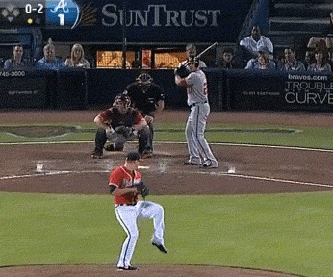
4-Seam Fastball vs. Curveball

Slide 5
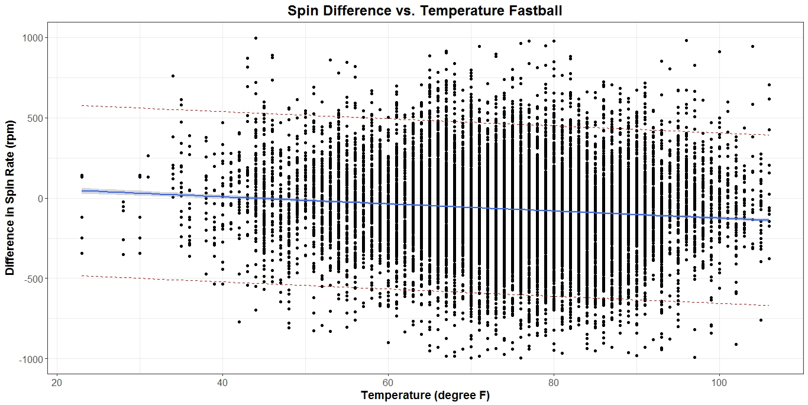
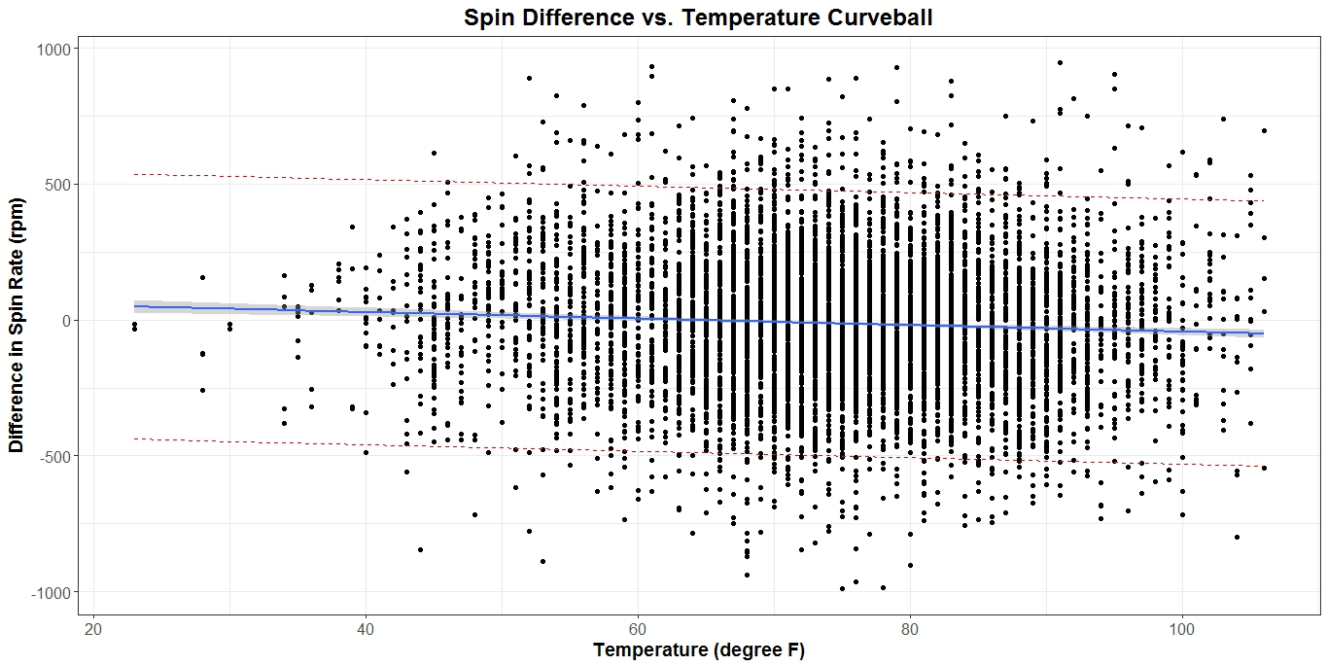
Spin Difference and Temperature
LS Slope: -2.2137 rpm/deg F
As the temperature increases, the spin rate (compared to seasonal average) decreases
95% Confidence Interval:
[-2.5455 , -1.8819]
P value < 0.05 (stat. significant)
LS Slope: -1.200 rpm/deg F
As the temperature increases, the spin rate (compared to seasonal average) decreases
95% Confidence Interval:
[- 1.647, -0.753]
P value < 0.05 (stat. significant)

Slide 6
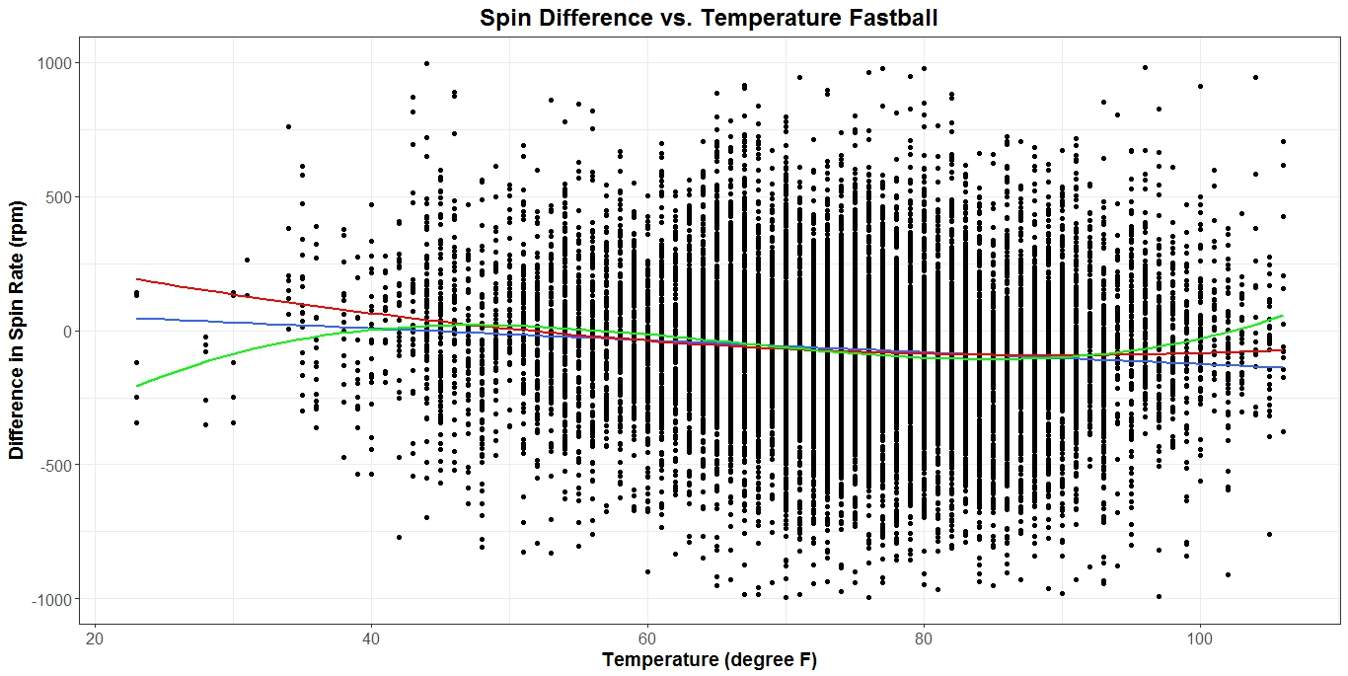
4-Seam Fastball - Temperature
Linear
Quadratic
Cubic

Slide 7
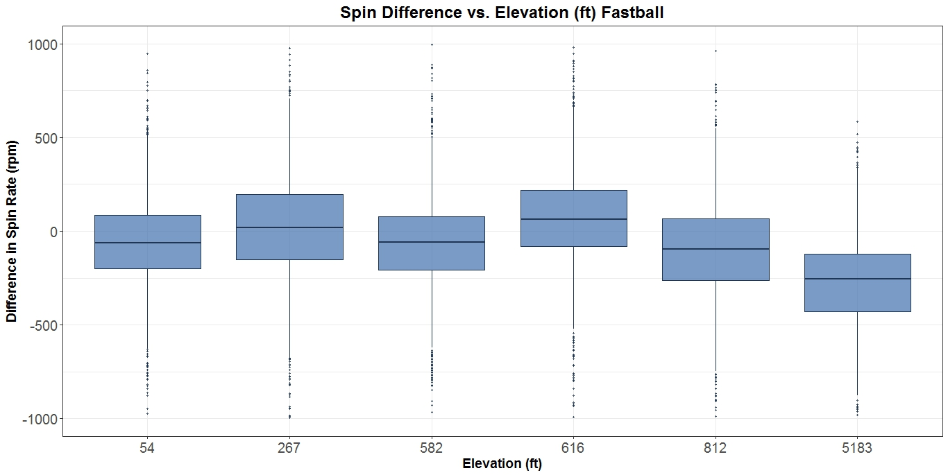
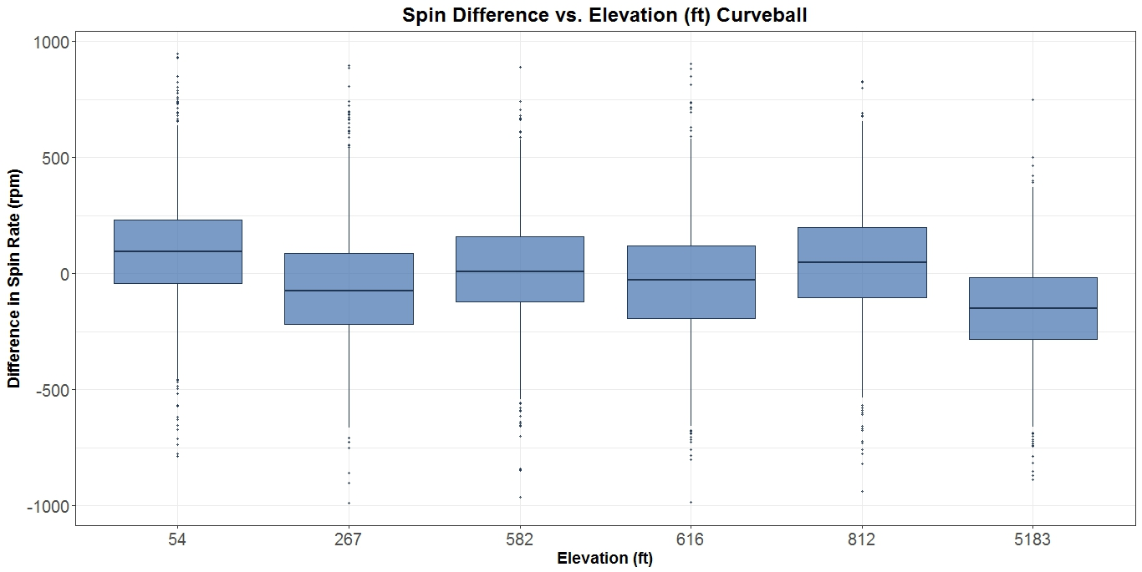
4-Seam Fastball - Elevation
At extreme elevations, the spin rate decreases relative to seasonal average
Distribution is consistent at all elevations
Not much difference in fastball and curveballs

Slide 8
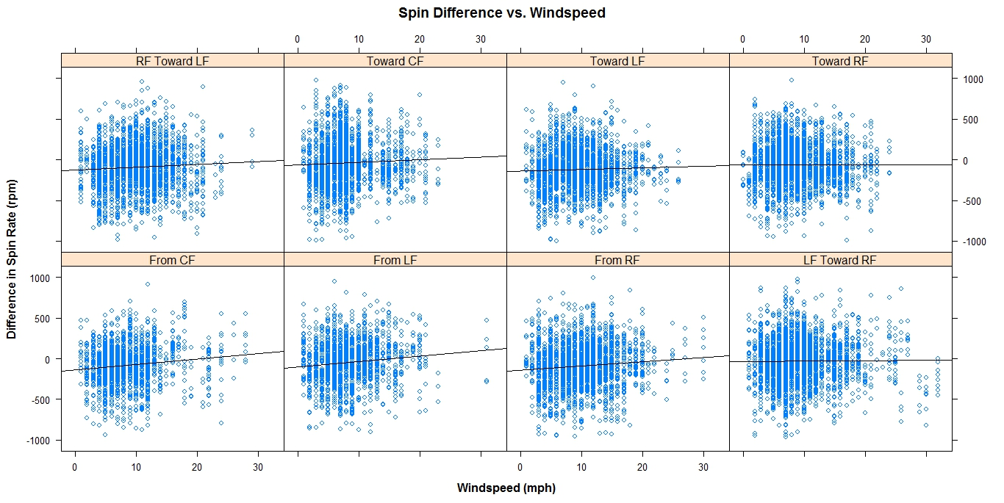
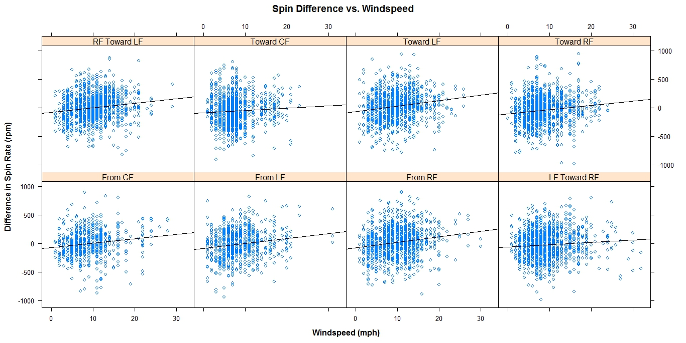
Wind Speed
4-seam Fastball
Curveball
LS Slope: 2.3988 rpm/mph
As the wind speed increases, the spin rate (compared to seasonal average) increases
95% Confidence Interval:
[1.5189 , 3.2787]
P value < 0.05 (stat. significant)
LS Slope: 7.9134 rpm/mph
As the wind speed increases, the spin rate (compared to seasonal average) increases
95% Confidence Interval:
[6.7485 , 9.0783]
P value < 0.05 (stat. significant)

Slide 9
4-Seam Fastball
Model1: lm(spin_diff ~ temp + factor(elevation) + windspeed)
Model2: lm(spin_diff ~ temp + I(temp^2) + factor(elevation) + windspeed)
Model3: lm(spin_diff ~ temp + I(temp^2) + I(temp^3) + factor(elevation) + windspeed)
Normality of Residuals
Constant Variance (No heteroscedasticity)
Errors independent from each other

Slide 10
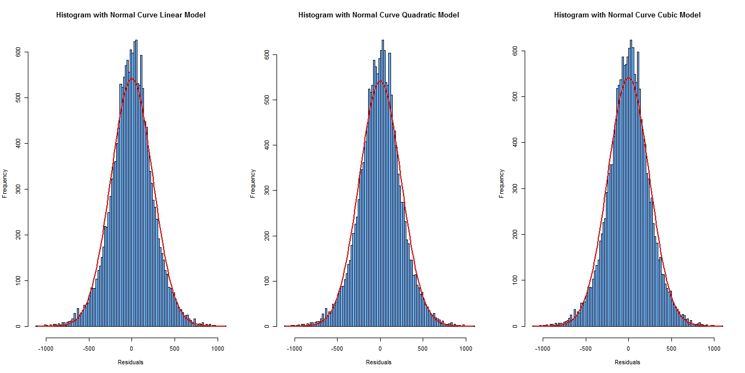
4-Seam Fastball – Normal Residuals
For all models, the residuals are normally distributed

Slide 11
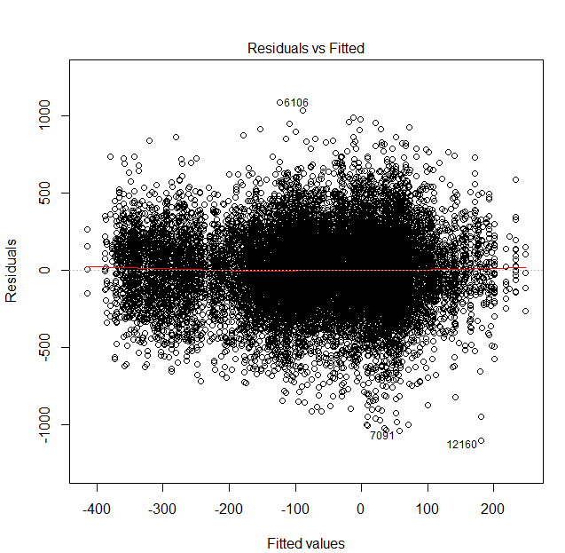
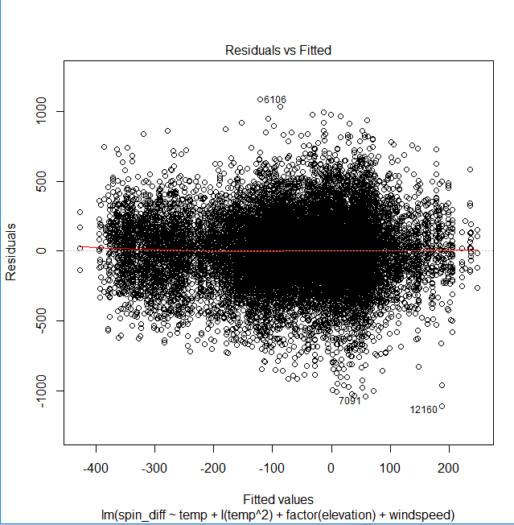
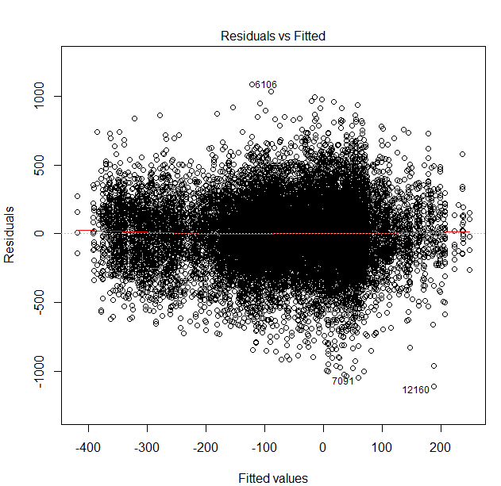
4-Seam Fastball – Constant Variance
Residual variance is mostly constant for all fitted values
Some heteroscedasticity at predicted values of 0.

Slide 12
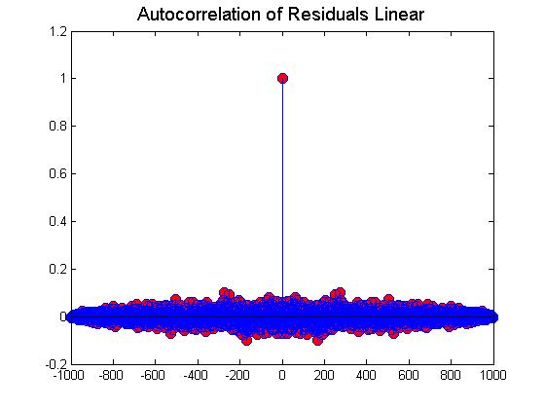
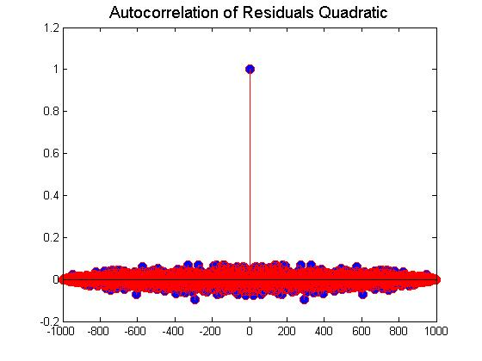
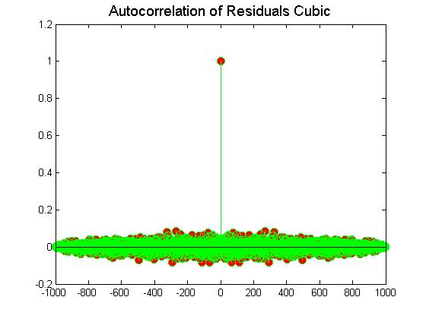
4-Seam Fastball – Independence of Errors
The autocorrelation of the residuals shows there is not a significant lag correlation for either the linear, quadratic or cubic fits
Since all three models pass the regression diagnostics and the nonlinear fits don’t seem to perform much better, choose the simplest model which is linear

Slide 13
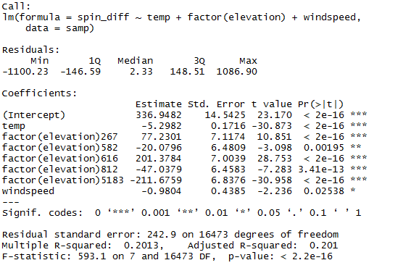
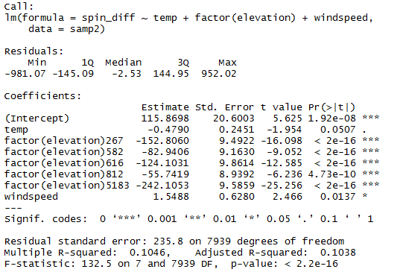
4-Seam Fastball vs. Curveball Model
Spin Difference = 336.95 – 5.2982 * Temperature – 0.9804 * Wind Speed + 77.2301 * $C_{267}$ – 20.0796 * $C_{582}$ + 201.3784 * $C_{616}$ – 47.0379 * $C_{812}$ - 211.6759 * $C_{5183}$

Slide 14
Conclusion
For both fastballs and curveballs, increasing the elevation to at extreme values leads to a significant decrease in spin rate
For fastballs, increases in temperature lead to larger increases in spin rate compared to curveballs
Increases in the wind speed lead to increases in curveball spin rate, but decreases in fastball spin rate although not as statistically significant as temperature or elevation.

