Slide 1
Trend Analysis of Aftershocks
after 2011 Tohoku Earthquake
EAS 4480
Zhongduo Zhang
4/20/2017

Slide 2
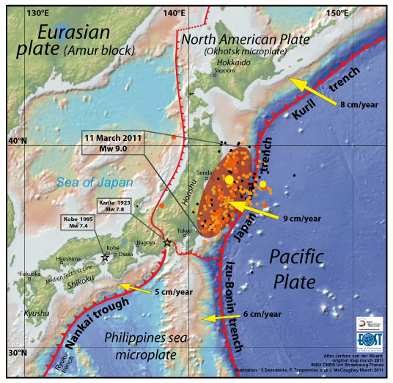
Background
Date: 11 March 2011
Magnitude: 9.0–9.1 (M_{w})
Most powerful earthquake ever hit Japan
70km off coast
29km deep
Caused by rupture of upper plate subducted by the Pacific Plate with a length of 500 km
Lingering aftershocks

Slide 3
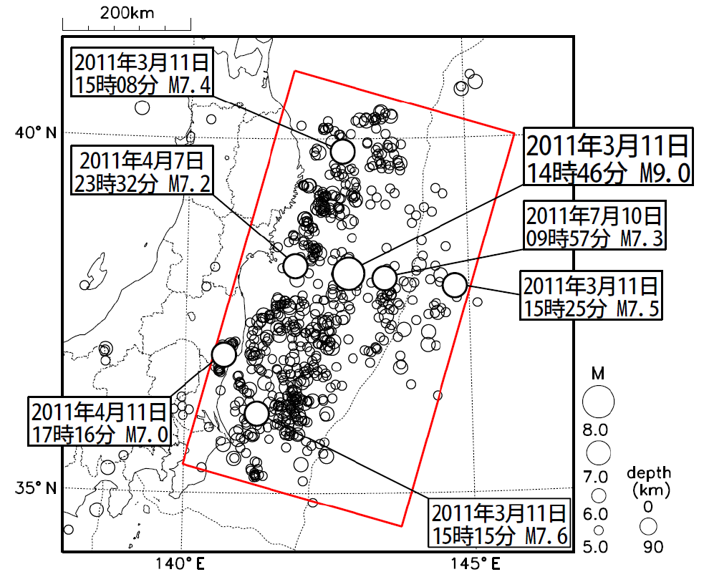
Range of Aftershocks
Shown in the red box
Includes earthquakes occurred on the plate boundaries, as well as other earthquakes proximate to the main shock of 3.11 Earthquake

Slide 4
Data for Analysis
Obtained from Japan Meteorological Agency (JMA)
Aftershock information currently available from March 2011 to March 2016 (5 years)
Only includes earthquakes with magnitude greater than 4.0

Slide 5
Overall Trend
7211 aftershocks in total
Significant decrease in number within first year after main shock
For the analysis, only use data beginning from one year after the main shock (13th month)

Slide 6
Regression Analysis
4-Year Period (4/2012 – 3/2016)
Average earthquakes per month: 39
LS Slope: -1.1794/month
CI: [-4.711, 2.3519]
Bootstrap Slope: -1.1654/month
CI: [-1.1489, -1.1818]

Slide 7
Regression Analysis
The slope of decrease in the last 12 months of the sampling period is about one half of that for entire
4-year period
Last 12 Months (4/2015 – 3/2016)
Average earthquakes per month: 21
LS Slope: -0.5490/month
CI: [-3.5208, 2.1529]
Bootstrap Slope: -0.5132/month
CI: [-0.4877, -0.5387]

Slide 8
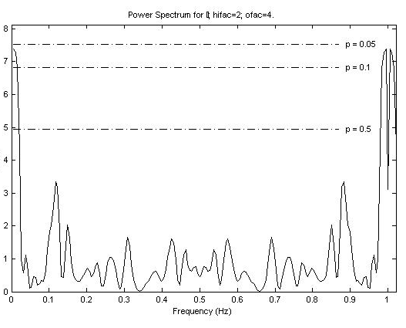
Frequency Analysis
Lomb-Scargle Method
No significant frequency found

Slide 9
Conclusion
The number of aftershocks tapers off as time elapses
However, as the time elapses, the decrease rate of aftershocks becomes slower
The aftershocks may still last for years
No periodicity implication for the aftershocks

Slide 10
Thank You!

Slide 11
Source
Japan Meteorological Agency (2016). “Aftershock Activity of 2011 Tohoku Pacific Coast Earthquake.” [http://www.jma.go.jp/jma/index.html]
Earth Observatory of Singapore (2011). “The great East Japan (Tohoku) 2011 earthquake: Important lessons from old dirt.” [http://www.earthobservatory.sg/news/great-east-japan-tohoku-2011-earthquake-important-lessons-old-dirt]

