Slide 1
The Impact of Weather on Activity Levels
Stephen Gessler
Georgia Tech
EAS 4480
Stephen Gessler
Georgia Tech
EAS 4480

Slide 2
Motivation for this study:
Active lifestyle is stress management technique.
Activity levels decrease in the winter.
High levels of depression/suicide in the winter. (SAD)
Assist urban planning in making cities more fitness friendly regardless of weather.

Slide 3
Related Research
Correlation of low activity levels in areas with hot, humid weather.
Baranowski 1993
Winter season in temperate climate is correlated to lower activity levels.
Dannenberg 1989
Inactivity levels in Canada jump from 49% in the Summer to 64% in Winter.
Merchant 2007

Slide 4
Scientific Problem
How does quality of weather influence activity levels?
Null Hypothesis
There is no correlation between poor weather and activity levels.
Gym memberships aren’t reserved for rainy days
Activity level = Gym Attendance

Slide 5
Introduction to Project
Data Source: Snap Fitness in Inman Park
Sample Size ≈ 600 active members
Electronic attendance system (April 2016 - March 2017)
Evaluate dependence of attendance on weather (NOAA.gov NCDC CDO)
Precipitation
High Temperature
Low Temperature

Slide 6
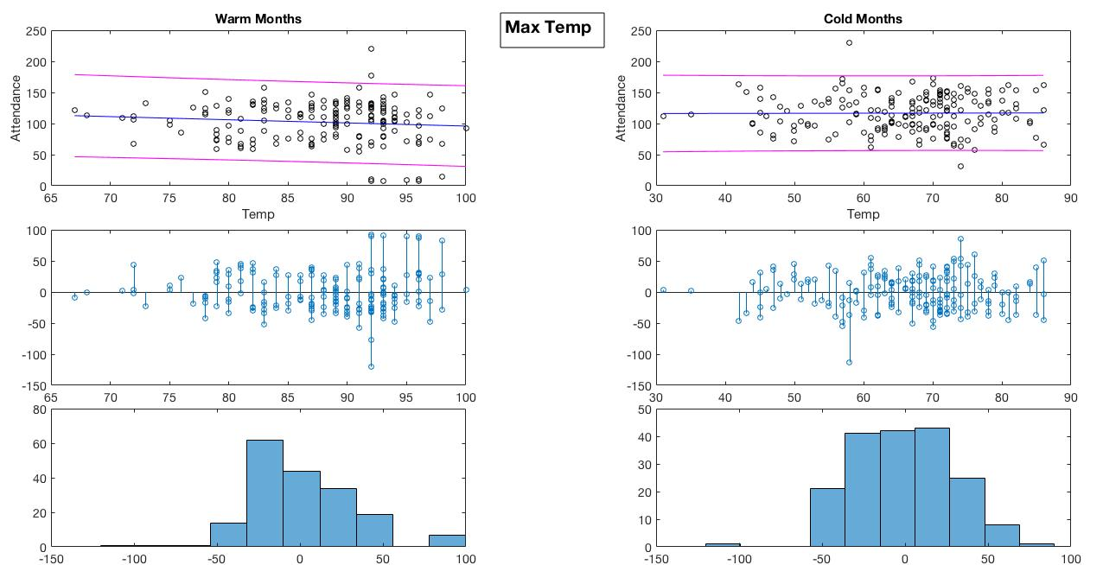
CI | [177.79 31.98]
CI | [176.88 55.38]

Slide 7
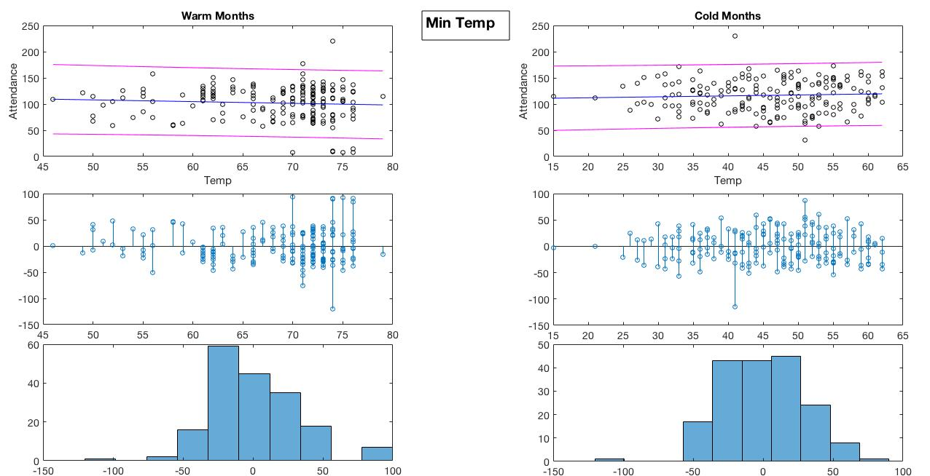
CI | [174.66 34.47]
CI | [178.98 50.58]

Slide 8
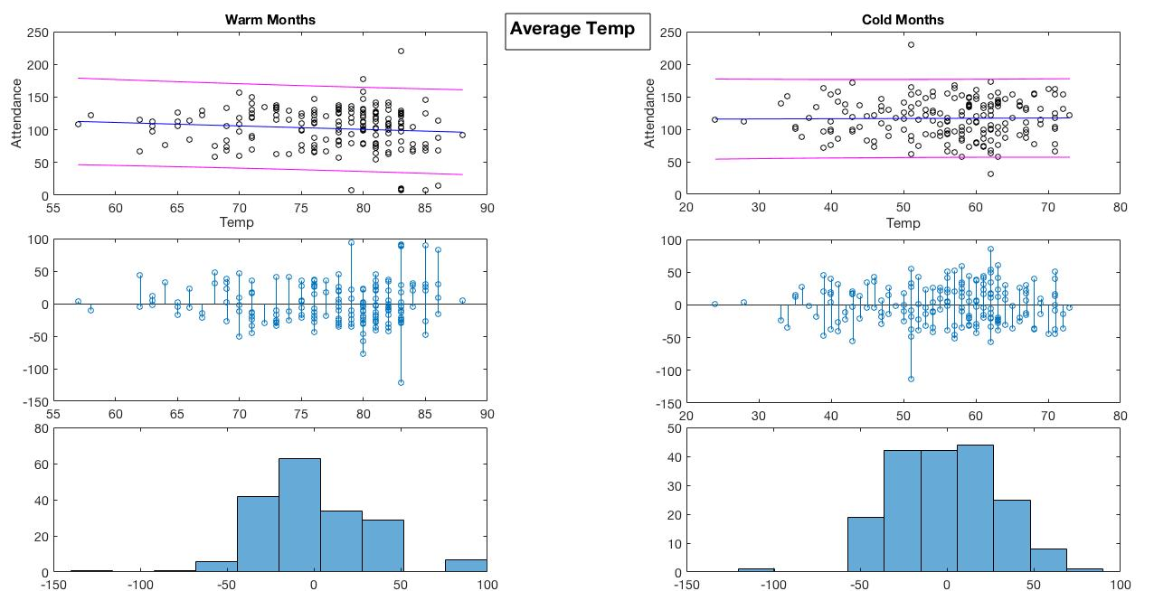
CI | [177.99 32.39]
CI | [176.87 54.83]

Slide 9
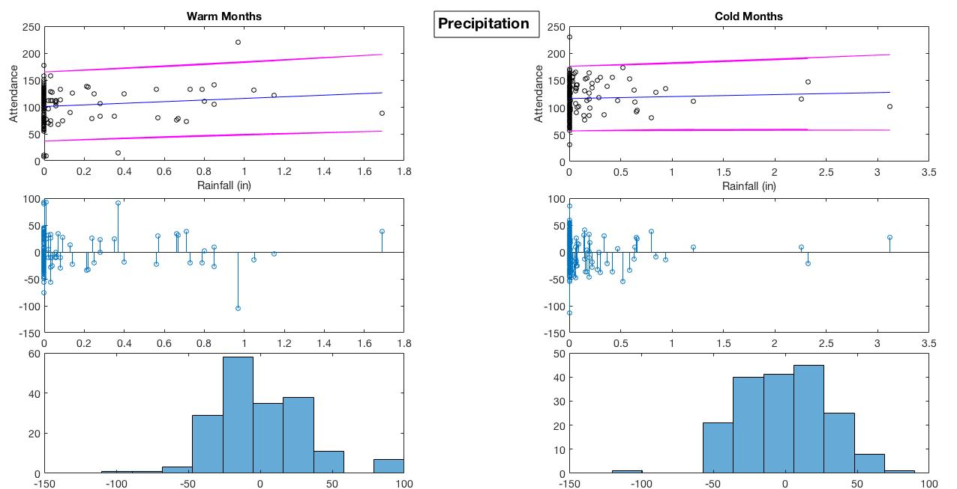
CI | [196.47 37.44]
CI | [196.45 57.26]

Slide 10
Correlation Values
 | Warm Months | Cold Months
Max Temp | -0.1027 | 0.0058
Min Temp | -0.0699 | 0.0577
Avg Temp | -0.1013 | 0.0119
Precip | 0.1152 | 0.0460

Slide 11
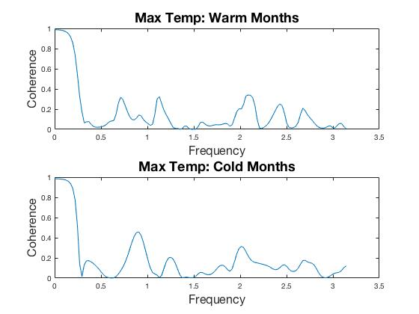
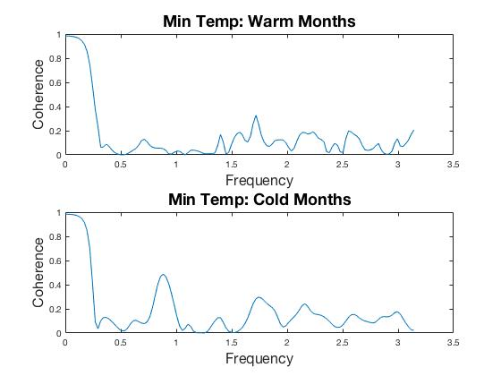
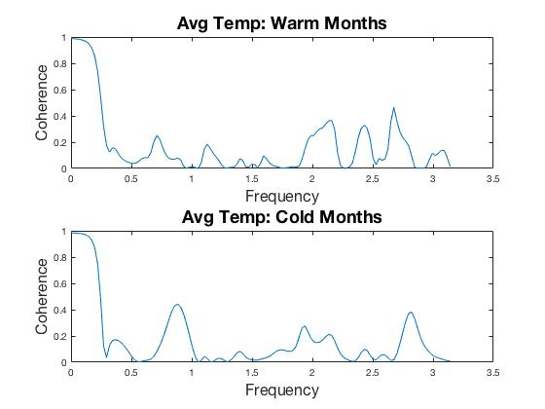
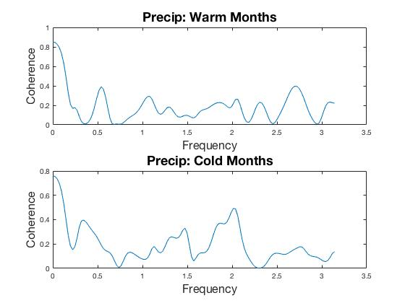

Slide 12
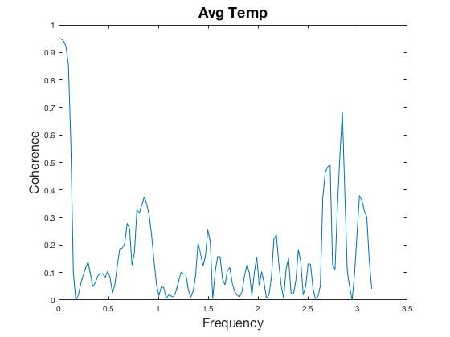
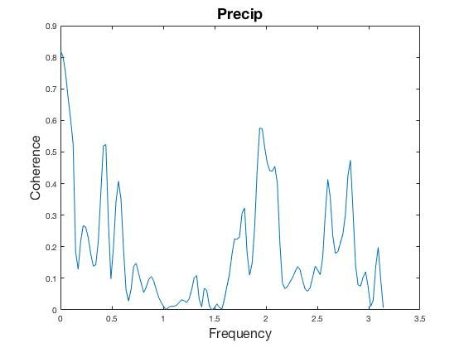
Coherence
Entire data set for comparison

Slide 13
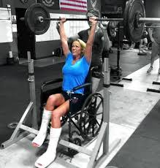
Conclusion
Correlation between weather and gym attendance data is not clear with these parameters.
Hot months/cold months not a significant way to distribute data.
Need more analysis with continuous weather data.
Daily Max/Min/Precip does not provide comprehensive depiction of weather influences. (i.e. Precip could occur at night.)
Weather could have no impact on gym behavior. (NO EXCUSES → )
Nice weather days may result in people exercising outside.

Slide 14
Sources:
Baranowski T, Thompson WO, DuRant RH, Baranowski J, Puhl J. Observations on physical activity in physical locations: age, gender, ethnicity, and month effects. Res. Q. Exerc. Sport. 1993;64:127
Dannenberg AL, Keller JB, Wilson PWF, Castelli WP. Leisure time physical activity in the Framingham Offspring Study: Description, seasonal variation, and risk factor correlates. Am. J. Epidemiol. 1989;129:76–88.
Merchant AT, Dehghan M, Akhtar-Danesh N. Seasonal variation in leisure-time physical activity among Canadians. Can. J. Public Health. 2007;98:203–208.
Chan CB, Ryan DA. Assessing the Effects of Weather Conditions on Physical Activity Participation Using Objective Measures. Int. J. of Env. Res. and Pub. Health. 2009;6(10):2639-2654.

