Slide 1
The Effects of Atmospheric Pressure on a Baseball
Kelly Grissom

Slide 2
Data Used
Home runs
Average Home Run Distance
Maximum Home Run Distance
5 years (2012-2016)

Slide 3
Correlation
Home Runs and Pressure
r-value: -0.1746 p-value: 0.0326
CI: [-0.0148 -0.3258]
Average Home Run Distance and Pressure
r-value: -0.5309 p-value: 9.3068*10⁻⁶
CI: [-0.4051 -0.6369]
Maximum Home Run Distance and Pressure
r-value: -0.3586 p-value: 6.6231*10⁻⁶
CI: [-0.2104 -0.4906]

Slide 4
Bootstrap Correlation
Home Runs and Pressure
r-value: -0.1638 CI = [-0.0062 -0.3213]
Average Home Run Distance and Pressure
r-value: -0.5241 CI = [-0.3756 -0.6725]
Maximum Home Run Distance and Pressure
r-value: -0.3511 CI = [-0.1649 -0.5373]

Slide 5
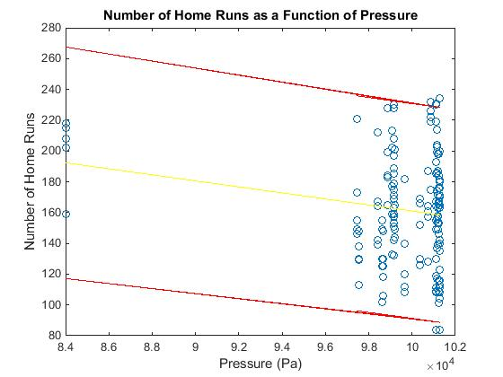
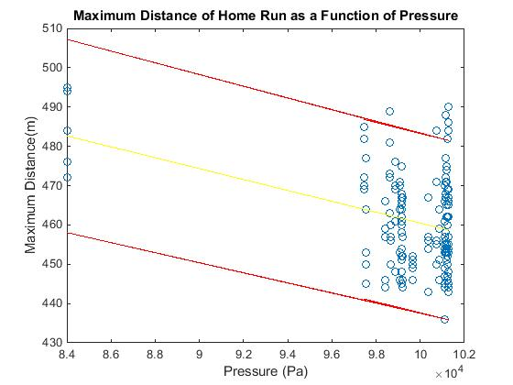
Least-Squares Regression
Slope: -0.002
CI width: 139.5 home runs
Slope: -0.0012
CI width: 23.3 meters
Slope: -0.0014
CI width: 45.6 meters

Slide 6
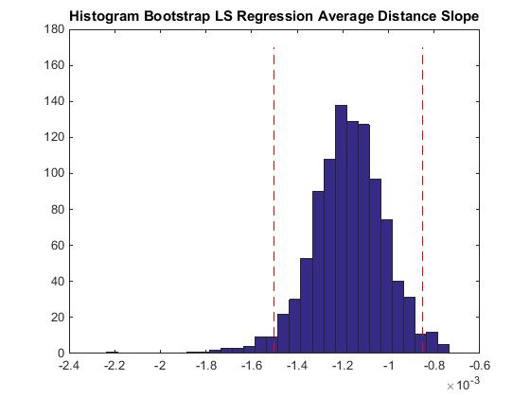
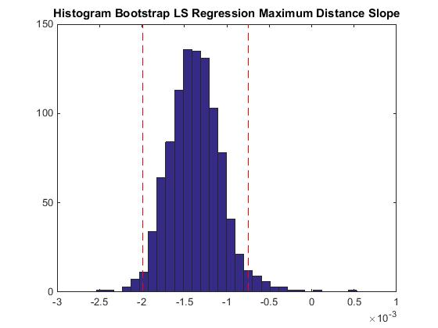
Bootstrap LS Regression
CI = [-3.2152*10⁻⁵ -0.0038]
CI = [-8.25*10⁻⁴ -0.0015]
CI = [-7.66*10⁻⁴ -0.002]

Slide 7
Residual Analysis
Chi2 Test
Critical Value = 18.307
Home Run Calculated Value = 16.5622
Residuals Distributed Normally
Average Distance Calculated Value = 9.7486
Residuals Distributed Normally
Maximum Distance Calculated Value = 21.4506
Residuals NOT Distributed Normally

Slide 8
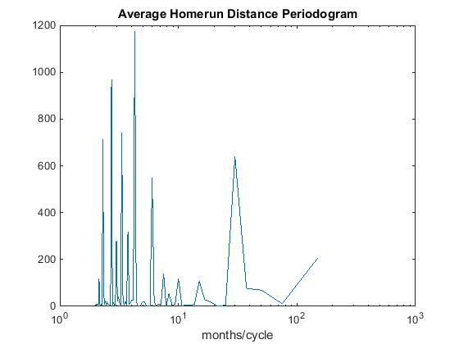
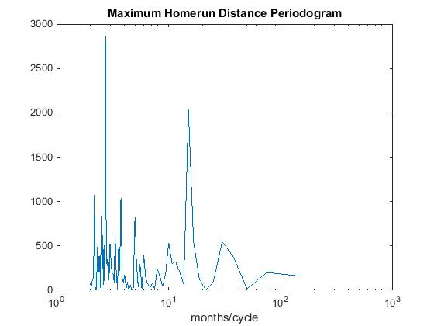
Periodicity

Slide 9
Home Runs and Temperature
4 teams at different elevations
Philadelphia (≈ sea level)
Cleveland (≈ 500 ft. above sea level)
Atlanta (≈ 1000 ft. above sea level)
Colorado (Denver ≈ 5000 ft. above sea level)

Slide 10
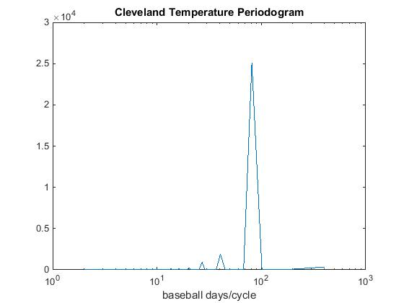
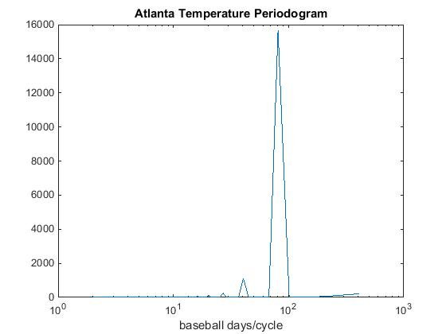
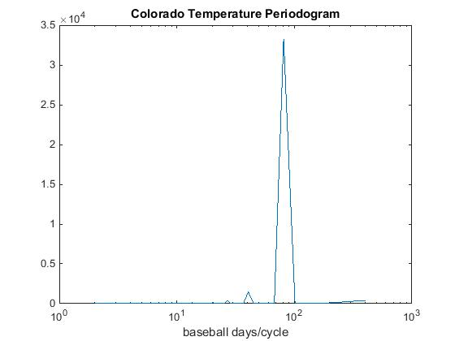
Temperature Periodicity
All display periodicity of approximately 1 baseball season

Slide 11
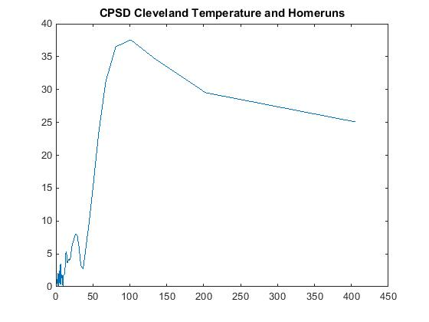
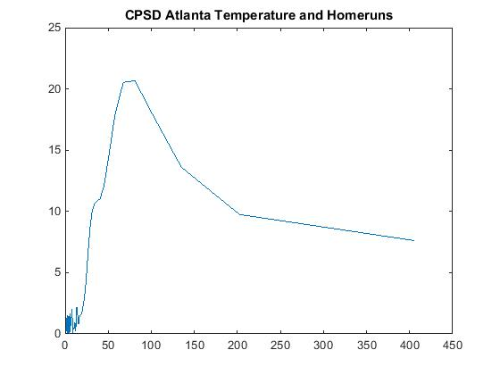
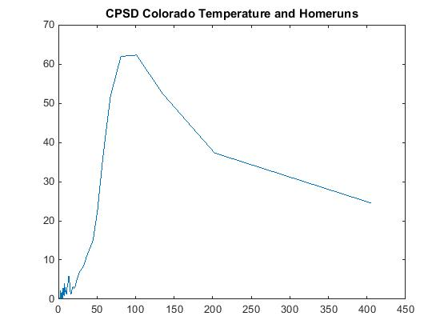
CPSD

Slide 12
Conclusions
Pressure does affect the distance a baseball travels.
Average home run distance: 75 ft.
Maximum home run distance: 87 ft.
Some evidence that pressure affects the number of homeruns hit, but may not be most important factor.
Number of home runs: 125
Other factors may include humidity and distance of the fence from home plate.
Colorado: 2nd longest distance to left field fence
3rd longest distance to center field fence
2nd longest distance to right field fence

Slide 13
Questions?

