Slide 1
Correlation Analysis of Glacier Melt
Are glaciers melting the same way?
By: Matt Barr

Slide 2
Introduction
Rapid glacial melt occurred during the 20th century, with negative trends continuing into the 21st century
Glaciological method calculates mass balance of glaciers
“Reference glaciers” are used as benchmarks, but they are strongly biased towards Europe and northern hemisphere
This study analyzed four reference glaciers:
Gries – Switzerland
Echaurren Norte – Chile
Midtre Lovenbreen – Svalbard
Devon Ice Cap - Canada

Slide 3
The Big Melt
Data for the second half of the 20th century and first years of the 21st century illustrate significant mass loss for the world’s glaciers.
Glaciers experience the consequences of climate change more immediately than most other natural phenomenon, making them valuable resources to observe the effects of climate change. [Source: Global Glacier Changes – UNEP]
The World Glacier Monitoring Service and its predecessors have organized glacier measurements since the 1890’s, with ongoing reports on glacier fluctuations published every five years, and mass balance every other year.
Source: United Nations Environment Programme

Slide 4
Glaciological Method of Mass Balance
Glaciological method involves extrapolation of mass balance estimates over the volume of a glacier. In situ measurements are taken at stake points, snow pits, and from shallow core extraction. These data are then used to calculate mass balance changes. [Source: Hanna et al. 2013]
Another method, the geodetic method, utilizes aerial photography and satellite imagery. This method is considered inferior to direct measurement, but when combined with the glaciological method, can provide accurate data regarding a glacier’s mass balance. [Source: Fischer 2011]

Slide 5
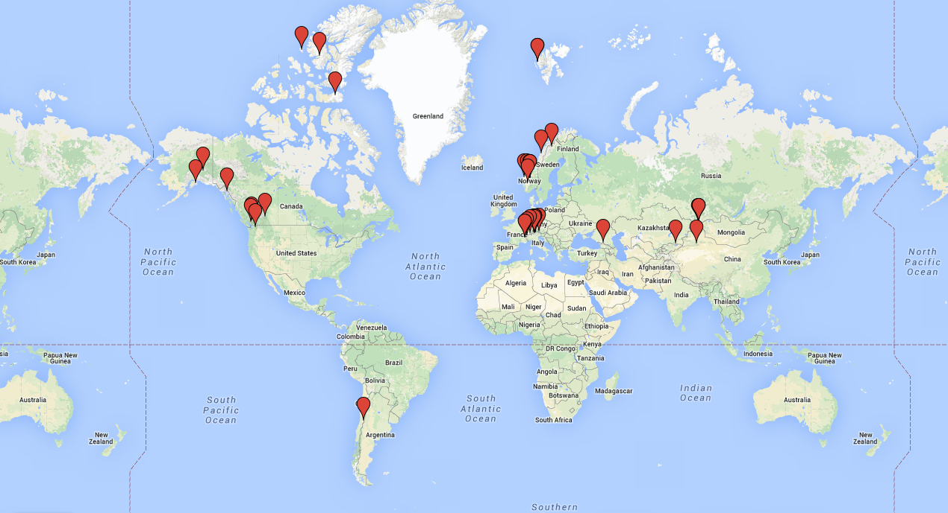
Reference Glaciers: 30+ years of continuous monitoring

Slide 6
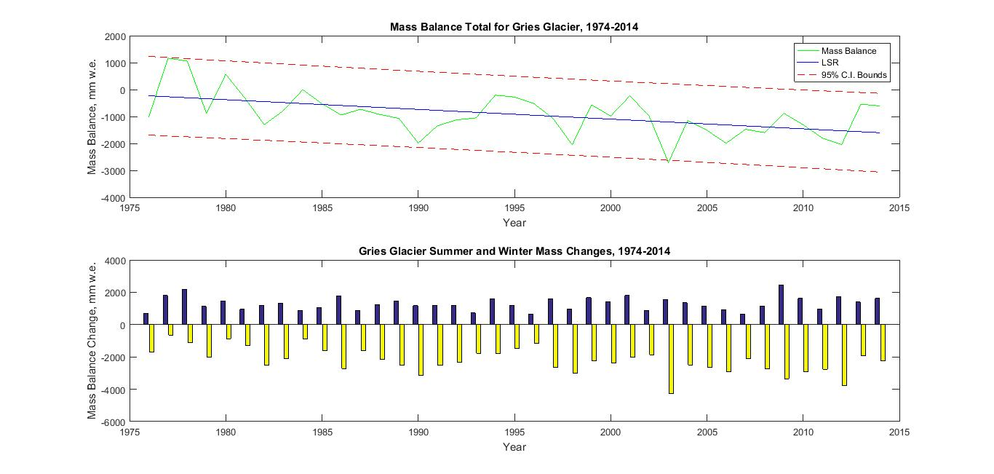
Gries - Switzerland

Slide 7
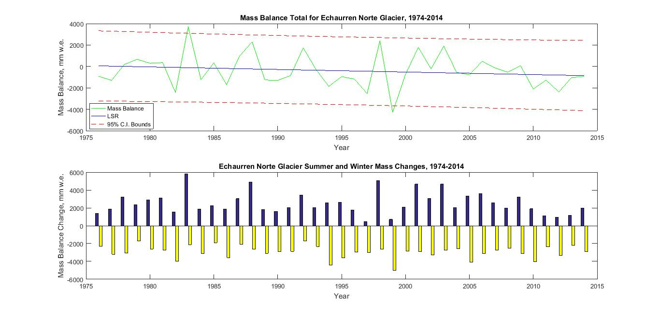
Echaurren Norte - Chile

Slide 8
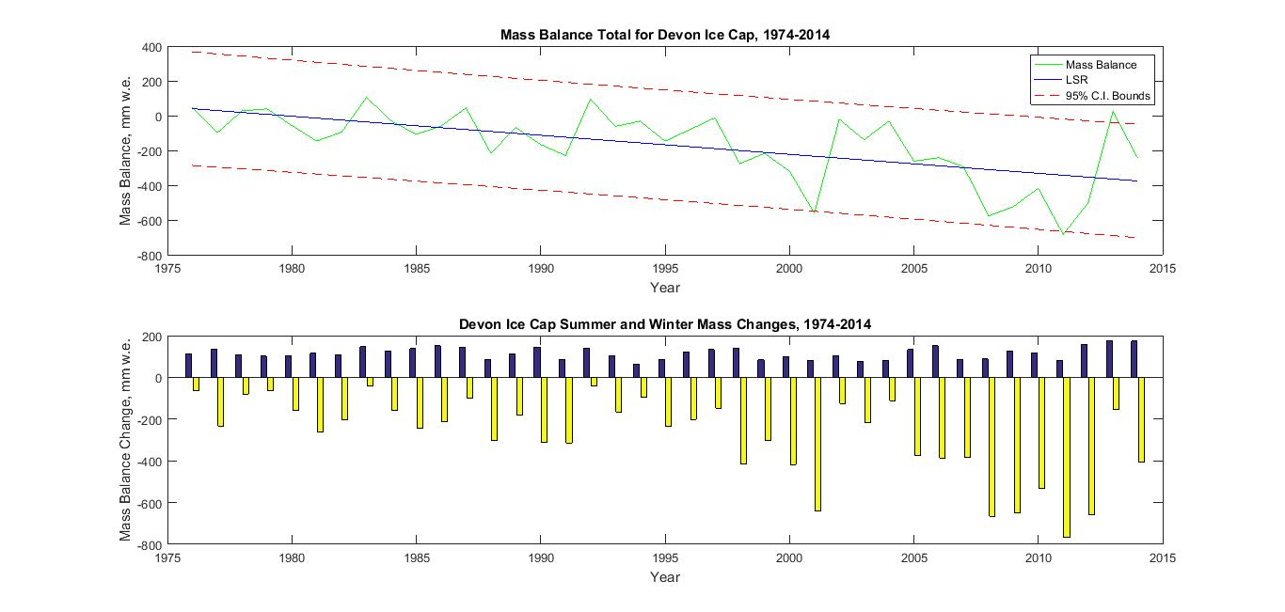
Devon Ice Cap - Canada

Slide 9
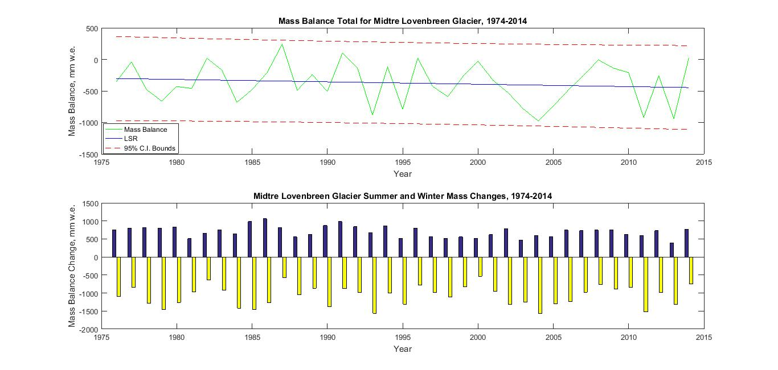
Midtre Lovenbreen - Svalbard

Slide 10
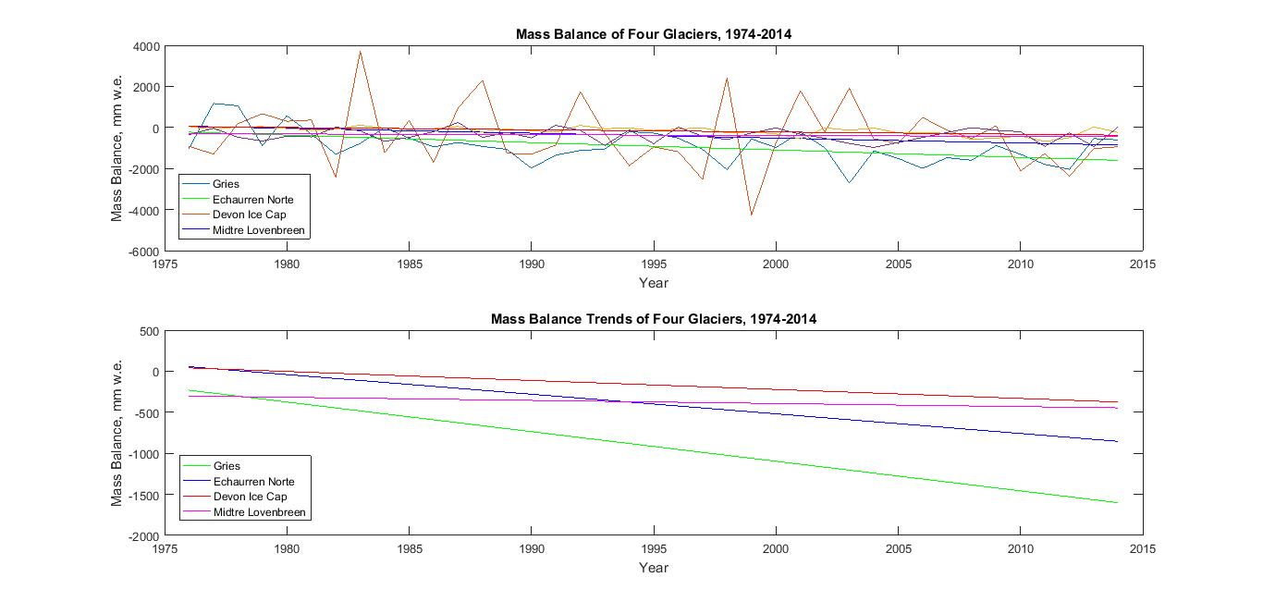
Melt Trends
Mass Balance Slopes (mm w.e./yr)
Gries = -36.07
Echaurren = -23.90
Devon = -10.94
Midtre = -3.78

Slide 11
Correlation Coefficients
Gries – Echaurren: -0.0667
Gries – Devon: 0.3568
Gries – Midtre: 0.1483

Slide 12
Correlation Coefficients
Echaurren – Gries: -0.0667
Echaurren – Devon: 0.1292
Echaurren – Midtre: -0.1079

Slide 13
Correlation Coefficients
Midtre – Gries: 0.1483
Midtre – Echaurren: -0.1079
Midtre – Devon: -0.0580

Slide 14
Correlation Coefficients
Devon – Gries: 0.3568
Devon – Echaurren: 0.1292
Devon – Midtre: -0.0580

Slide 15
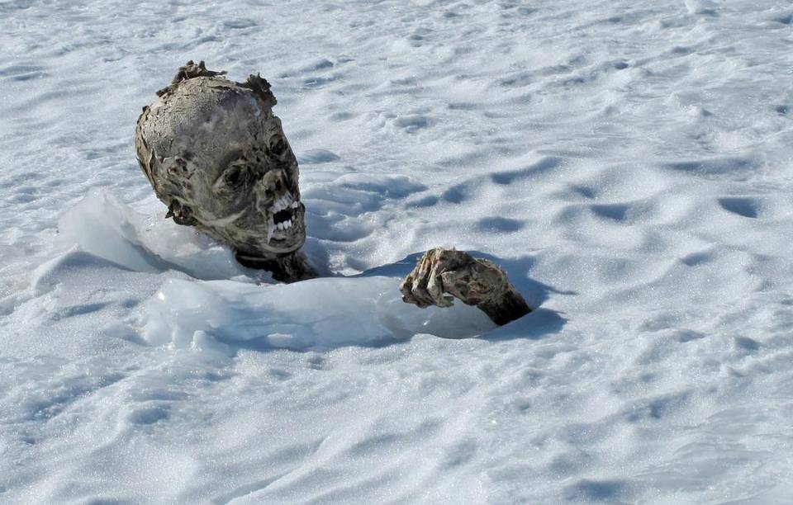
Conclusions
All glaciers analyzed exhibit negative mass balance trends; indication of eventual disappearance due to disequilibrium favoring ablation.
Melting among analyzed glaciers does not appear to correlate well, lending support to the variety of ways that glacier mass balance is affected (e.g. debris cover, type, location, elevation distribution of area, local climate, etc.)
Glacier mass balance changes reflect local atmospheric conditions, but total mass balance changes over the globe can be useful for observing immediate affects of changes in global atmospheric conditions.

