Slide 1
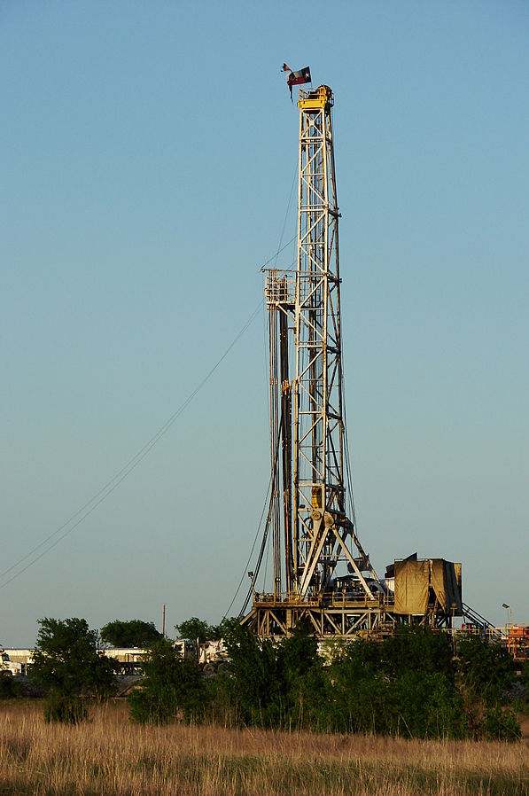
Does fracking cause earthquakes?
Brian Sherman
18 April 2017

Slide 2
What is fracking?
Well stimulation technique to draw oil or natural gas out of rock formation
Applied to old wells, shale, and “tight” formations

Slide 3
How It Works
High pressure fracking fluid injected
Water
Proppants (sand or ceramic materials)
Thickening agent
Causes fractures within the formation
Fractures allow gas or oil to flow more freely

Slide 4
History of Fracking
First experiment 1947
First used commercially 1949
Not used on shale formations until 1998
Made large shale formations in Texas viable for drilling
Fracking has been used on around 1 million wells

Slide 5
The Study
Previous research (Kim, 2013):
Single well induced seismic activity
Along dormant or unknown fault
Is there a correlation between the amount of hydraulic fracturing and the number of earthquakes?
Study region: Texas
254 counties
Study timeframe: Nov 2006-Nov 2016
Number of earthquakes: 1372

Slide 6
Data
Earthquakes: ANSS Composite Catalog
Gas wells: Texas Railroad Commission
Texas counties GPS: Google Fusion Tables
Spatial Resolution: 30 arc sec

Slide 7
r-value: 0.84 p-value: 3.4 x 10⁻⁶

Slide 8
r-value: 0.025 p-value: 0.075

Slide 9
Scurry County Texas

Slide 10
r-value: 0.049 p-value: 0.0005

Slide 11
Depth of Earthquakes
Most fracking occurs around 2-6 km
Mean depth: 5.44 km

Slide 12
Min: 0.8 Mean: 2.77 Max: 5.8

Slide 13
Conclusions
Overall, fracking rates correlate with earthquake rates
Difficult to find correlation at local levels
Earthquakes caused by oil drilling
Short timeframe
Mean depth of earthquakes points to fracking
Possible that magnitudes have increased from fracking
Most earthquakes won’t be felt
Largest earthquakes could cause slight damage

Slide 14
Questions

