Slide 1
War and freedom: a study of countries’ CO₂ emissions and freedom index
An Environmental and historical analysis
Presented By: Lucia Lombardo

Slide 2
Hypothesis and data
Hypothesis: an increase in CO₂ emissions will lead to a decrease in freedom index rating in a country (and vice versa)
CO₂ emissions by country per year 1973-2014
Measured in metric tons per capita
Freedom House Freedom Index number by country per year 1973-2014
Unit-less number from 1-7, with 1: most free and 7: least free
Average of political rights and civil liberties, weighted equally
Countries taken out of data sets: incomplete data in one or both data sets, independence issues
Preliminary analysis:
CO₂ emissions – mean: 1.1846; std: 0.368
Freedom Index – mean: 5.3571; std: 0.7181
Notes:
-hypothesis is that an increase in CO2 emissions will lead to a freer country (meaning a lower index rating), and also that a decrease in CO2 emissions will lead to a less free country (meaning a higher index rating)
-CO2 emissions fluctuate because of changes in industrialization but also due to major population changes
-CO2 data ranged from 0.1-90 or so metric tons/capita
-Countries and territories are assessed by external analysts, primarily using in-country contacts, field research, nongovernmental and government reports, news articles, and other open-source information. The analysts’ conclusions are then vetted by teams of expert advisers
-Free (1.0 to 2.5), Partly Free (3.0 to 5.0), or Not Free (5.5 to 7.0)
-At the score level, a country/territory is awarded 0 to 4 points on each of 25 indicators, for a maximum total of 100 points. These indicators, which take the form of questions, are grouped into the categories of Political Rights and Civil Liberties. A country/territory is assigned a rating (7 to 1) for each of these two categories based on its scores.
-How was data chosen or excluded? Countries taken out of data sets: East/West Germany, Marshall Islands, South Sudan, Timor-Leste, North/South Vietnam, Palau, Northern Cyprus, Montenegro, Czechoslovakia, Cape Verde (no CO2 data), North/South Korea, Taiwan, USSR/Russia, etc

Slide 3
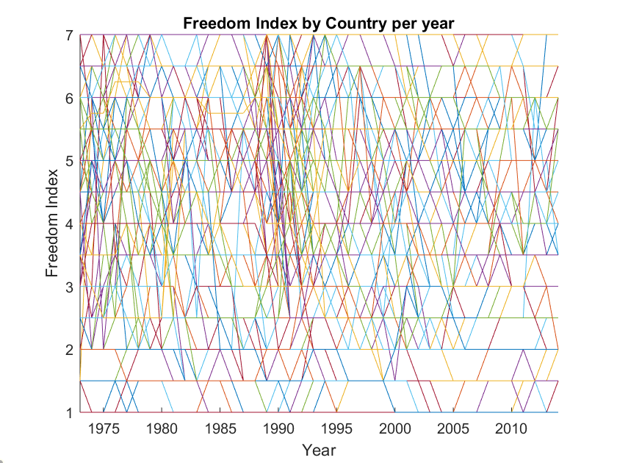
World data graphed
Qatar
UAE
Luxembourg
Notes:
-don’t forget, STD of CO2 data is 0.368, meaning anything above 2.288 (3 STDs above mean) is an outlier
- Ask people to guess about the highest lines on CO2 figure and why

Slide 4
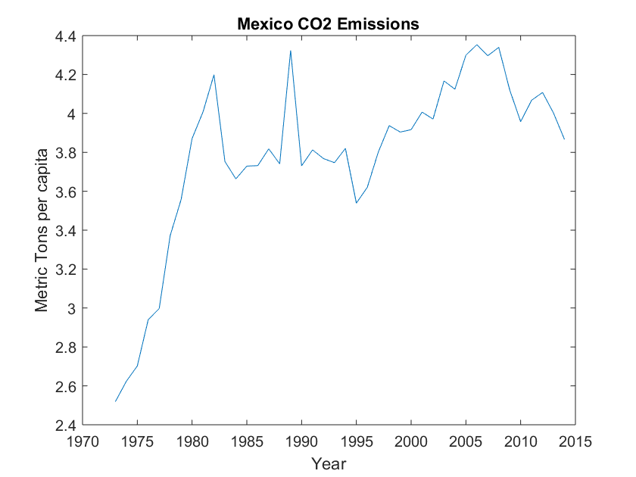
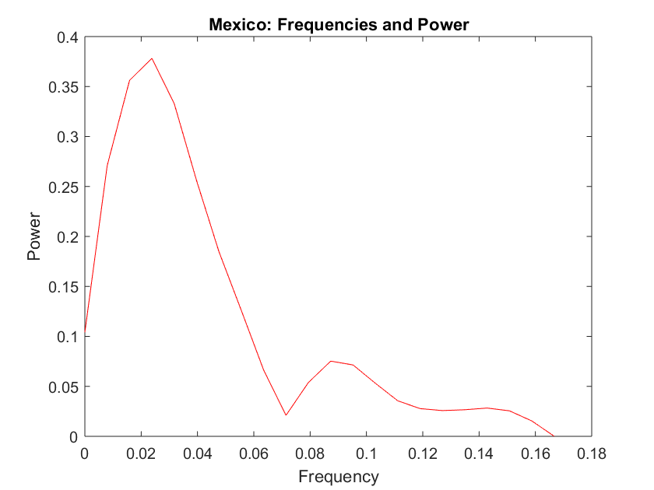
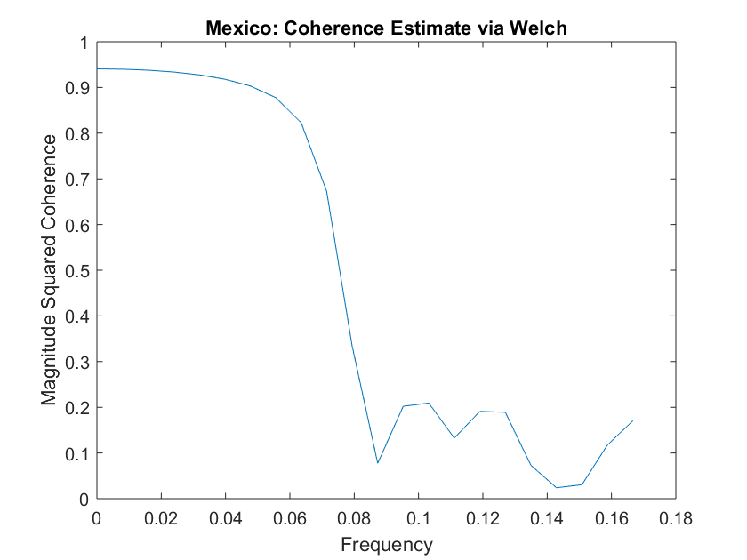
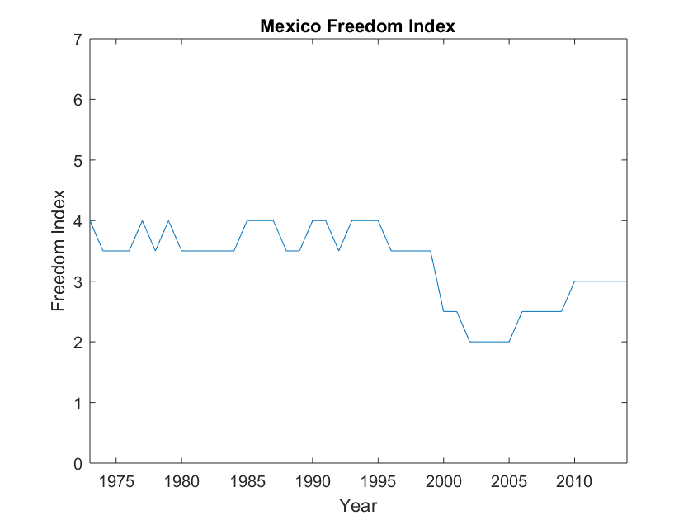
Analysis – cross-spectral, coherence, lags
Importance of statistically significant analyses – U.S.A. great example
0.021
0.94
Time lag of 16.8 years
Oil reserves found
Notes:
The cross spectral analysis seems to show significant frequencies and the time lag is -2.66, again implying that CO2 emissions lags behind the freedom index score and is possibly influenced by the freedom score. Problem? The U.S. freedom index score has been at 1 since the index was started in 1973 and thus there is no significance that this number caused the overall drop in the U.S. CO2 emissions since 1973.
- For this project, I looked at 7 specific countries, 5 of which are in this presentation because of time constraints, that give a snapshot of the world, meaning they are from different continents and regions with different forms of government and political history
- They also have larger populations to ensure analysis dealing with the CO2 data is significant
Mexico: giant spike in CO2 emissions from about 1975-1982 followed by a significant drop in freedom score about 15 years later. What was happening in Mexico in 1975-1982? Oil reserves were found off the Gulf of Mexico coast, leading to massive industrialization and wealthy for the country until the mid-1980s when the country almost went bankrupt

Slide 5
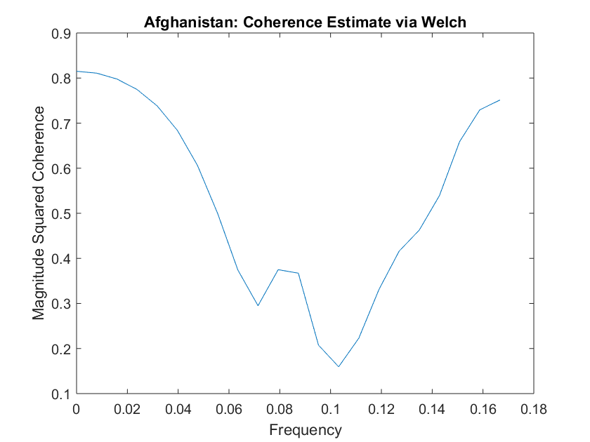
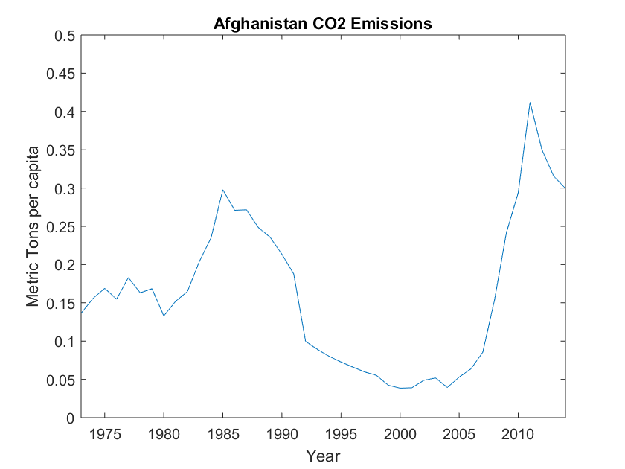
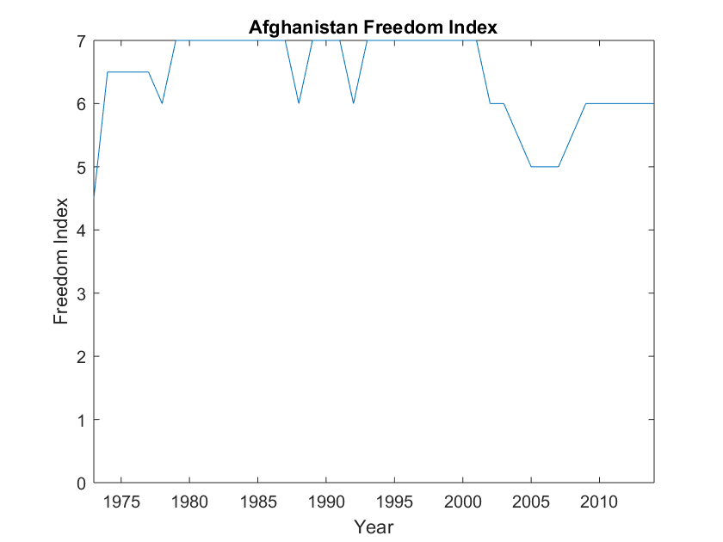
Country analysis
0.02
0.8
Timelag of 12.32 years
Afghan Civil War
Notes:
-Afghanistan: significant frequency at 0.02, which corresponds to a __ R^2 value in the coherence analysis. Time lag is 12.32 years, meaning CO2 emissions precedes the freedom index by 12.3 years and may have caused or influenced changes in the freedom index. (For this specific case, we know the civil war precipitated both a drop in emissions and yearly changes in the freedom index. US involvement in the country changed the country’s freedom index, making the country more free, and during the same time period CO2 emissions began to increase)

Slide 6
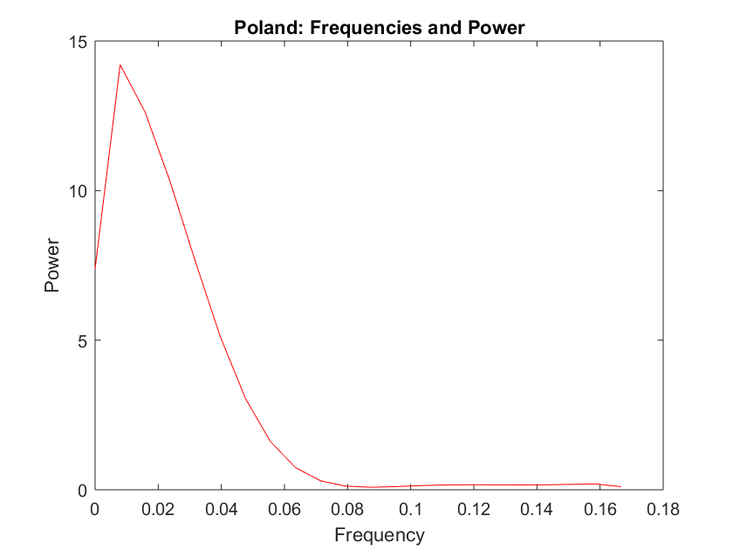
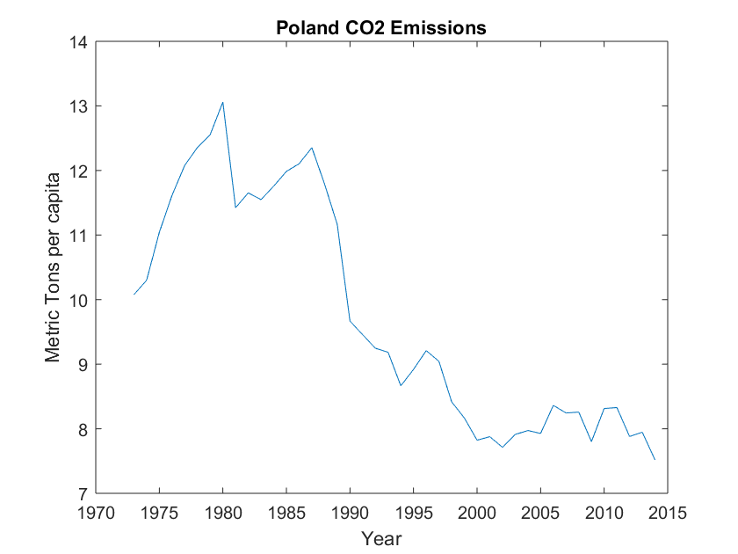
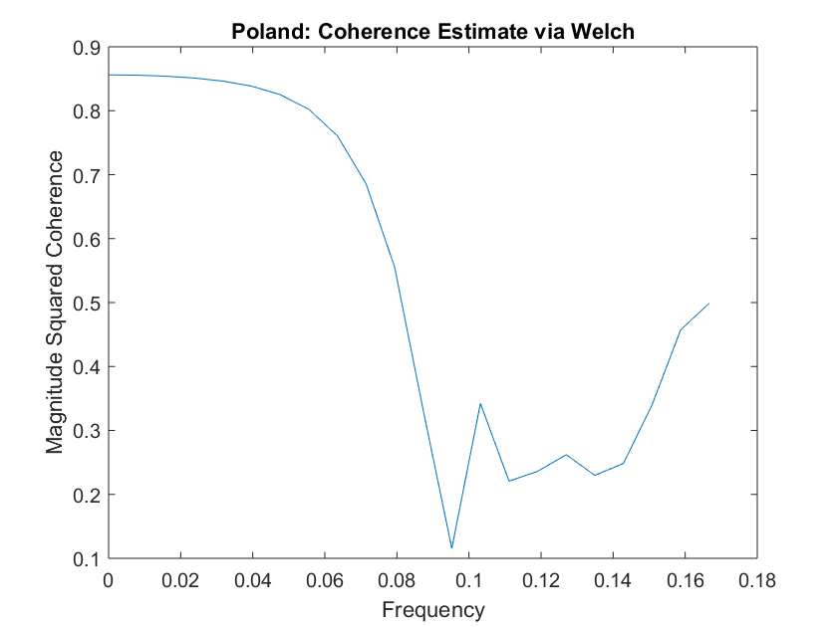
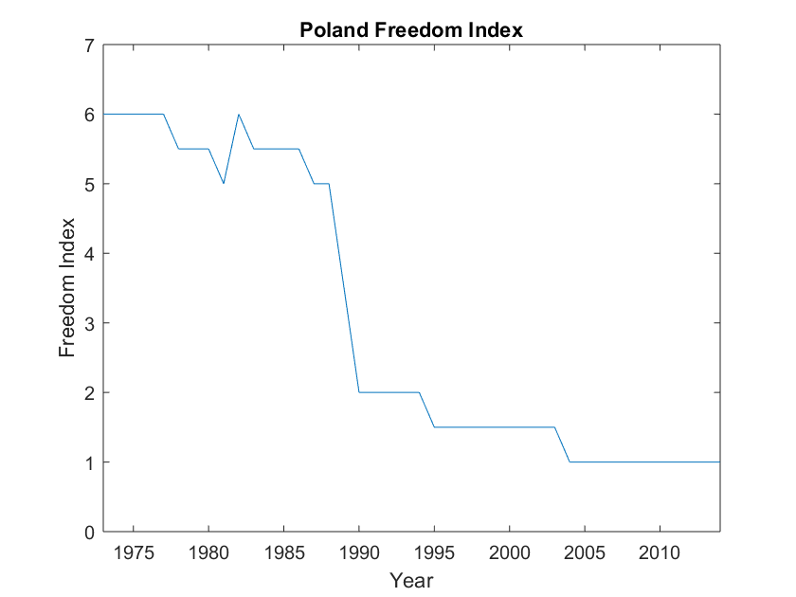
Country analysis
0.01
Fall of Nations
Time lag of -0.7 years
0.87
Notes:
Poland: significant frequency at 0.01 which corresponds to an R^2 value of 0.87. The time lag for Poland is -0.7 years, which means CO2 emissions lags behind the freedom index by about 8.4 months.
Fall of Nations in Poland and around Eastern Europe beginning in 1989 in Poland. Revolutions that ushered in freer democracies.

Slide 7
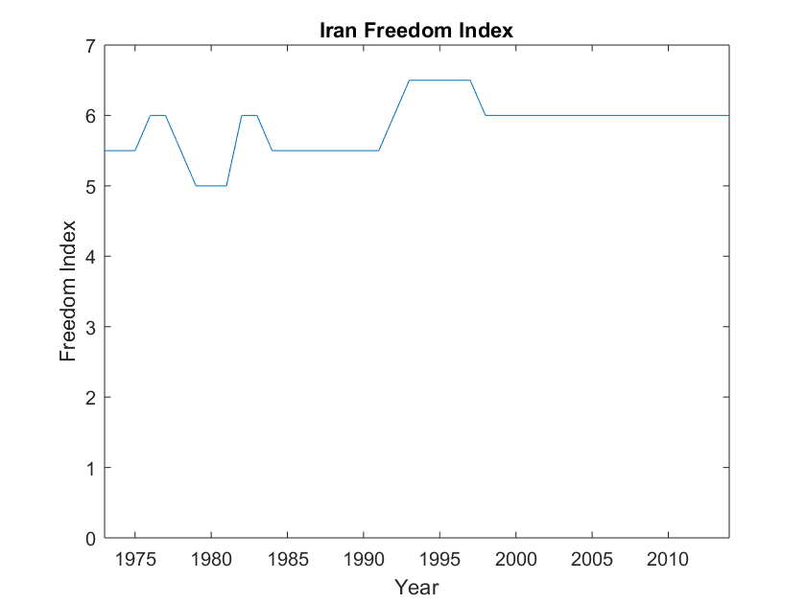
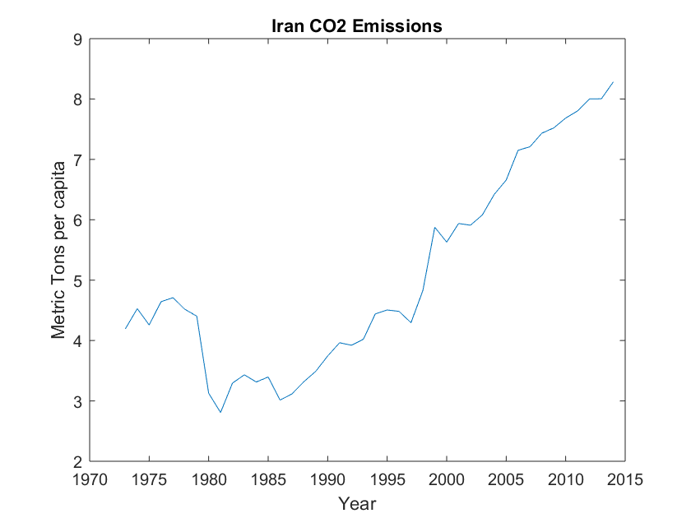
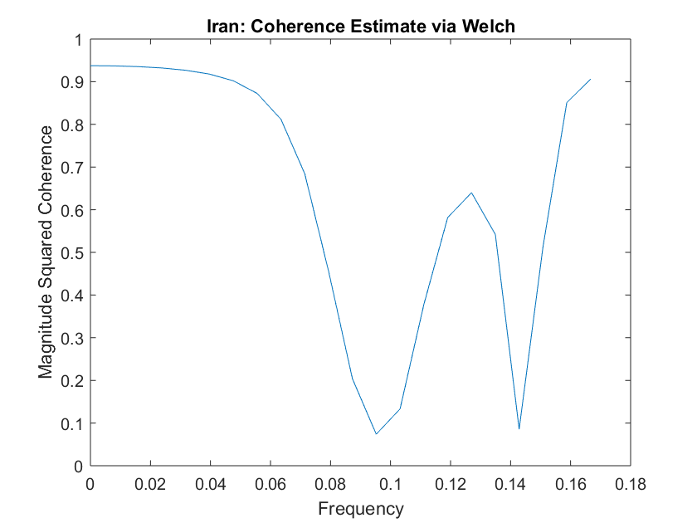
Country analysis
0.022
Iranian Revolution
0.94
Time lag of -14.36 years
Notes:
Iran: significant frequency at 0.022, which corresponds to a 0.94 R^2 value, confirming this frequency is significant. Time lag is -14.36 years, meaning CO2 emissions lagged behind changes in the freedom index by this many years.
History: Iranian Revolution in 1979 which ushered in a freer society but also precipitated a slight drop in CO2 emissions because priorities were on a war and not on producing or industrializing. However the outcome of the revolution caused industrialization again and there is a general rising trend in CO2 emissions. We see a slight mellowing out about 13 years after a rise in freedom index (less free), followed by another slight bump around 2006, which was possibly influenced by an increase in freedom score from 1992.

Slide 8
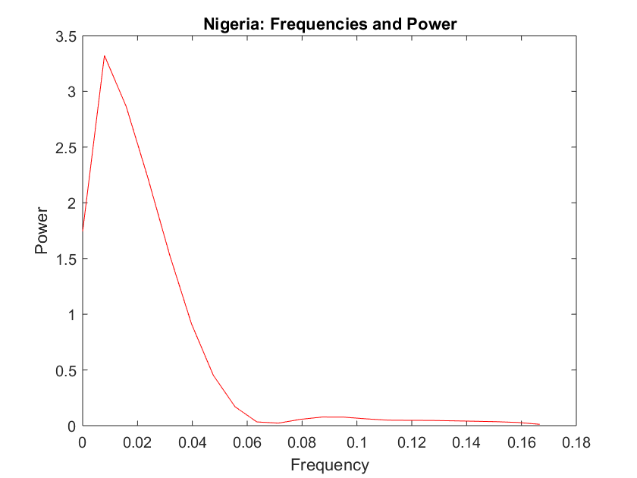
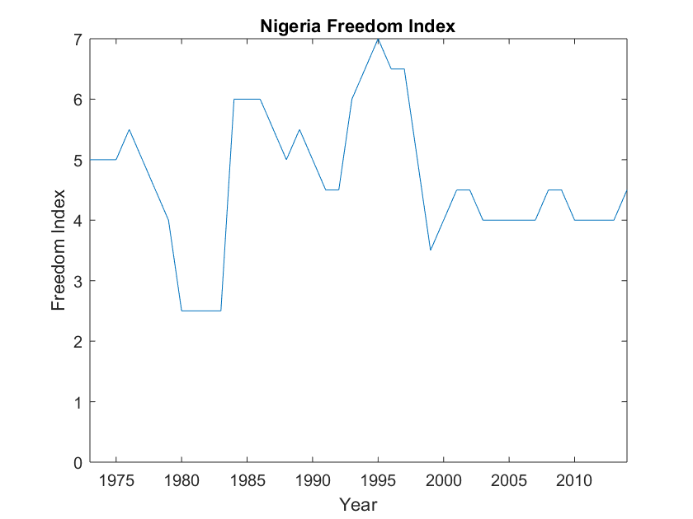
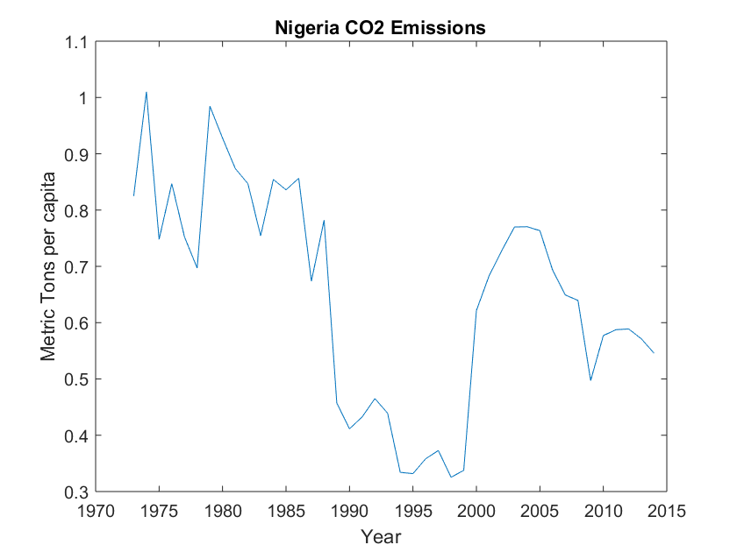
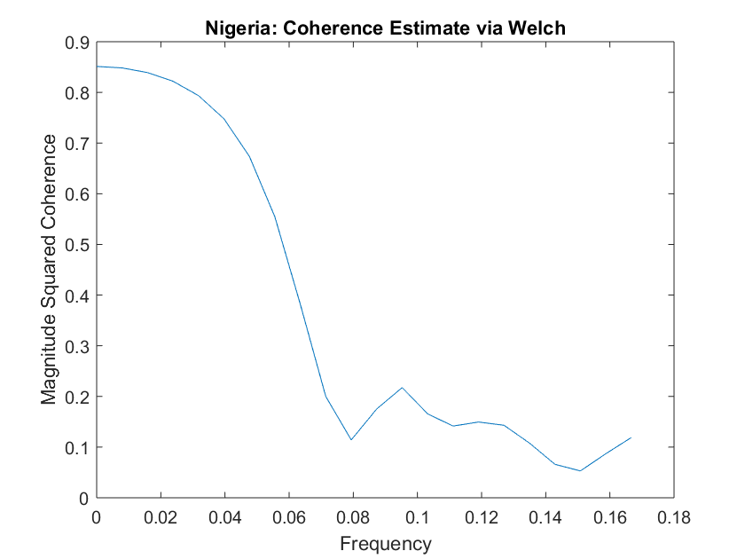
Country analysis
0.01
0.86
Time lag of 20.3 years
Notes:
Nigeria: significant frequency at 0.01 and a corresponding R^2 value of 0.86, confirming that this frequency is significant. Time lag is 20.338 years, meaning CO2 emissions precede freedom index changes by 20 years. This implies that CO2 emissions, or whatever causes CO2 emissions (industrialization), influenced changes in the freedom index score. For example, shown on the graph, the arrow on CO2 emissions shows a drop over a few years, which is mirrored by a rise in the freedom index, meaning the country became less free, about 20 years later.
Second arrow on CO2 data: this is an important arrow because if the analysis is to be believed, we should see a freer Nigeria around now, 2020ish. Nigeria has been massively developing since 2000, along with a population boom. In 2000 they had a population of 122 million, and today their population is 191 million. This is a country to watch as it emerges as a developed leader on the continent of Africa.
Nigeria in 2018 had a freedom rating of 4, down 0.5 points from the last data point in 2014 of 4.5
Mention Environmental Kuznets Curve*** once a certain level of wealth is reached by a country’s citizens, environmental actions begin, which could mean lower CO2 emissions as the country becomes “cleaner”

Slide 9
conclusions
The time lag varies by country and by region
Some countries are not good to analyze due to little to no change in their freedom index score (USA, Canada)
War, revolution or rebellion can lead to a freer country, oftentimes at the expense of their infrastructure
More analysis is needed, using more variables to define freedom and industrialization rates of countries
Analysis by region, continent and decade to see global trends
Notes:
However, in some cases a decrease in freedom rating also means a decrease in CO2 emissions, which is the opposite of my initial hypothesis. Why? War can mean a loss of infrastructure, so a decrease in emissions, but the outcome of that war can lead to a freer society.
Results not conclusive because each country is so specific to its history and region of the world. More analysis needed and would need to look at additional variables such as population change, type of government, age of country, etc
What does this mean? It means as a country becomes more free, its CO2 emissions increase, implying industrialization is or was taking place. On the flip side, as a country becomes less free, its CO2 emissions decrease, possibly due to war or some other domestic issue.

