Slide 1
Analyzing Distribution of goals in soccer in 10 minute intervals
EAS 4480
April 18 2019
Emile Kanazi

Slide 2
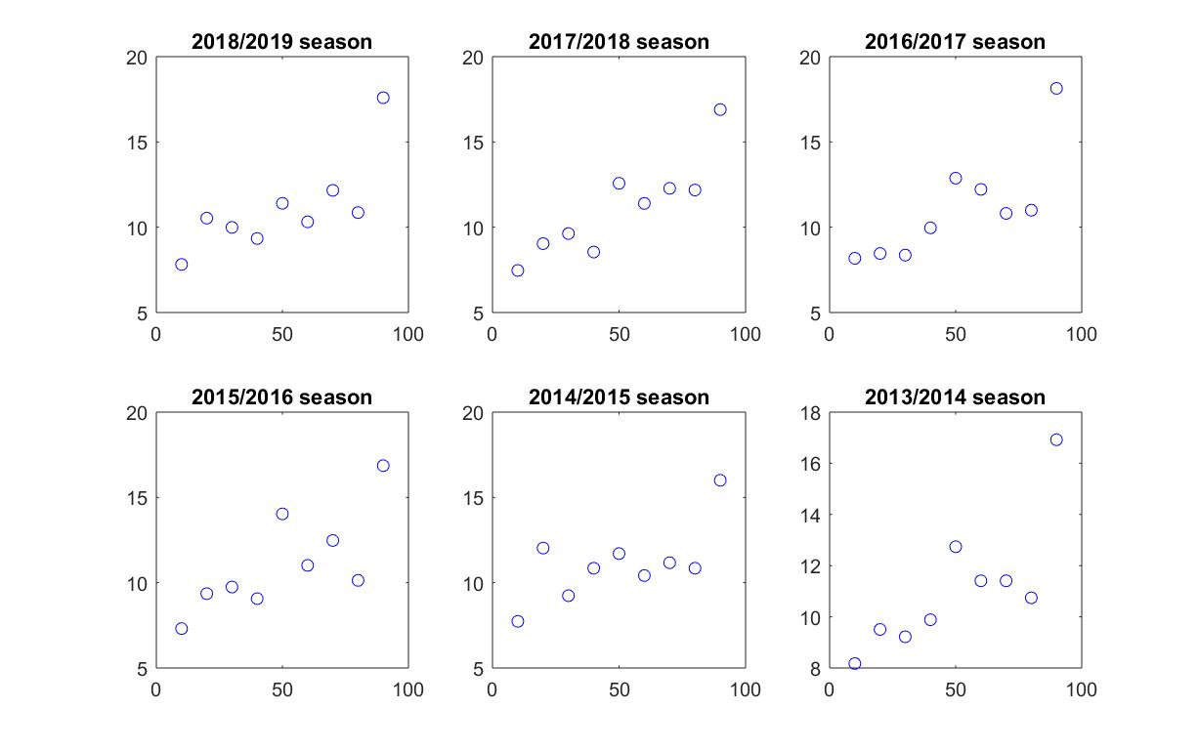
Motivation for the project

Slide 3
A possible explanation of this phenomenon
Physical deterioration of players (fatigue)
Goal scoring ability is not impacted by fatigue but the ability to defend is
Dehydration of players
Managerial tactical choices
Lapses in concentration

Slide 4
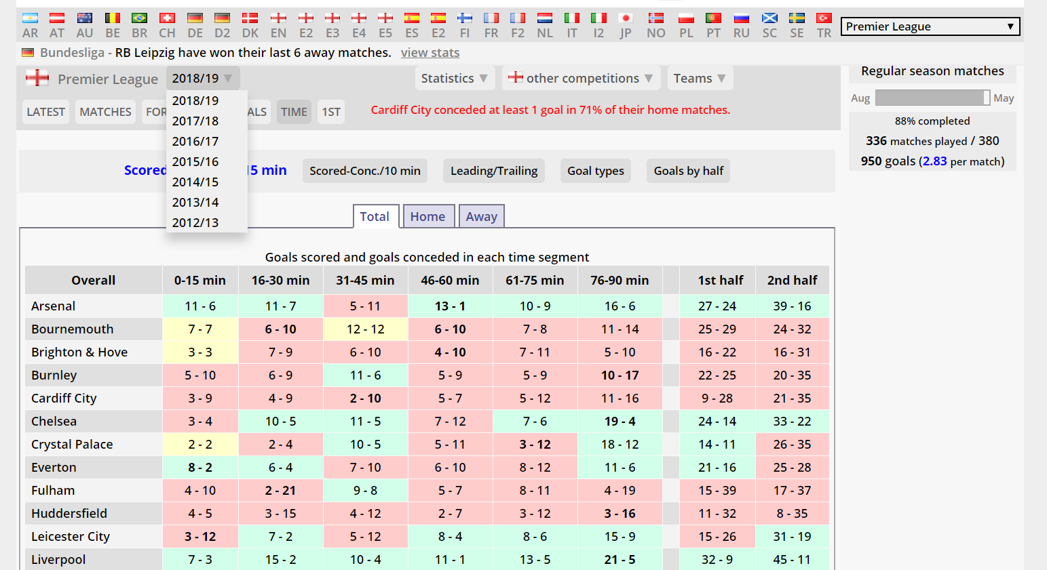
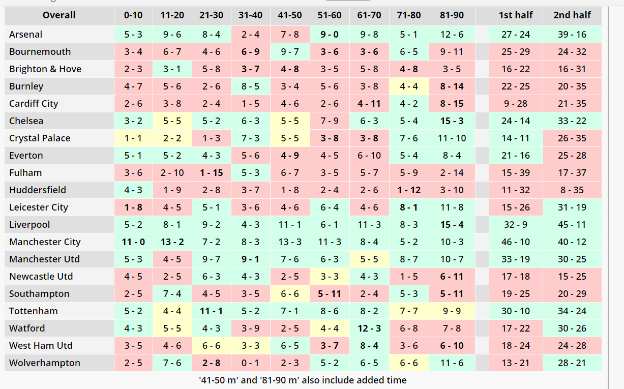
Source of the data

Slide 5
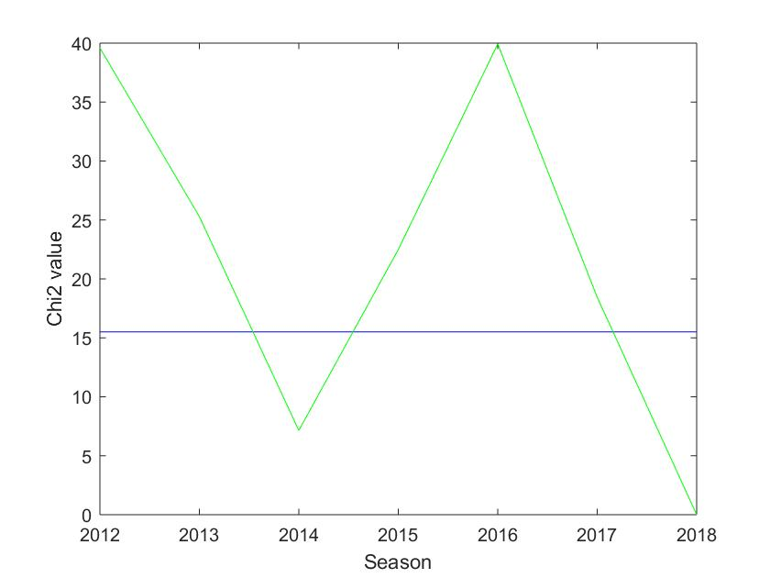
Comparison of goals distribution for different seasons in the English league

Slide 6
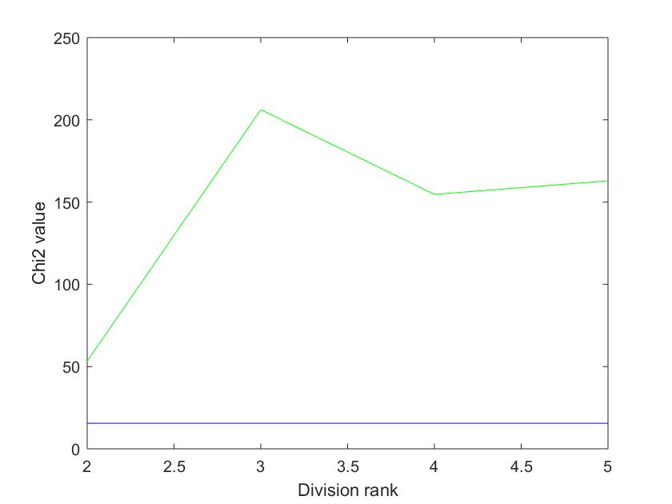
Comparison of the goal distribution in the English league by team rank

Slide 7
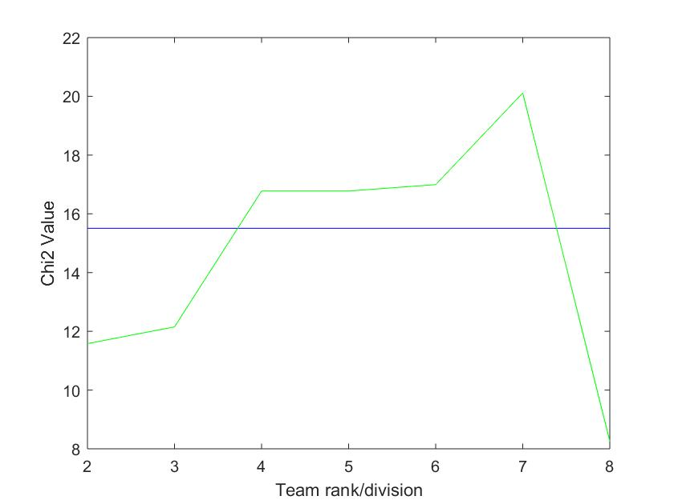
Comparison of the goal distribution in the German league by team rank

Slide 8
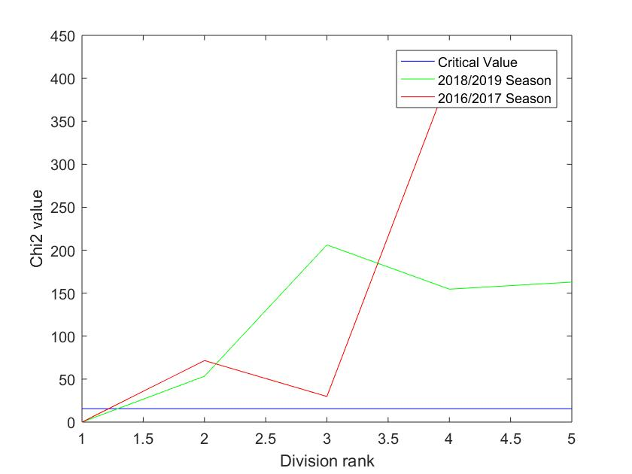
Comparison by rank for two different seasons in the EPL

Slide 9
Is the data in the last 10 minute interval normally distributed?
 | German League (Bundesliga) | English Premier League
Chi2 value | 5.693 | 3.9007
Critical value | 12.59 | 12.59
Since both chi2 values are less than the critical chi2 value, we cannot reject the null hypothesis stating that the data is normally distributed

Slide 10
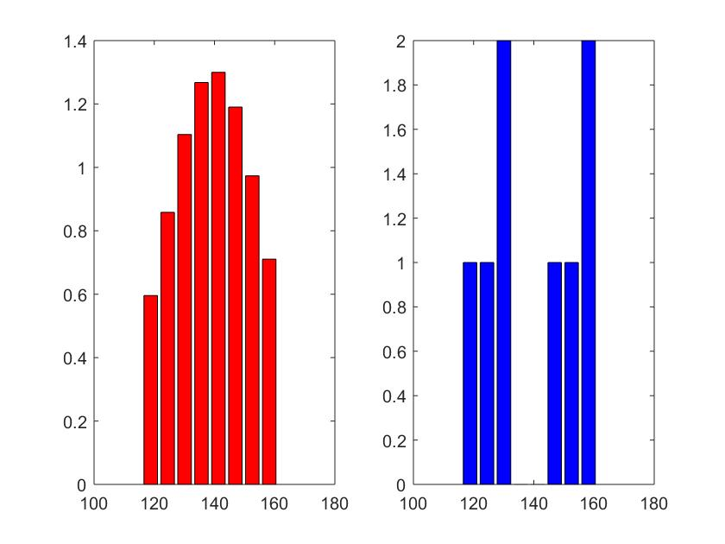
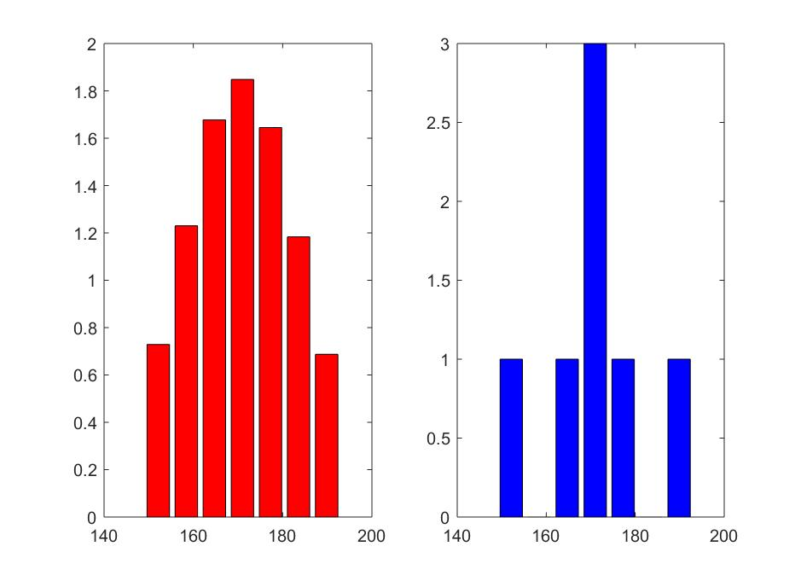
Distribution of goals in the 80th to 90th minute in the English Premier League
Distribution of goals in the 80th to 90th minute in the Bundesliga

