Slide 1
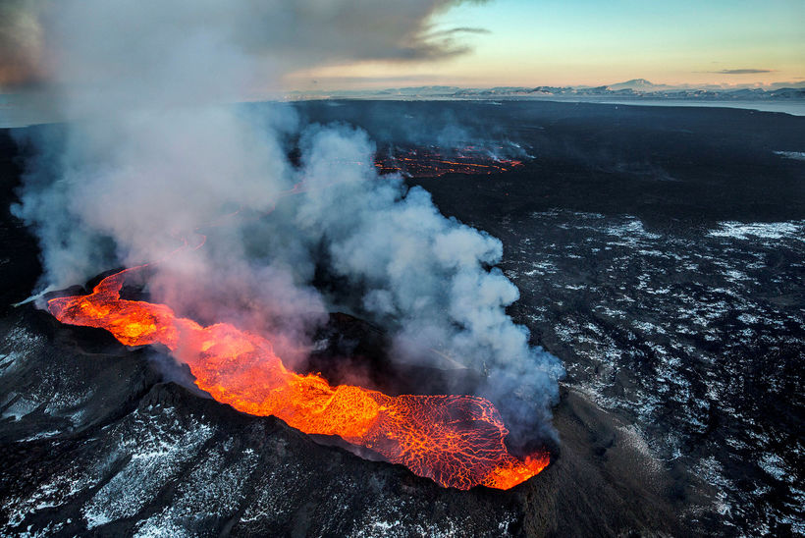
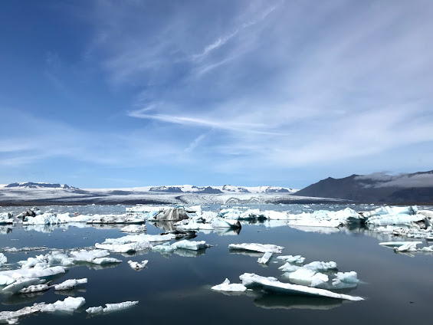
Glacial Retreats and the Surge of Volcanic Activity: Iceland
Source: Iceland Monitor
Riannon Colton

Slide 2
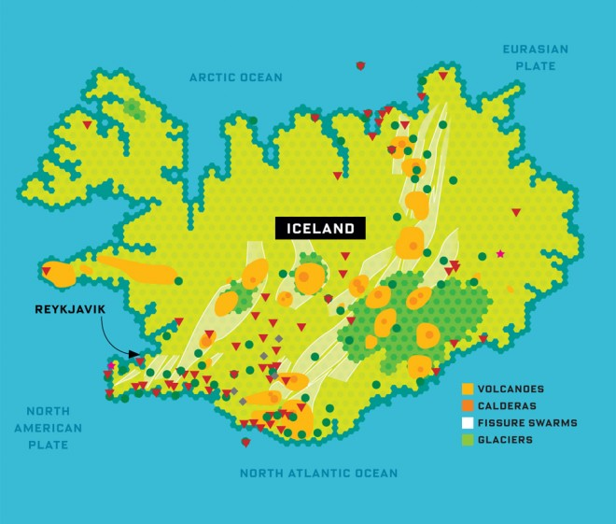
Motivation of Study
The retreat of Iceland’s largest glacier, Vatnajokull, will cause local volcanoes to erupt more frequently
Glaciers in Iceland have been shrinking for the past century, losing 10% of their mass
A recent study showed that the reduction of the weight of the ice on top of the volcanoes has reduced pressure on the Earth’s surface
As a result, the ground has risen (isostatic rebound) allowing magma to flow upward more often
Other areas affected are Antarctica, Aleutian Islands, and Patagonia
Since 1980, significant global warming has led rapid glacial retreats
Source: UC Davis
Source: Wired

Slide 3
Hypothesis: Glacial retreats are followed by more frequent volcanic eruptions.

Slide 4
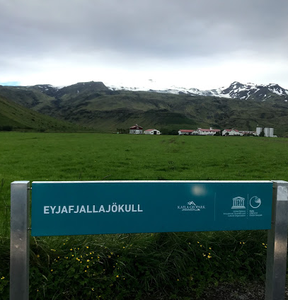
Glacier Analysis
Retrieve Data
World Glacier Monitoring Service
Years: 1986 – 2016
Selected One Country (Iceland)
Look at Individual Glacier SMB
Average Glacier SMB Changes
Least-Squares Regression (LSR)
Residuals
Chi² Test
Correlation with Volcano Data

Slide 5
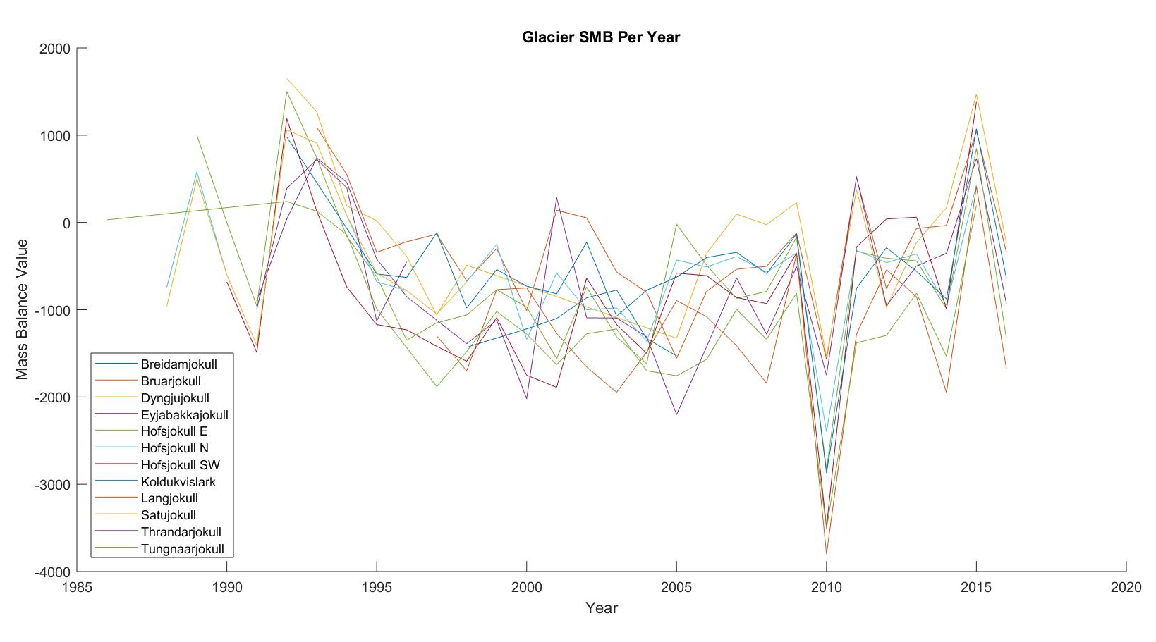
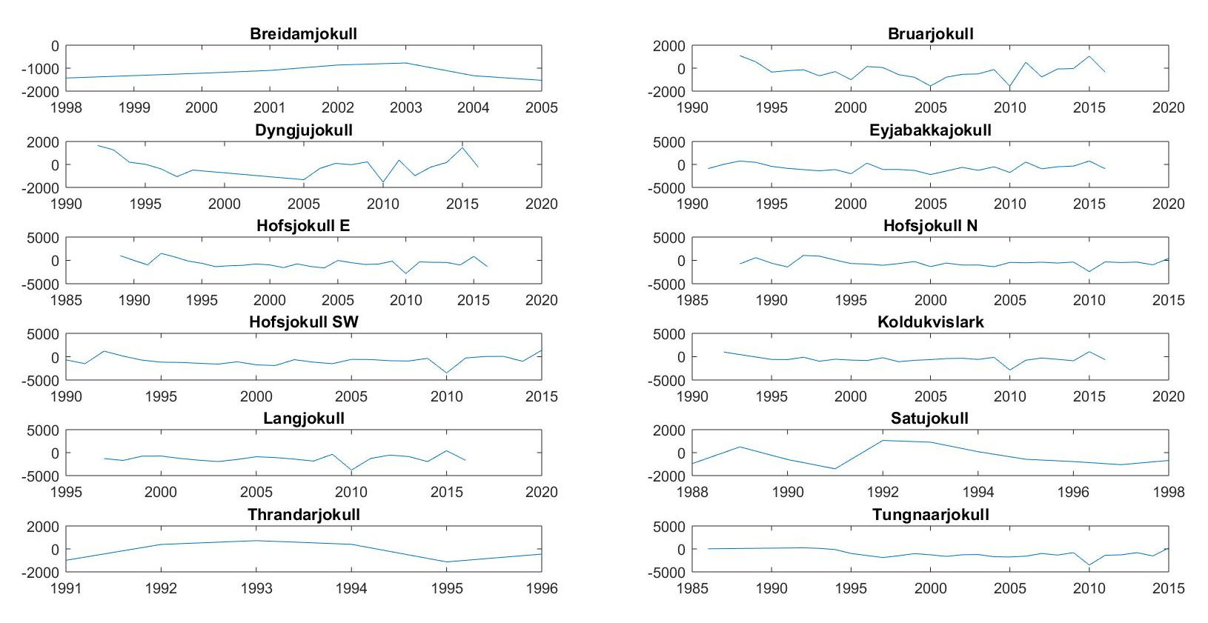
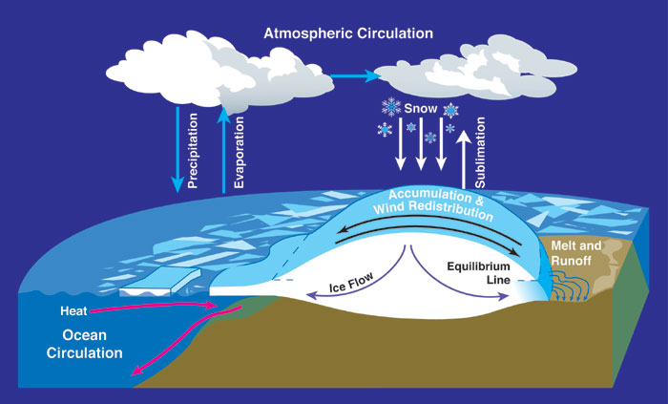
Surface Mass Balance (SMB)
SMB is the accumulation and ablation of ice from a glacier system
SMB < 0 : Net Loss
SMB > 0 : Net Gain
Source: Antarctic Glaciers

Slide 6
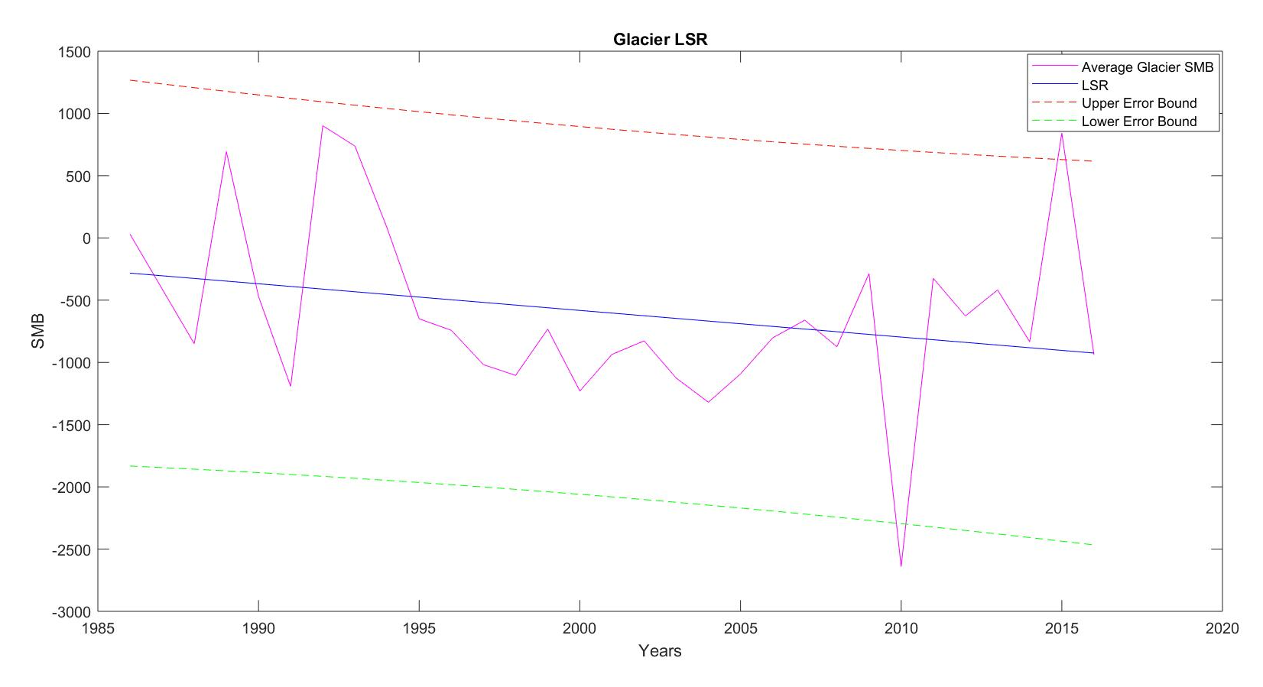
Least-Squares Regression (LSR)
LSR Slope: -21
Significant negative trend
Indicates Glacier SMB is decreasing over time
Notes:
LSR finds the line that best represents observations in a bivariate data set.

Slide 7
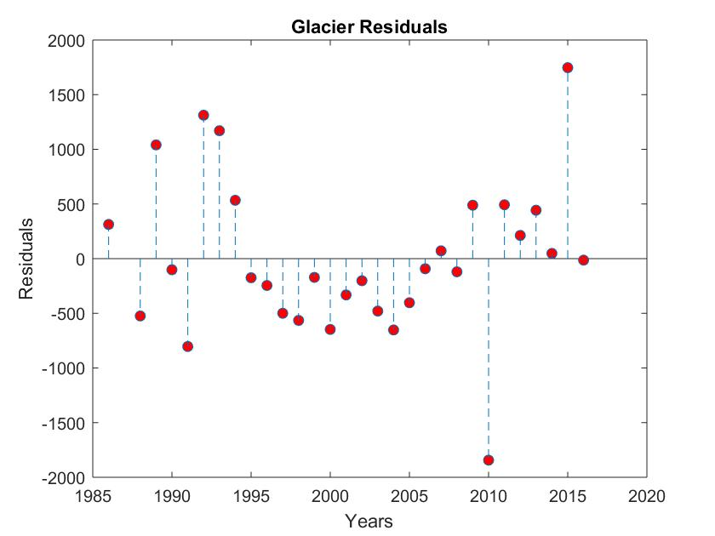
Residuals
Sum: 1.2824e-10
Mean: 4.2746e-12
Both values are extremely close to zero
Values are randomly dispersed around zero
Indicates the LSR is appropriate to use
Notes:
Residuals are the difference between the observed value of the dependent variable (y) and the predicted value (y*).
The sum and the mean of the residuals are equal to zero.

Slide 8
Chi^2 Test
Chi² Value: 7.5917
Chi² Inv: 7.8147
Chi² < Chi² Inv: The hypothesis cannot be rejected
Indicates the actual data fits well with the expected distribution (Gaussian)

Slide 9
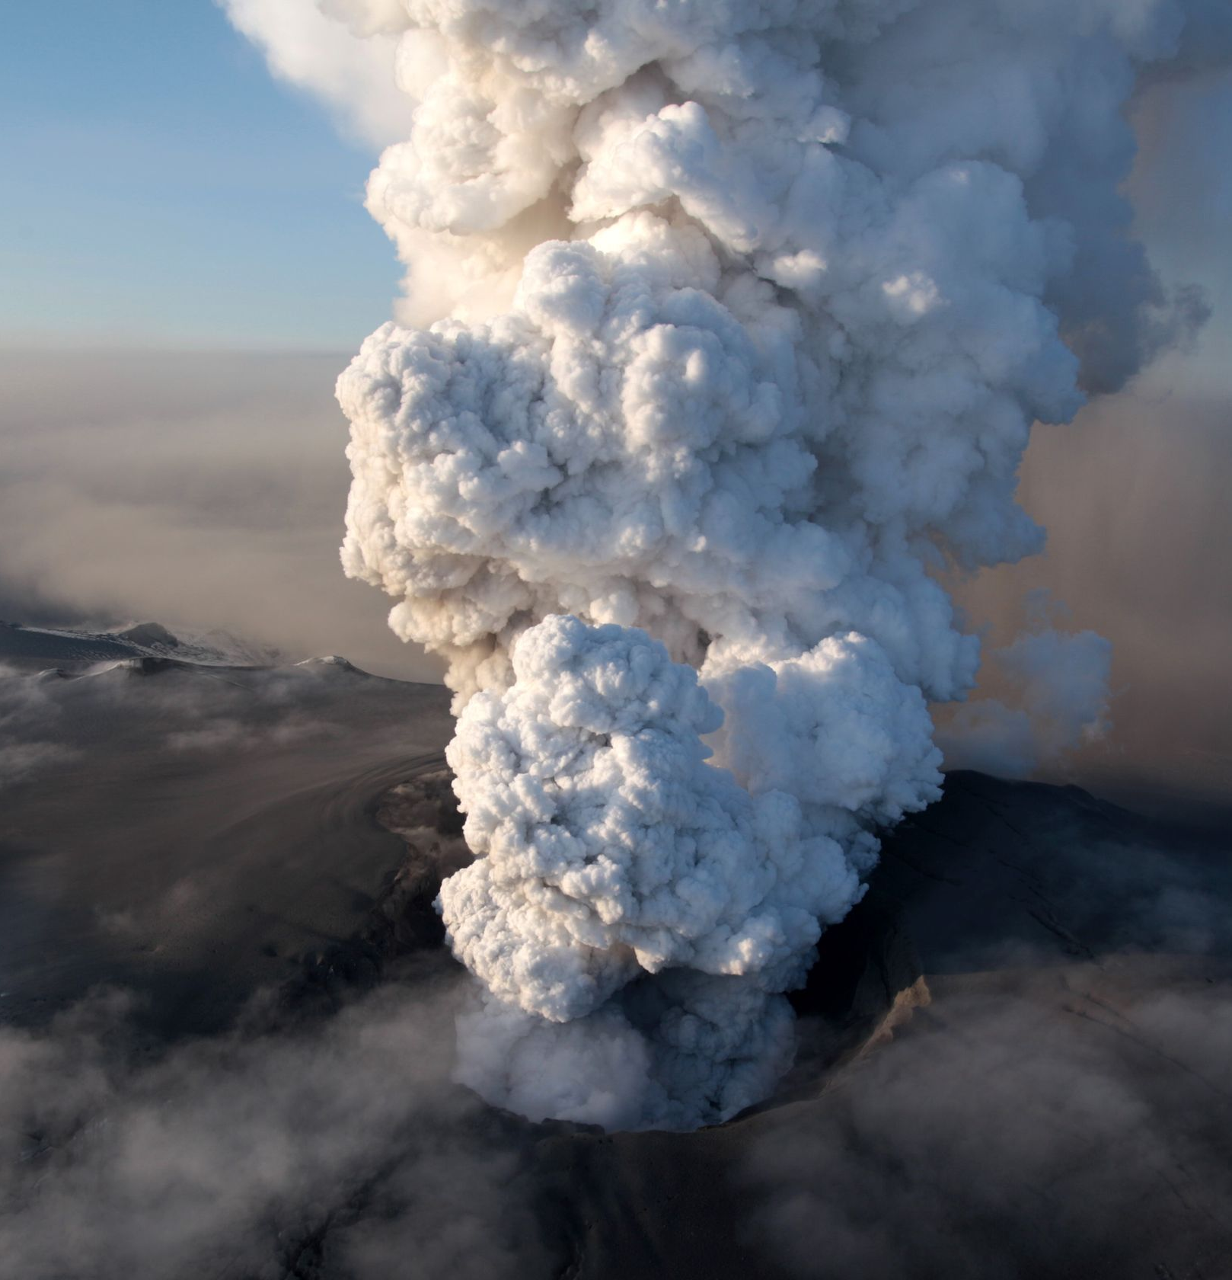
Volcano Analysis
Retrieve Data
Smithsonian Institution National Museum of Natural History Global Volcanism Program
Years: 6500 B.C.E - 2014
Find Frequency of Eruptions
Split Data into 3 Categories
All
Before Glacial Melt
After Glacial Melt
Least-Squares Regression (LSR)
Residuals
Chi² Test
Fast Fourier Transform (FFT)
Correlation of Volcanic Eruptions After Glacial Melt Data with Glacier Data
Source: USA Today

Slide 10
Least-Squares Regression (LSR)
All
Slope: -0.0047
Slightly negative trend
Indicates time intervals between eruption are decreasing
Before
Slope: -0.0047
Slightly negative trend
Indicates time intervals between eruption events are decreasing
After
Slope: 0.079
Slightly positive trend
Indicates time intervals between eruption events are increasing

Slide 11
Residuals
All
Sum: 3.304e-13
Mean: 7.5091e-16
Both values are extremely close to zero
Values are not randomly dispersed around zero (linear)
Indicates LSR is not appropriate to use
Before
Sum: -1.3145e-13
Mean: -3.093e-16
Both values are extremely close to zero
Values are not randomly dispersed around zero (linear)
Indicates LSR is not appropriate to use
After
Sum: -8.2423e-13
Mean: -5.8874e-14
Both values are extremely close to zero
Values are not randomly dispersed around zero (linear)
Indicates LSR is not appropriate to use

Slide 12
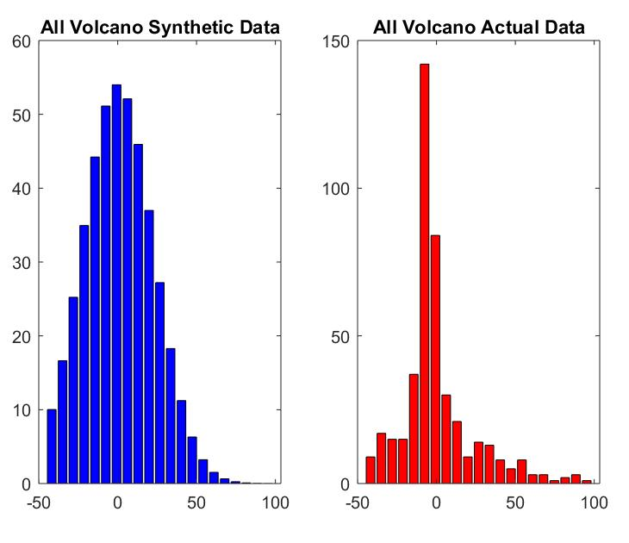
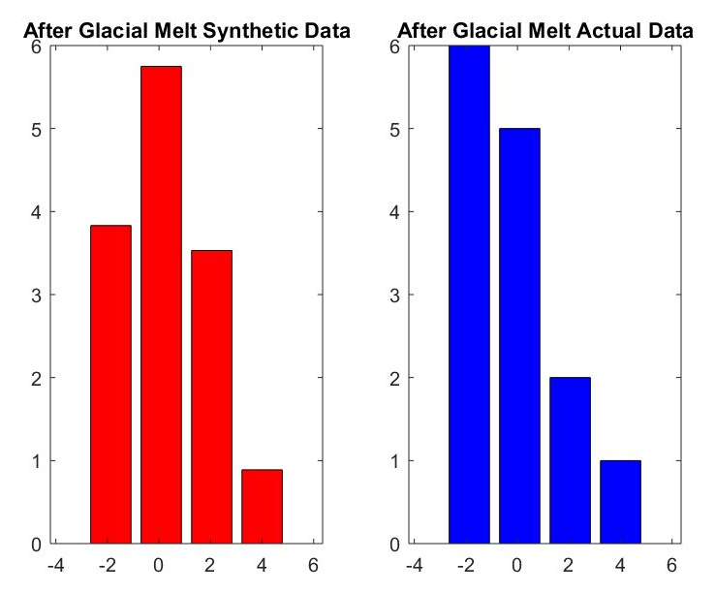
Chi^2 Test
All
Chi² Value: 720.1639
Chi² Inv: 28.8693
Chi² Value > Chi² Inv : The hypothesis can be rejected
Indicates the actual data does not fit well with the expected distribution (Gaussian)
Before:
Chi² Value: 615.1455
Chi² Inv: 28.8693
Chi² Value > Chi² Inv : The hypothesis can be rejected
Indicates the actual data does not fit well with the expected distribution (Gaussian)
After:
Chi² Value: 2.0022
Chi² Inv: 3.8415
Chi² Value < Chi² Inv : The hypothesis cannot be rejected
Indicates the actual data fits well with the expected distribution (Gaussian)
Notes:
Chi^2 test compares the difference between each observed and theoretical frequency for each possible outcome.

Slide 13
Fast Fourier Transform (FFT)
All
Reverse of original data plot
More smaller frequencies than larger frequencies
Smaller periods per smaller amplitudes
Indicates there are more smaller time intervals than larger time intervals between volcanic eruptions
Before
Reverse of original data plot
More smaller frequencies than larger frequencies
Smaller periods per smaller amplitudes
Indicates there are more smaller time intervals than larger time intervals between volcanic eruptions
After
Reverse of original data plot
Not enough data
Most are within a period of 10 and an amplitude of 10
All time intervals represented on the figure are considered small
Notes:
Representative of the frequency domain

Slide 14
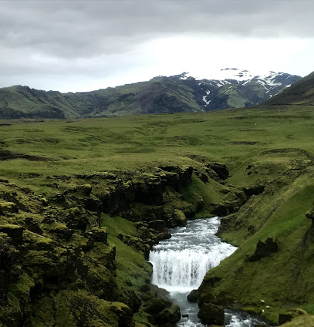
Correlation Coefficient
Correlation between Glacial SMB decrease and volcanic eruptions after 1980
Correlation Coefficient: .061
Extremely weak positive correlation

Slide 15
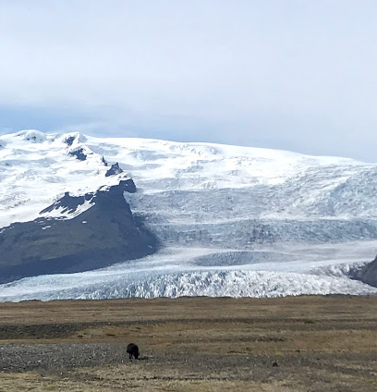
Conclusions
The hypothesis cannot be confirmed
Glacier Data
LSR
Residuals
Chi^2 Test
Correlation Coefficient
Volcano Data
LSR
Residuals
Chi² Test (After data)
FFT (All and Before Data)
Correlation Coefficient
Too few data points for volcanic eruptions after glacial melt
There were multiple eruptions in some years; However all volcanic eruptions in one year were counted as one eruption event
This is a smaller amount of data points than the actual amount

