Slide 1
Weather Model Analysis
By Andrew Alsup

Slide 2
Research Questions
How well do the GFS and NAM predict weather conditions 24 hours in advance?
How does the accuracy of the GFS and NAM change over time?

Slide 3
Why I Chose This Topic

Slide 4
The Data
Model and Observation Data From the Iowa Environmental Mesonet
Weather data gathered from 10 randomly distributed airports around Georgia
The time frame is from December 21st to March 20th (Winter)

Slide 5
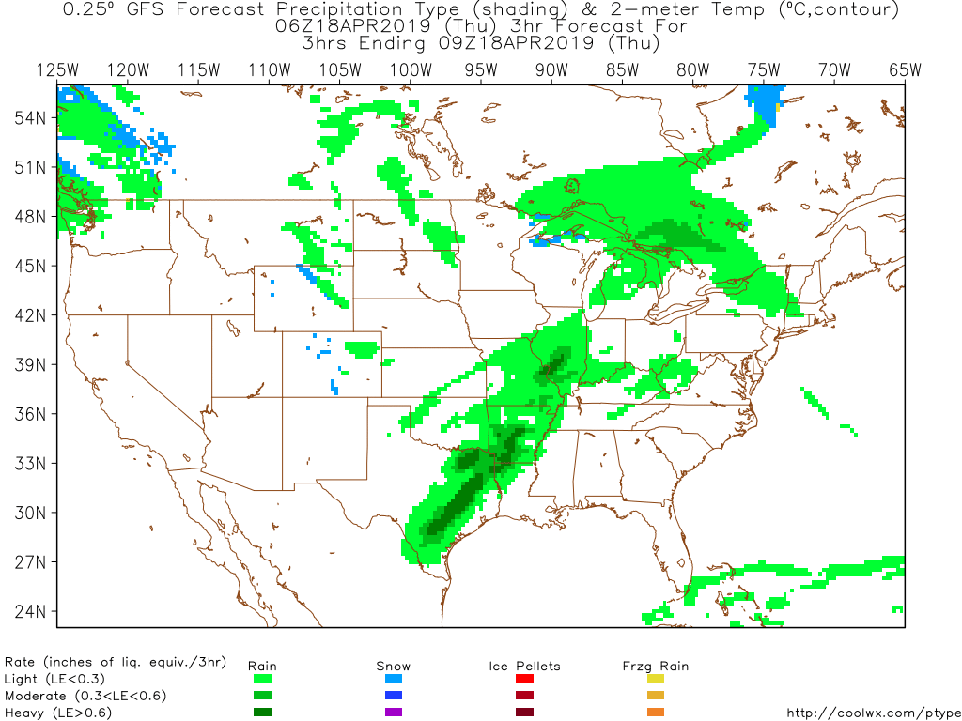
The Models

Slide 6
The Observations

Slide 7
Analysis Procedures
Accuracy of 24 hr forecast
Chi Squared Test on Residual
Mean and Variance of Residual
Skill of the Model
Change of variance over time
Find variance for each time step
Fit the data to a line and describe the slope

Slide 8
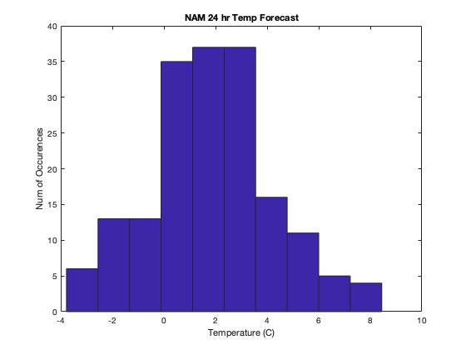
Chi Squared Test

Slide 9
Mean and Variance
GFS:
Mean: 0.4295
Variance: 30.0369
NAM:
Mean: 1.8043
Variance: 5.8441

Slide 10
Skill
Benchmark Forecast: Persistence Model
Skill is defined as:

Slide 11
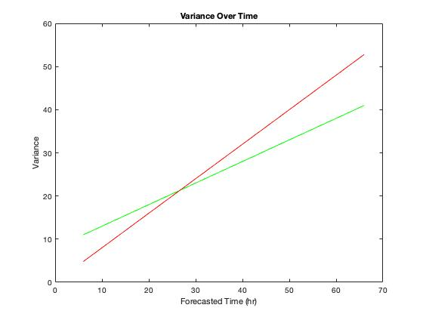
Variance Over Time

Slide 12
Improving the Analysis

Slide 13
The End
Any Questions?

