Slide 1
The effects of Climate Change on Hurricane formation dates
A. Russ, EAS 4480, 2022

Slide 2
The Question
-As sea surface temperatures rise, how will this effect hurricane behavior? Specifically, will out-of-season hurricanes become more common?
-My hypothesis is, as the average SST rises, we will see an increase in outlier hurricanes (hurricanes formed before July and after October).

Slide 3
The Data
-Using the NWS archives, I recorded for every hurricane formed from 1970-2020 it’s month of formation and category classification (from 0-5)
-Due to the shear amount, I ended up only using every other year
-Resulted in 936 data points for the 26 years of collection in the form of year, month (1-12) and category (0-5) for the hurricanes that were recorded

Slide 4
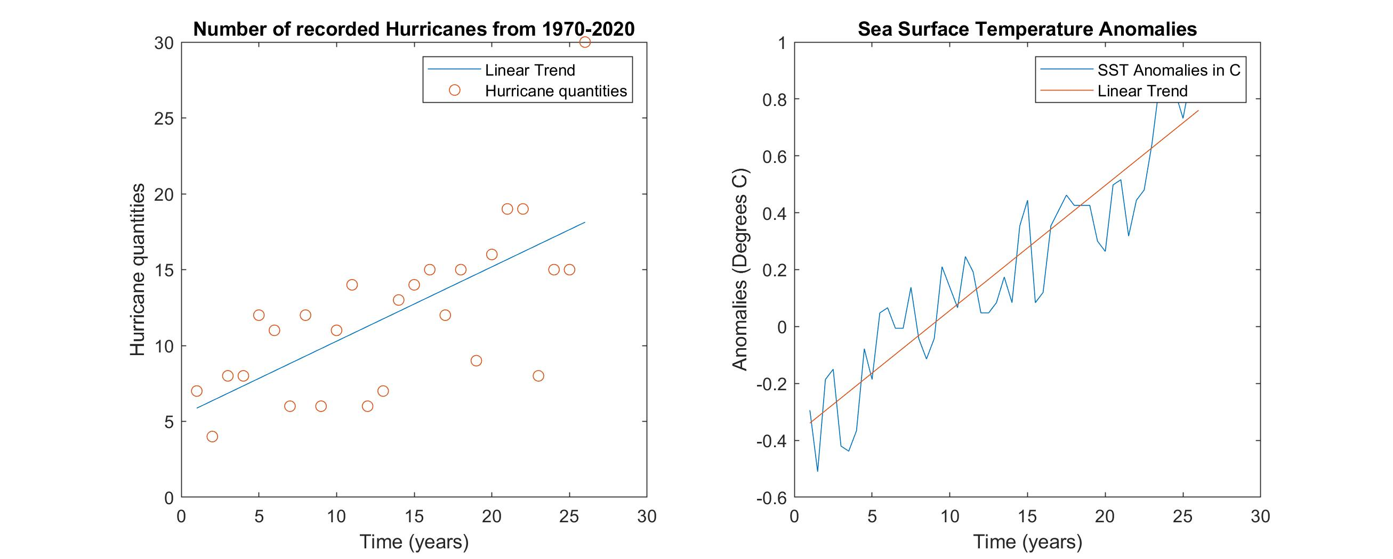
Hurricane quantities

Slide 5
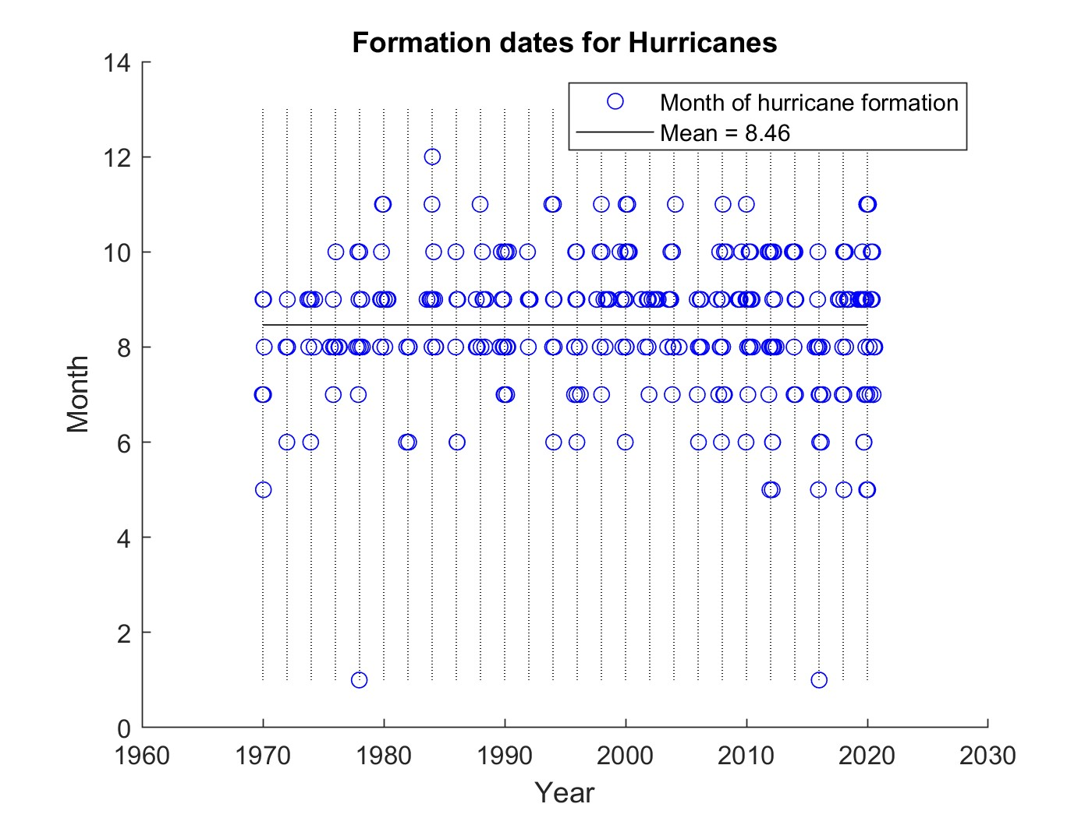
Hurricane months

Slide 6
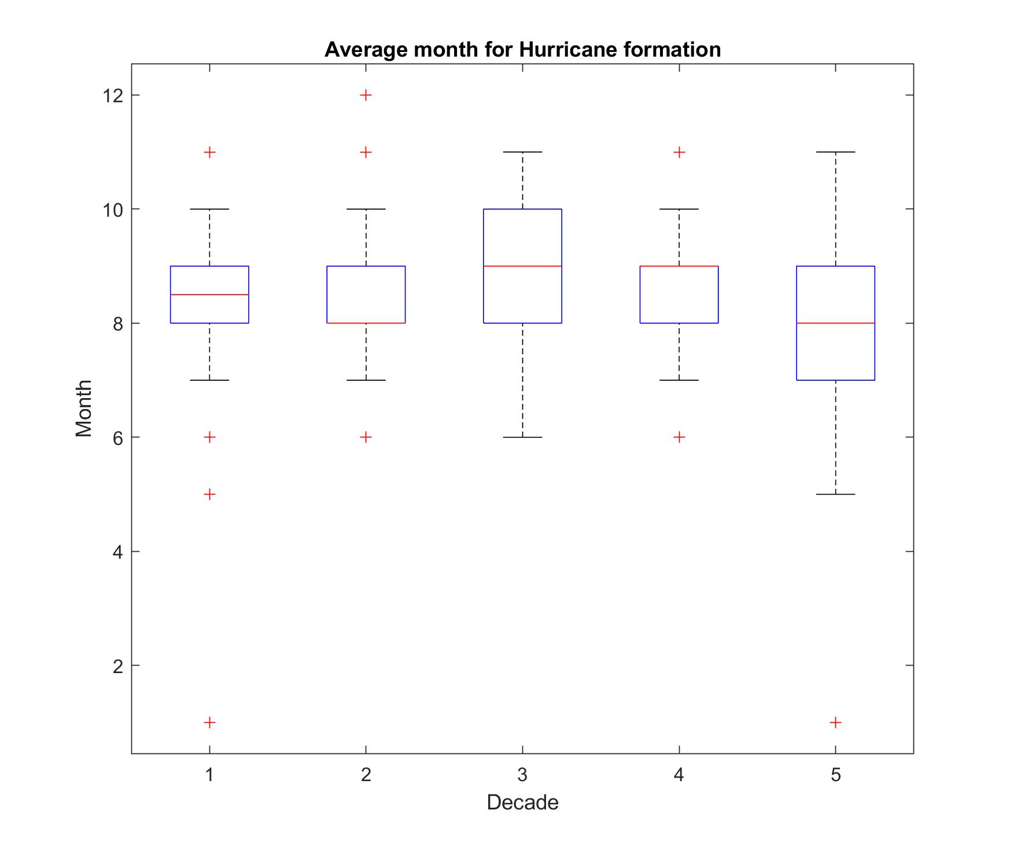
Hurricane months
DECADE | MEAN MONTH | STANDARD DEVIATION
1970-80 | 8.320 | 1.570
1980-90 | 8.551 | 1.292
1990-2000 | 8.873 | 1.263
2000-10 | 8.591 | 1.103
2010-20 | 8.138 | 1.713

Slide 7
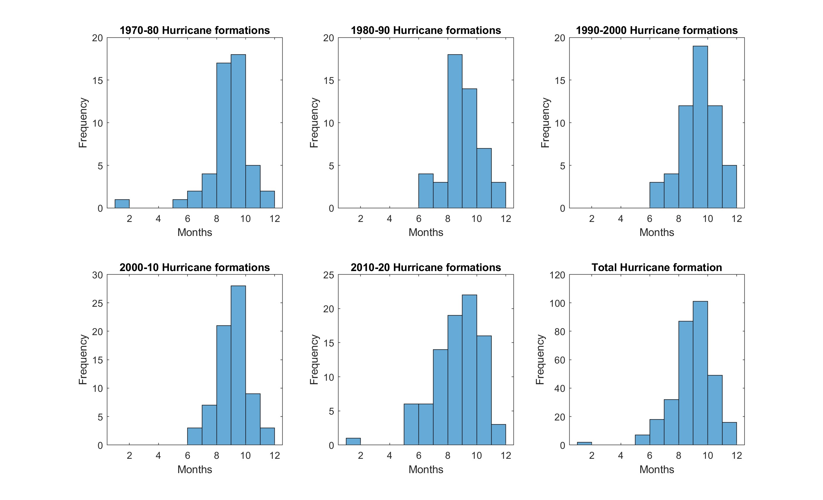
Hurricane months

Slide 8
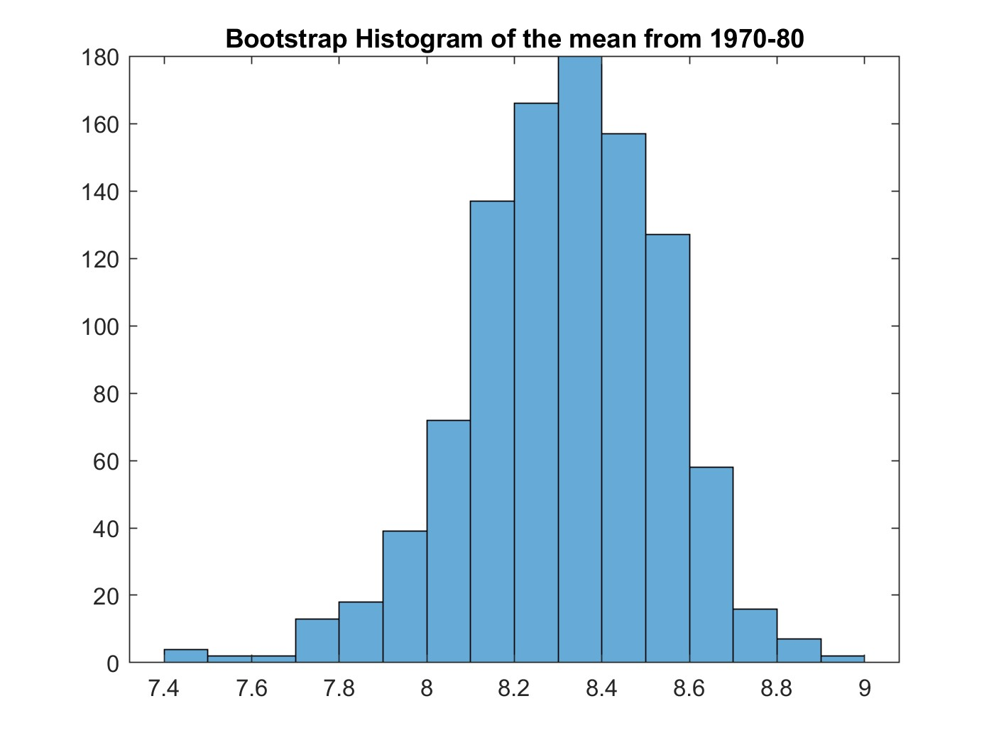
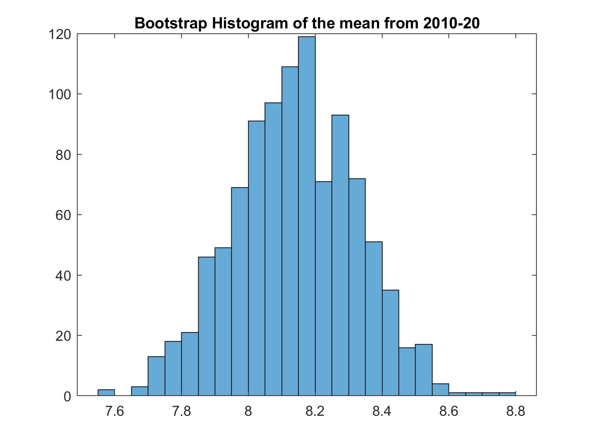
First and Last decade
DECADE | MEAN MONTH | STANDARD DEVIATION
1970-80 | 8.320 | 1.570
2010-20 | 8.138 | 1.713

Slide 9
Change in Mean?
-Null Hypothesis: The value hurricane month formations between the first and fifth decade have equivalent means.
-Using paired-sample t-test on the data from 1970-80 and 2010-20, their means are statistically equivalent.
tstat = 0.905
p = 0.368
ci = [-0.218,0.582]
h = 0 (meaning our Null Hypothesis is true)

Slide 10
Change in Variance?
-Null Hypothesis: The value hurricane month formations between the first and fifth decade have equivalent variances.
-Using two-sample f-test on the data from 1970-80 and 2010-20, their variances are statistically equivalent.
fstat = 0.84
p = 0.5133
ci = [0.518,1.41]
h = 0 (meaning our Null Hypothesis is true)

Slide 11
Results
-There is no statistically significant effect of climate change on what time hurricanes are forming
-While there is an increase in frequency, they still form within the expected timeframe
-So? While we can expect more active seasons, there is no reason to think out-of-season activity is increasing.

Slide 12
Moving Forward
-Look into severity changes over time
-The category data was recorded and processed, but for the sake of brevity, it was not included in this presentation

Slide 13
Sources
https://www.nhc.noaa.gov/data/
National Hurricane Center’s data base
https://www.mathworks.com/help/
Mathworks MATLAB Help center

