Slide 1
How Does External Pressure Affect Soccer Players’ Behavior
By: Anikait Dhond

Slide 2
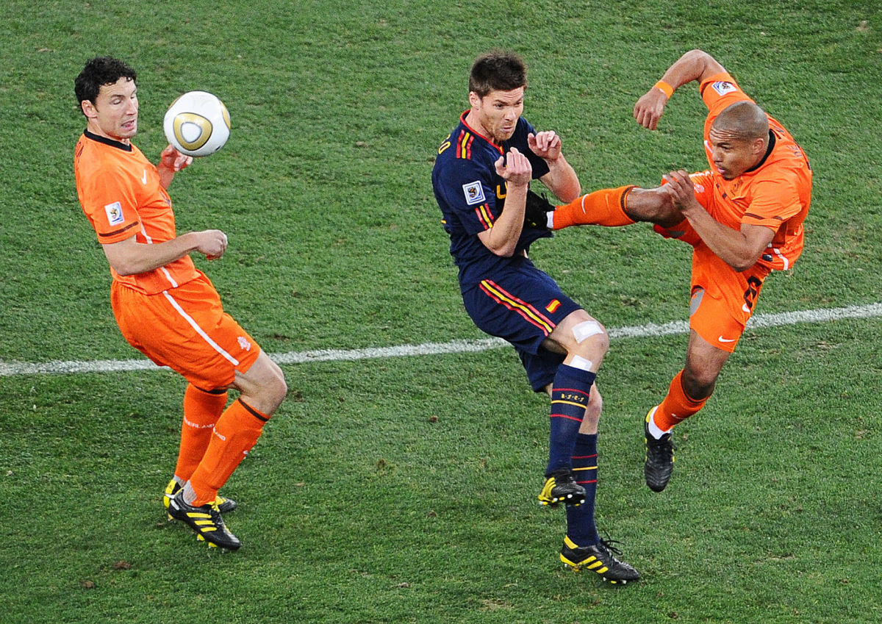
Overview
Motivation
Background Information
Analysis
Indicator
Conclusion
Sources

Slide 3
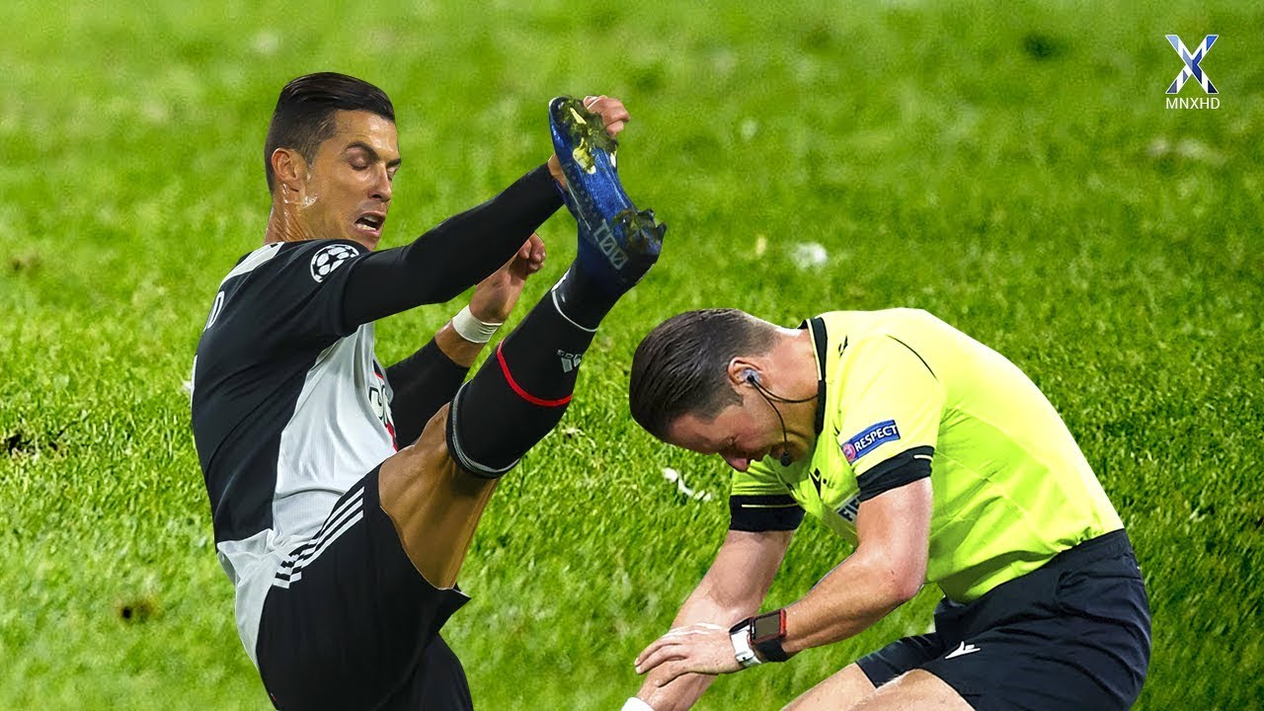
Motivation
Player experience
Referee experience
“Heat of the moment”
Help quantify and predict how players may behave during a match

Slide 4
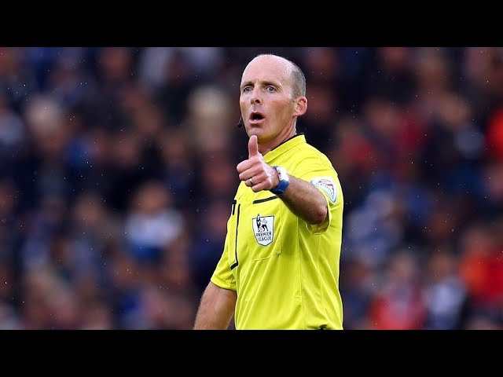
Background Information
Main Problem: What increases the aggressiveness
or ’heat level’ in a game?
Indicators of “heated” player behavior:
Tackles
Fouls
Yellow Cards/Red Cards
What could impact this?
Rivalries/Derbys
Competitiveness of games
Time in the Season
Weather Conditions
League: Premier League – UK
Matches: Officiated by same official: Mike Dean

Slide 5
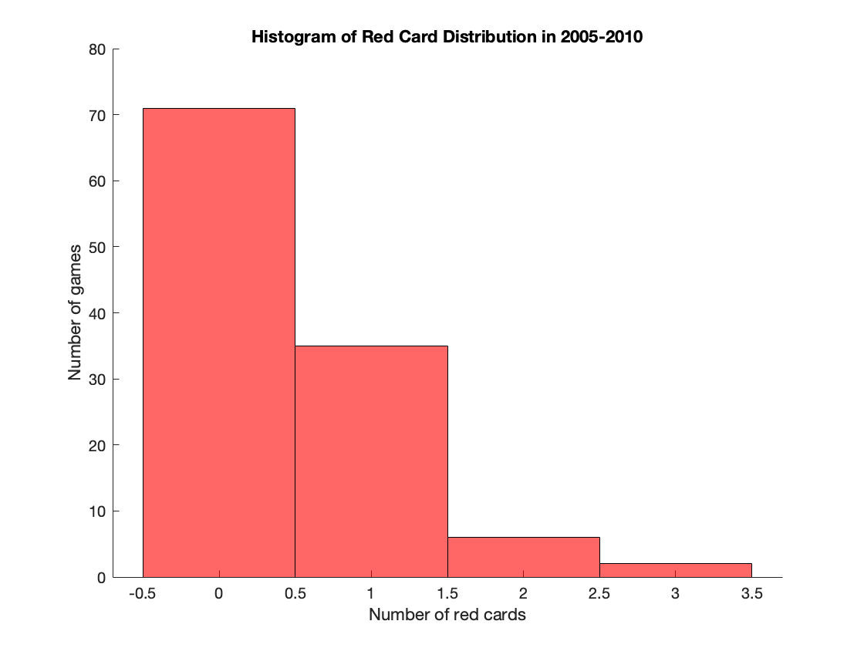
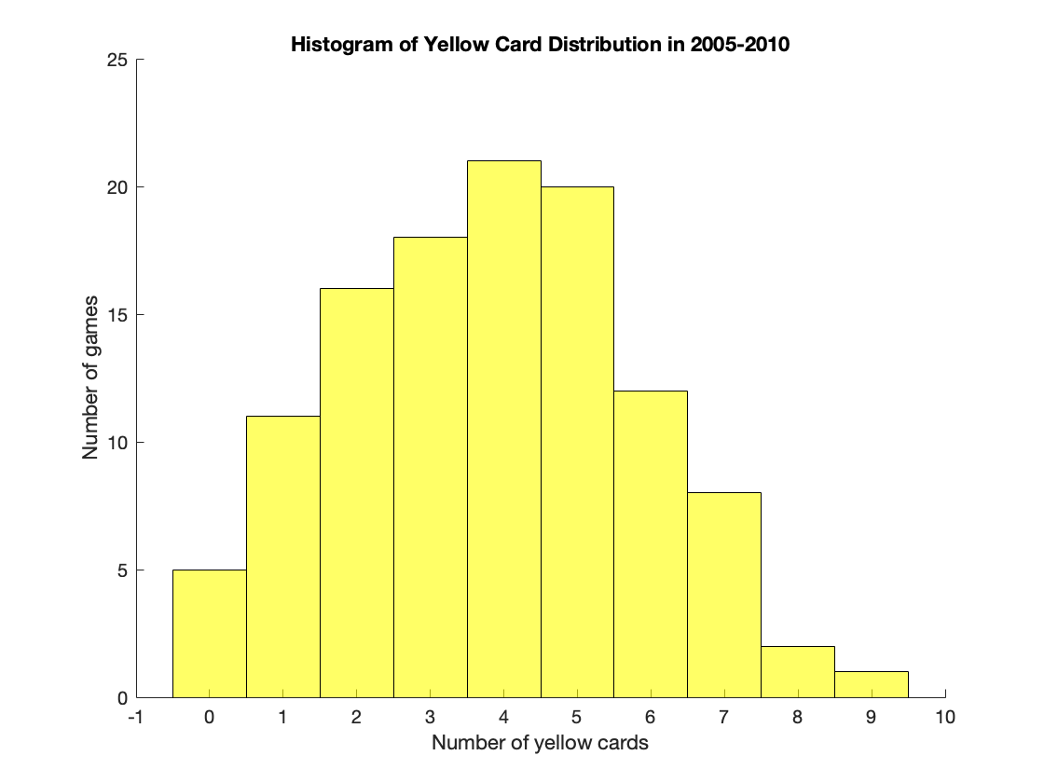
Analysis 1a - Indicators

Slide 6
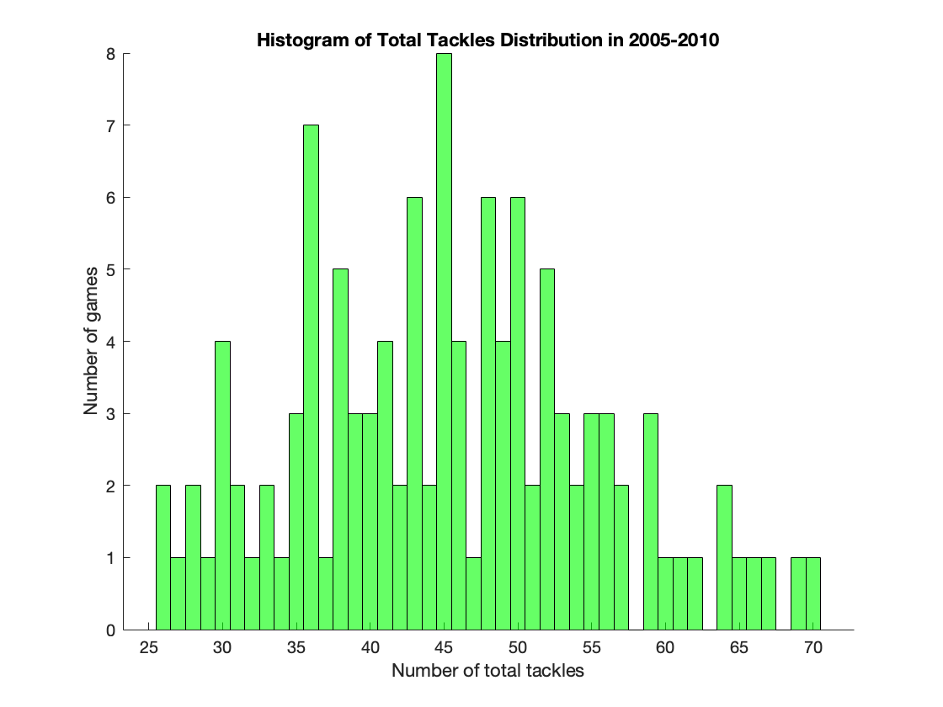
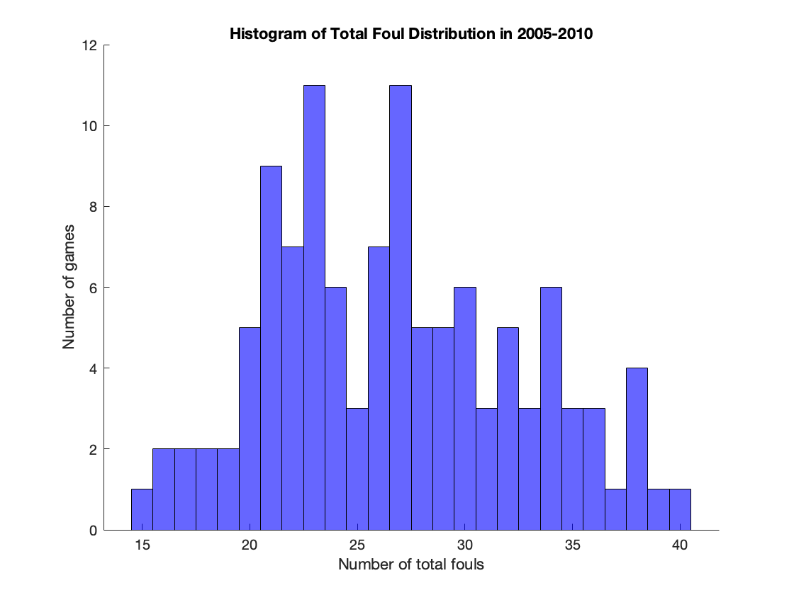
Analysis 1a - Indicators

Slide 7
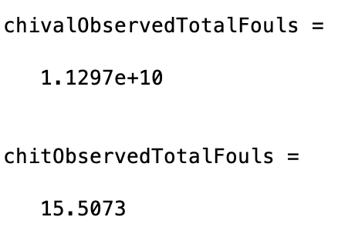
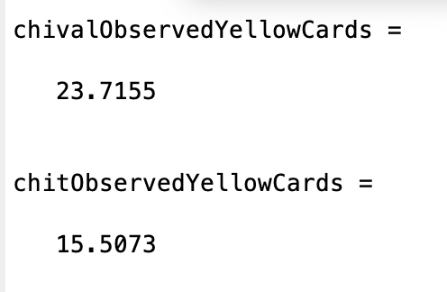
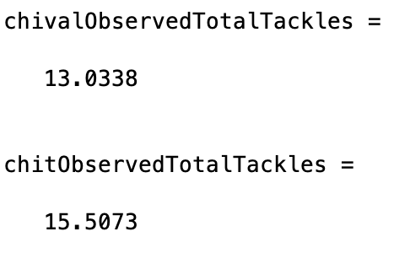
Analysis 1b – chi squared test
FAILED
FAILED
PASSED!

Slide 8
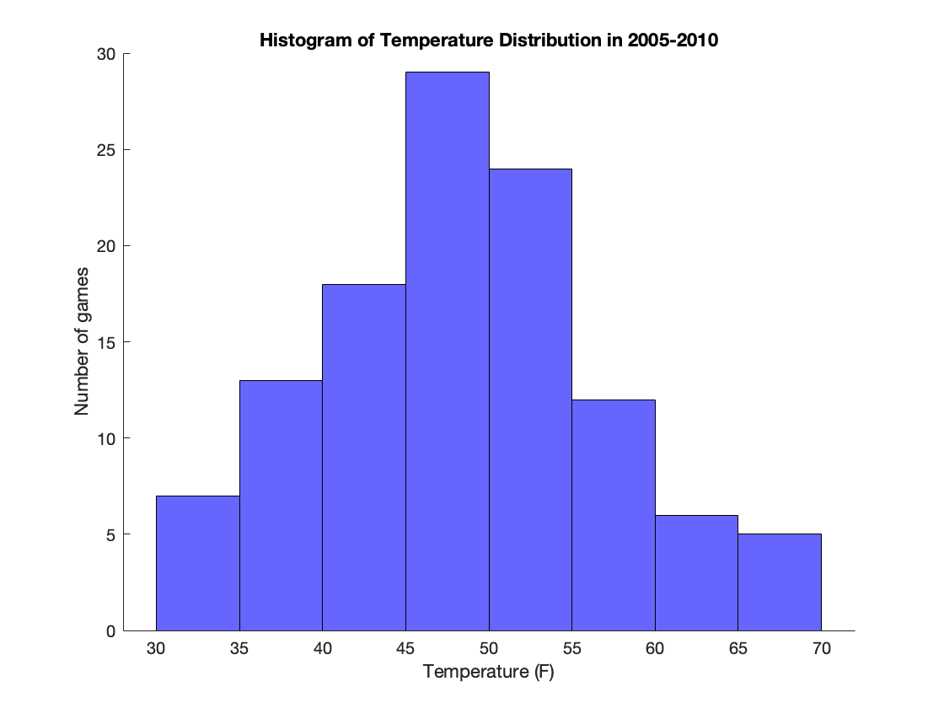
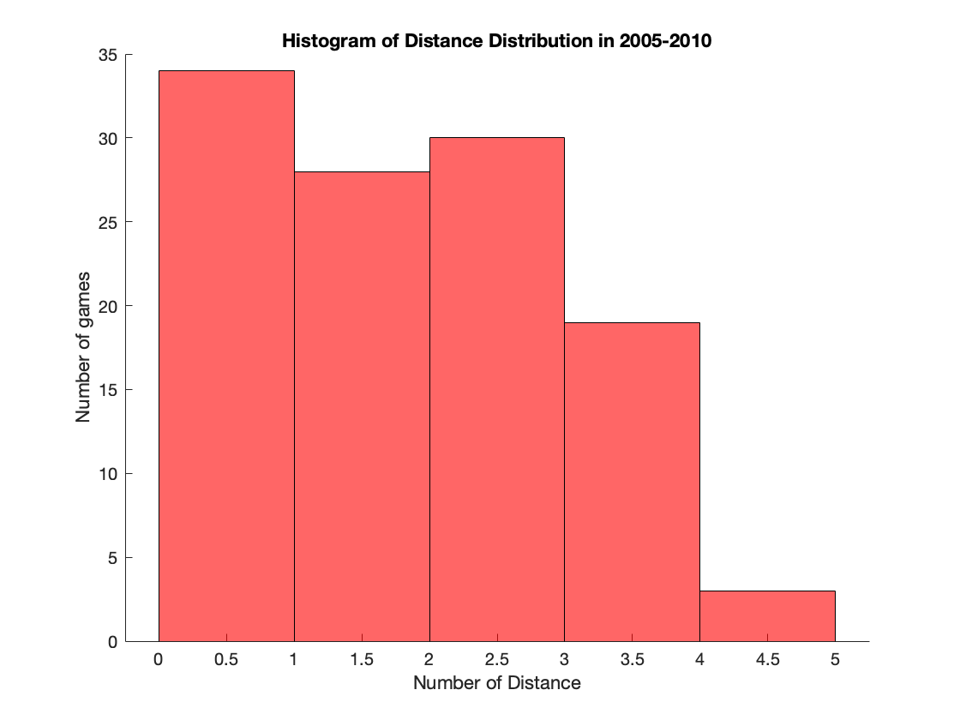
Analysis 2a - Factors

Slide 9
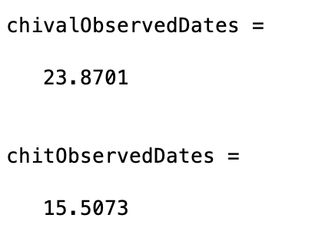
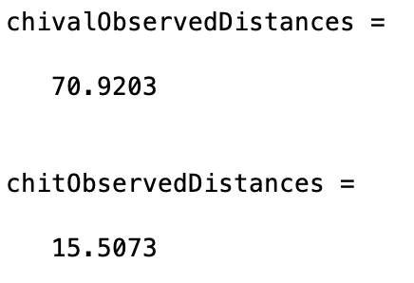
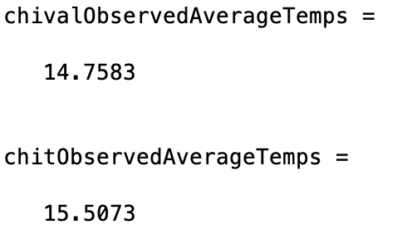
Analysis 2b – chi-Squared Test
FAILED
FAILED
PASSED!

Slide 10
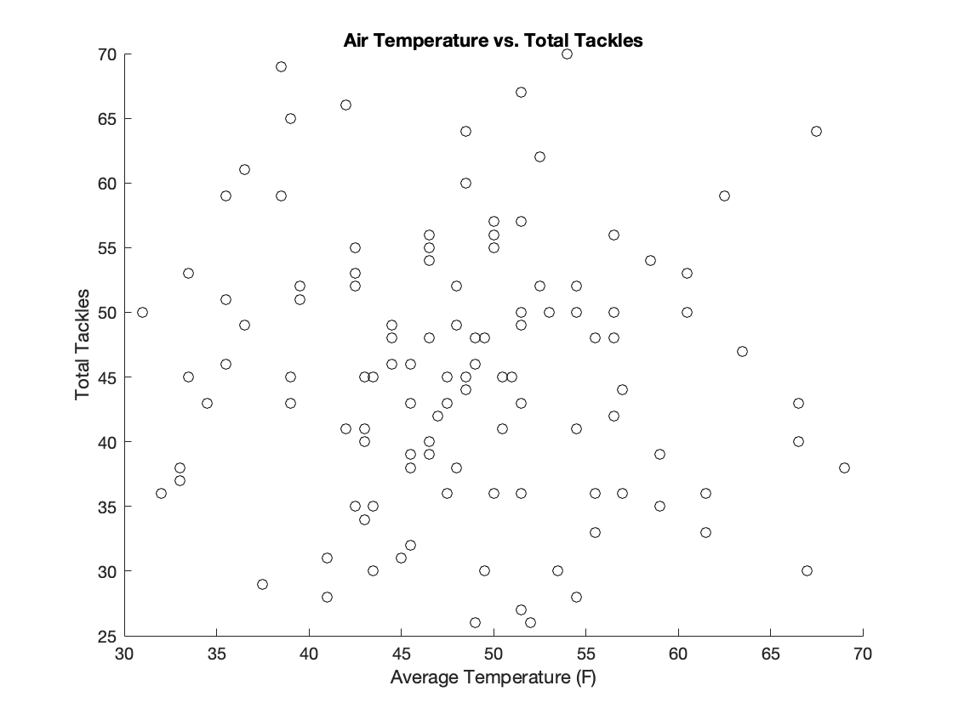
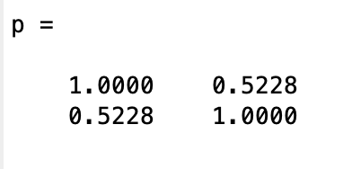
Analysis 3: Example of Failed Correlations

Slide 11
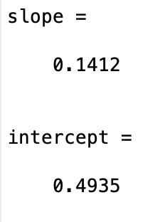
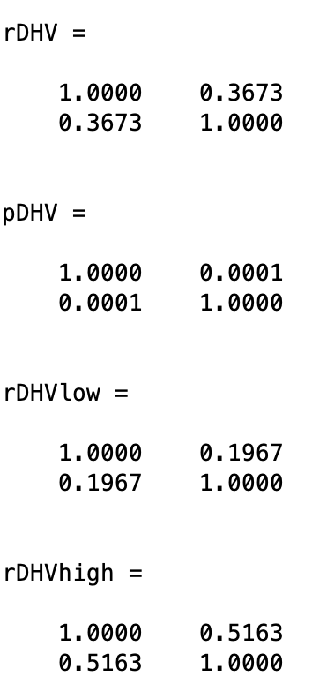
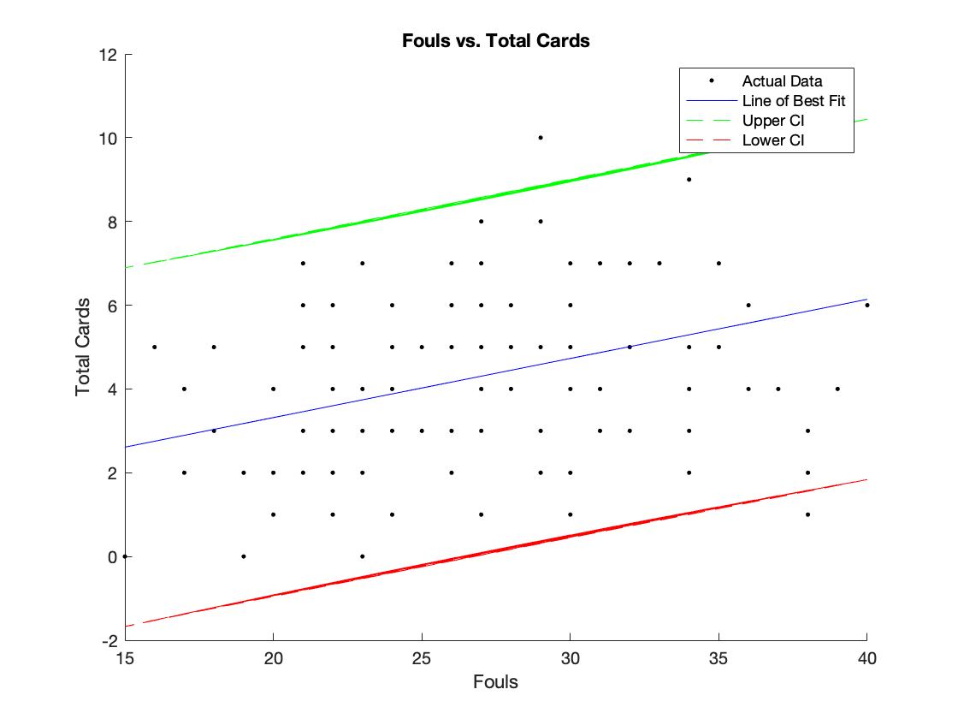
Analysis 4: Fouls & Cards

Slide 12
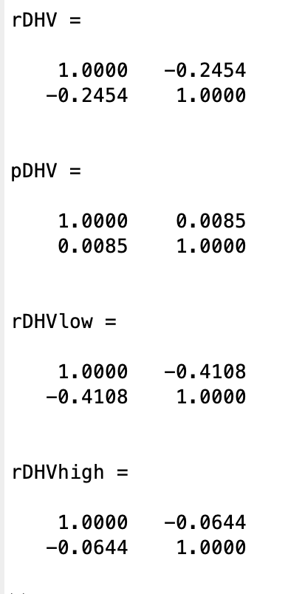
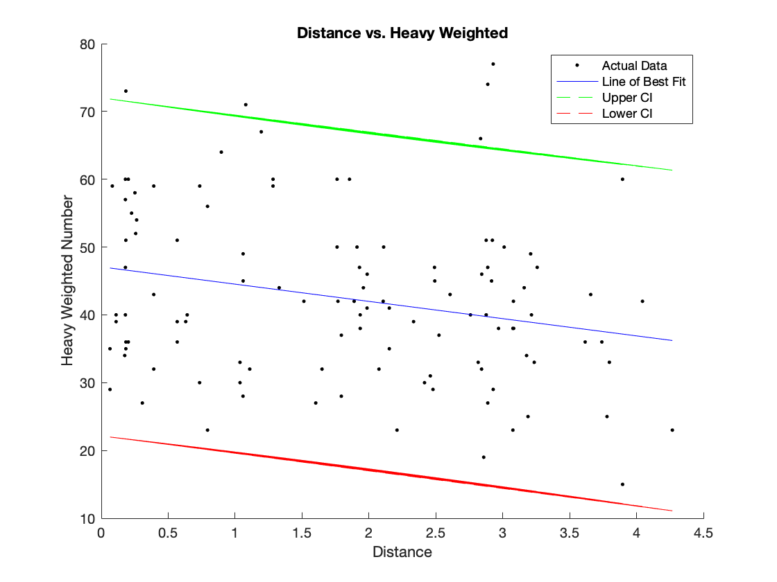
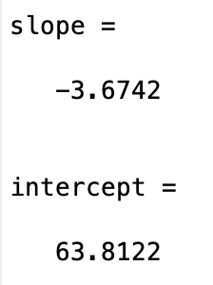
Indicator # 1: Distance vs. ‘Heavy Weighting/Equivalent Fouls
“Heavy Weighting”:
HV = [(Total Cards / 0.1412) + 0.4935] + [Total Fouls – Total Cards]

Slide 13
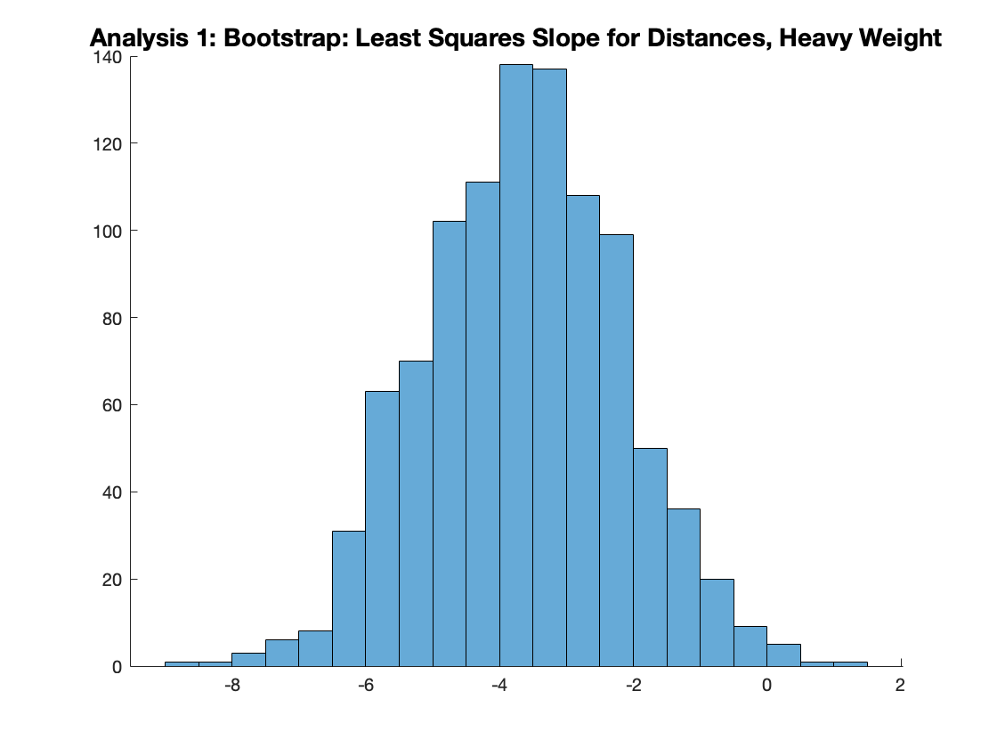
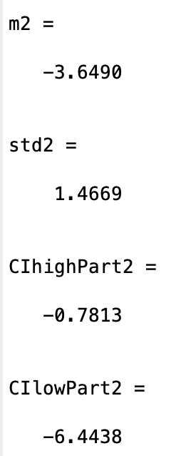
Bootstrapping Indicator #1

Slide 14
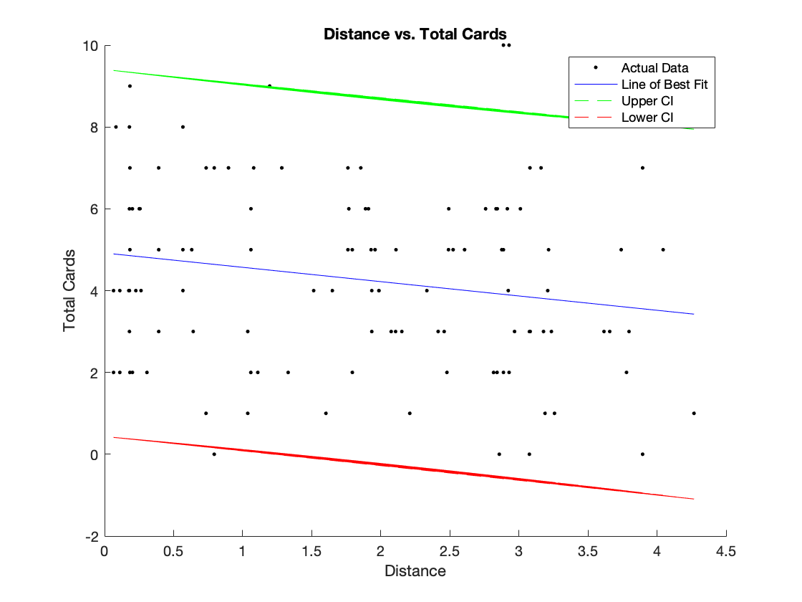
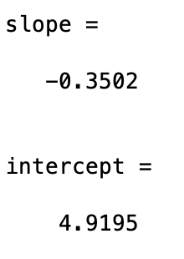
Indicator #2: Distance Vs Total CArds

Slide 15
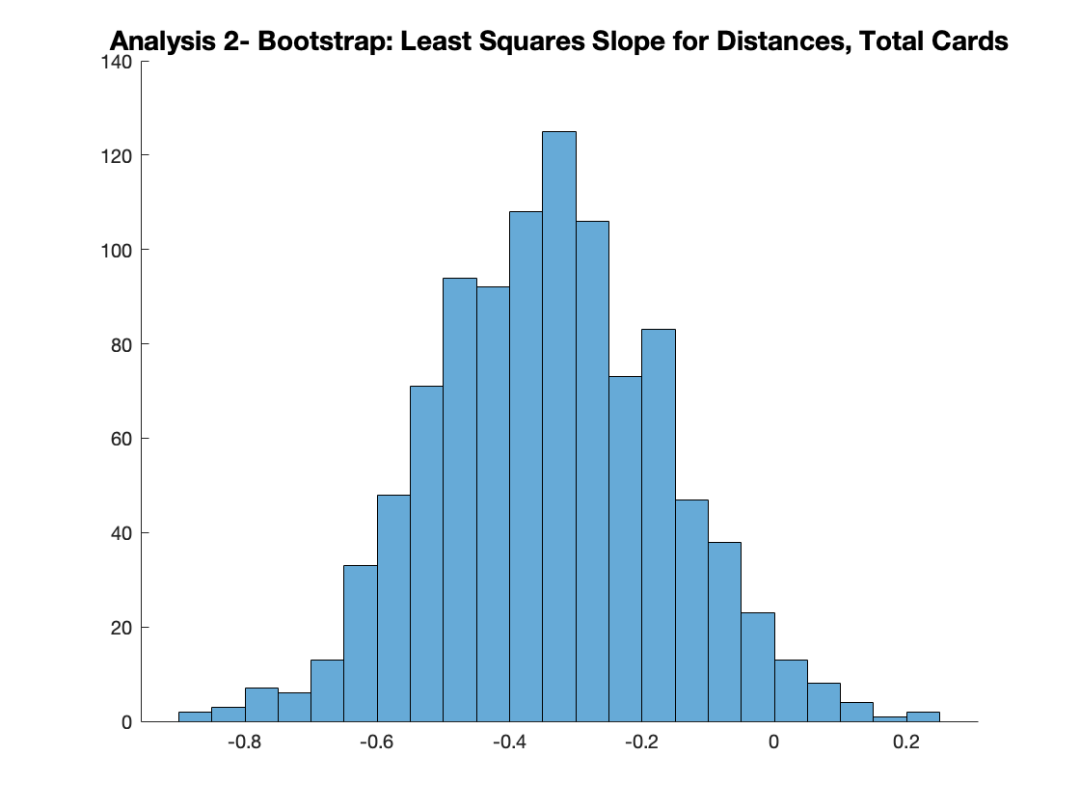
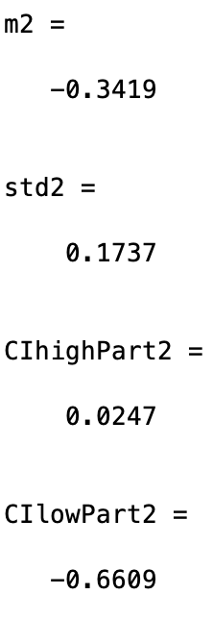
Bootstrapping Indicator #2

Slide 16
Conclusion
Despite the professionalism and focus that players that professional soccer players must uphold during matches, the environment of derbies and rivalries ”amps up” or increases the intensity and aggression of the game
Indirectly: Despite score line differences, weather conditions, and point in the season, players and referees have done a considerable job in staying constant in behavior/calls.

Slide 17
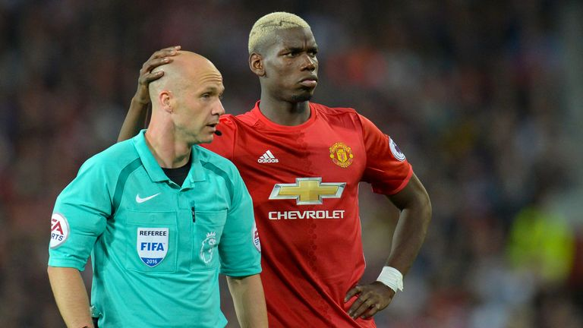
Thank YOU For Watching!
Questions?

Slide 18
Sources
https://www.businessinsider.com/english-football-referees-rule-2016-7
https://www.youtube.com/watch?v=eQpsqG-RhM4&ab_channel=MNXHD
https://www.youtube.com/watch?v=0wGjTXS75QI&ab_channel=SportagalAgency
https://howtheyplay.com/team-sports/Top-10-Most-Famous-Football-Soccer-Derbies-in-the-World
Matlab

