Slide 1
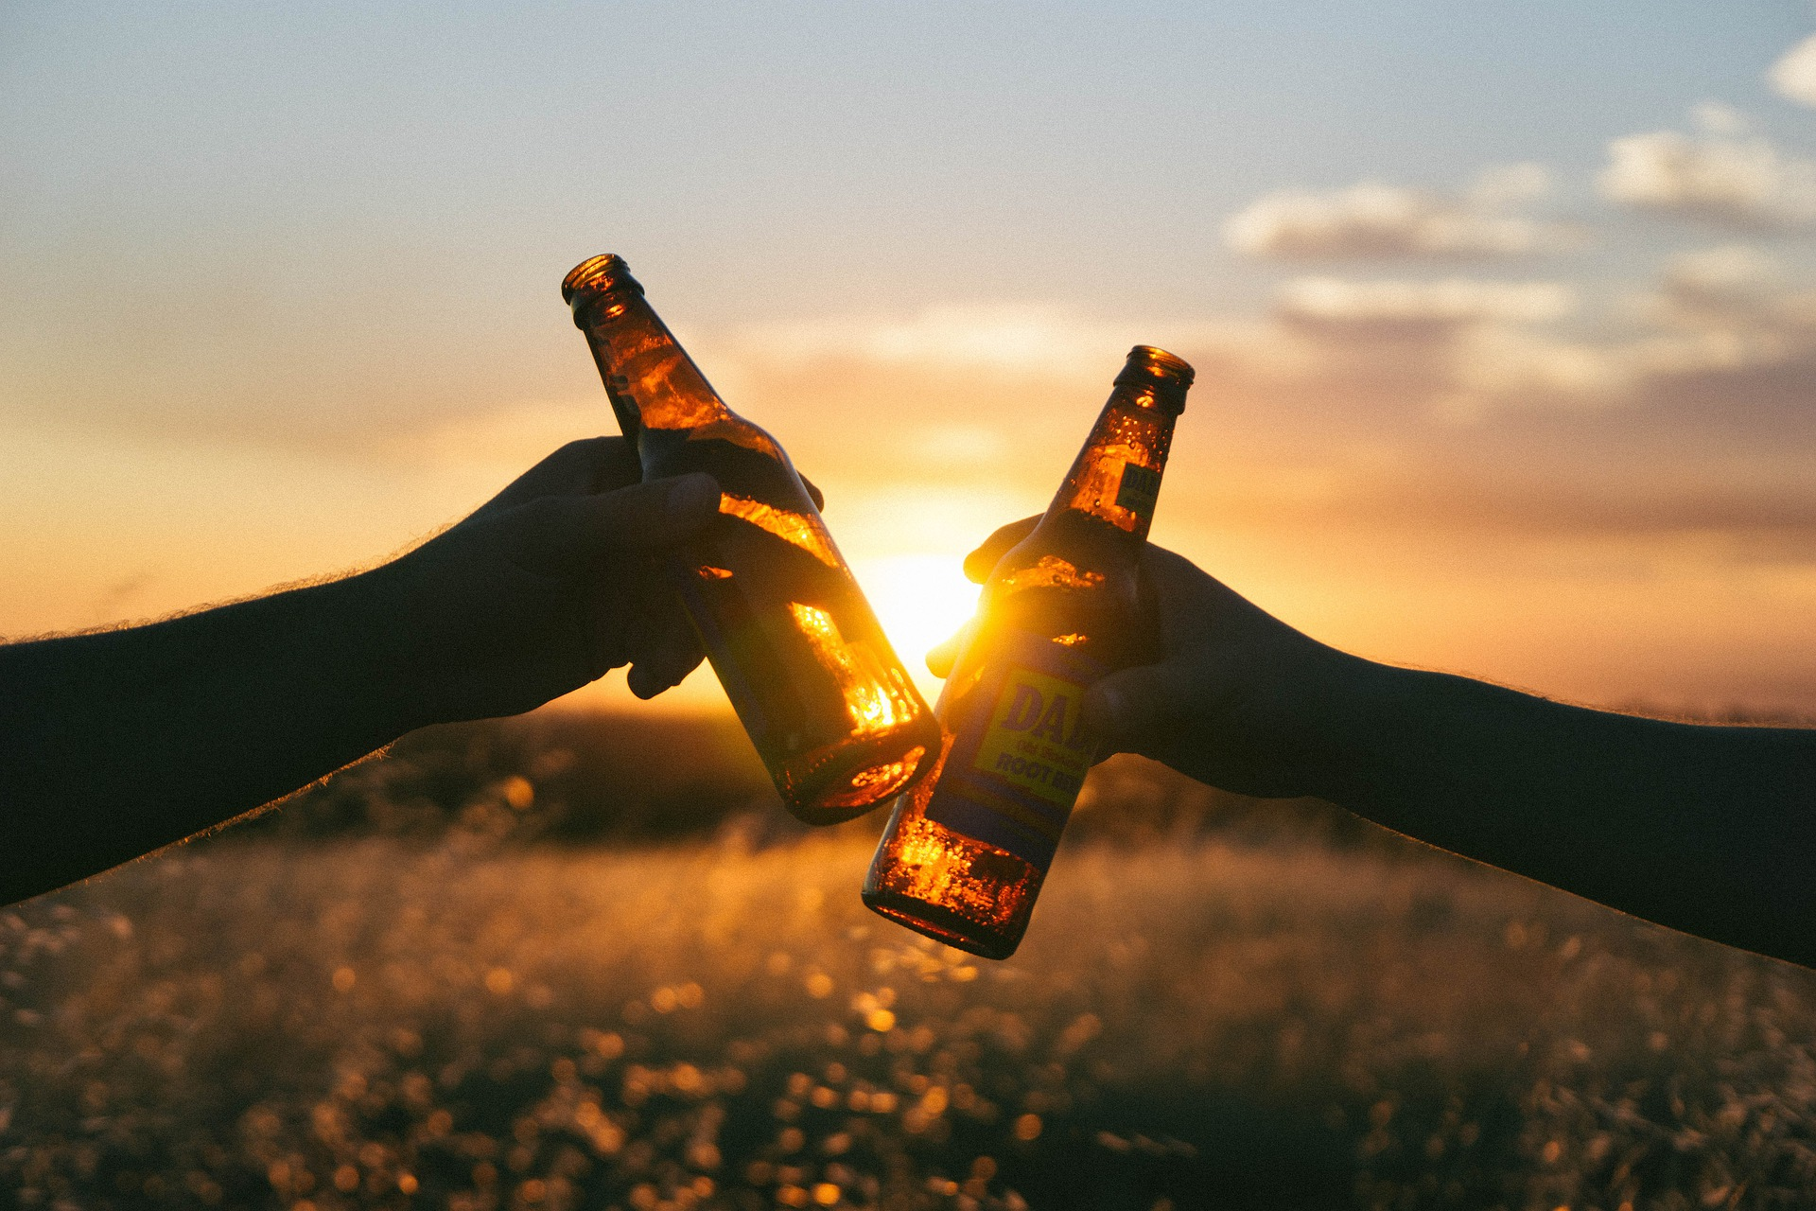
A Study of Happiness and Alcohol Consumption Globally
Project author : Anna Redanz

Slide 2

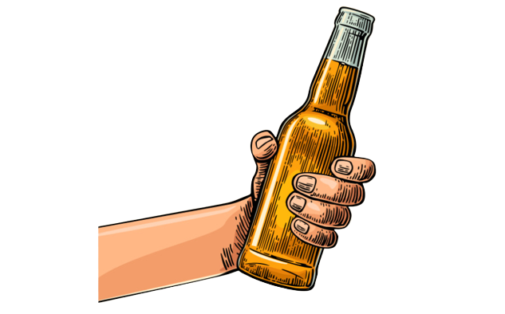
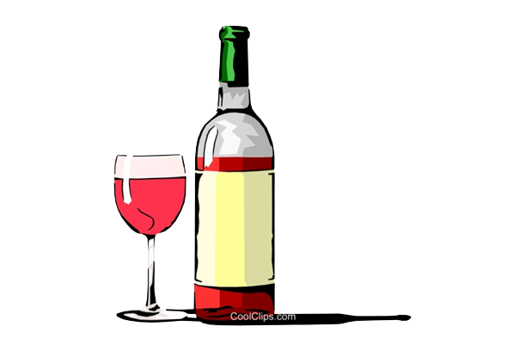
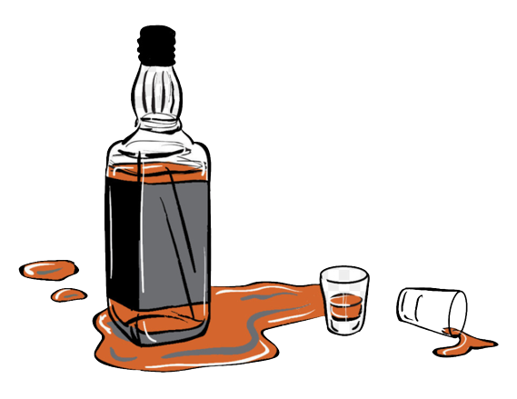
The Focus of my Study: Happiness and Types of Alcohol
Beer Wine Spirits
I will be analysing the per capita consumption of these 3 types of alcohol in 122 countries across the globe and then comparing them to the respective happiness score of each country in order to determine if there is a correlation between consumption and happiness.

Slide 3
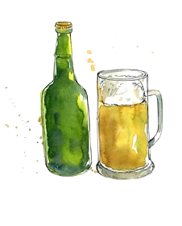
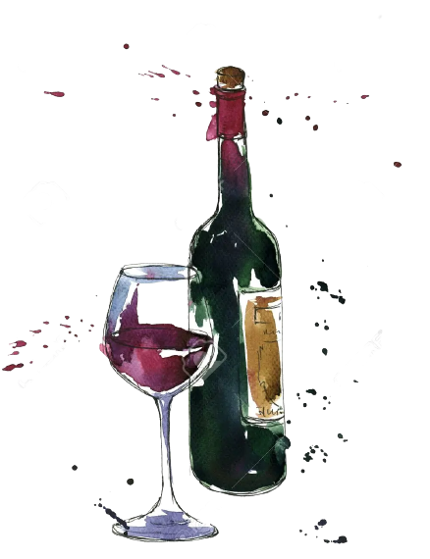
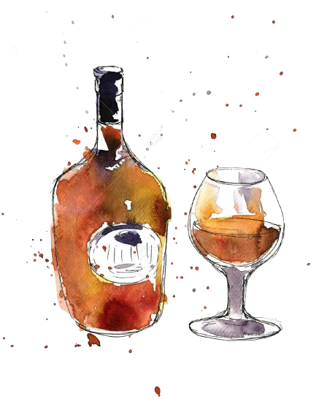
Hypotheses!
Overall hypothesis
→ On a scale of total alcohol consumption I believed that in general, happiness would decrease as alcohol consumption increased.
Beer hypothesis:
→ Given the culture surrounding beer consumption i hypothesised that beer would have a positive correlation with happiness.
Wine Hypothesis
→I did not define a definite wine hypothesis
Spirits Hypothesis:
→Due to its potent alcohol content I hypothesised that hard liquor would have a negative correlation with general happiness

Slide 4
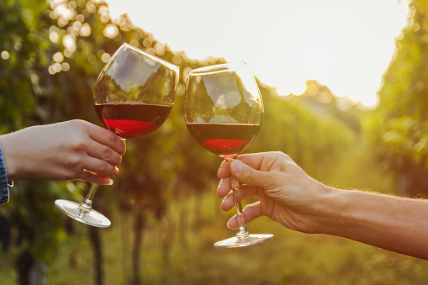
Methods
→ I decided to do a linear regression for my analysis using corrcoef to find my r and p values
→ for any p values less than .05 i conducted a bootstrap analysis in order to determine if the correlation was significant and not based on outliers

Slide 5
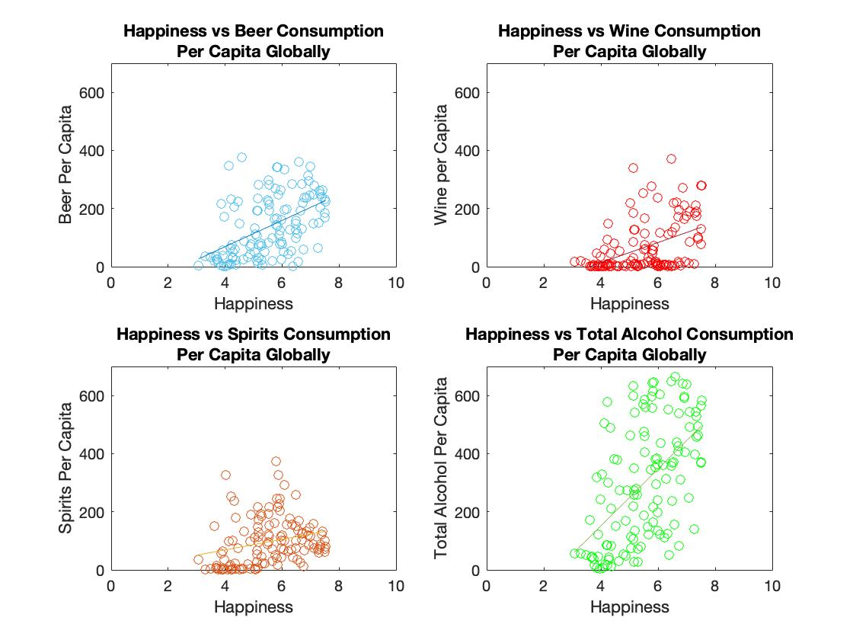
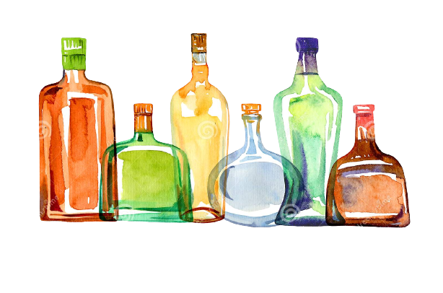
Global Consumption
Vs
Global Happiness
→ It's important to note that each data point is the average happiness value for a specific country plotted against the corresponding alcohol consumption per capita.
→ Every graph had a p value of 0 except spirits which was .0044

Slide 6
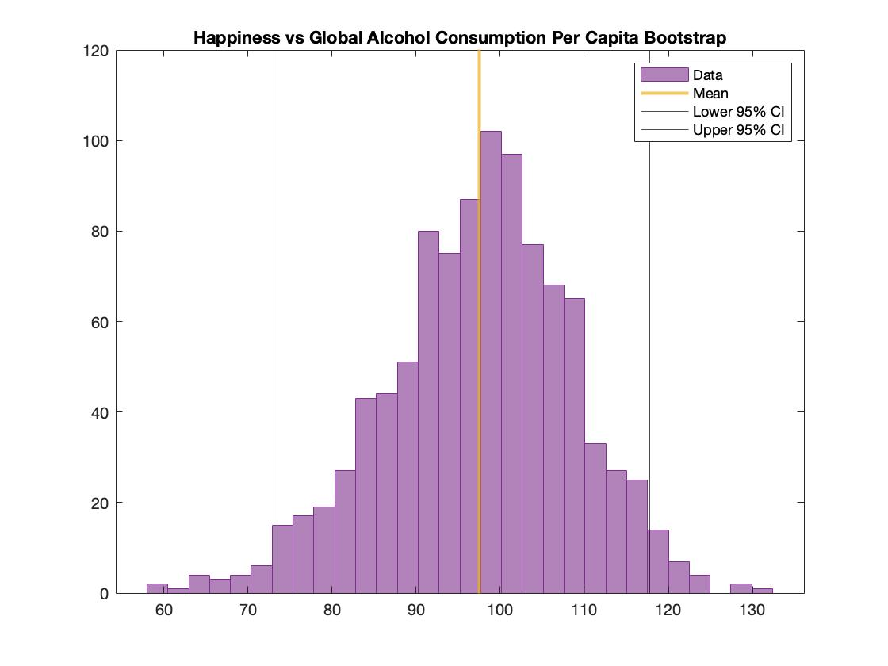
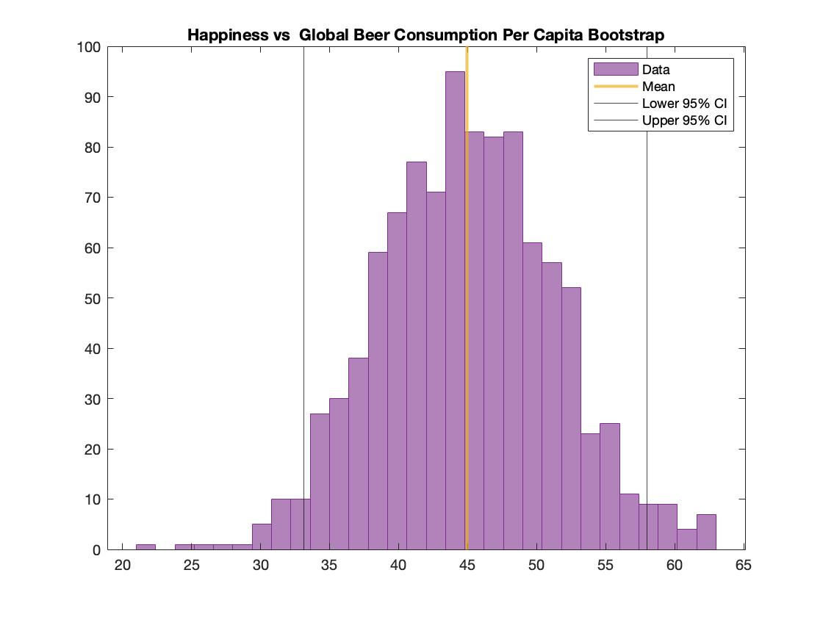

Bootstrap Method Analysis
→ these are the bootstrap graphs for the beer and total alcohol from the last slide

Slide 7
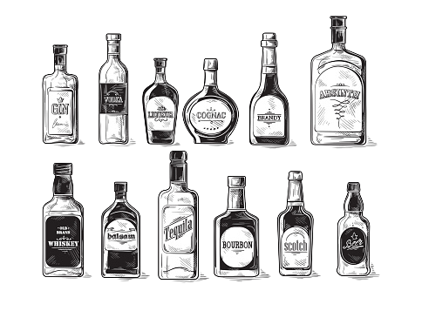
Results!!
→I concluded that for the majority of my graphs (which is 169) only 14 had significant p values less than .05 and of those 14 only a few had normally distributed bootstrap results

Slide 8
Thanks for listening!
Any questions?

