Slide 1
Analysis of Bird Populations
August Harrell
-
EAS 4480
-
Spring 2022

Slide 2
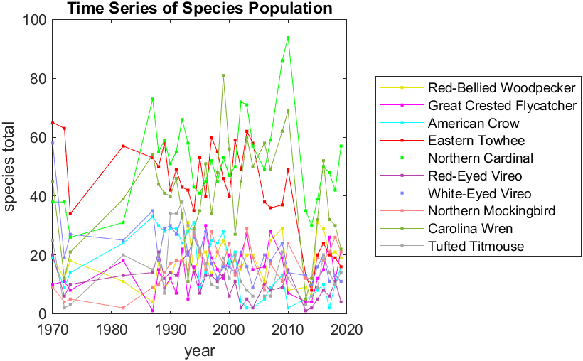
Data Description
Source:
North American Breeding Bird Survey (BBS), USGS
Location: Near Brunswick, GA (Route 1)
Timeframe: 1970-2019
June, Peak breeding season
Missing Data before 1987
Notes:
Chose species with highest number of data points (33)

Slide 3
Analysis
Overall Goal: Characterize patterns in bird population across multiple species
Least Squares Regression with 95% confidence interval
Detrend Data
Chi-Squared Test for Normality
Periodograms
Inter-species Correlation

Slide 4
Least Squares Regression
Goal: Analyze trend of population data.
Questions: Which populations are growing and which are declining? How much error is there in the LSR?
Results:

Slide 5
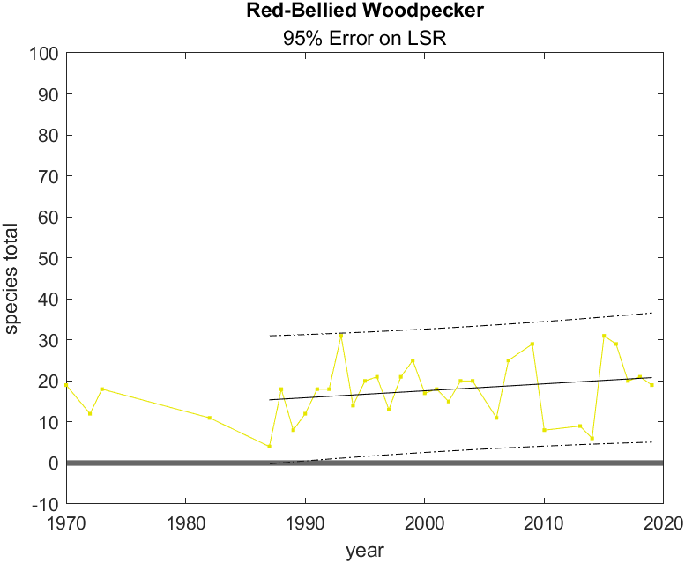
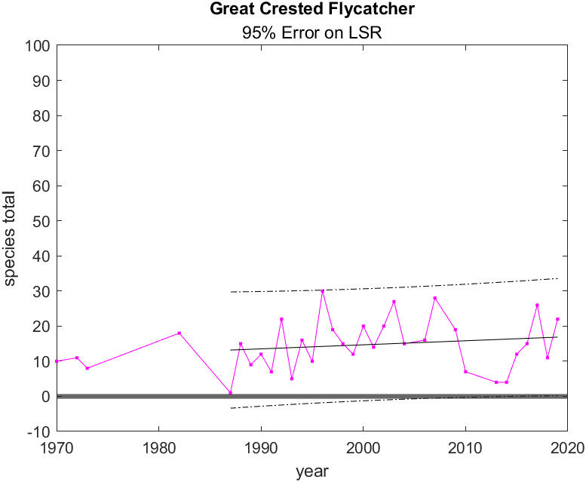
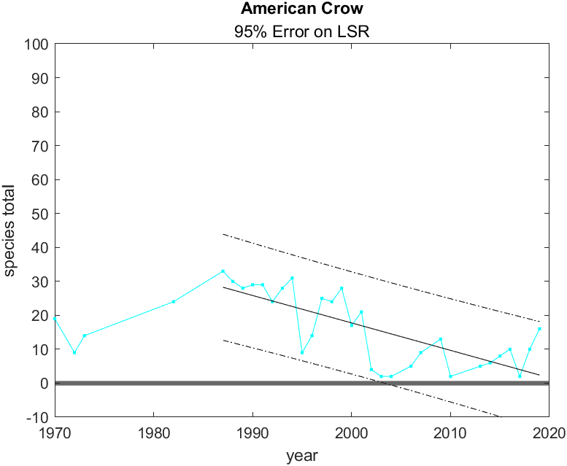
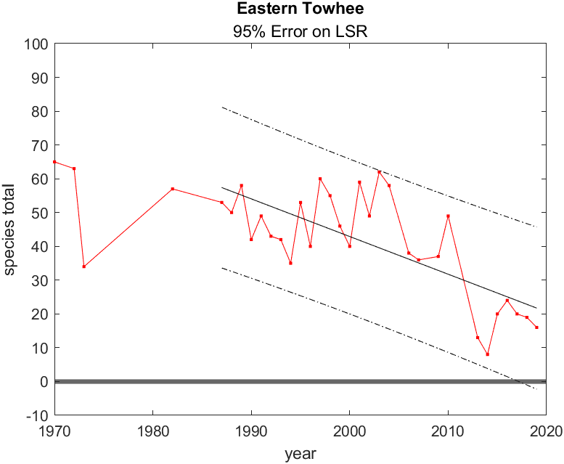
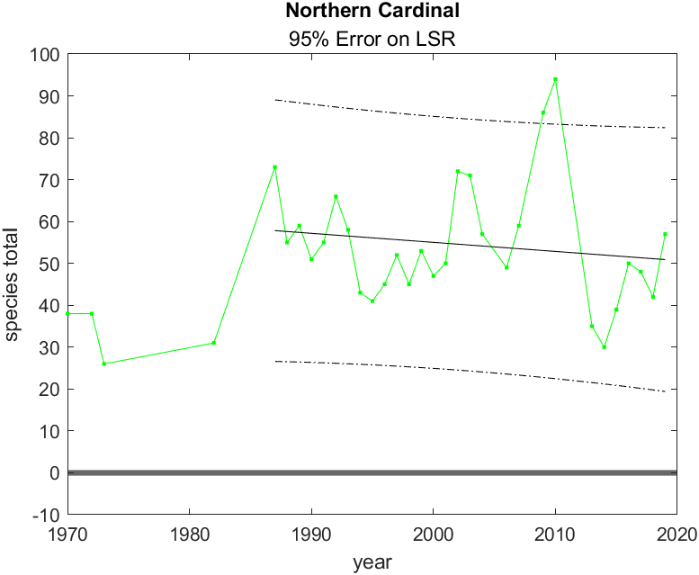
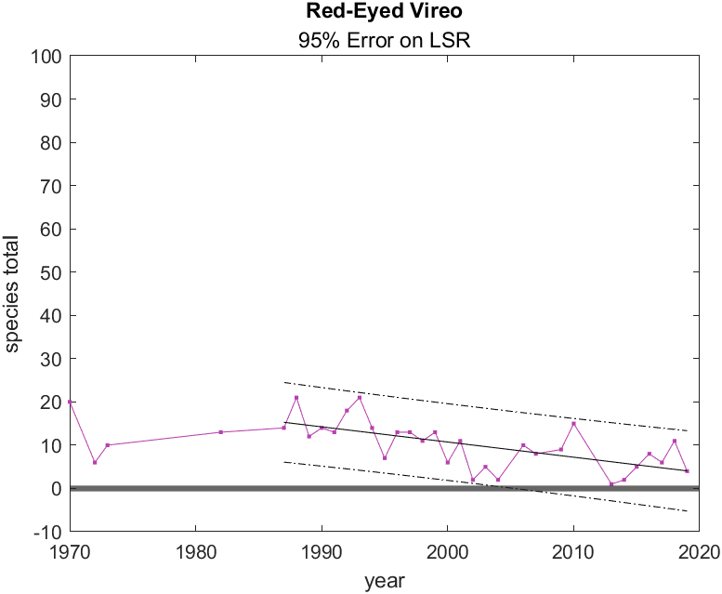

Slide 6
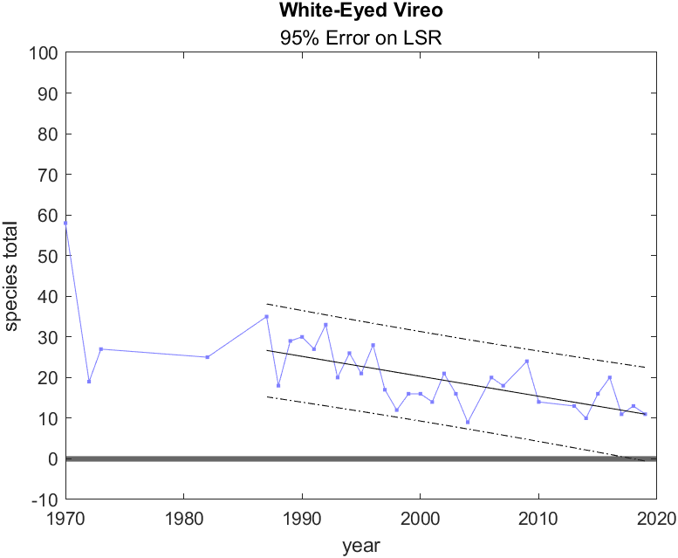
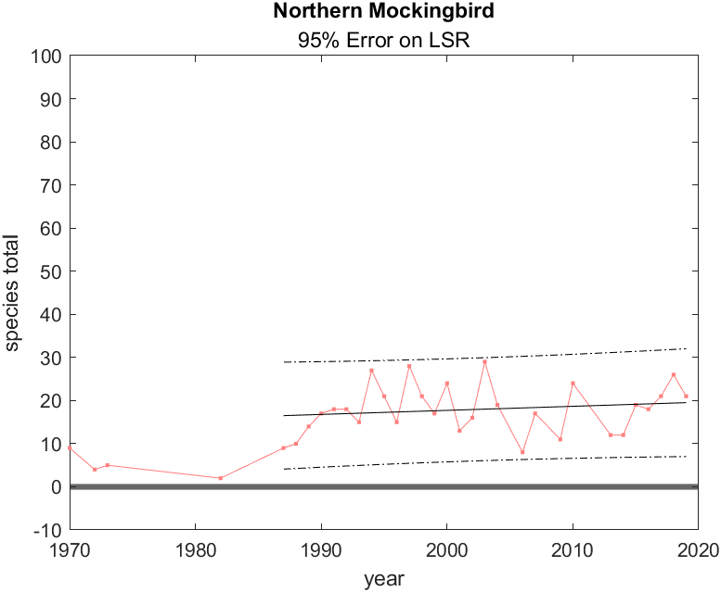
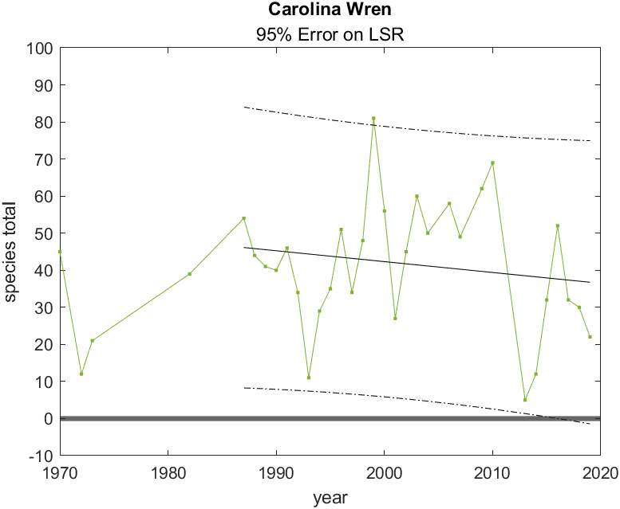
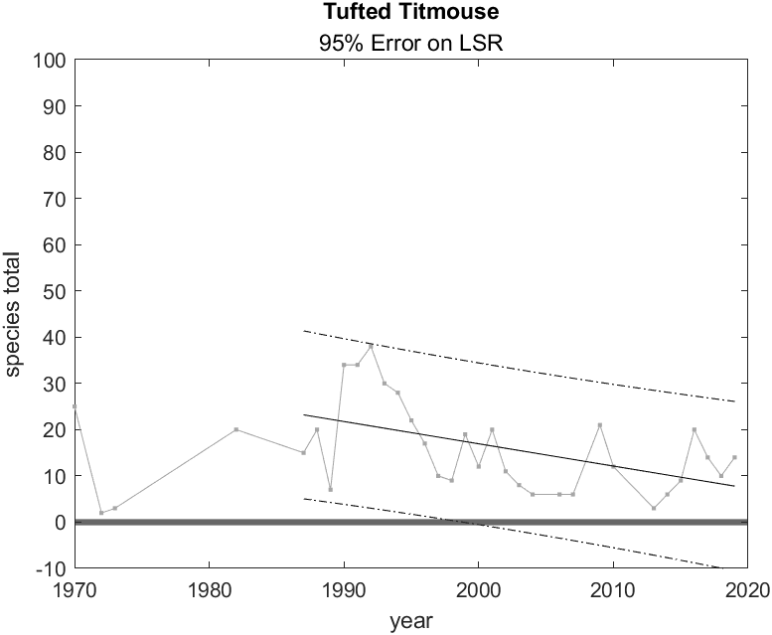
There will be more figures…

Slide 7
Pearson’s Chi-Squared Test
Goal: Determine which populations follow Normal Distribution when Detrended
Questions: Is it a reliable assumption to assume normality? What further statistical tests can we do?
Null hypothesis: Data is not significantly different from normal distribution
If de_chi2<chi2: Null hypothesis is not rejected, data is normally distributed, 0
If de_chi2>chi2: Null hypothesis is rejected, data is not normally distributed, 1

Slide 8
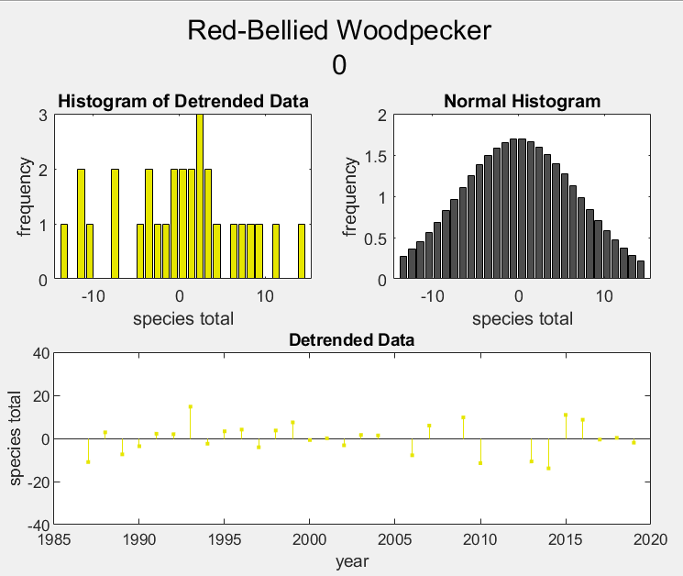
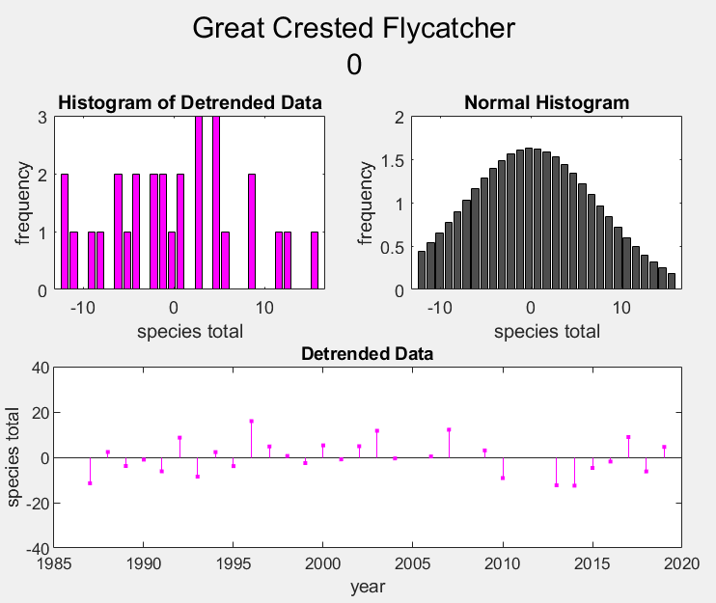
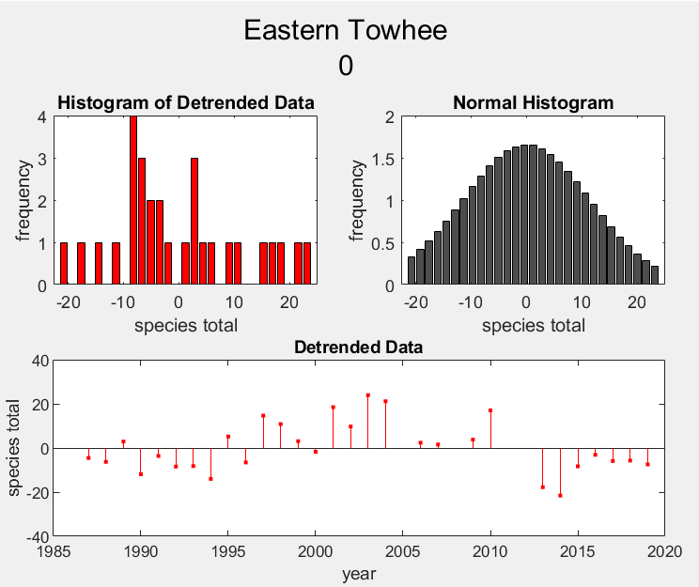
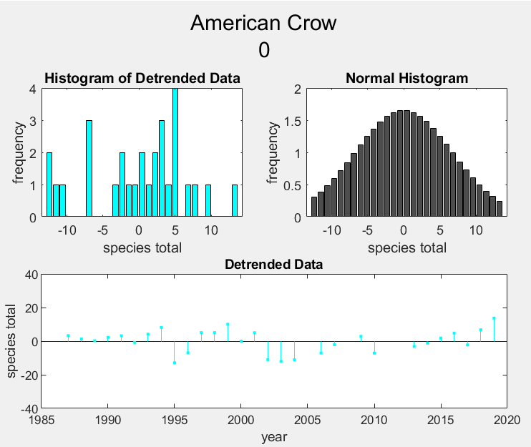
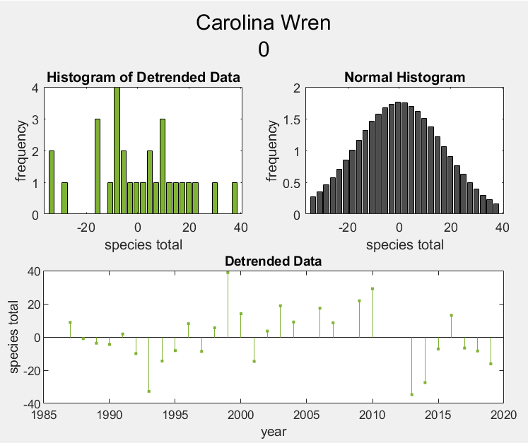
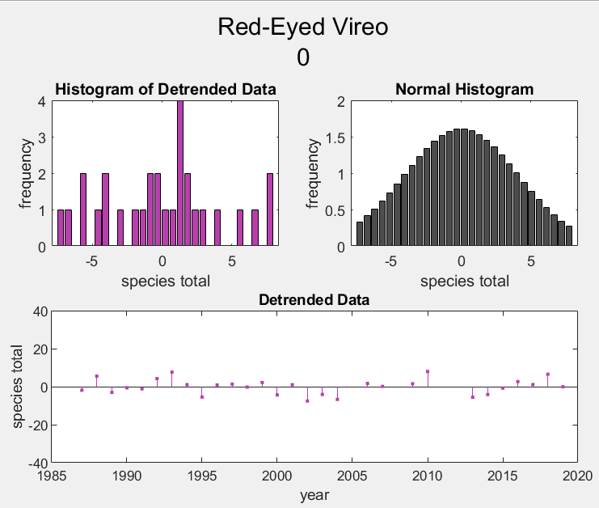

Slide 9
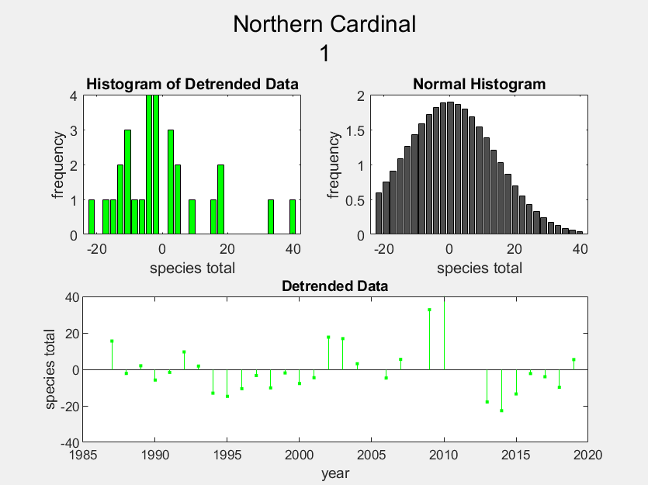
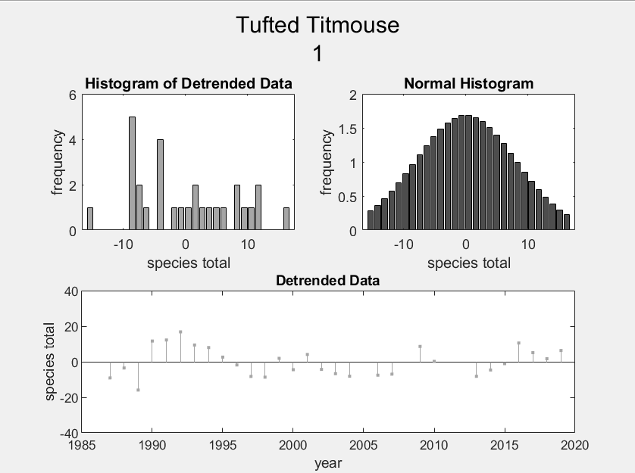
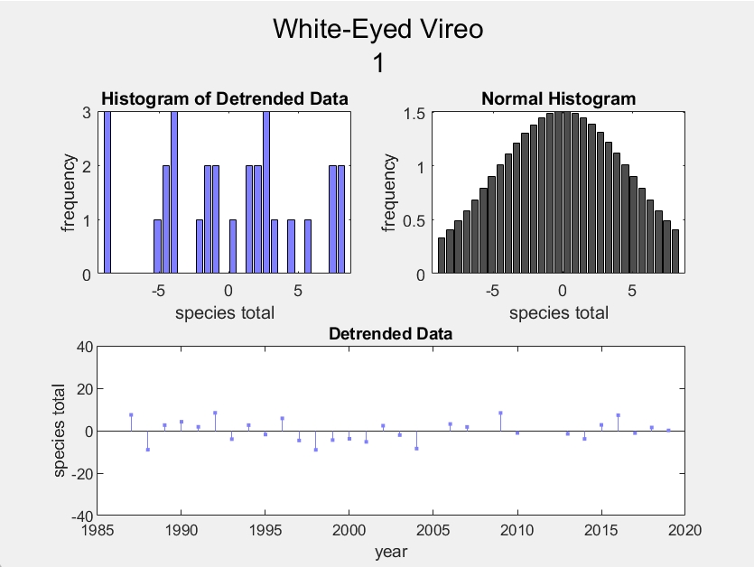
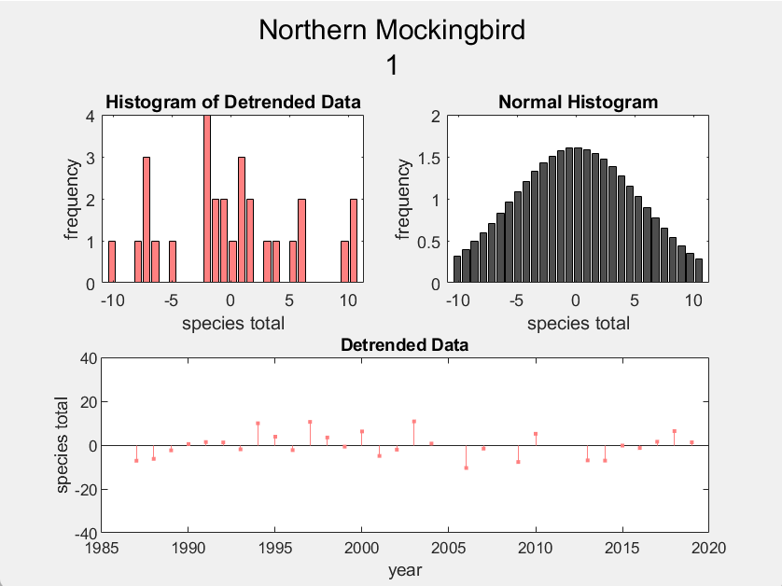
Still not done with the figures…

Slide 10
Periodograms
Goal: Find periodicities in the data’s “noise” to help explain variation from LSR
Questions: Are the variations from the least squares regression predictable? What factors could be affected population? Do the different species vary on the same time scales?
Results:

Slide 11
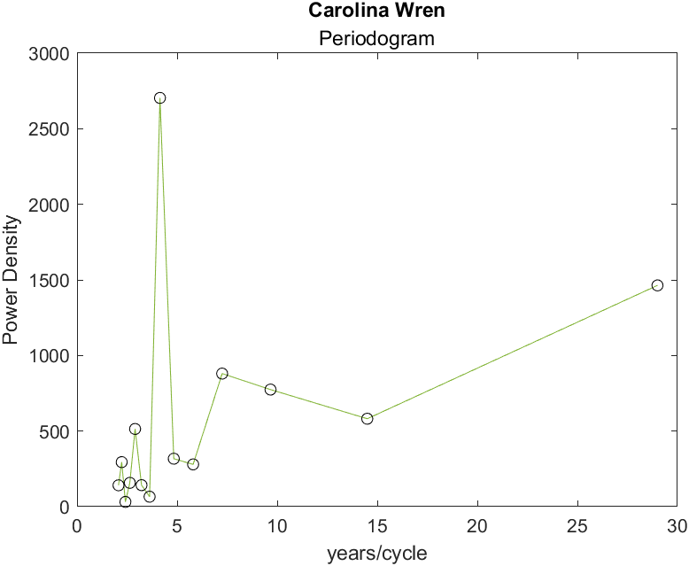
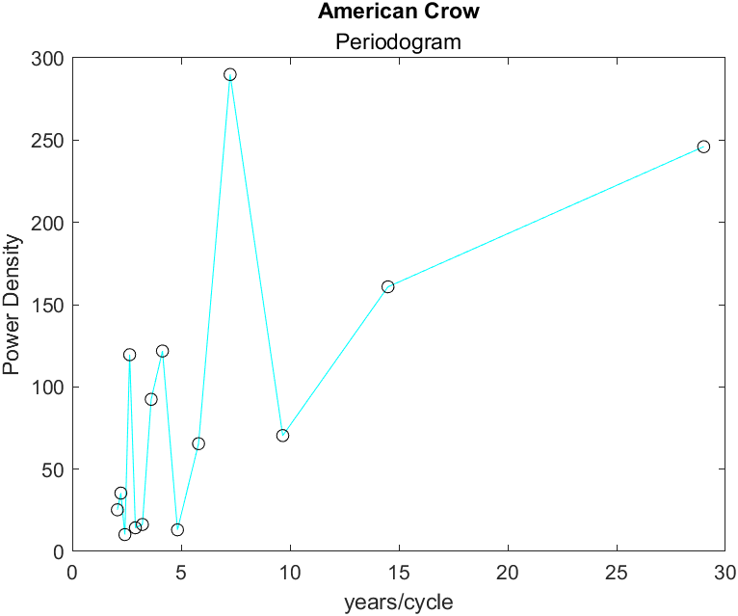
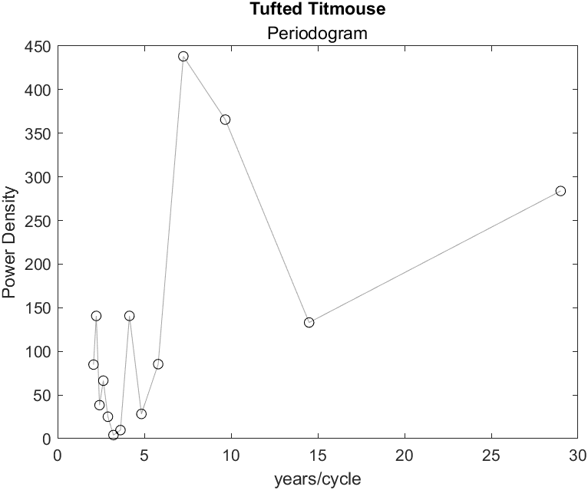
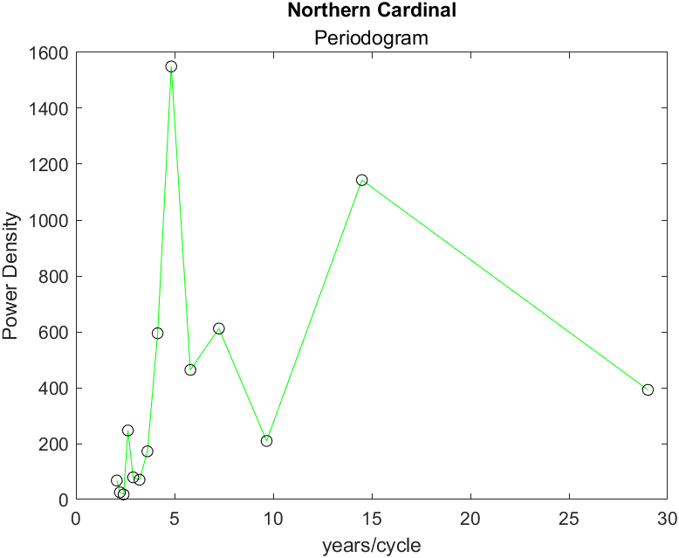
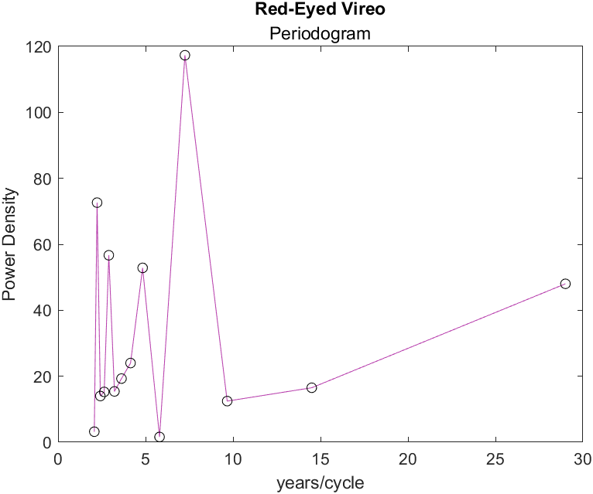
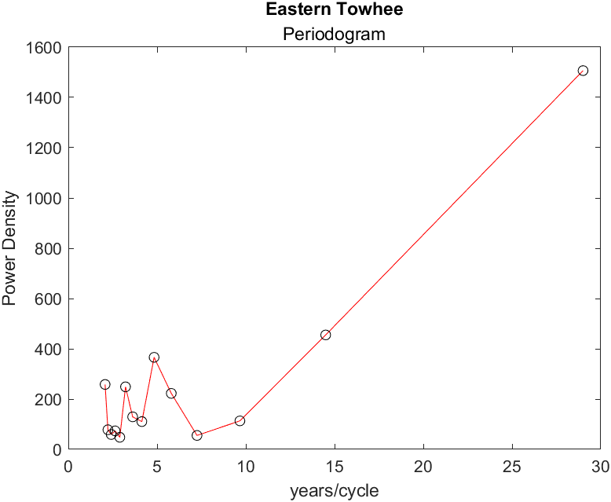

Slide 12
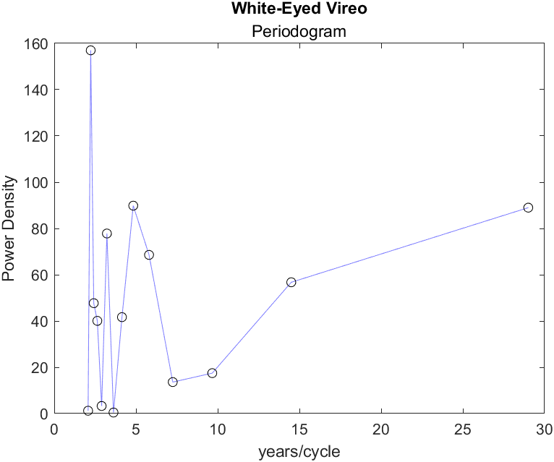
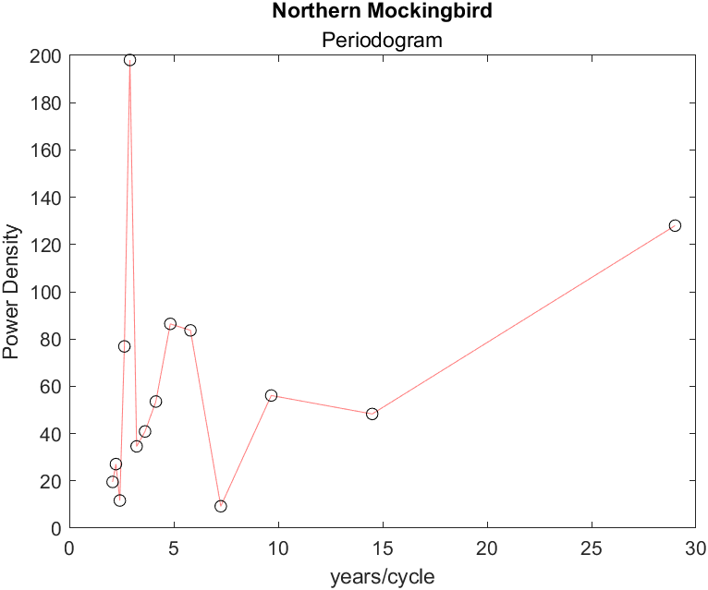
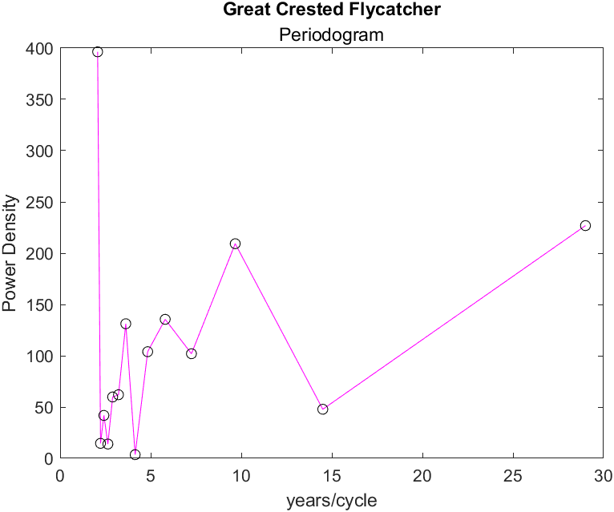
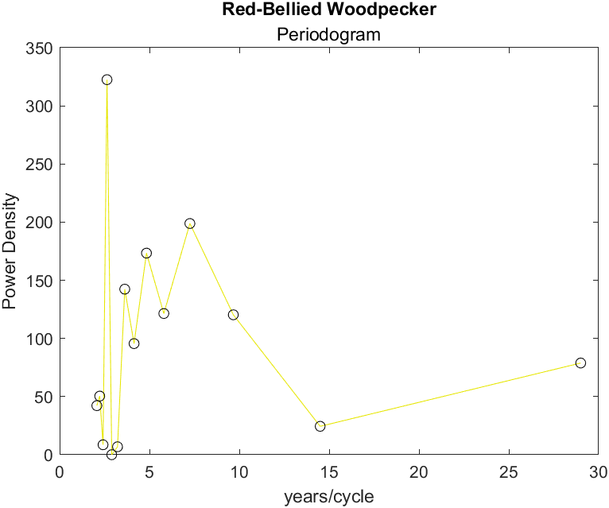
I hear you saying “August, that’s too many figures” but you’re wrong

Slide 13
Inter-Species Correlation
Goal: Determine if there is significant Correlation between Different Species
Questions: Does a change in population of one bird affect other birds? Are multiple species experiencing population change at the same time? Which species have related population variations?
Results: correlation coefficient, 95% CI low bound, 95% CI high bound, significance (<0.05)

Slide 14
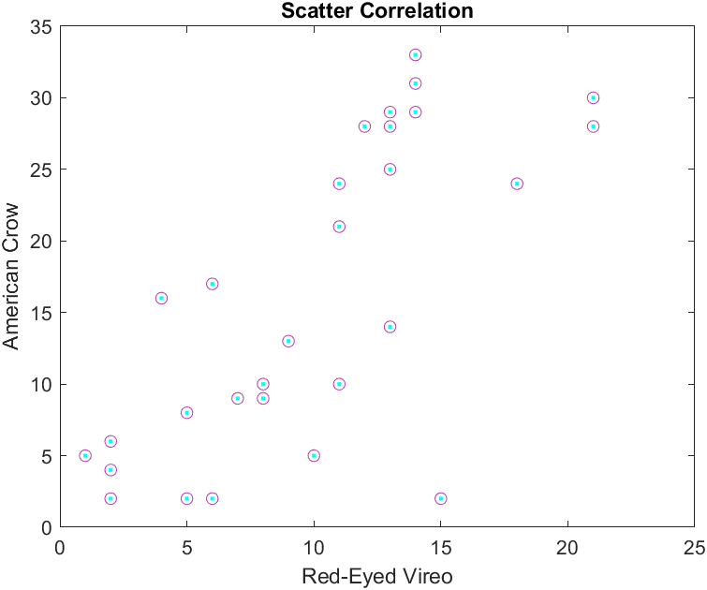
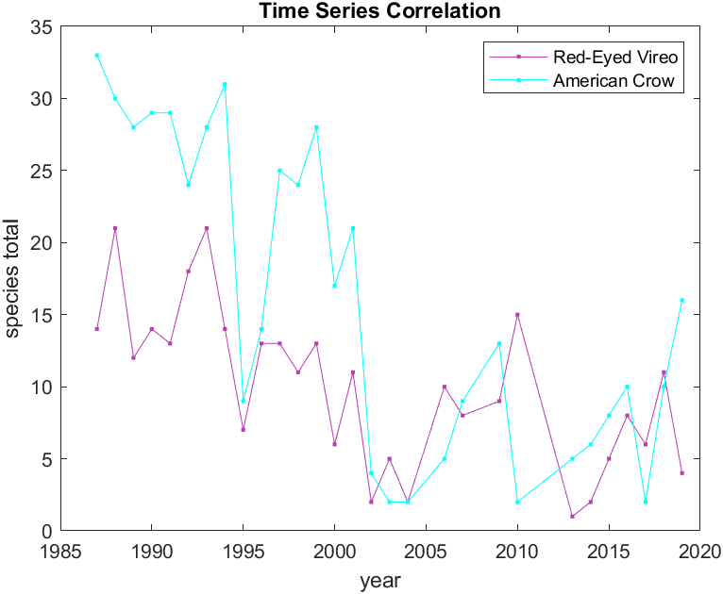

Slide 15
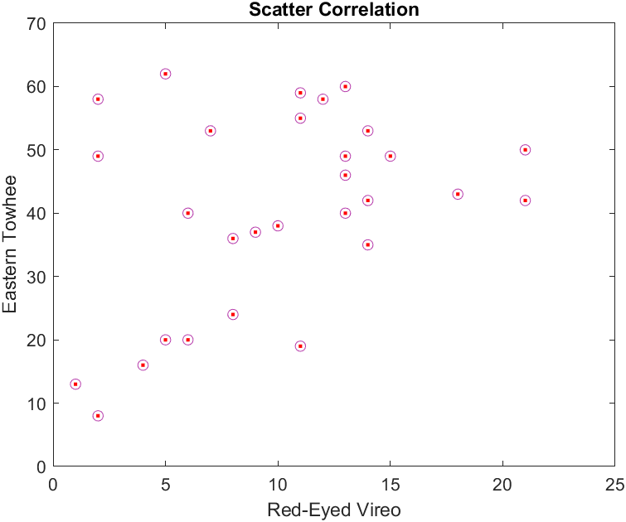
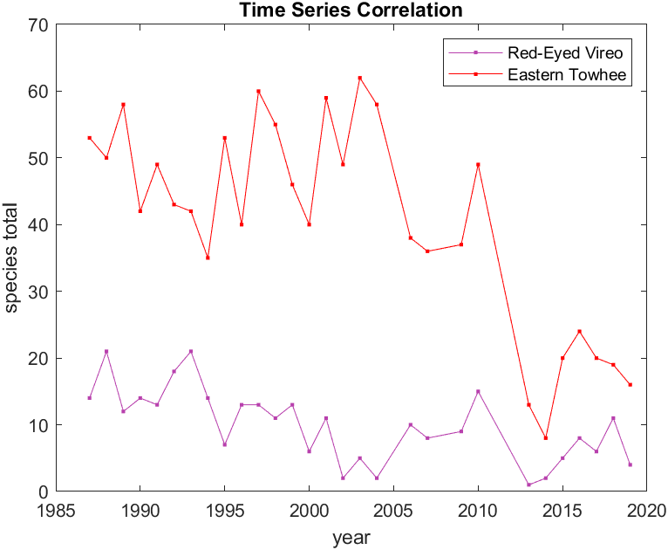

Slide 16
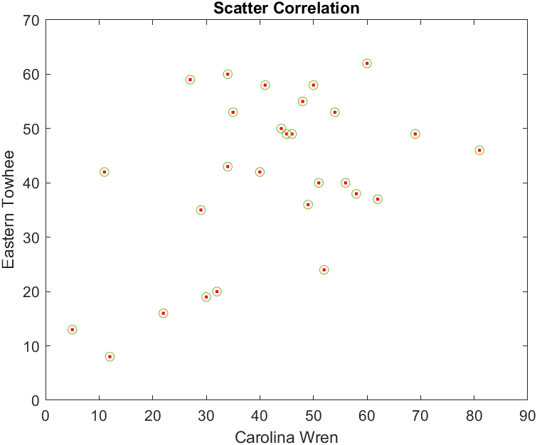
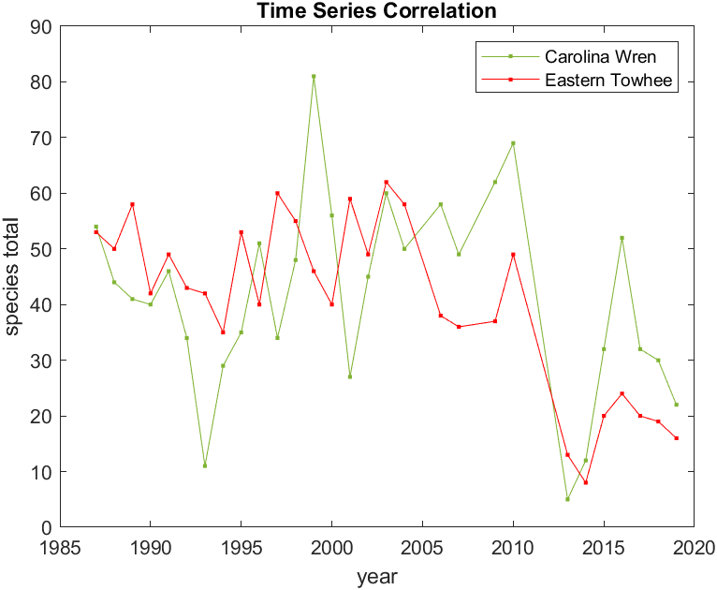
Ok maybe too many figures…

Slide 17
Conclusions
Species do not all follow the same: trend, distribution, or periodicity
Source of differences unclear
Overall need for more data (longer study)
In the future: focus on fewer birds and look at data from multiple locations

Slide 18
