Slide 1
DOES female Prevalence IN SCHOOLS CORRELATE TO FERTILITY RATES?
By Caroline Krall

Slide 2
Motivation
Observed: higher education → gender equality + empowering women → better decisions related to family
Hypothesis: as the rate of women enrolled in educational institutions increases, in a specific country, the fertility rates will decrease
Country Economic Classifications (according to the UN) – Developed, Developing, and Least Developed
Analysis of 3 countries in each economic classification – Spain (Developed), Mexico (Developing), and Nepal (Least Developed)
Developed + Developing: literacy, sex education, financial education,
Least Developed: self-discipline, impact of getting out of the home, routine, interaction with same-age non-relatives on a daily basis,
Notes:
It is observed that in general education encourages gender equality and tends to empower women with the knowledge to make informed decisions about family planning and their own right to mobility and autonomy
Therefore, two datasets will have a negative linear correlation.
Developed and developing countries have education systems increase women’s literacy rates, knowledge of the world around them, and access to sex education and knowledge of contraceptive options
Whereas in less developed countries the simple act of attending school proves to be most important for improving gender equality by women skills that empower then such as self-discipline, routine, and independence. It is also important for women to be able to get out of the home on a daily basis and interact with other same-age people that are not their relatives

Slide 3
Data and limitations
All 6 databases (2 for each country) taken from World Bank Database
Secondary Education Enrollment (% Female) and Fertility Rates (Birth per Woman) for all three countries
46 data points
Sampled yearly (from 1972 to 2018)
Missing Datapoints
Mexico “Secondary Education Enrollment % Female” missing 1 data point and Nepal “Secondary Education Enrollment % Female” missing 3 data points

Slide 4
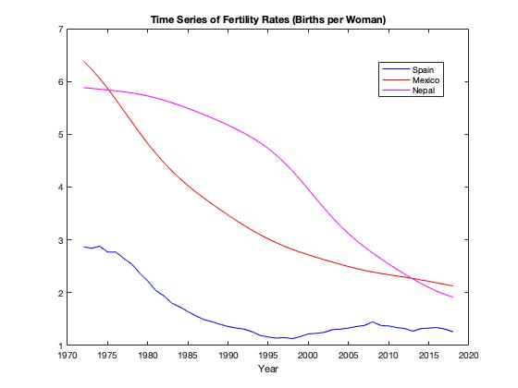
Time-Series
Notes:
- For each country, I performed a 1st, 2nd, and 3rd least squares regression to determine which was the best fit for the given data

Slide 5
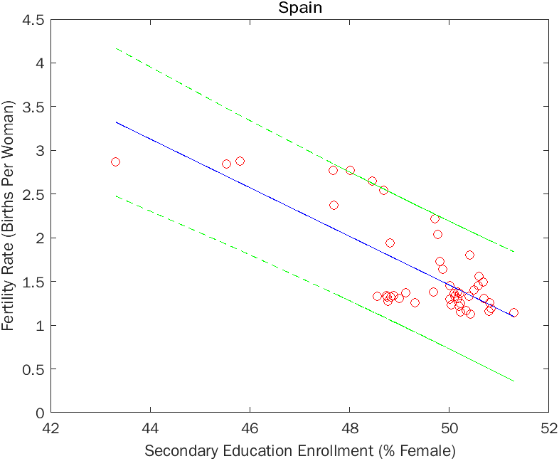
% FEMALE SECONDARY EDUCATION ENROLLMENT VS. FERTILITY RATE LS REGRESSION : SPAIN
LS Slope | -0.2784
95% Confidence Interval LS Slope | [-0.7591, 0.2023]
Correlation Coefficient (r) | -0.7627
95% Confidence Interval Corr. Coeff.(r) | [-.8612, -.6089]
Relatively strong Correlation
LS Slope not statistically significant
However, 2nd and 3rd do not fit well either→ further investigation should be done

Slide 6
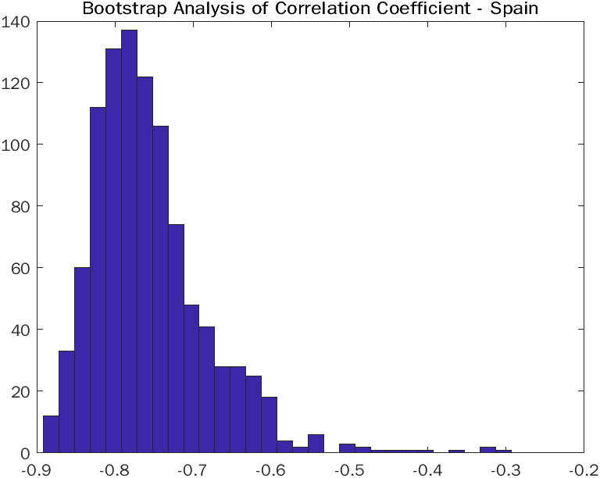
Spain- Bootstrap
Mean | STD | 95% CI
-.2822 | .0407 | [-0.3754, -0.2139]
Mean | STD | 95% CI
-.7580 | .0676 | [-0.8592, -0.6037]

Slide 7
Spain - Autocovariance
Residuals are randomly distributed and not correlated but show slight periodicity

Slide 8
% FEMALE SECONDARY EDUCATION ENROLLMENT VS. FERTILITY RATE LS REGRESSION : Mexico
LS Slope | -0.3331
95% Confidence Interval LS Slope | [-0.506, -0.1602]
Correlation Coefficient (r) | -0.9691
95% Confidence Interval Corr. Coeff.(r) | [-0.9829, -0.9445]
Strong Correlation
Statistically negative linear relationship

Slide 9
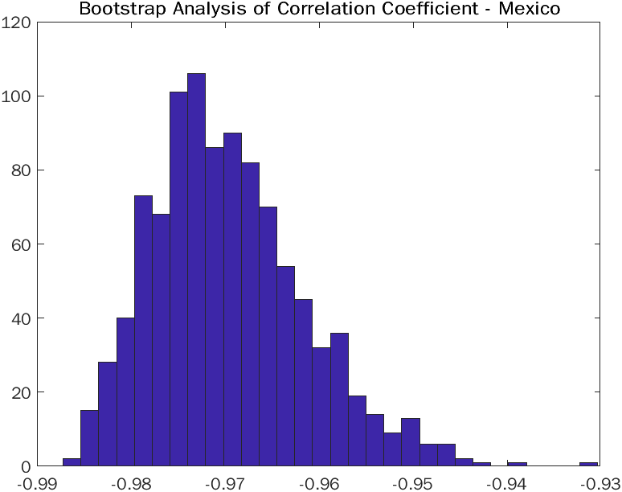
Mexico- Bootstrap
Mean | STD | 95% CI
-.3367 | .0207 | [-0.3841, -0.302]
Mean | STD | 95% CI
-.9703 | .0083 | [-0.9837, -0.9525]

Slide 10
Mexico - Autocovariance
Residuals are randomly distributed with slight periodicity observed

Slide 11
% FEMALE SECONDARY EDUCATION ENROLLMENT VS. FERTILITY RATE LS REGRESSION : Nepal
LS Slope | -0.1081
95% Confidence Interval LS Slope | [-0.1625, -0.0537]
Correlation Coefficient (r) | -0.971
95% Confidence Interval Corr. Coeff.(r) | [-0.9842, -0.9471]
Strong Correlation
Statistically negative linear relationship

Slide 12
Nepal – Autocovariance for linear LS regression
Periodicity shown → Residuals might not randomly distributed
Chi-Square test to determine if residuals are normally distributed
Chi-Square Value = 5.6384
Threshold Value = 7.8147
5.6384 < 7.8147 so residuals are normally distributed

Slide 13
2nd order linear Regression fit + Autocovariance
Correlation Coefficient (r) | -0.971
95% Confidence Interval Corr. Coeff.(r) | [-0.9842, -0.9471]
Strong Correlation
Y = .0758x^2 + 5.3046x - .0027
Could be because Nepal has been rapidly developing in more recent years

Slide 14
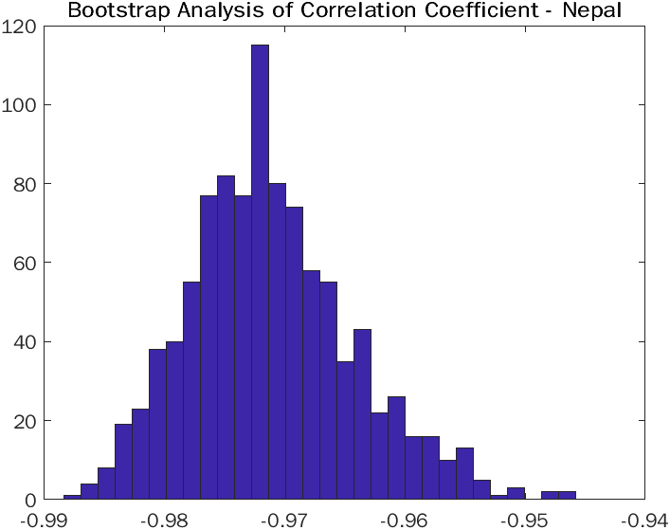
Nepal- Bootstrap
Mean | STD | 95% CI
-.9713 | .0066 | [-0.9828, -0.9562]
Correlation coefficient is strongly significant

Slide 15
Nepal- Autocovariance
Some periodicity shown → Residuals might not randomly distributed
Chi-Square test to determine if residuals are normally distributed
Chi-Square Value = 3.6167
Threshold Value = 7.8147
3.6167 < 7.8147 so residuals are normally distributed

Slide 16
Correlation coefficient (r) over time (20-year period)
Sampling r at 20 increment intervals over entire time period
Spain LS regression might have a lower correlation coefficient because it is an already developed country so once women present in half of the school population we shouldn’t see much variation → plateaus
As Mexico becomes better economically developed we start to see a similar trend in the r value of the data
Dip in correlation coefficient from 1986-2006 Spain
Instability in the country (deadliest terror attack in Europe in the 2000s) that could have caused fertility rates to temporarily increase, interrupting the downward trend

Slide 17
Conclusion
Overall, it appears that increases in female secondary education enrollment tend to lead to decreases in fertility rates for all stages of economic development
Strong linear negative correlations for Spain and Mexico and strong 2nd polynomial fit for Nepal
All residuals found to be normally distributed, but show slight periodicity
Magnitude of Correlation Coefficients: Nepal > Mexico > Spain
Many other factors may play into decreases in fertility rate that were unable to be captured in this analysis, therefore, further research should be done to account for other variables

Slide 18
Questions?

Slide 19
References
Basu, A. M. (2002, September 4). Why does education lead to lower fertility? A critical review of some of the possibilities. World Development. Retrieved April 17, 2022, from https://www.sciencedirect.com/science/article/pii/S0305750X02000724
Country Classification - United Nations. UN. (2014). Retrieved April 17, 2022, from https://www.un.org/en/development/desa/policy/wesp/wesp_current/2014wesp_country_classification.pdf
Fertility rate, total (births per woman). World Bank (n.d.). Retrieved April 17, 2022, from https://data.worldbank.org/indicator/SP.DYN.TFRT.IN
Secondary Education, pupils (% female). World Bank (n.d.). Retrieved April 17, 2022, from https://data.worldbank.org/indicator/SE.SEC.ENRL.FE.ZS
UN list of least developed countries. UNCTAD. (n.d.). Retrieved April 17, 2022, from https://unctad.org/topic/least- developed-countries/list

