Slide 1
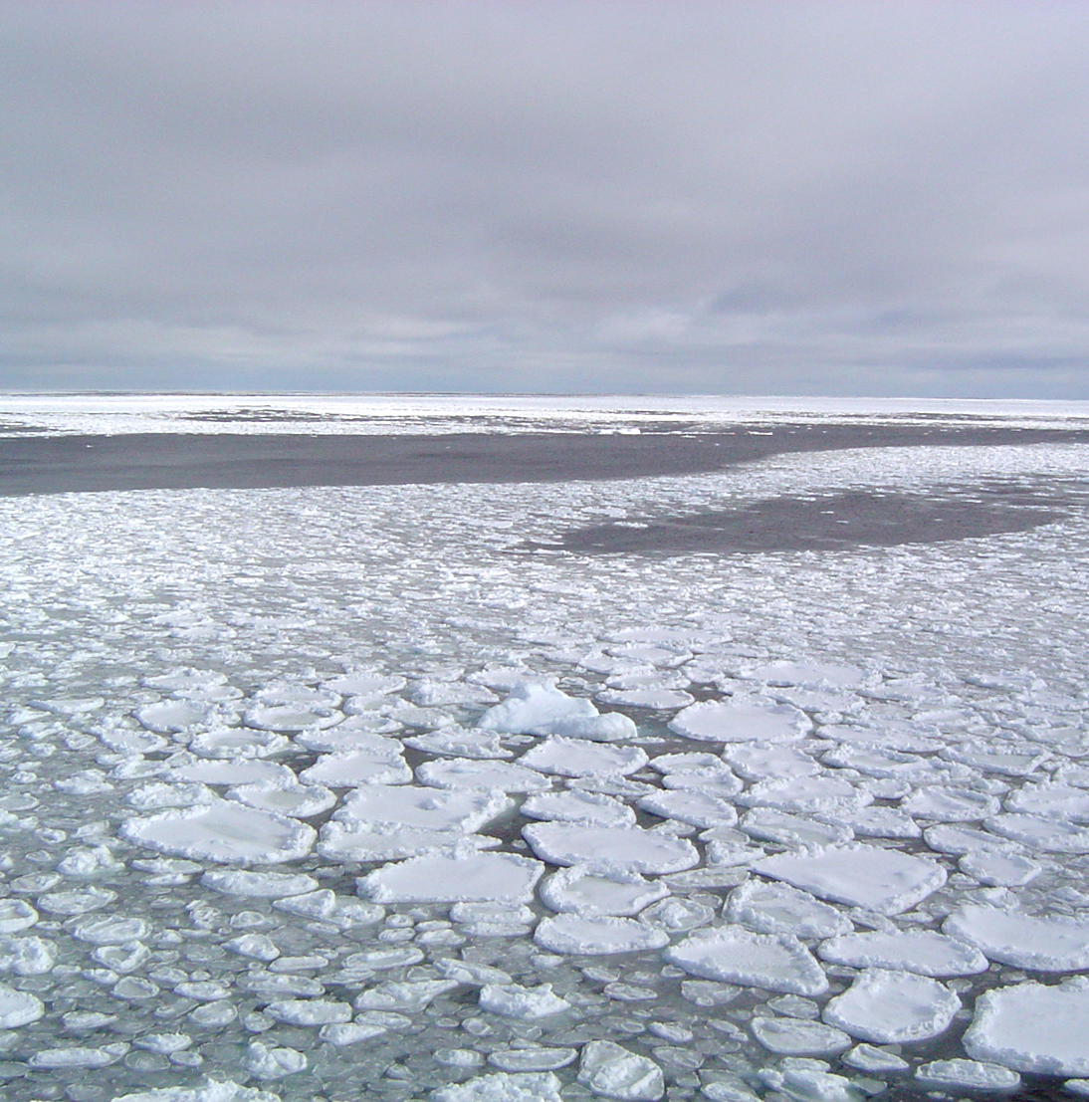
Linking CO2 Concentrations and Arctic Sea Ice Patterns
Ethan Losasso
EAS 4480

Slide 2
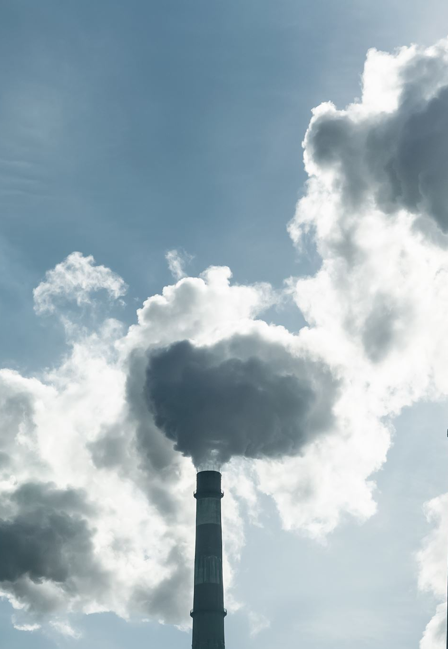
Introduction
Carbon dioxide is a common greenhouse gas and is largely cited as one of the driving factors for climate change
As climate change continues, the equilibrium of Arctic sea ice coverage may be thrown off balance
Main goal is to use linear regression and time series analysis to see how closely the seasonal trends for carbon dioxide concentration and Arctic sea ice coverage are linked

Slide 3
LS regression of monthly CO2 data (top)
  Slope = 1.8325
  Intercept = -3292
  Error of LS Regression Slope = [0.8238, 2.8371]
  Indicates CO2 levels are increasing over time
LS regression of monthly Arctic sea ice coverage data (bottom)
  Slope = -0.0285
  Intercept = 66.231
  Error of LS Regression Slope = [-0.5512, 0.4942]
  Indicates Arctic sea ice coverage is slightly decreasing over time

Slide 4
Bootstrap for LS regression of monthly CO2 data (top)
  Slope mean = 1.8316 Intercept mean = -3290
  Slope STD = 0.0233 Intercept STD = 46.6365
  95% CI of slope bootstrap = [1.7869, 1.8781]
  95% CI of intercept bootstrap = [-3383, -3201]
Bootstrap for LS regression of monthly Arctic sea ice coverage data (bottom)
  Slope mean = -0.0279 Intercept mean = 65.1439
  Slope STD = 0.0118 Intercept STD = 23.5796
  95% CI of slope bootstrap = [-0.0519, -0.0054]
  95% CI of intercept bootstrap = [20.0752, 113.017]

Slide 5
Chi-square test for monthly CO2 residuals (10 bins)
  Chi2 = 115.93
  Critical Chi2 = 14.0671
Chi-square test for monthly Arctic sea ice coverage (10 bins)
  Chi2 = 211.98
  Critical Chi2 = 14.0671
For both datasets, null hypothesis that the error terms are normally distributed around 0 can be rejected
  Linear (LS) regression is not valid for these models

Slide 6
Plot of unbiased autocorrelation of the CO2 error terms with a time lag of 36 months shows periodicity (yearly cycles)
  Error terms are correlated, residuals not randomly distributed
Plot of unbiased autocorrelation of the Arctic sea ice coverage error terms with a time lag of 36 months shows periodicity (yearly cycles)
  Error terms are correlated, residuals not randomly distributed

Slide 7
CO2 data shows significant power at 1 year per cycle frequency
  Secondary spike at ½ year per cycle frequency
Arctic sea ice coverage shows significant power at 1 year per cycle frequency
Both datasets exhibit extremely strong yearly cycles

Slide 8
Cross PSD as a function of periodicity shows both datasets share a major periodicity of 1 year
Phase angle at 1 cycle per year frequency is -2.601 degrees
  Phase time lag is -0.0072 years
  CO2 lags Arctic sea ice coverage by ~2.62 days
Coherence at 1 cycle per year frequency is 0.9968
  Extremely high r-squared value at dominant frequency – the yearly cycles of the two datasets line up very closely

Slide 9

Questions?

Slide 10
Solomon, S., Qin, D., Manning, M., Chen, Z., Marquis, M., Averyt, K. B., Tignor, M., & Miller, H. L. (2007). The carbon cycle and the Climate System. IPCC Fourth Assessment Report: Climate Change 2007. Retrieved April 20, 2022, from https://archive.ipcc.ch/publications_and_data/ar4/wg1/en/ch7s7-3.html
Fetterer, F., K. Knowles, W. N. Meier, M. Savoie, and A. K. Windnagel. 2017, updated daily. Sea Ice Index, Version 3. North Monthly data. Boulder, Colorado USA. NSIDC: National Snow and Ice Data Center. doi: https://doi.org/10.7265/N5K072F8. Retrieved April 20, 2022
Dlugokencky, E.J., J.W. Mund, A.M. Crotwell, M.J. Crotwell, and K.W. Thoning (2021), Atmospheric Carbon Dioxide Dry Air Mole Fractions from the NOAA GML Carbon Cycle Cooperative Global AiR Sampling Network, 1968-2020, Version: 2021-07-30, https://doi.org/10.15138/wkgj-f215
References

