Slide 1
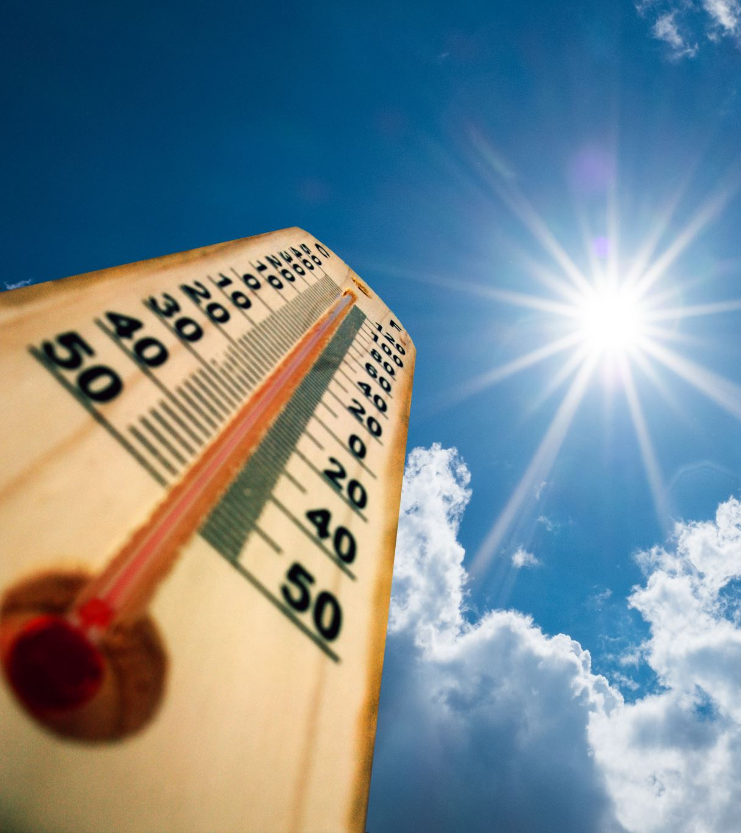
Correlating Weather Factors and Outdoor Mobility in Fulton County
Ethan Wang
EAS 4480

Slide 2
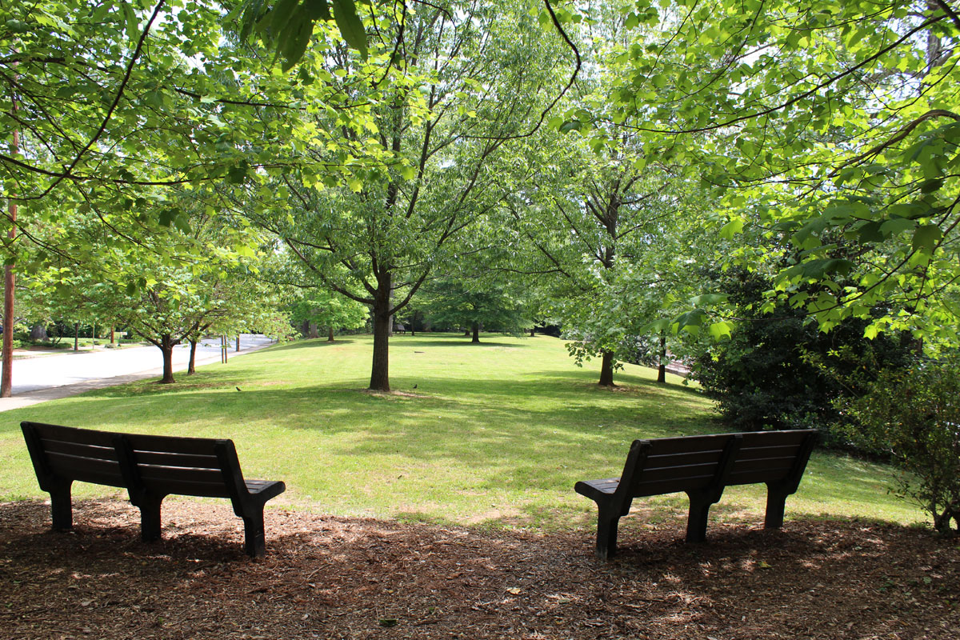
Project Goal
Initially, to determine poor air quality and smog’s impact on people’s lives
Extended to other weather factors such as temperature, precipitation, and wind
Measure the impact of weather conditions on outdoor recreation

Slide 3
Data Sources
Air Quality Data from EPA
Atlanta / United Avenue Site
Year-long Weather Data from Metostat
Atlanta / Carroll Heights Station
Mobility Trends obtained from Community Mobility Reports from Google
Used to measure the effects of COVID-19
Example Air Quality Data

Slide 4
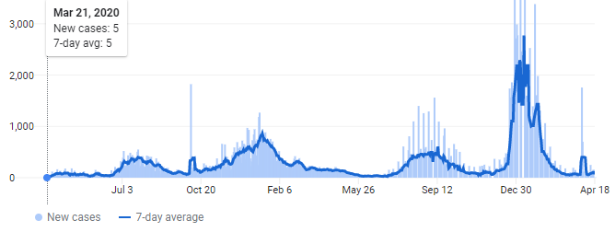
Time Period of Data
Data is from March 15 – July 17, 2021
“Flattened curve” should reduce the impact of COVID-19 lockdowns on data
Covid-19 Cases in Fulton County, GA – Data was taken from the highlighted period

Slide 5
Techniques Used
Correlation Analysis between weather factors and mobility in parks
Multivariate Regression
Uncertainty Analysis:
95% confidence interval of correlation coefficient from Bootstrap
Standard Error Analysis

Slide 6
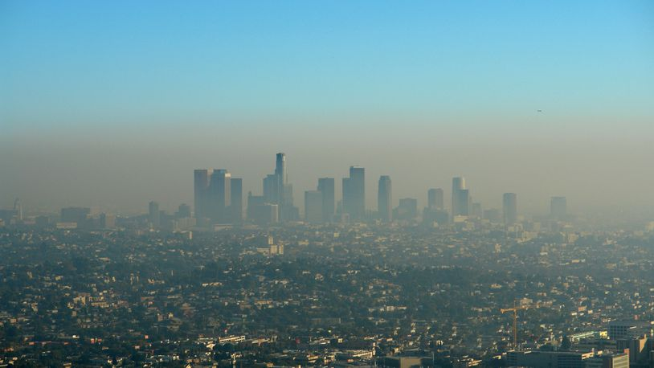
Correlation – Air Quality & Mobility
Weak Positive Correlation Found for both PM 2.5 and Ozone
R: 0.2432, 0.2187
Confidence Intervals
Low: 0.1094, 0.0383
High: 0.4153, 0.3631
Heat, Precipitation, likely confounding variables

Slide 7
Correlation – Weather & Mobility
Temperature (AVG) | Temperature (MIN) | Temperature (MAX) | Precipitation (mm) | Average Wind Speed (km/h)
0.2035 | 0.0464 | 0.3077 | -0.4410 | -0.2863
0.2008 | 0.0454 | 0.3012 | -0.4312 | -0.2866
[0.0533, 0.3474] | [-0.1148, 0.1902] | [0.1341, 0.4496] | [-0.5633, -0.2753] | [-0.4283, -0.1173]
R
Mean R from Bootstrap Test
Confidence Interval from Bootstrap Test

Slide 8
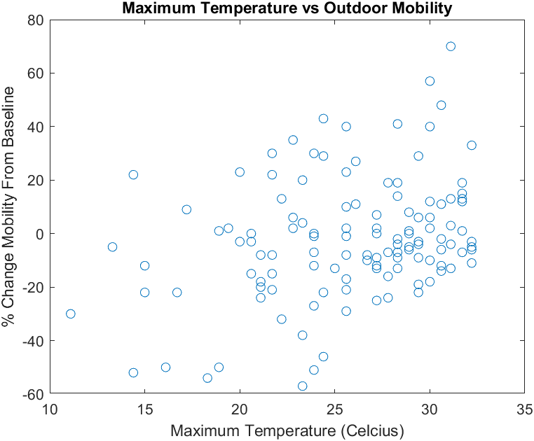
Graphs of Correlating Variables

Slide 9
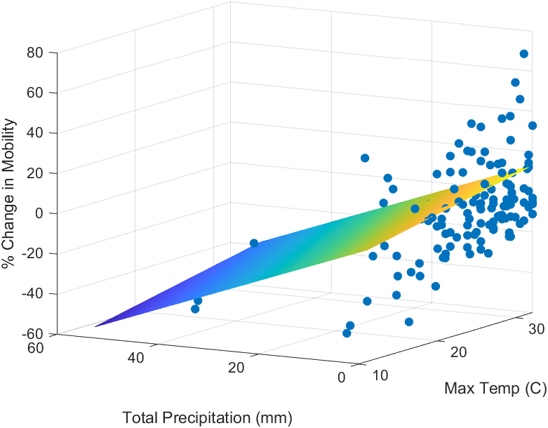
Multivariate Regression
$$Y= β_{0}+β_{1}x_{1}+β_{2}x_{2}+ β_{3}x_{3}$$
$Y$ = % Change in Mobility
$x_{1}$ = Max Temperature (C)
$x_{2}$ = Precipitation (mm)
$x_{3}$ = Average Wind Speed(km/h)
$β_{0….3}$ = Coefficients

Slide 10
Regression Results
Residual Standard Error = 19.3685
Validation Residual Standard Error = 32.3107
When introducing day of the week as a variable, the error improves to:
Residual Standard Error = 12.1190
Validation Residual Standard Error = 31.5752
$β_{0}$(Intercept) | $β_{1}$(Max Temperature) | $β_{2}$(Precipitation) | $β_{3}$(Wind Speed)
-13.7358 | 0.8384 | -0.9535 | -0.8276
[-40.8611, 13.3896] | [0.0005, 1.6762] | [-1.3286, -0.5784] | [-1.8624, 0.2073]
Coefficients
95% Confidence Interval

Slide 11
Conclusion
Certain Weather Factors are correlated with Outdoor Mobility
Air Quality by itself is not negatively correlated with Outdoor Mobility, but more advanced analysis is needed
Multivariate Regression can help predict how crowded a location will be

