Slide 1
Earthquakes: What can we learn?
Jose Pages
Eas 4480 - Spring 2022

Slide 2
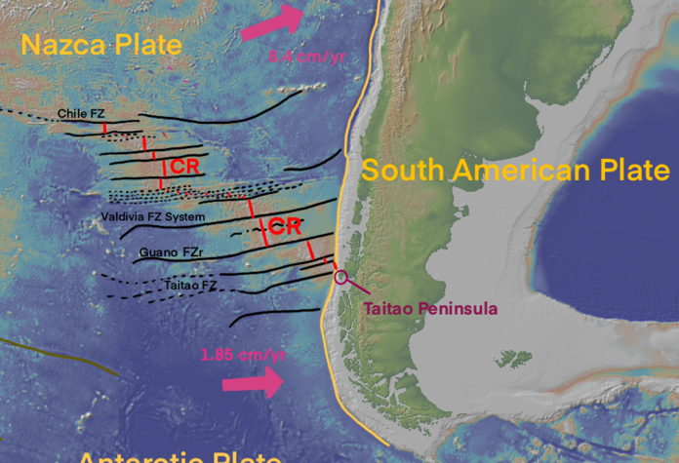
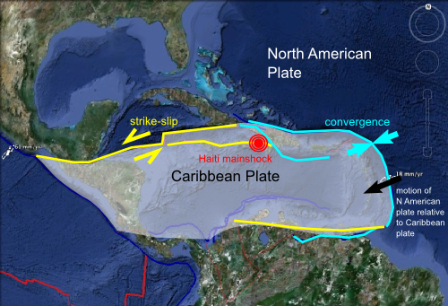
Tecnonic Plates
Dominican Republic/Haiti: Caribbean Plate and NA Plate
Chile: Nazca Plate and South American Plate.
‘Earthquake Hotspot’?
Chile is located on the boundary of the Nazca tectonic plate and the South American plate. The Nazca plate moves 6.6 cm east yearly, thus it subducts under the South American plate, therefore forming an ‘Earthquake hotspot’.
1960 Valdivia Earthquake - 9.5
Notes:
Septentronial Flaut and Enriquillo Fault

Slide 3
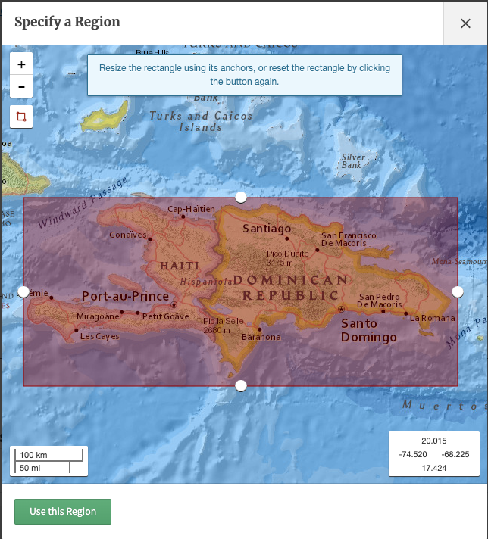
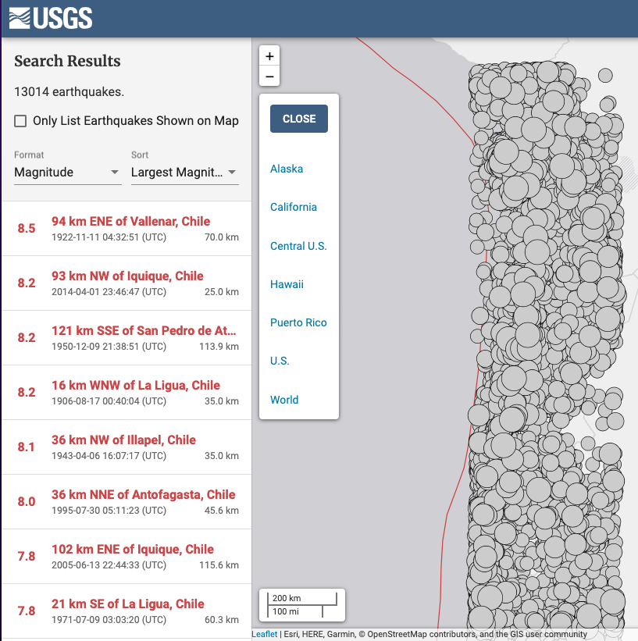
USGS: Data sets used
Notes:
United States Geological Survey: Downloaded data Degree of Earthquakes, timeline, etc Passed into Excel

Slide 4
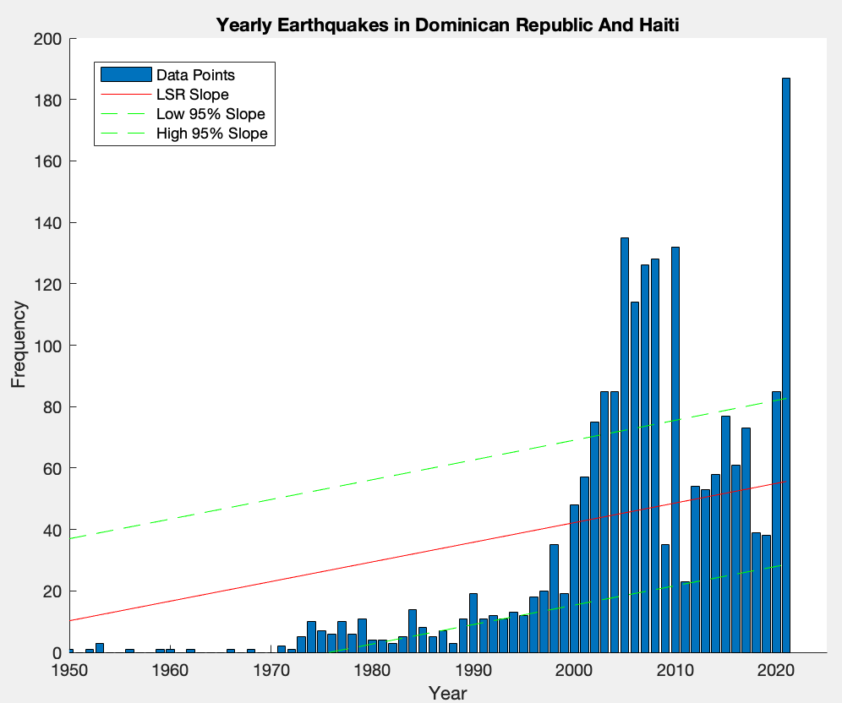
Histograms: Dominican Republic/Haiti and Chile
Corrcoef: 0.769
Slope Ratio: 1:9.3
Earthquake Ratio: 1:10

Slide 5
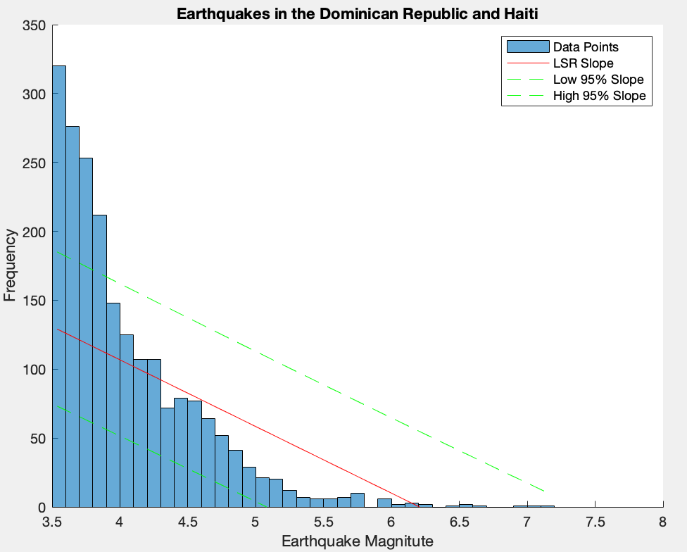
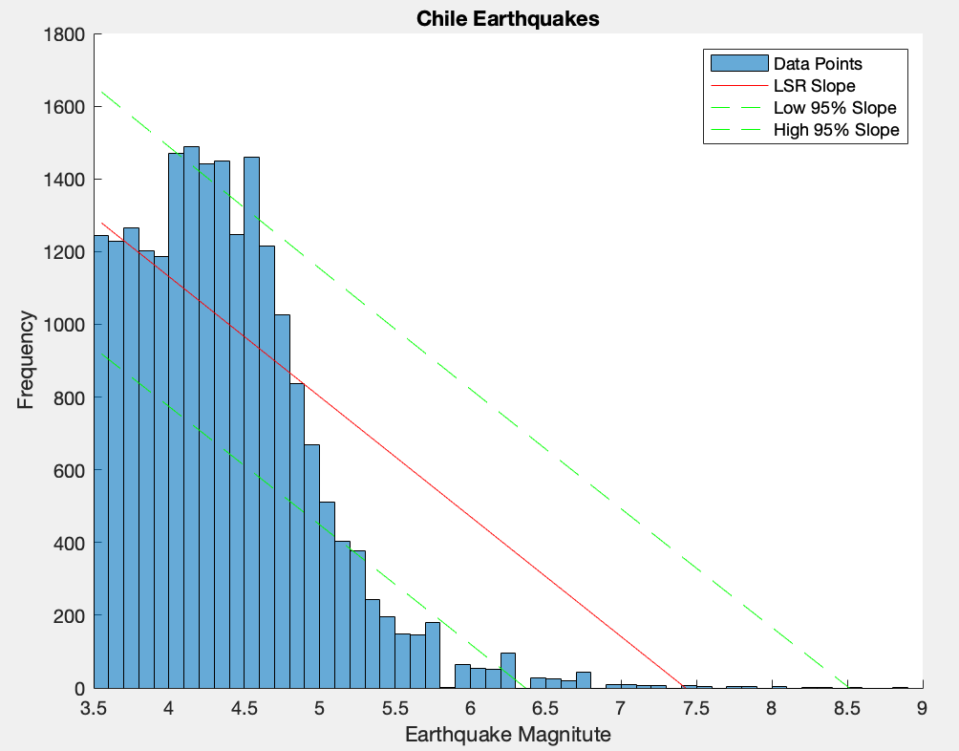
Histograms: Dominican Republic/Haiti and Chile
Corrcoef: 0.82
Magnitue amount correlation: 0.75

Slide 6
Questions?

