Slide 1
The Effect of Air Temperature on Sea Level Change in the Gulf of Mexico
Kiera Tran
Environmental Data Analysis Project

Slide 2
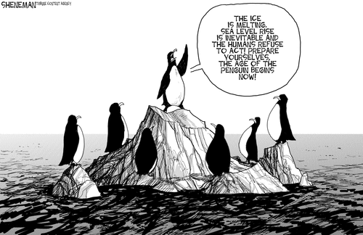
1. Motivation
Thermal expansion is the main cause for sea level rise globally.
Focus question: How relative air temperature change affect the sea level in the Gulf of Mexico?

Slide 3
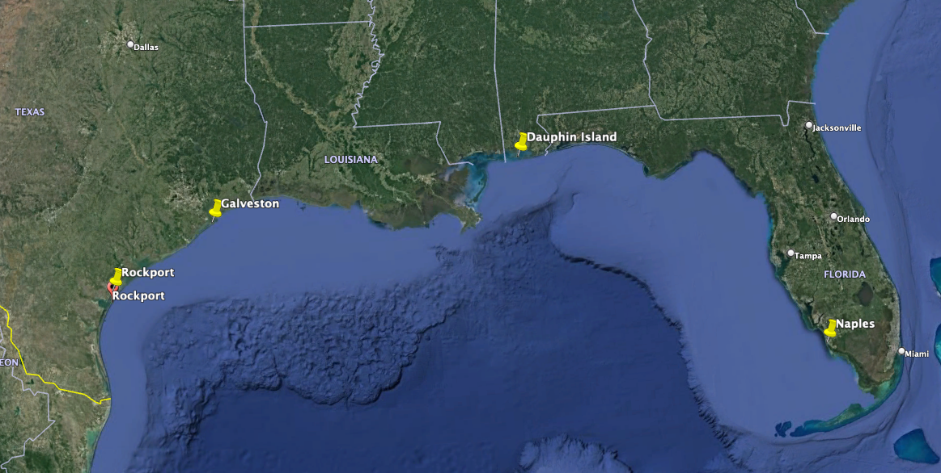
2. Retrieved data
Air temperature: https://www.ncdc.noaa.gov/cdo-web/
Tide gauges: https://tidesandcurrents.noaa.gov/
Monthly data 1975-2021
4 sites => Loop cells

Slide 4
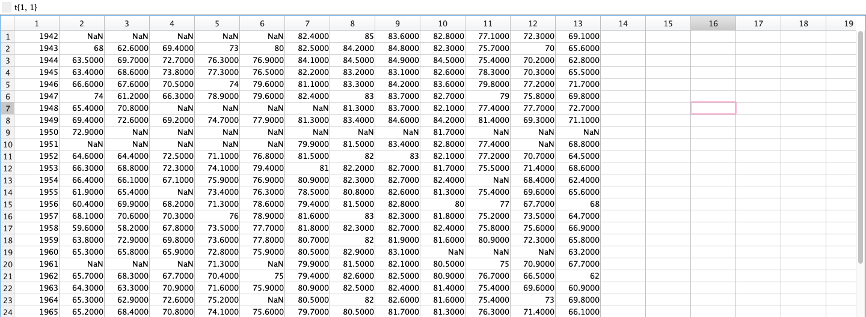
3. Analysis
3.1: Data process (Reshape, extract, remove NaN, and demean)

Slide 5
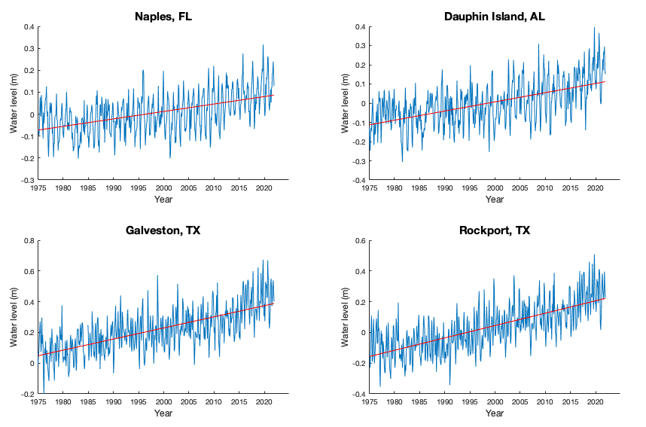
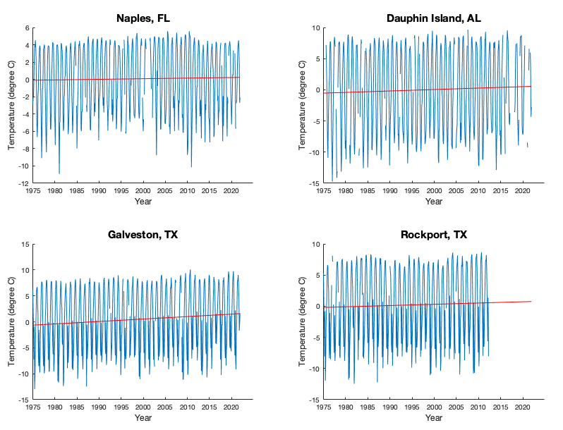
3. Analysis
3.2: Data displayed and first order linear trend

Slide 6
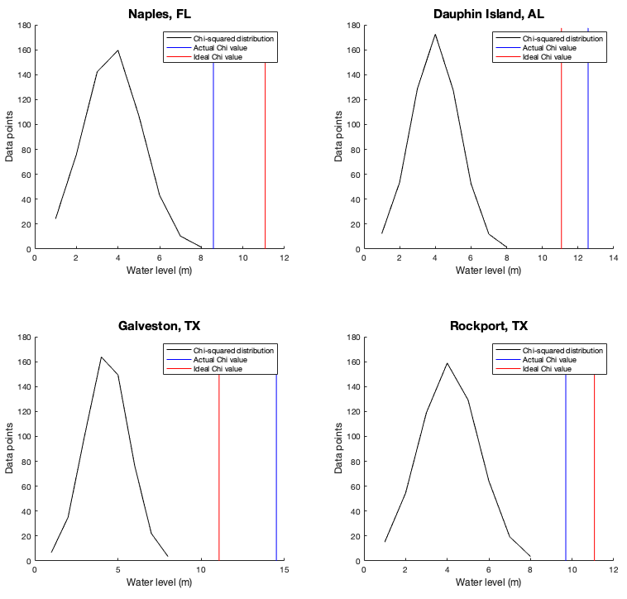
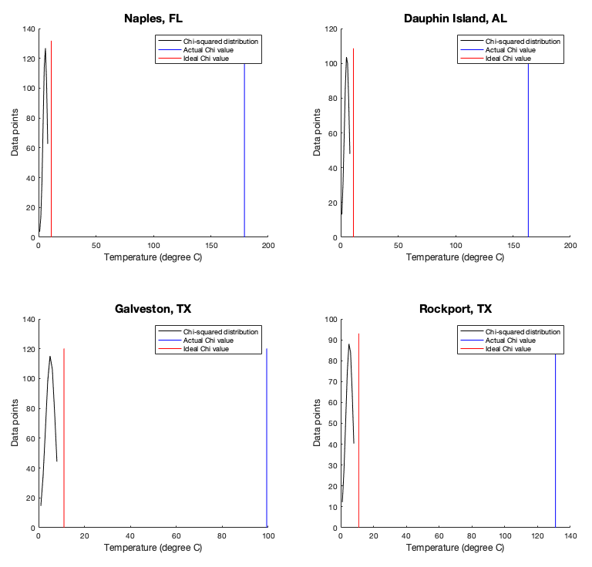
3. Analysis
3.3: Chi-squared test (variations based on normal distribution, less => accepted)

Slide 7
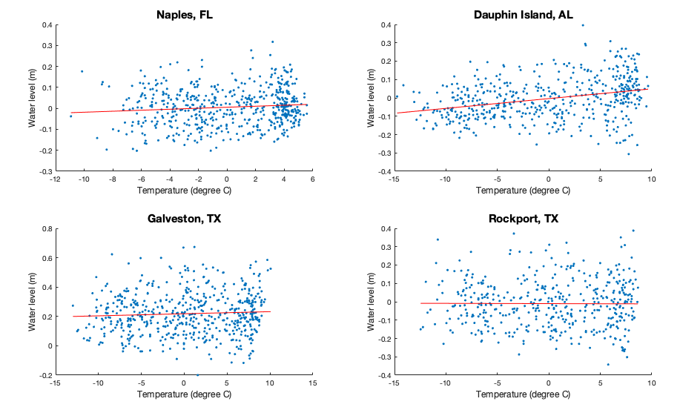
3. Analysis
3.4: Linear regression + Correlation coefficient
Significant correlation coefficient of air temperature vs water level : NONE

Slide 8
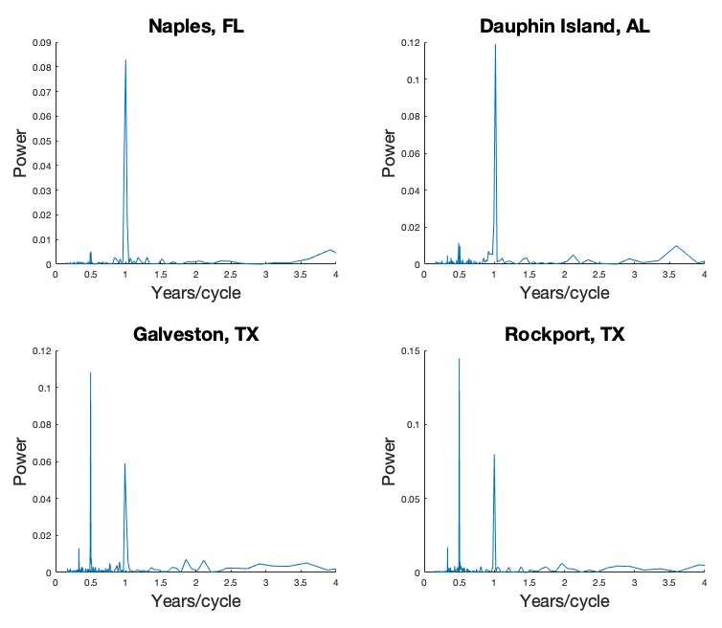
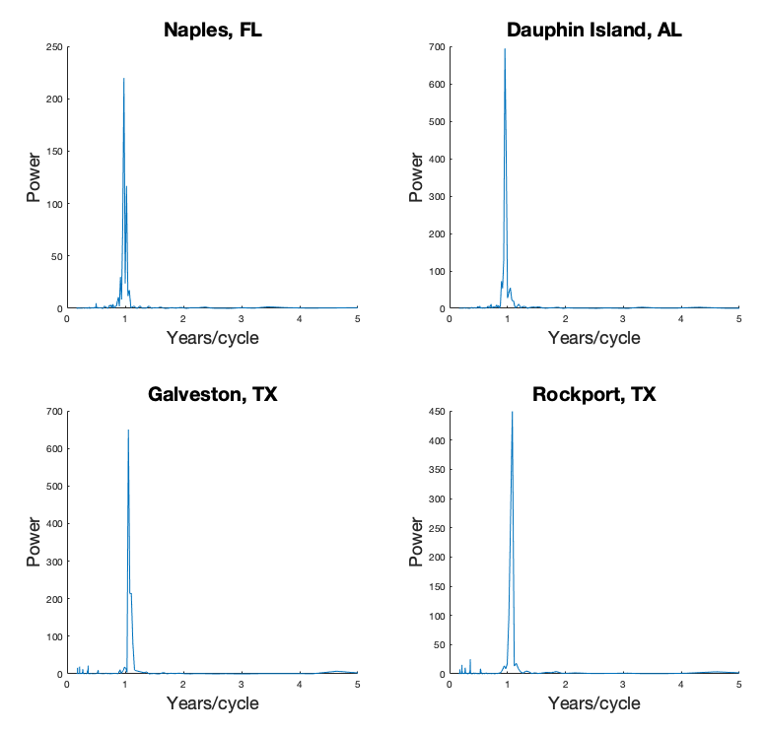
3. Analysis
3.5: Periodogram (dominant periods)

Slide 9
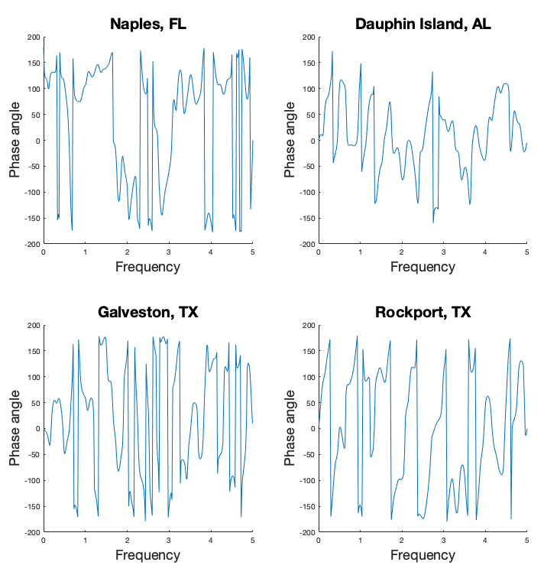
3. Analysis
3.6: Time lags
The phase lag (air temperature is the function of sea level)
- Naples, FL: 20.613 years.
- Dauphin Island, AL: -2.8091 years.
- Galveston, TX: -0.49152 years.
- Rockport, TX: 27.0321 years.

Slide 10
4. Interpretations/Conclusions
Naples, FL and Rockport, TX are lagging ~20.5 – 27 years
Dauphin Island, AL and Galveston, TX are leading ~ 0.5 -3 years
Local temperature rise has impacts on sea level change. However, the progress is slow.
Possible reasons for the leading phase lag are subsidence, upstream flood control, erosion, regional ocean currents, variations in land height, and whether the land is still rebounding from the compressive weight of Ice Age glaciers.

Slide 11
5. Questions?

