Slide 1
Effects of a Pandemic on Air Quality:
A correlation analysis between COVID and [NO2] data
EAS 4480 Environmental Data Analysis Project
Kristie Yoo
April 20, 2022

Slide 2
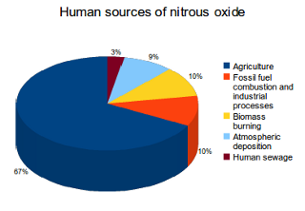
Motivation
NO2 emissions come from anthropogenic sources.
During a pandemic, people are more likely to stay indoors and work at home.
Curiosity and predicament about how less human activity outside might mean less air pollution, better air quality, lower levels of NO2
Source: https://whatsyourimpact.org/greenhouse-gases/nitrous-oxide-emissions

Slide 3
Data Sources
Data from 3/6/2020 to 10/30/2021
600 data points
Daily COVID data from GA DPH
COVID: Fulton County, GA Total Cases data
Daily NO2 data from US EPA AirNow Data
NO2: Daily max-1 hour NO2 concentrations in ppb

Slide 4
Hypotheses
1: There is a negative correlation between COVID case count and NO2 concentrations.
2: There is a positive correlation between the occurrence of a pandemic and air quality.
Increase in COVID cases → Less outside human activity → Decrease in NO2 concentrations → Increase in air quality
Decrease in COVID cases → More outside human activity → Increase in NO2 concentrations → Decrease in air quality

Slide 5
Time series of COVID case count

Slide 6
Time series of NO2 concentration

Slide 7
[NO2] as a function of COVID case count

Slide 8
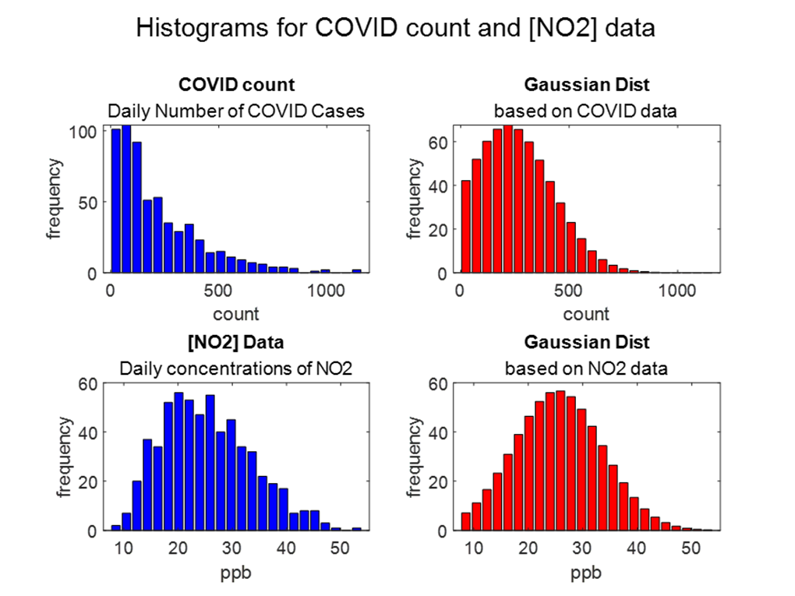
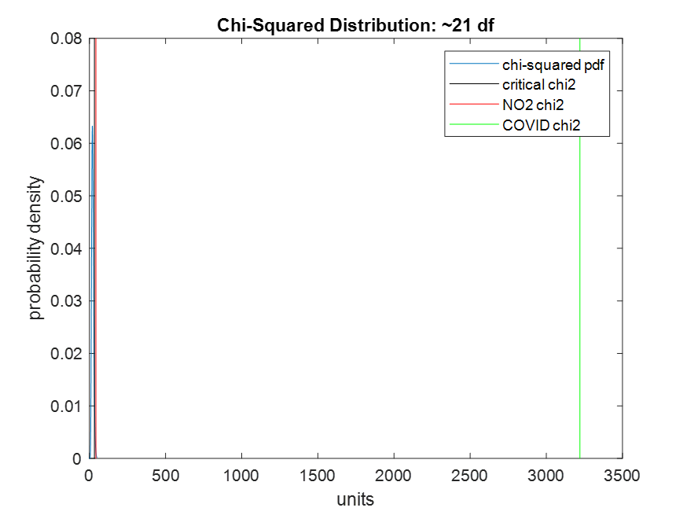
Test for Normality

Slide 9
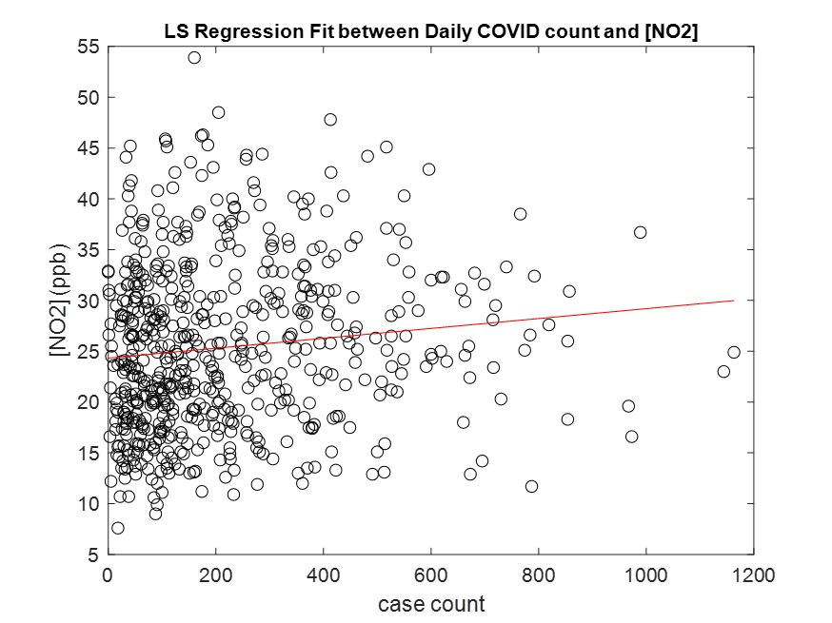
Least Squares Regression

Slide 10
Bootstrap Analysis of Correlation Coefficient

Slide 11
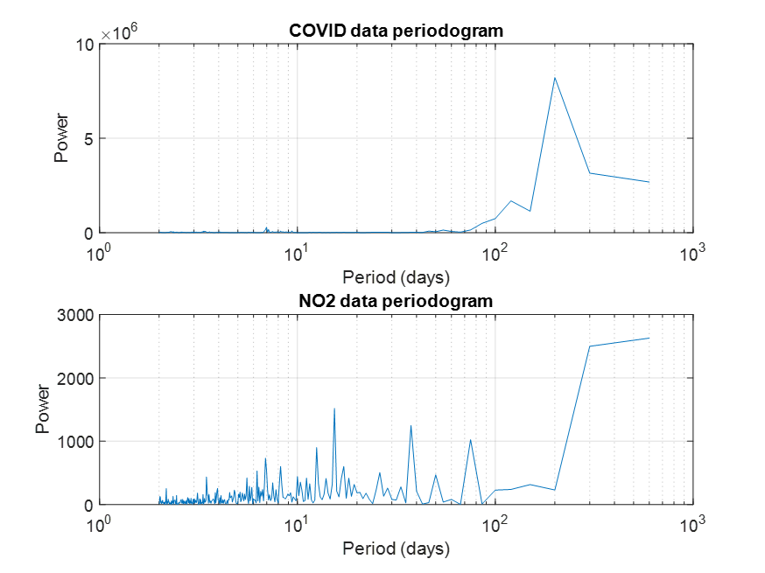
Periodograms

Slide 12
PSD Estimate

Slide 13
Cross-spectrum FFT/CPSD

Slide 14
Phase Lag

Slide 15
Coherence/Uncertainty Analysis

Slide 16
Conclusion
Good certainty in results of the analysis
Hypotheses refuted. ☹
Small, but positive correlation!
Increase in COVID cases → Increase in NO2 concentrations → Decrease in air quality
Occurrence of a pandemic does not seem to better air quality.

Slide 17
Sources
https://dph.georgia.gov/covid-19-daily-status-report
https://www.epa.gov/outdoor-air-quality-data/download-daily-data
https://whatsyourimpact.org/greenhouse-gases/nitrous-oxide-emissions

