Slide 1
Global Temperature and wildfire occurrence in california
Leah Hornsey, EAS 4480

Slide 2
Motivation
“Weather and climate are the most important factors influencing fire activity and these factors are changing due to human-caused climate change” (Flannigan et al., 2006).
Understanding how climate affects forest fires is essential to mitigating their impact.
It is also essential in our conversations about the impact of climate change on the natural environment and human society.

Slide 3
Three Key datasets
Global Land Temperature Anomaly
Wildfire count
Acres burned
🔥
Total amount of wildfires in California each year from 1987 to 2018.
Total acres burned by wildfires in California each year from 1987 to 2018.
With respect to the 20th century global average.

Slide 4
The Question
How strongly does global land temperature anomaly and wildfire occurrence/extent correlate?

Slide 5
Statistical Methods
Periodograms and
Cross-spectrum fft
Least-Squares Regression
Bootstrap
Looking for correlation:
Fire Count vs. Anomaly
Acres Burned vs. Anomaly
To assess variability
Comparing the frequencies of Fire Count, Acres Burned, and Global Temperature Anomaly

Slide 6
Linear Regression

Slide 7
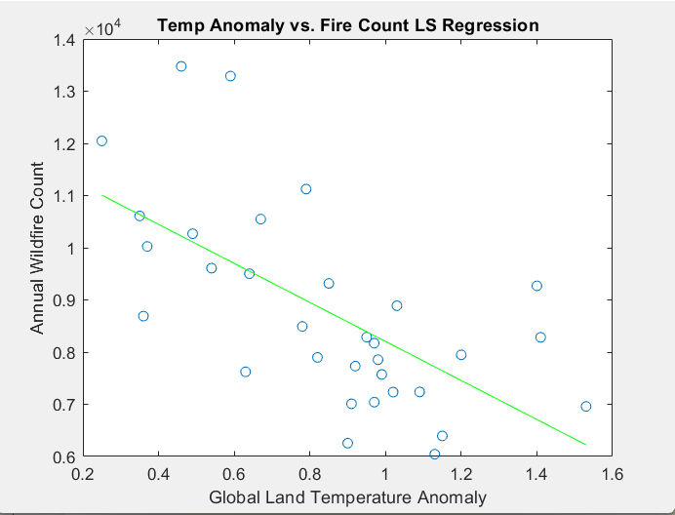
Least-Squares Regression - Fire Count
Negative correlation (Very interesting…)
R-value = -0.6368
P-value = 8.9*10^-5 (Statistically significant)
Strongest correlation, but has a negative relationship. This is unexpected.

Slide 8
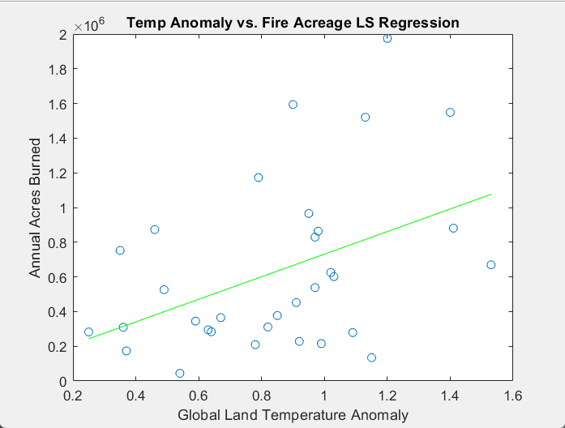
Least-Squares Regression - Acres burned
Positive correlation (Very VERY interesting…)
R-value = 0.4340
P-value = 0.01 (Statistically significant)

Slide 9
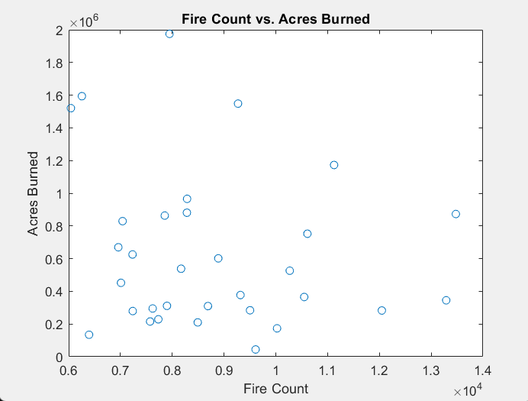
Fire Count and Acres burned
Fewer, but more intense fires?
R-value = -0.1569
P-value = 0.39 (Statistically insignificant)
Inconclusive results here.

Slide 10
02
Bootstrap

Slide 11
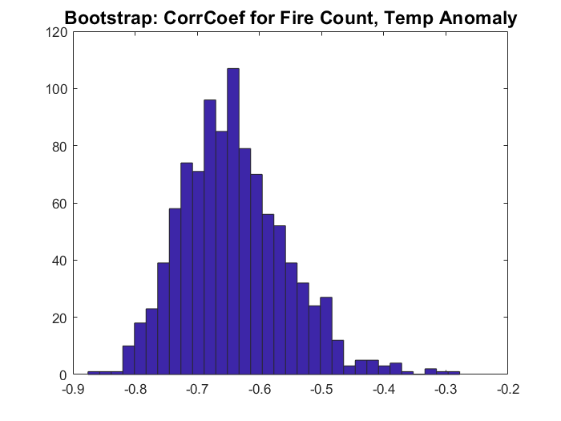
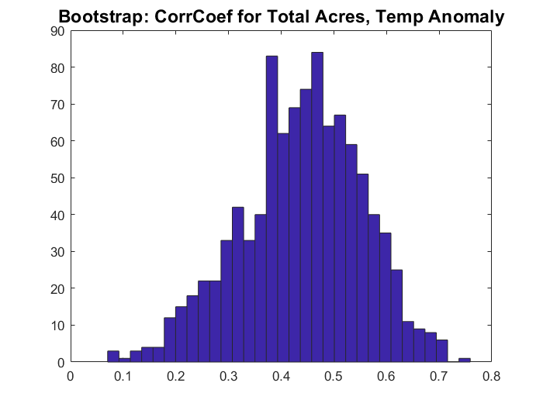
bootstrap
CI = [-0.78157 -0.44765]
CI = [0.16071 0.63337]

Slide 12
Periodograms and cross-spectrum FFT

Slide 14
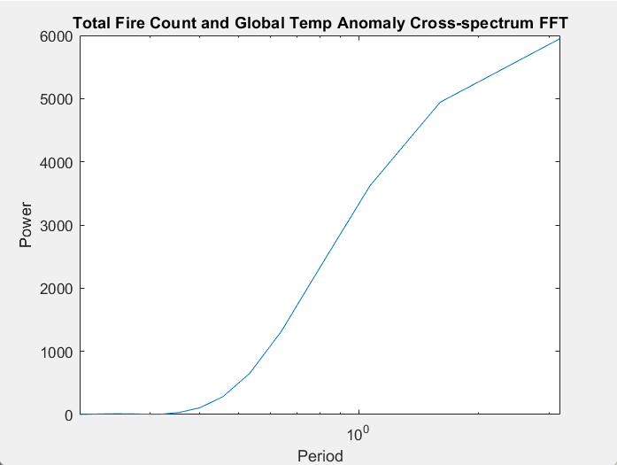
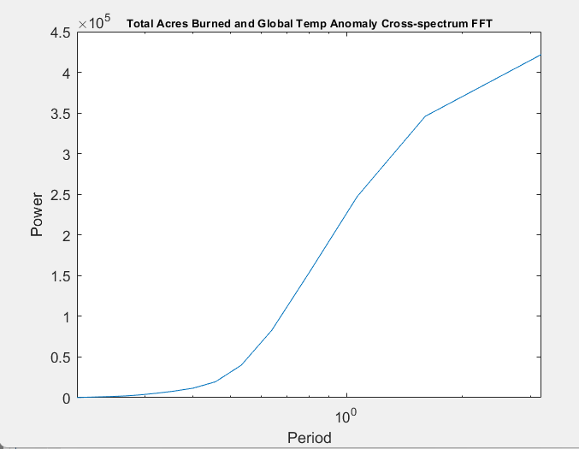
Cross-Spectrum FFT
The major periodicities are every ~3 to ~12 years

Slide 15
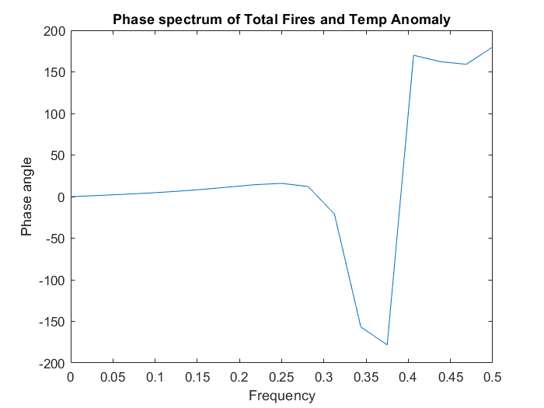
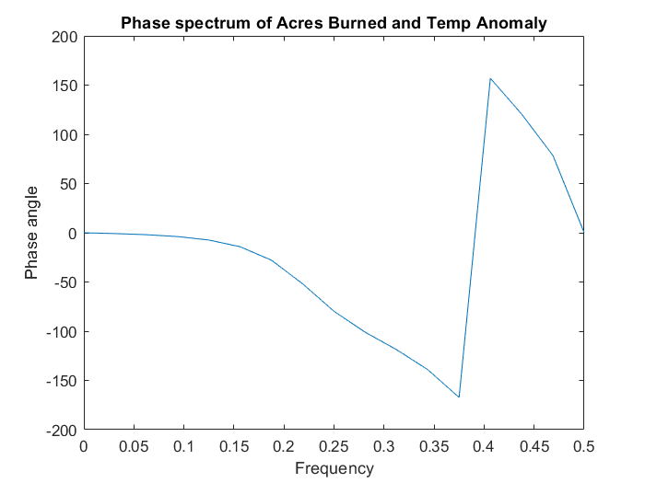
PHase lag
The phase lag at the frequency corresponding to the largest psd is 0.36953 years.
The phase lag at the frequency corresponding to the largest psd is -0.23025 years.

Slide 16
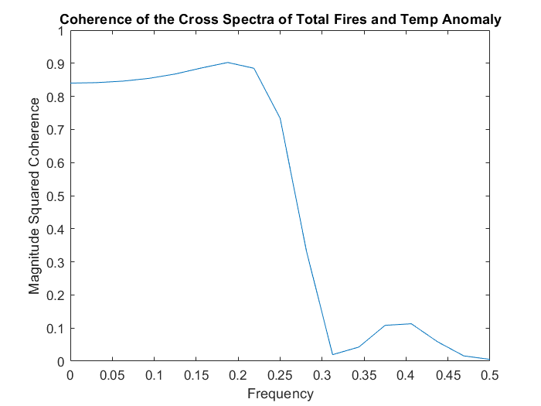
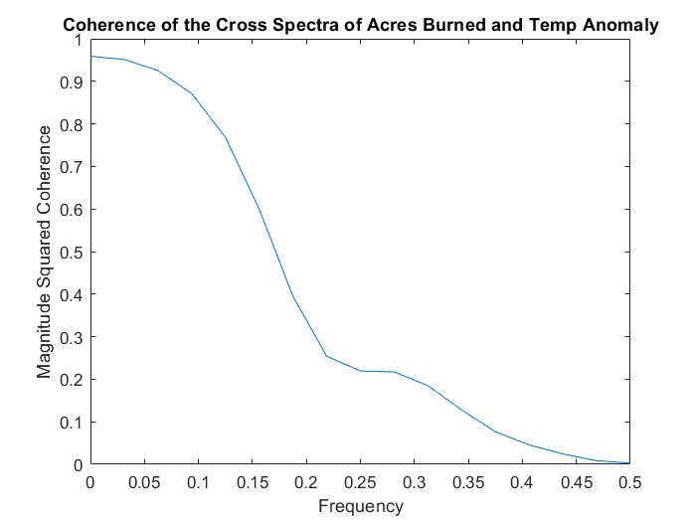
coherence
The coherence value at the frequency corresponding to the largest psd is 0.84147.
The coherence value at the frequency corresponding to the largest psd is 0.95129.

Slide 17
Conclusions
FFT
Least-squares regression
bootstrap
SUMMARY
All seem to have an approx. 3 year cycle
Strange phase lag
Strong coherence
Negative correlation between fire count and temperature anomaly
Positive correlation between acres burned and temperature anomaly
Normally distributed (not affected by outliers)
Wildfire count could be influenced by an external factor
The strongest correlation is a negative relationship between fire count and temperature anomaly
Further research: other tests, use a different region, find a dataset with more years

Slide 18
Any Questions?
Credits: https://link.springer.com/article/10.1007/s11027-005-9020-7

