Slide 1
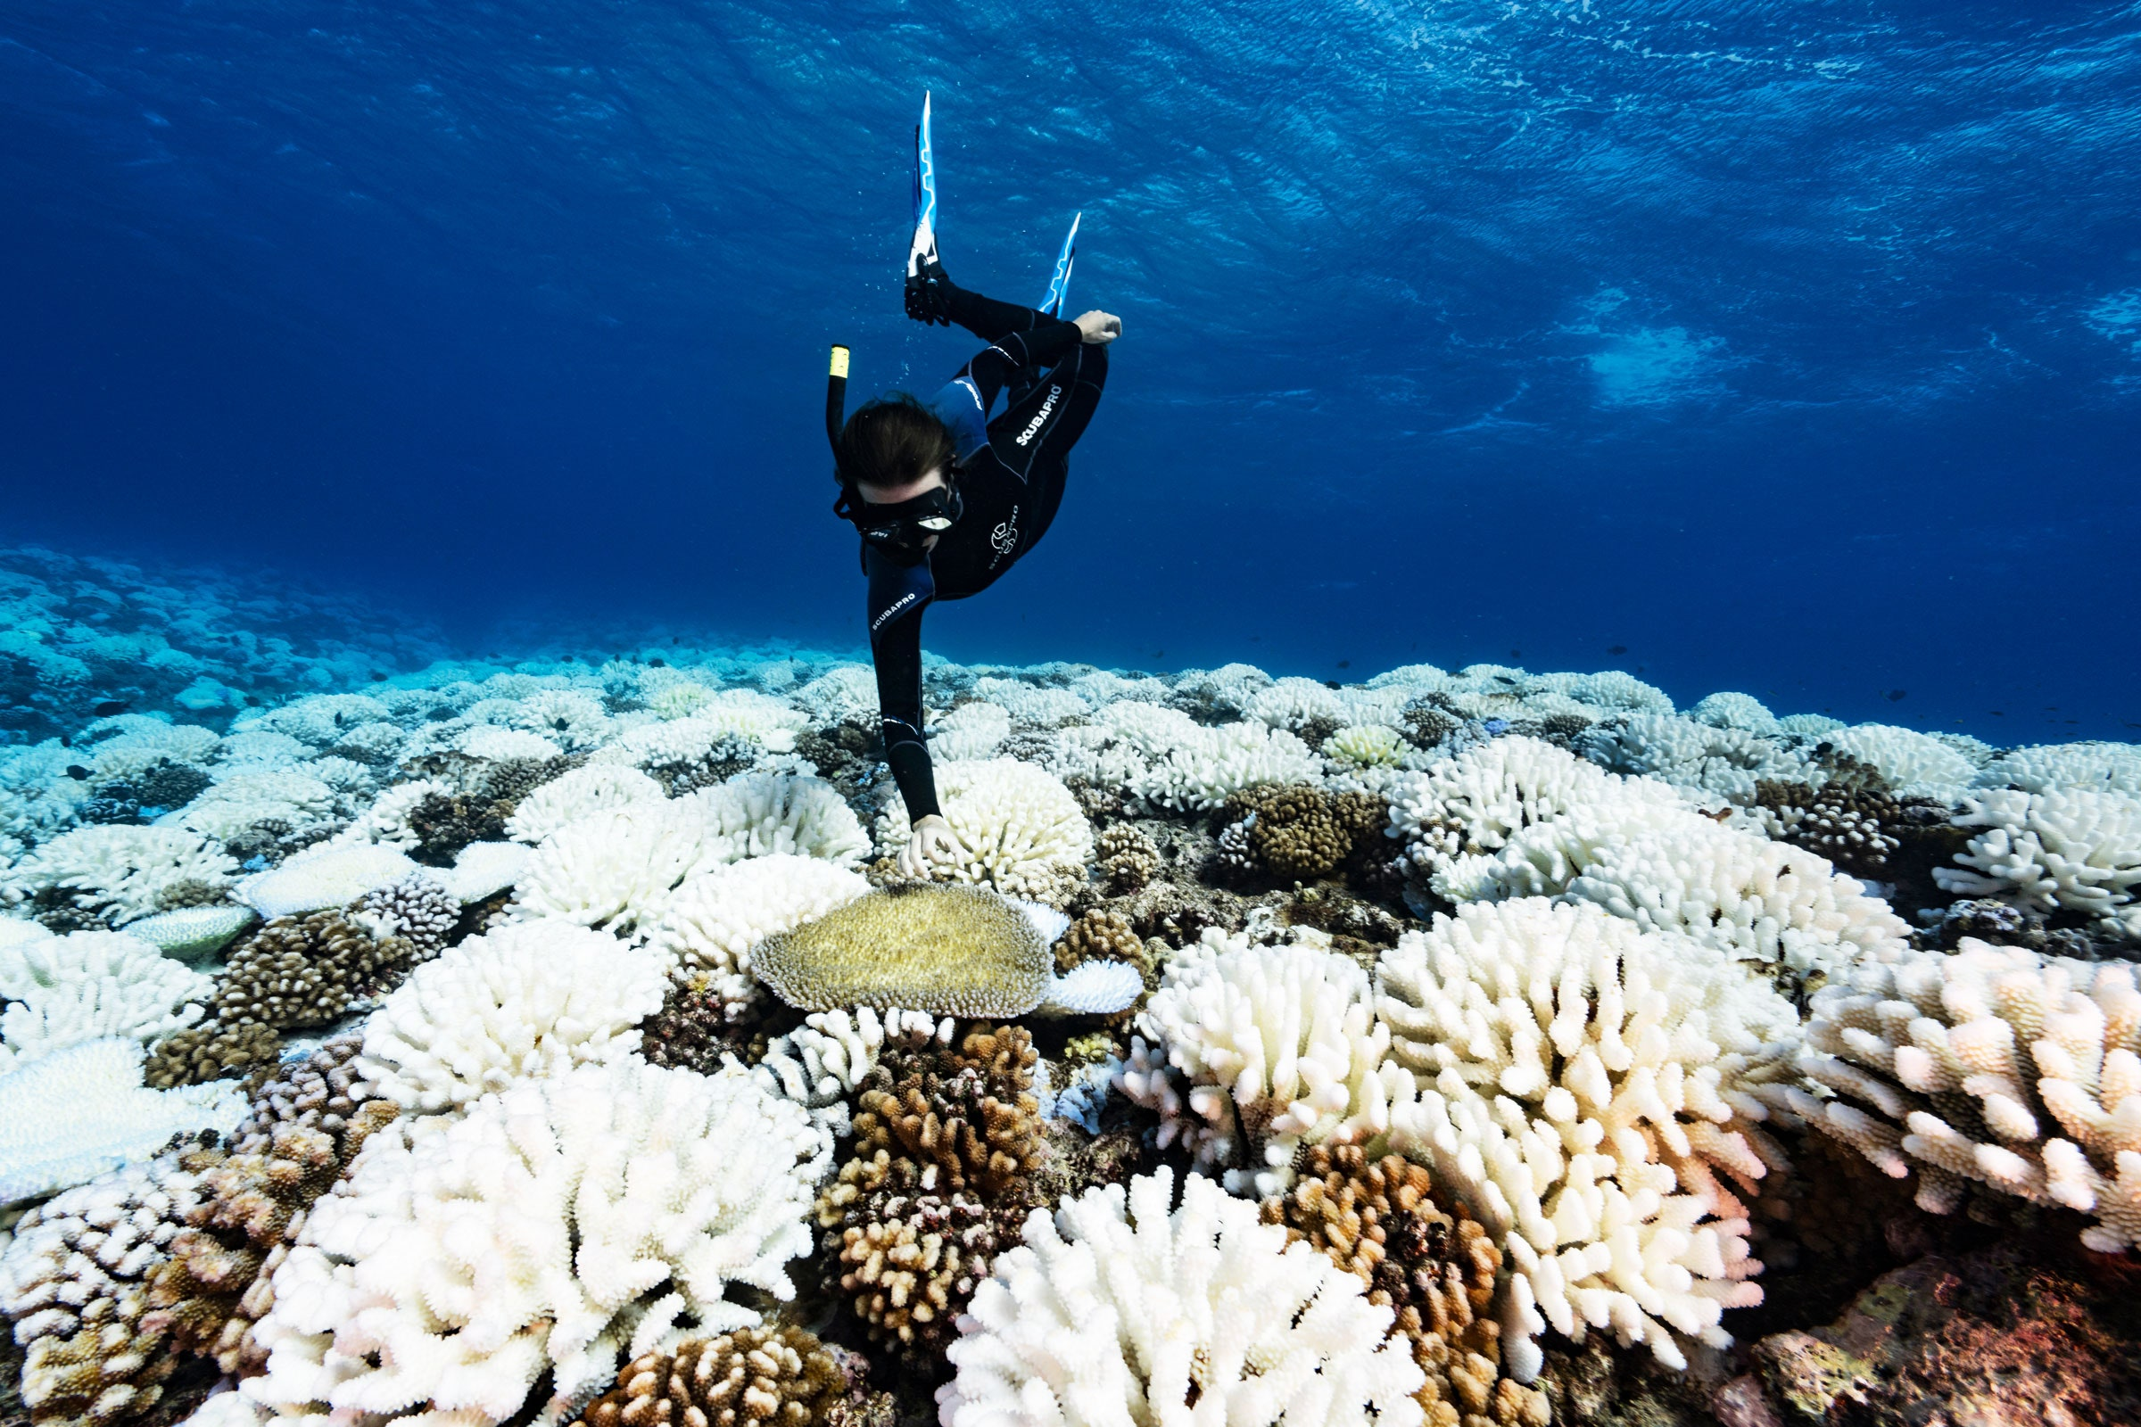
Seasonal Variability In the Relationship between Coral Sr/Ca and and Sea Surface Temperature
Madeleine Hardt
EAS 4480
Image: WIRED
Notes:
Image credit: https://media.wired.com/photos/61854aac1441a4f1781a6ac2/3:2/w_2400,h_1600,c_limit/Science_bleachedcoral_climatedesk_GettyImages-1148855562.jpg

Slide 2
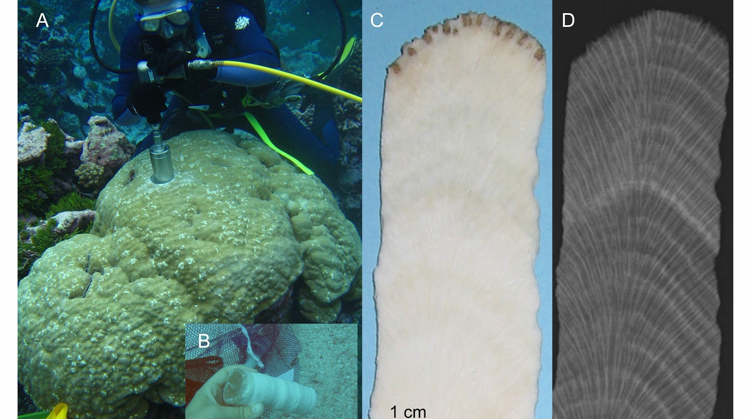
Motivation
Paleoclimatology: Study of Past Climates
Proxies include tree rings, ice cores, bee pollen, and coral skeletons
Corals grow larger with time, like tree rings
Annual bands in skeletons to calculate growth rate
Image: Carilli Blog

Slide 3
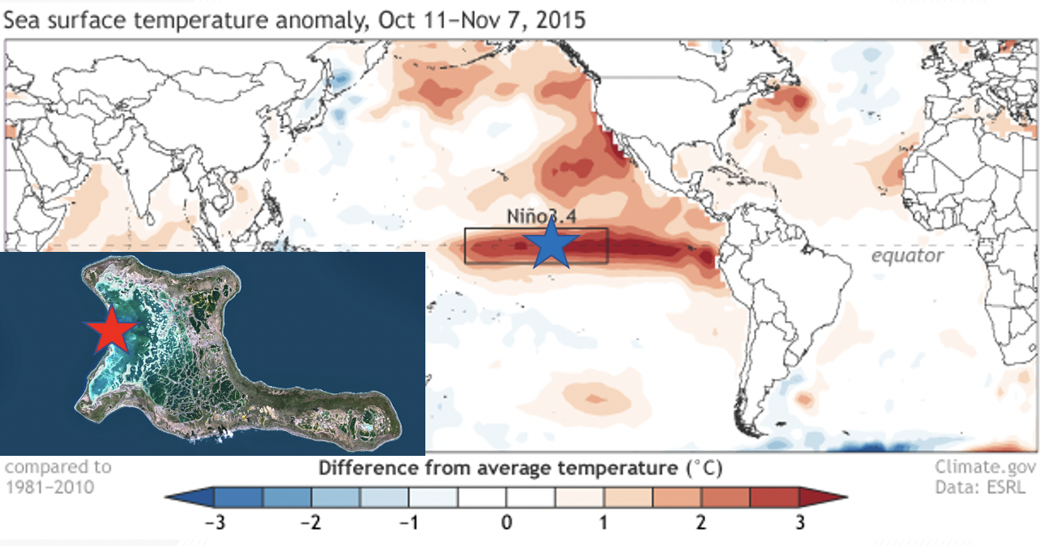
How does seasonal variability affect the relationship between Sea Surface Temperature and Coral Sr/Ca?
Image: NOAA

Slide 4
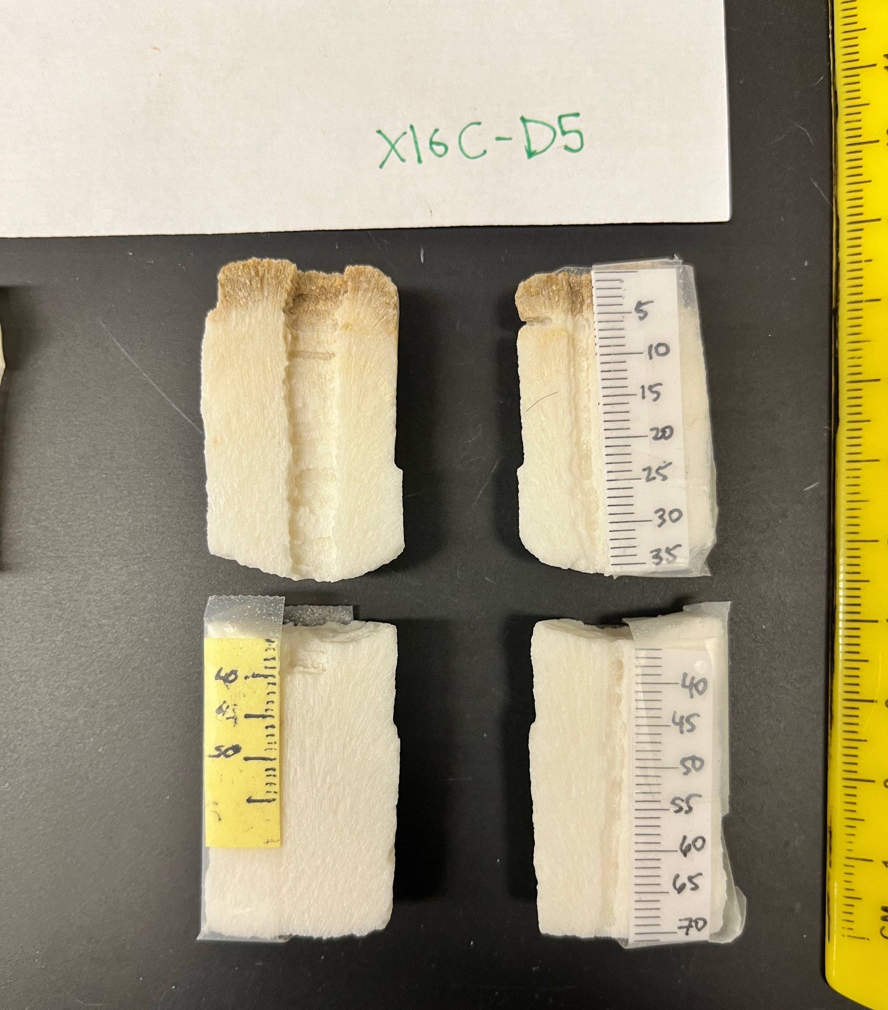
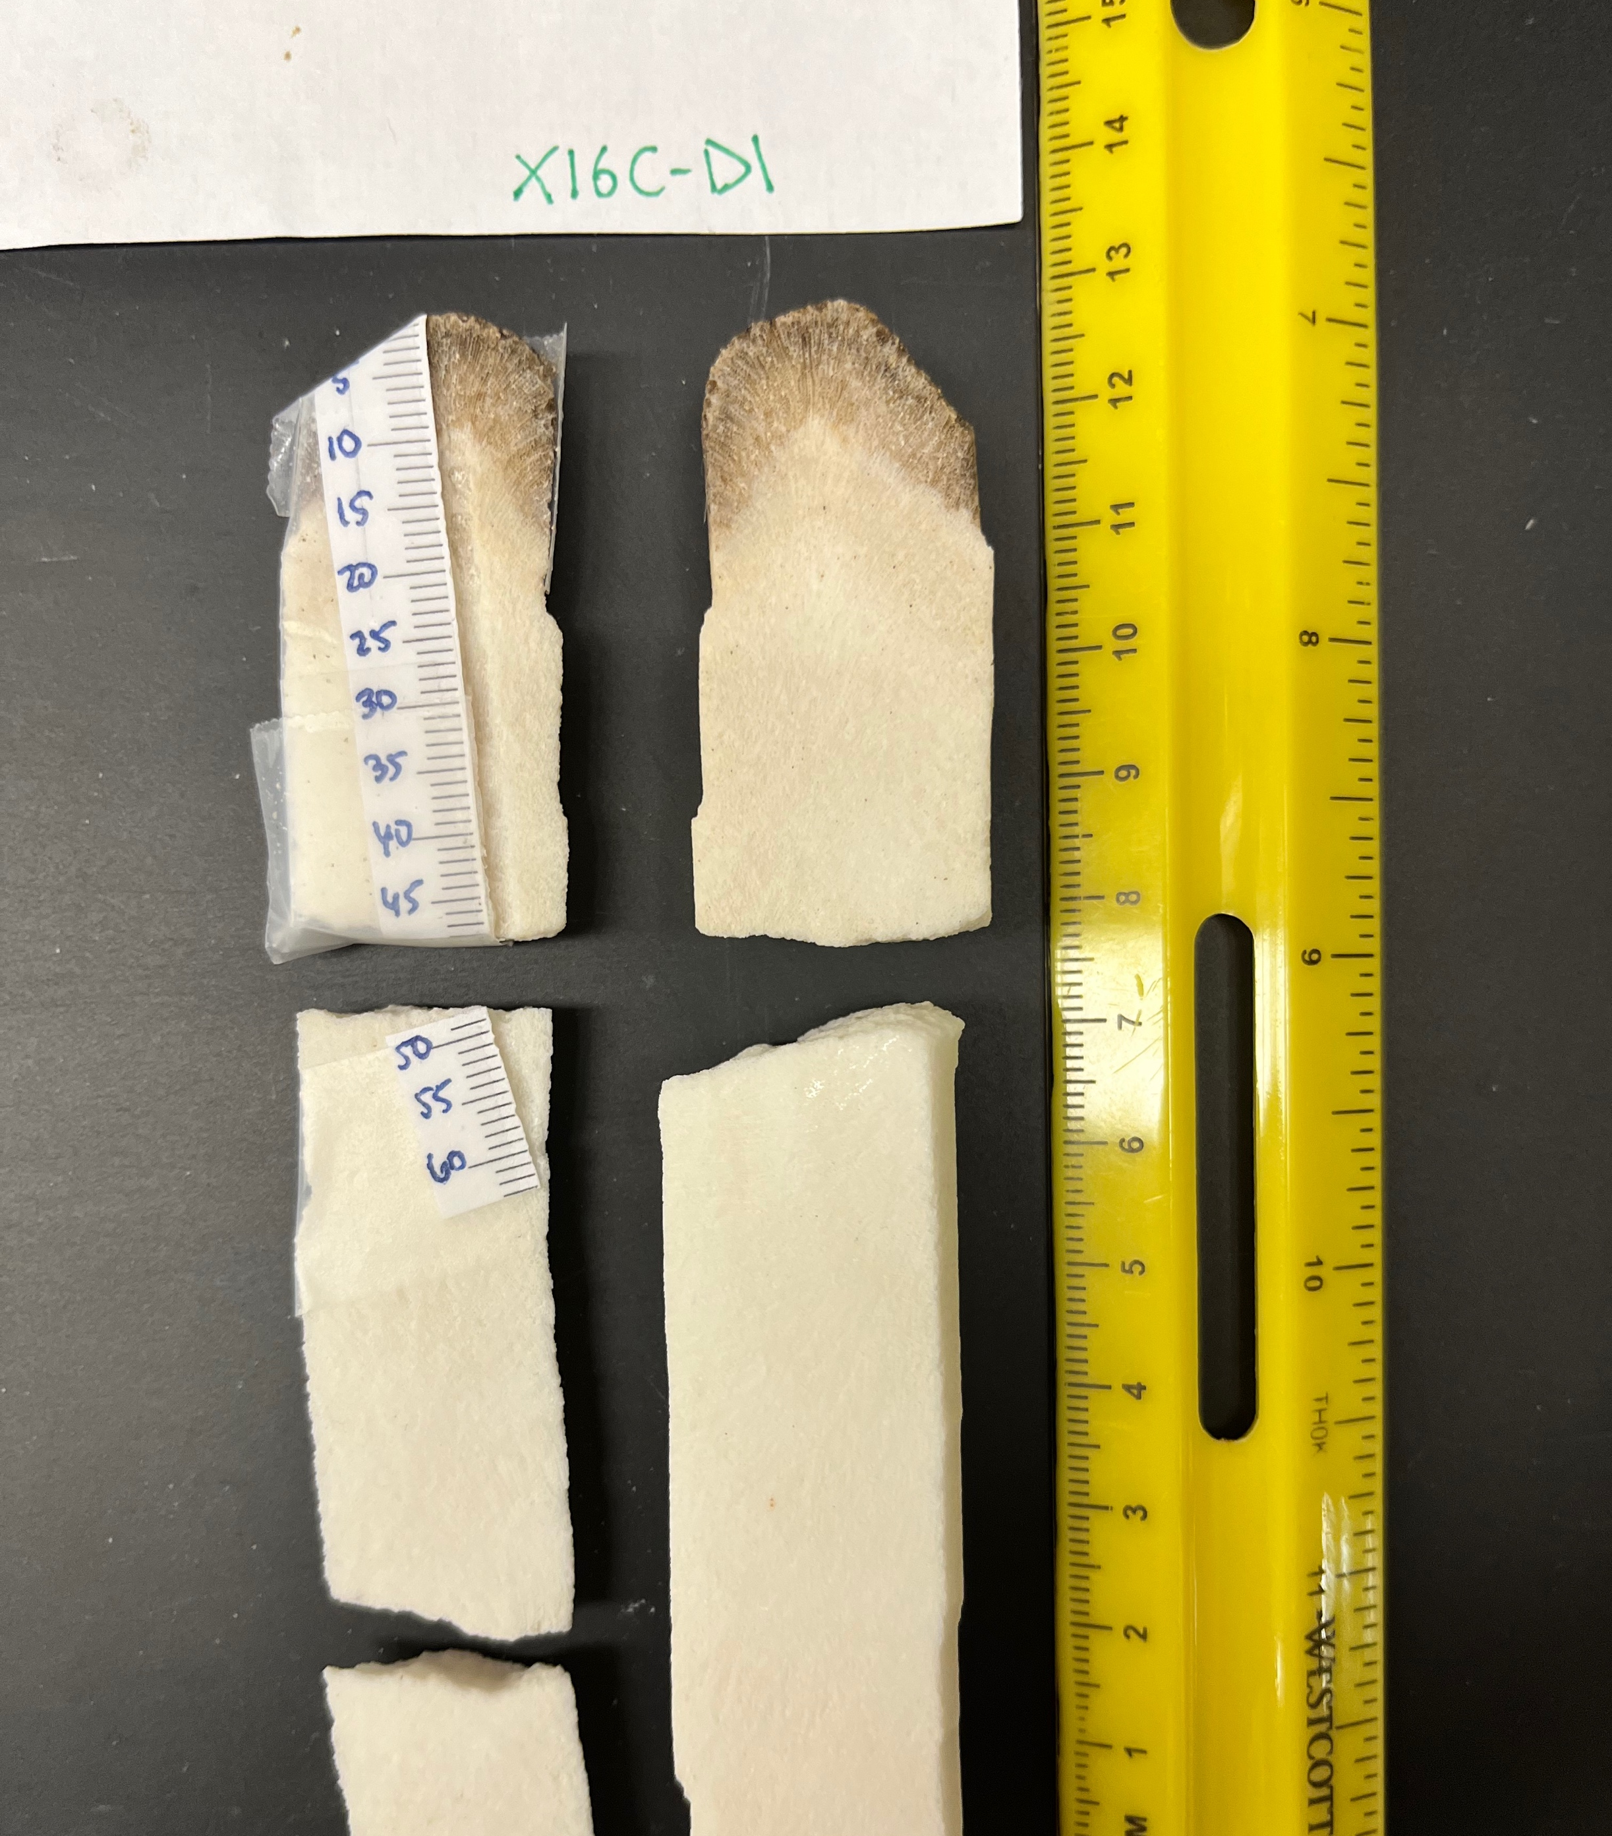
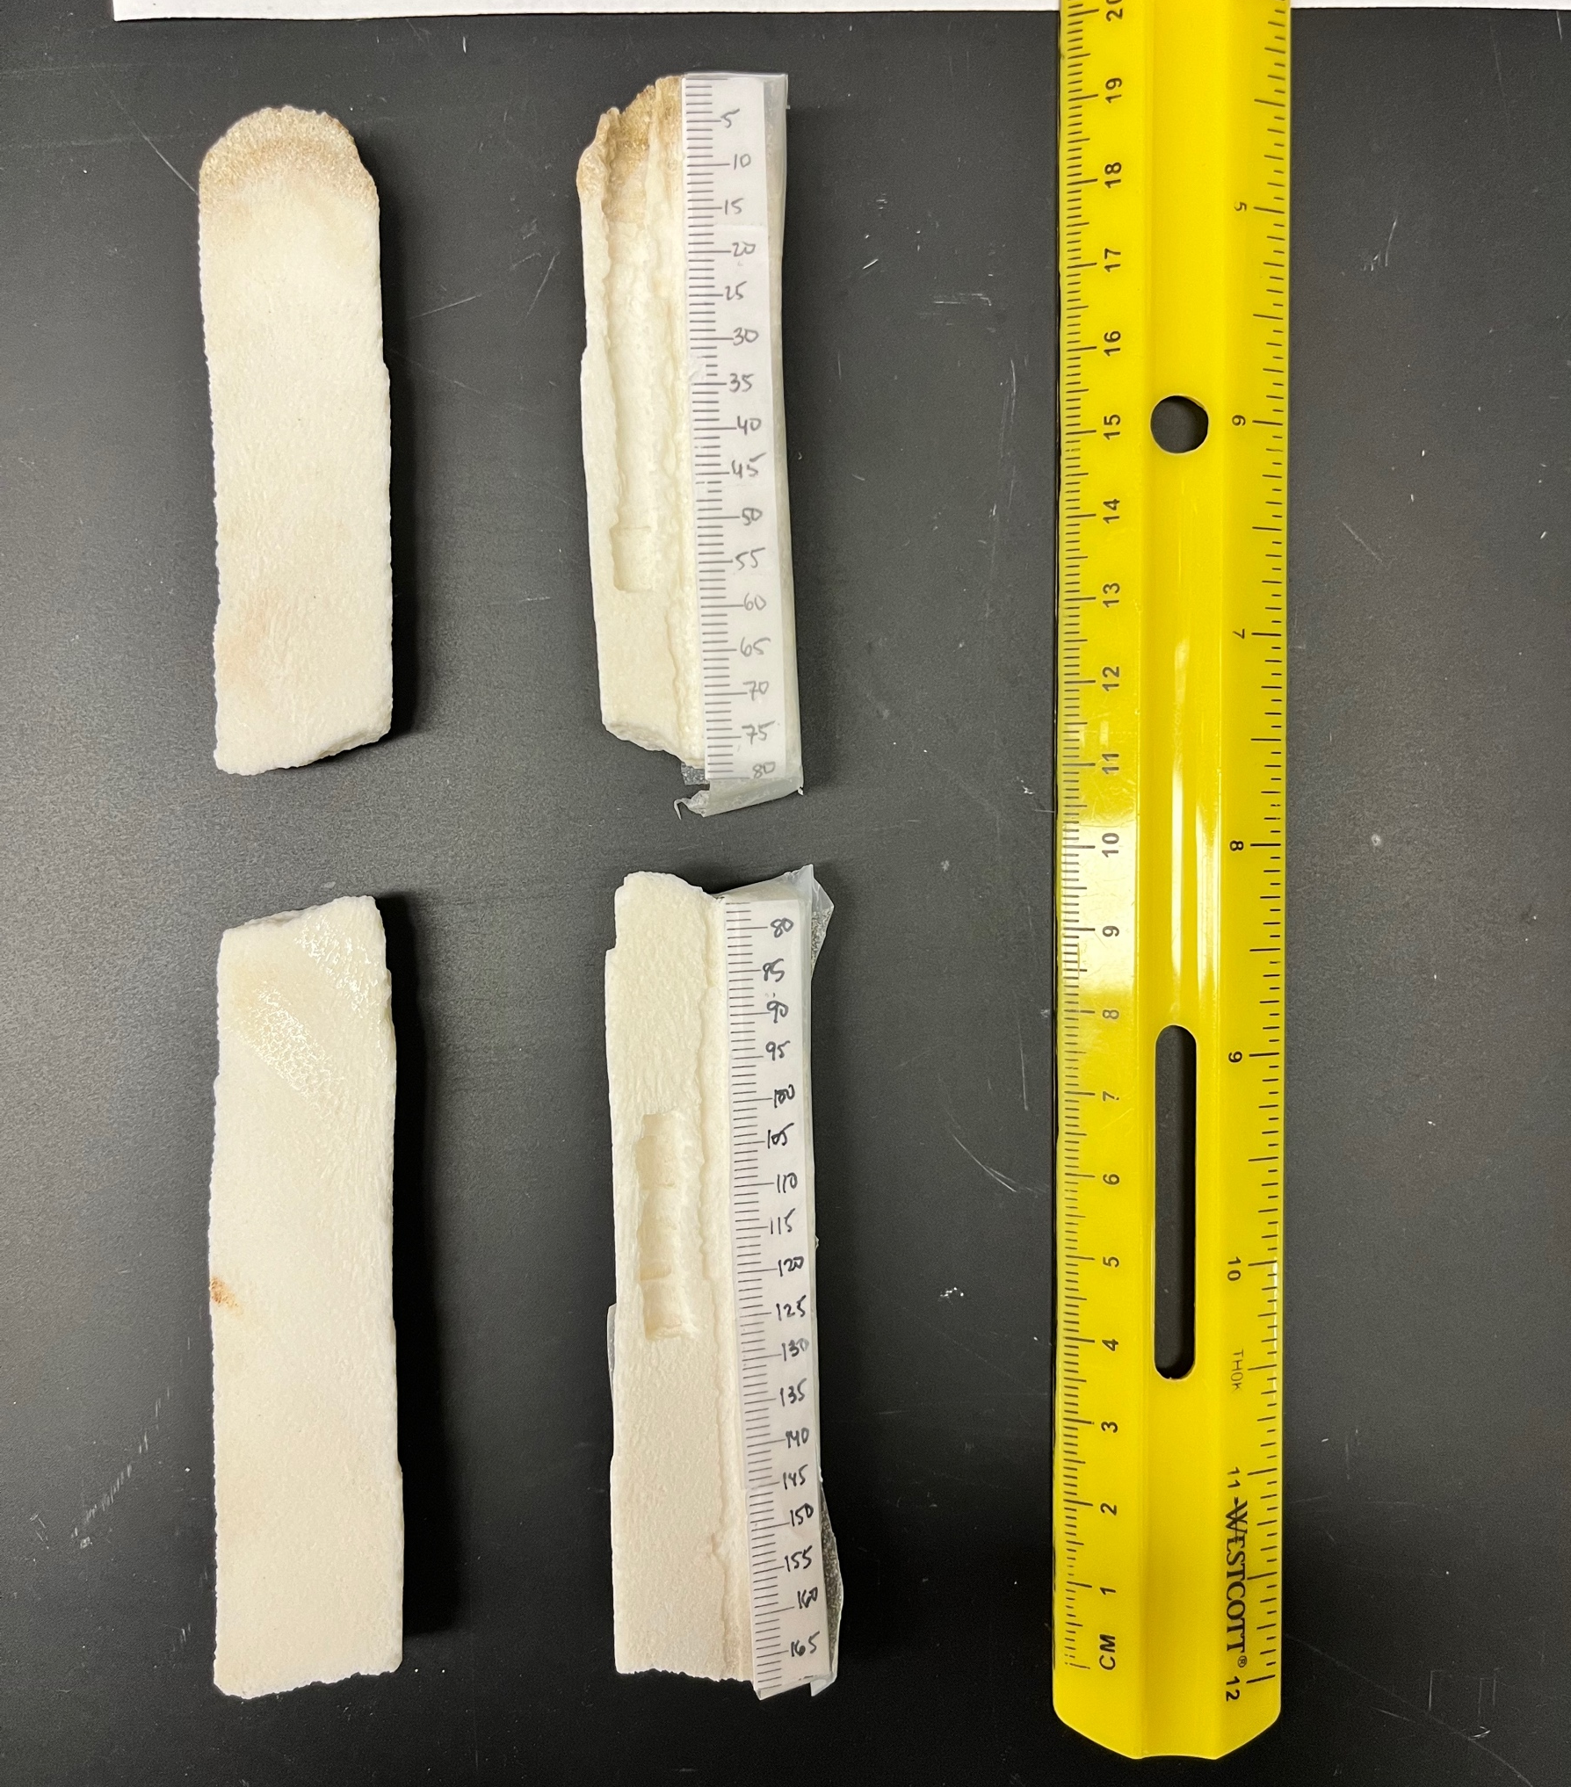
Meet the Cores
Collected in November of 2016 from live corals
Span around 2012-2016
Xray shows growth rate and transect placement

Slide 5
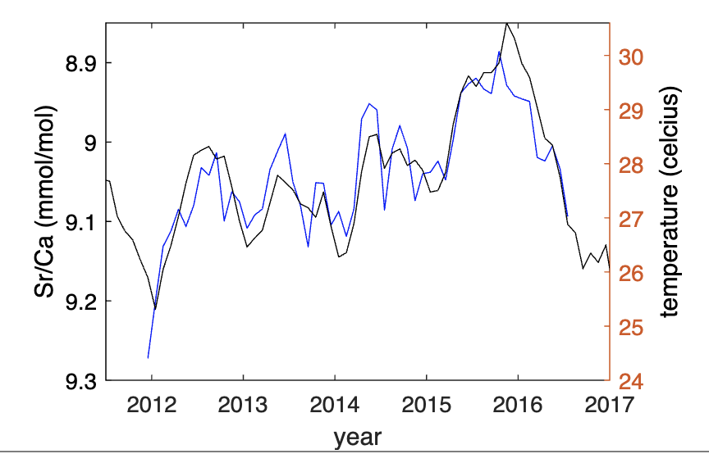
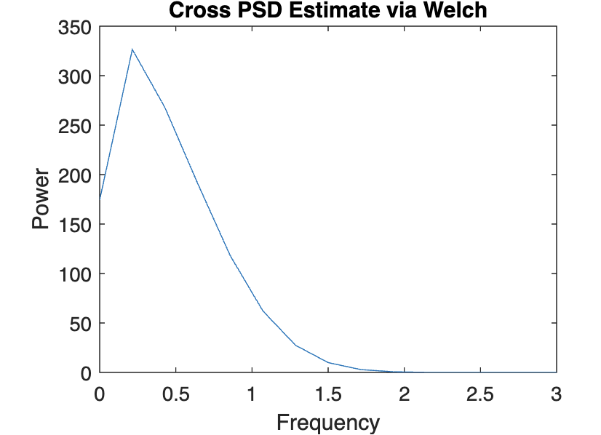
X16C-D10 vs Sea Surface Temperature
R=-0.8770
year

Slide 6
Least Squares Regression Analysis of X16C-D10
Correlation Coefficient :
R= -0.8770
95% CI :
lower= -0.9263
Upper= -0.7681
Notes:
Something super interesting about this plot, most of the residuals in highest/lowest temps are fairly small, so when there is an anamoly the record and sst seem to agree

Slide 7
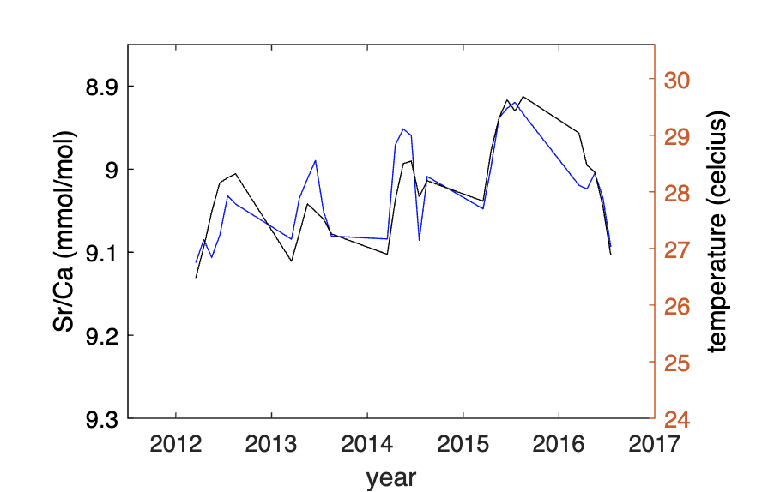
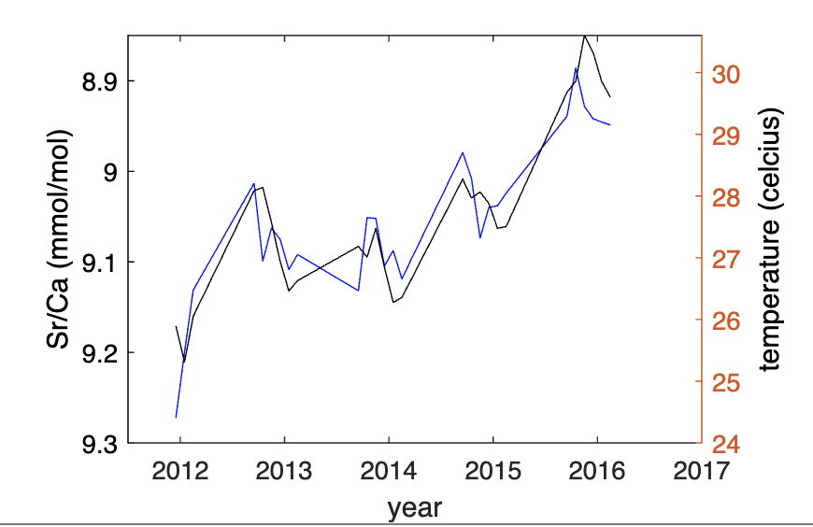
Now, Let’s Look Separately at Summer (April-September) and Winter (October-March)
Summer Winter

Slide 8
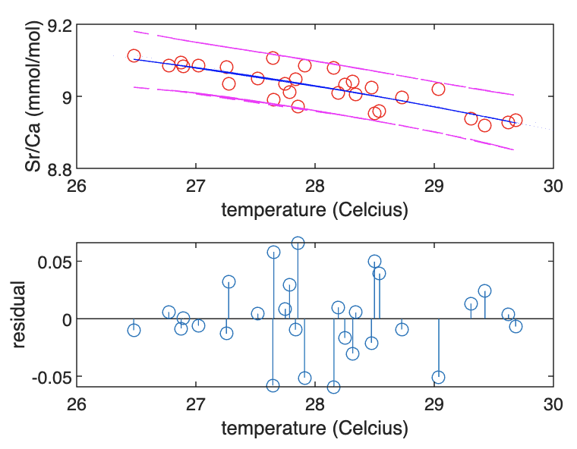
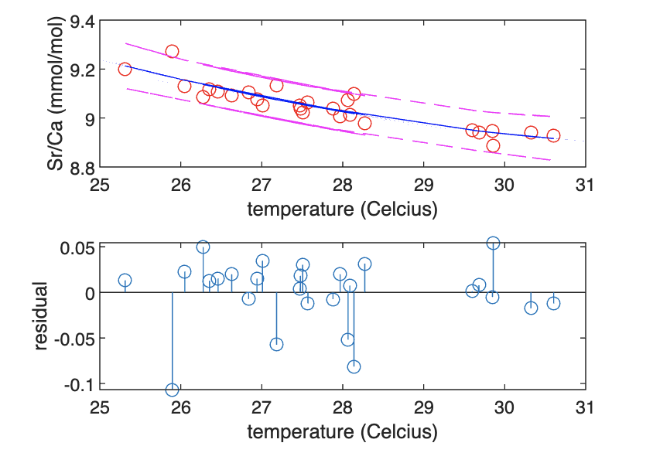
X16C-D10
Summer Winter
Correlation coefficient= -0.8282
Correlation coefficient= -0.8968
Notes:
Summer- normal spread of residuas, winter- weird spread

Slide 9
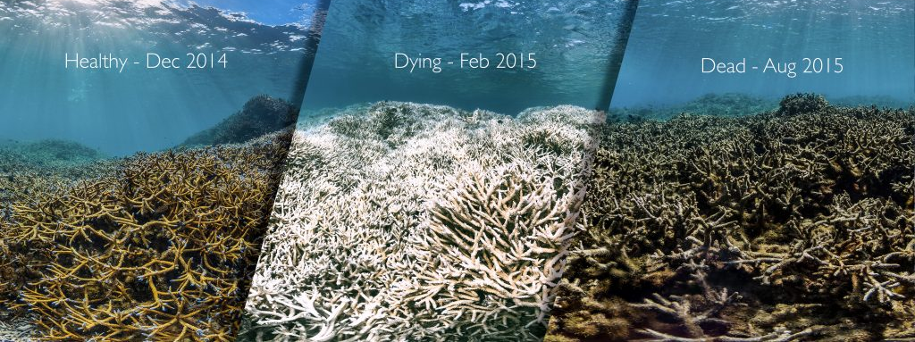
Potential Answer- Coral Bleaching
Occurs during summer months as temperatures rise above those optimal for coral growth
2014, 2015, 2016 were all particularly bad years for coral bleaching

Slide 10
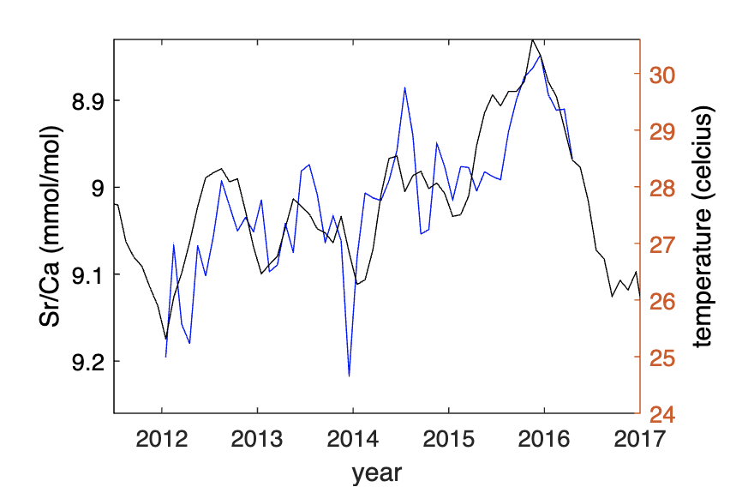
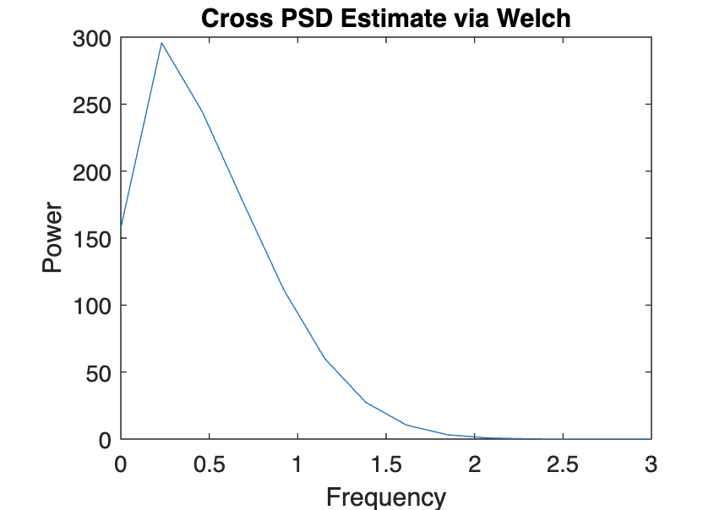
Is this trend replicated across other coral cores?
X16C-D5
R=-0.7552

Slide 11
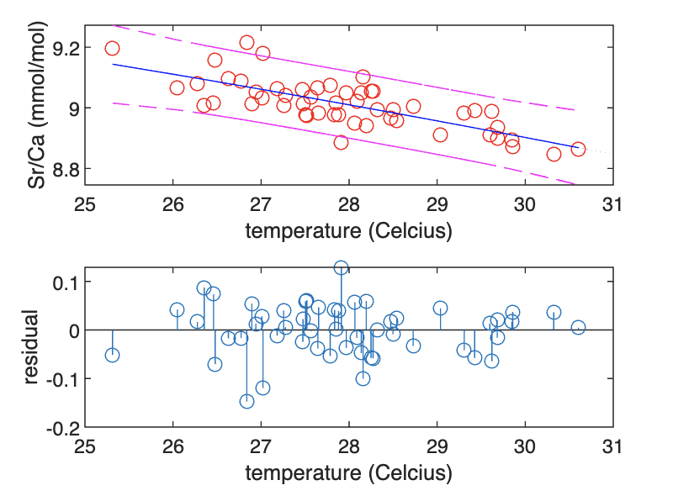
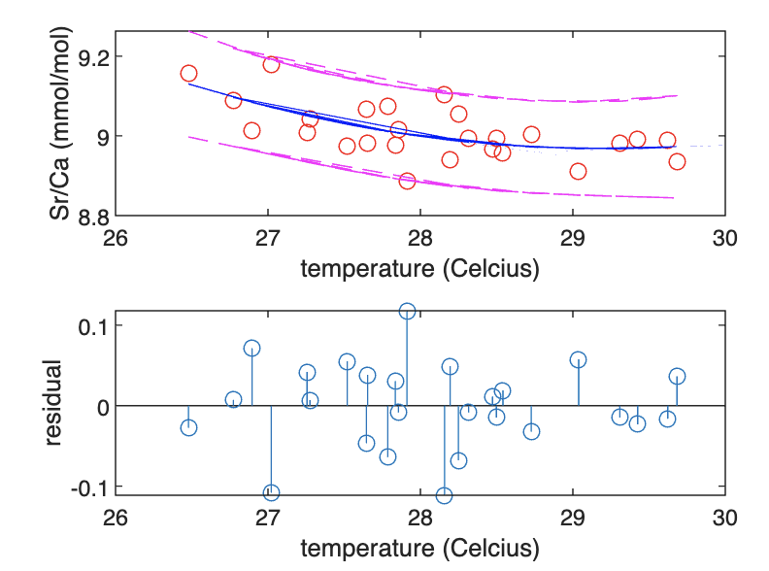
Correlation Coefficient: R= -0.8483 95% CI: lower:-0.9300 upper:-0.6865
Correlation Coefficient:
R= -0.5792 95% CI:
lower: -0.789 upper: -0.2474
Summer Winter

Slide 12
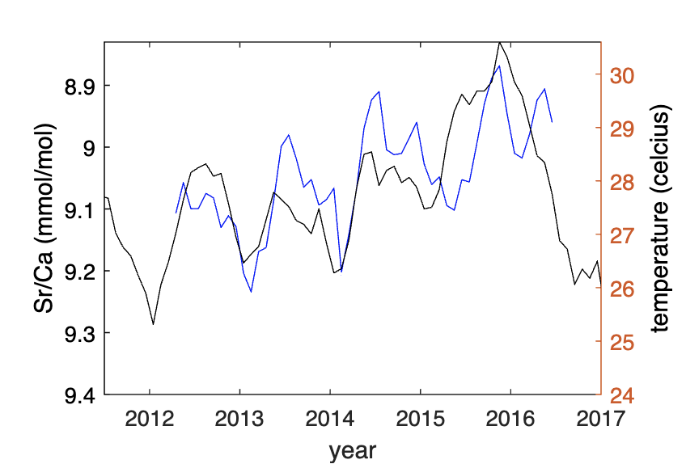
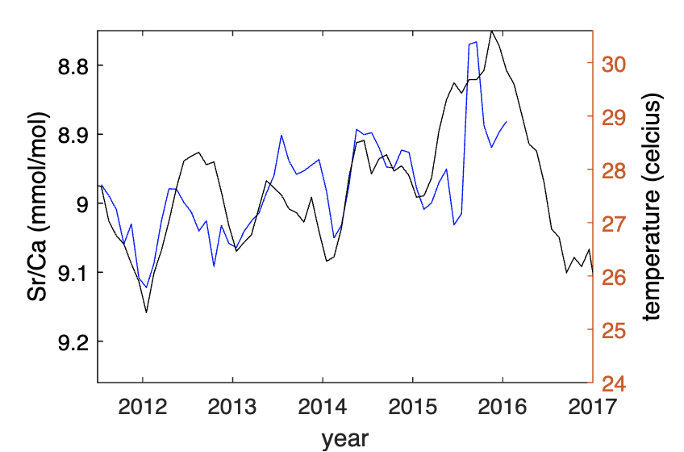
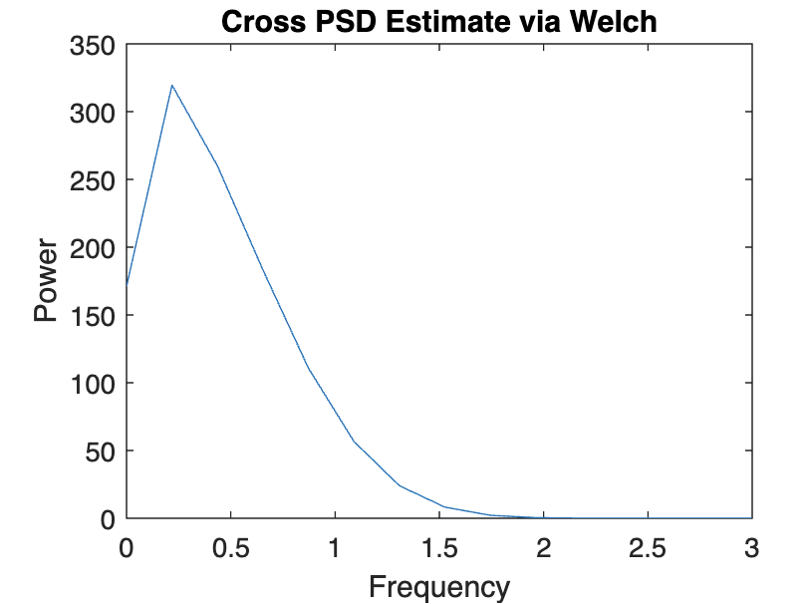
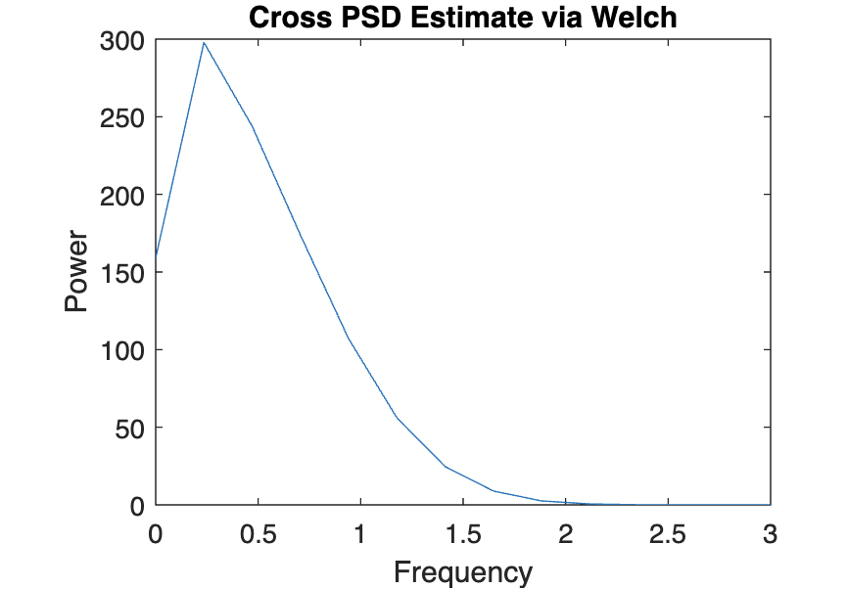
Now, let’s look at X16C-D3 and X16C-D1
X16C-D3
X16C-D1
R= -0.6209
R= -0.6483

Slide 13
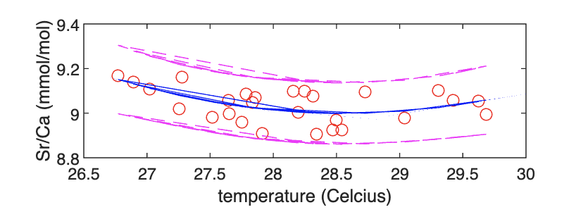
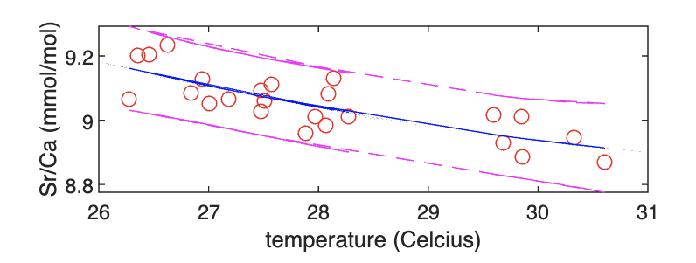
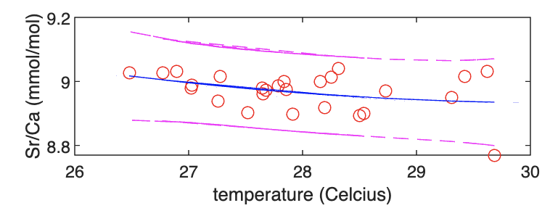
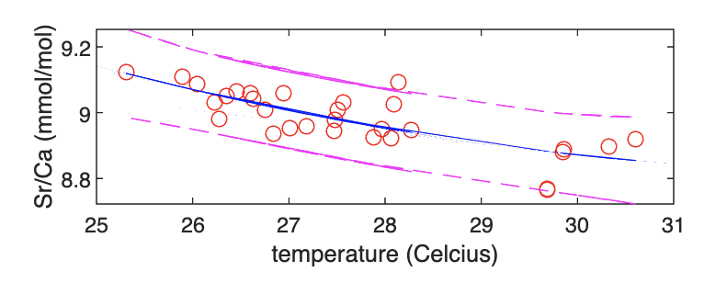
Correlation Coefficient: R= -0.8020 95% CI: lower:-0.9107 upper:-0.5812
Correlation Coefficient:
R= -0.3068 95% CI:
lower: -0.6151 upper: 0.0852
X16C-D3
Summer Winter
X16C-D1
R= -0.3581 95% CI: lower: -0.6546 upper: 0.0340
R= -0.7787 95% CI: lower: -0.8894 upper: -0.5815

Slide 14
Overall Comparison
Coral name | Correlation Coefficient R | R (summer-April-Sept) | R (winter- October-Mar) | 95% Confidence Interval-Lower | 95% Confidence Interval- upper
X16C-D10 | -0.8770 | -0.8282 | -0.8968 | -0.9263 | -0.7981
X16C-D5 | -0.7552 | -0.5792 | -0.8483 | -0.8524 | -0.6075
X16C-D1 | -0.6483 | -0.3581 | -0.7787 | -0.4626 | -0.7796
X16C-D3 | -0.6209 | -0.3068 | -0.8020 | -0.7655 | -0.4166

Slide 15
Overall Comparison
Coral name | Correlation Coefficient R | R (summer-April-Sept) | R (winter- October-Mar) | 95% Confidence Interval-Lower | 95% Confidence Interval- upper
X16C-D10 | -0.8770 | -0.8282 | -0.8968 | -0.9263 | -0.7981
X16C-D5 | -0.7552 | -0.5792 | -0.8483 | -0.8524 | -0.6075
X16C-D1 | -0.6483 | -0.3581 | -0.7787 | -0.4626 | -0.7796
X16C-D3 | -0.6209 | -0.3068 | -0.8020 | -0.7655 | -0.4166
For all 4 coral records, we see a stronger correlation between Sr/Ca and sea surface temperature (SST) during the winter months

Slide 16
Thank You!
Questions?

