Slide 2
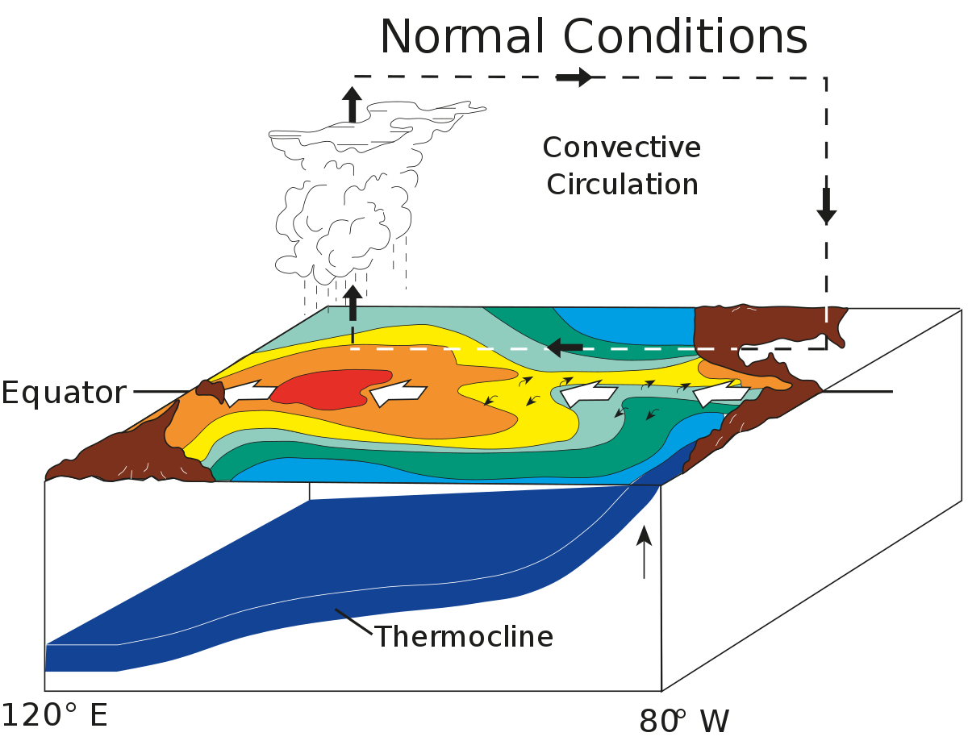
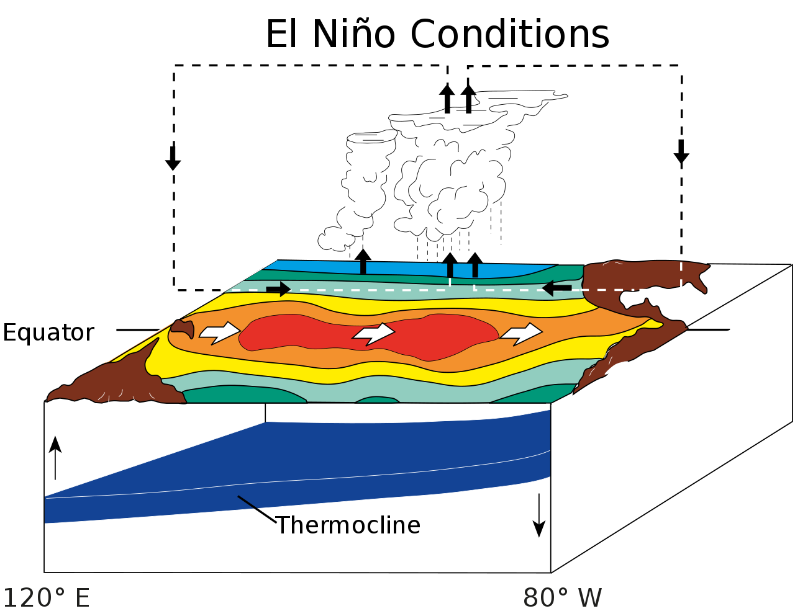
Background
2015/16 El Niño is one of the strongest on record
El Niño is often associated with:
Sea Surface Temperature
Atmospheric convection, precipitation
Sea Surface Salinity
https://en.wikipedia.org/wiki/El_Ni%C3%B1o#/media/File:ENSO_-_normal.svg

Slide 3
Background
2015/16 El Niño is one of the strongest on record
El Niño is often associated with:
Sea Surface Temperature
Atmospheric convection, precipitation
Sea Surface Salinity
Research question
How do the relationships between these variables change over the ENSO cycle?
https://en.wikipedia.org/wiki/El_Ni%C3%B1o#/media/File:ENSO_-_normal.svg

Slide 4
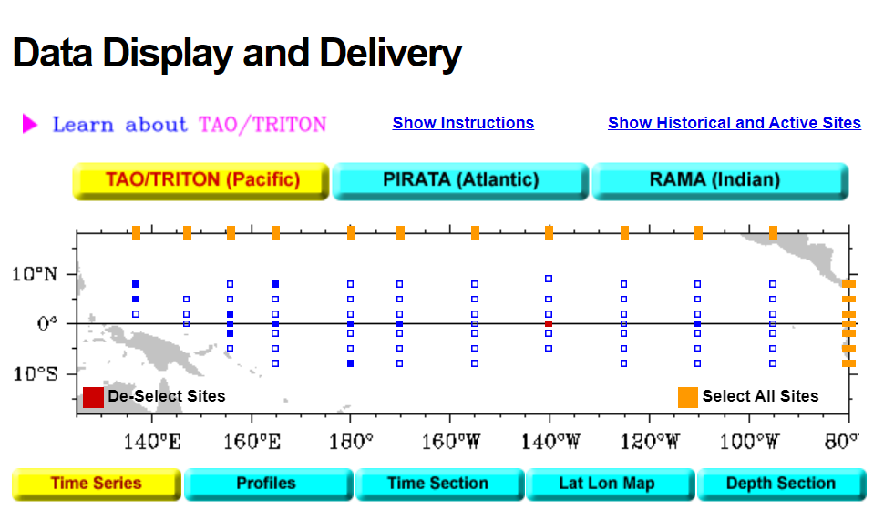
Methods
Time period: 10/1/2015 – 10/1/2017
Location: central Pacific (0N, 140W)
Variables: rain, SST, SSS
Sampling rate: 1/day
https://www.pmel.noaa.gov/tao/drupal/disdel/

Slide 5
Methods
Time period: 10/1/2015 – 10/1/2017
Location: central Pacific (0N, 140W)
Variables: rain, SST, SSS
Sampling rate: 1/day
Time series
pick out major rain periods (2)
LS regression between 3 variables
Cross-spectral analysis
https://www.pmel.noaa.gov/tao/drupal/disdel/

Slide 6
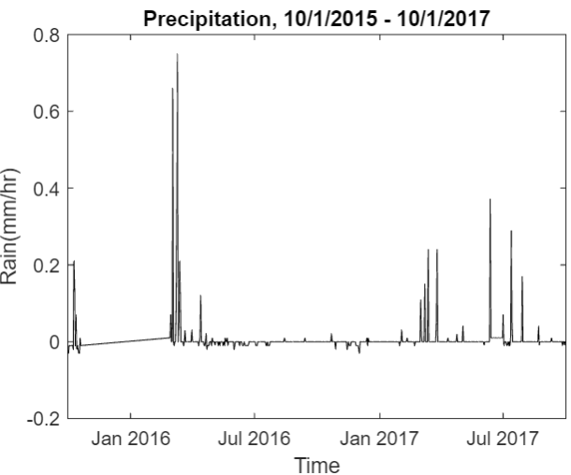
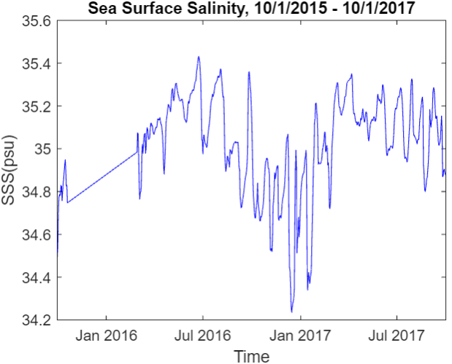
Time series analysis

Slide 7
Time series analysis
Lack of data between 10/21/2015 – 2/27-2016

Slide 8
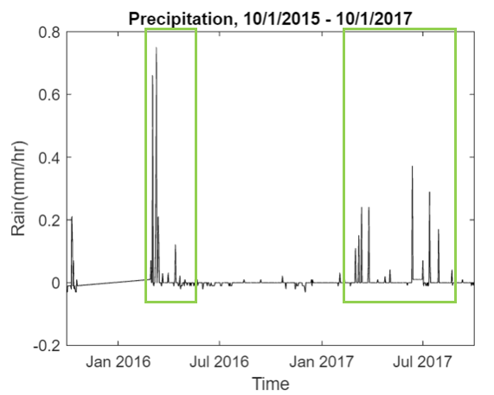
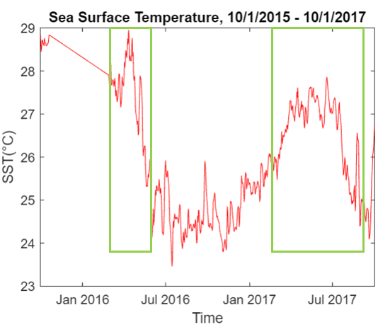
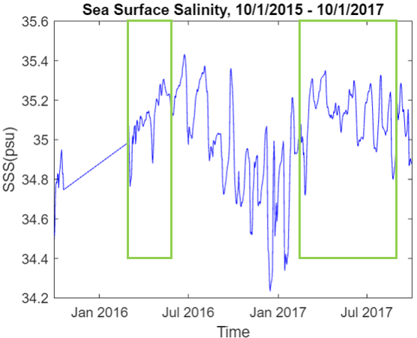
Time series analysis
2 major rain periods:
(1) 3/2/2016 – 4/14/2016, after El Niño peak
(2) 3/1/2017 – 7/30/2017, after La Niña peak

Slide 9
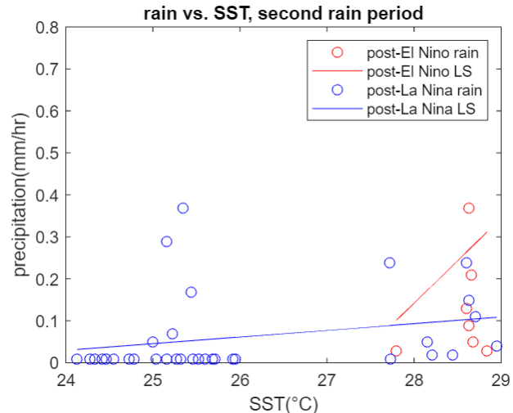
Precipitation vs. SST, regressions analysis
Y = 0.20*X – 5.516
Y = 0.02*X – 0.352
General increase of precipitation with increasing SST
Not significant

Slide 10
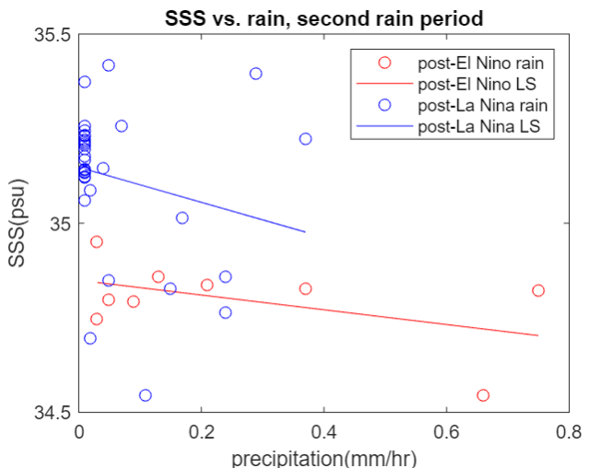
SSS vs. rain, regressions analysis
Y = -0.195*X + 34.95
Y = -0.0463*X + 35.15
General decrease of SSS with increasing precipitation
Not significant

Slide 11
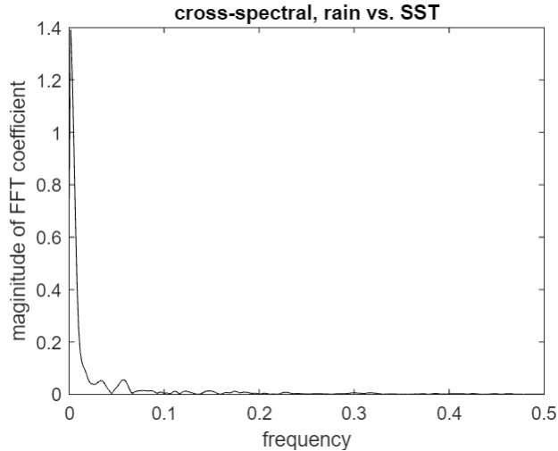
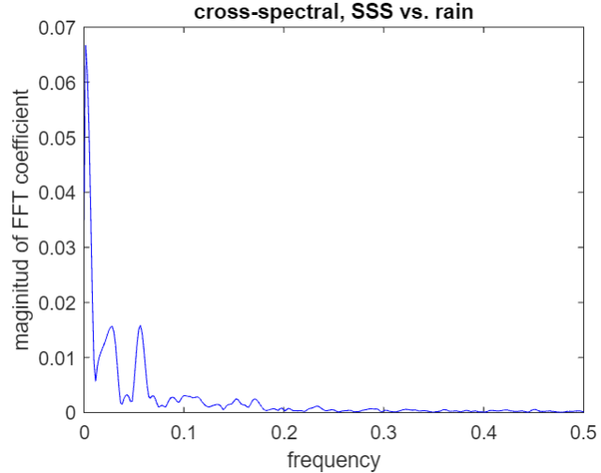
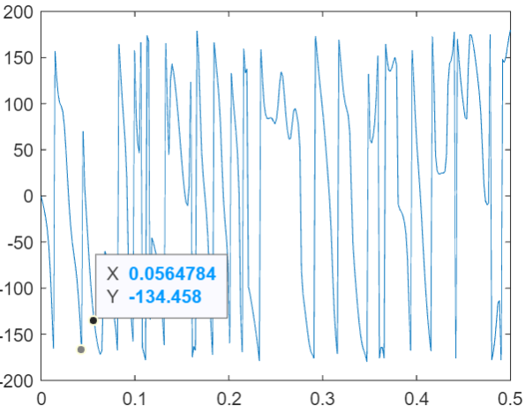
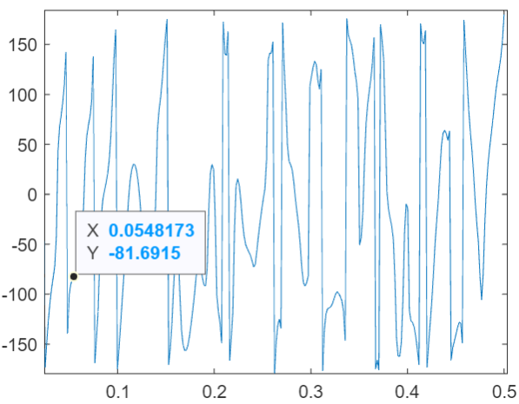
Cross-spectral analysis

Slide 12
Cross-spectral analysis
Cross-spectral magnitude peak: 0.056
Corresponding phase lag: -134 degrees
Time lag = -134/360*T = -6.6 hours
Cross-spectral magnitude peak: 0.055
Corresponding phase lag: -82 degrees
Time lag = -82/360*T= -4.1 hours

Slide 13
Adjustments and next steps
Do the data actually correlate in frequency space?
Coherence test
Extend period of analysis to better capture cycles

