Slide 1
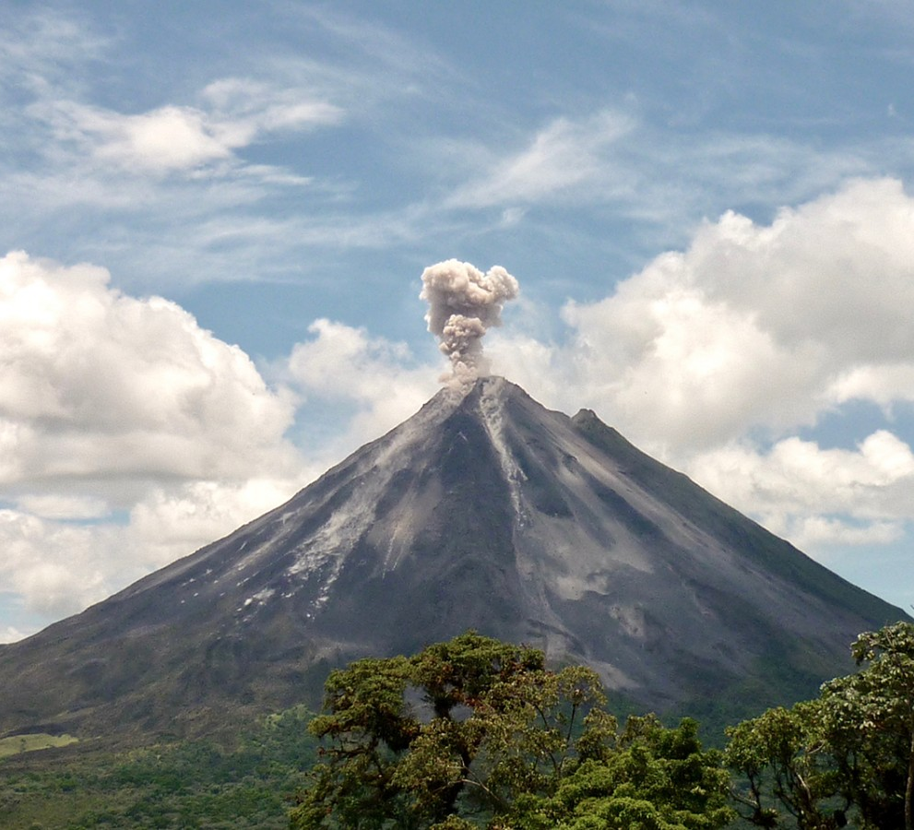
Correlation Analysis of Volcanic SO₂ Emissions and Temperature Anomaly
EAS 4480 Term Project
By: Marcus Morris

Slide 2
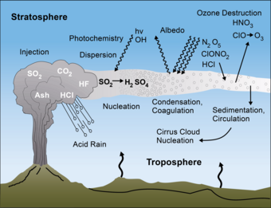
Introduction and Background
During large eruptions (VEI>3) volcanic eruptions can deposit large amounts of SO₂
SO₂ can last several weeks in the stratosphere, during which sulfate aerosols are formed which reflect incoming solar radiation
Reduction in incoming solar radiation results in global cooling
Hypothesis: There is a correlation between SO₂ deposited from volcanic eruptions and the resultant decrease in global average temperature compared to the long-term average
Notes:
Sources:
https://sacs.aeronomie.be/so2-atmos.php
https://www.usgs.gov/programs/VHP/volcanoes-can-affect-climate#:~:text=Volcanoes%20can%20impact%20climate%20change,are%20injected%20into%20the%20stratosphere.&text=But%20volcanic%20gases%20like%20sulfur,potential%20to%20promote%20global%20warming.

Slide 3
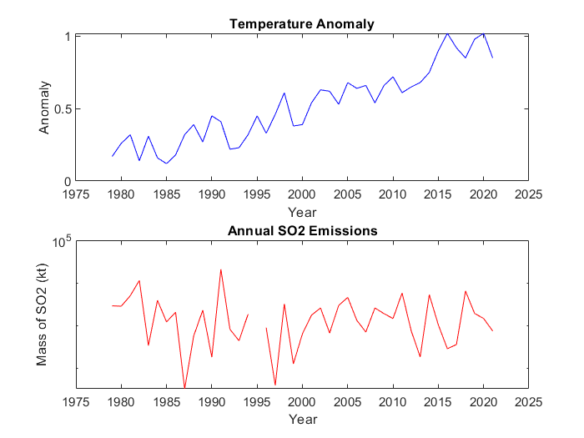
Data
Data retrieved from NASA’s Goddard Institute for Space Studies
Date Range: 1979-2021
Global Scale
Preliminary Analysis
Correlation Coefficient: r= 0.065, [-0.24, 0.36]
P-value: p=0.68, p>0.05 so correlation is not significant

Slide 4
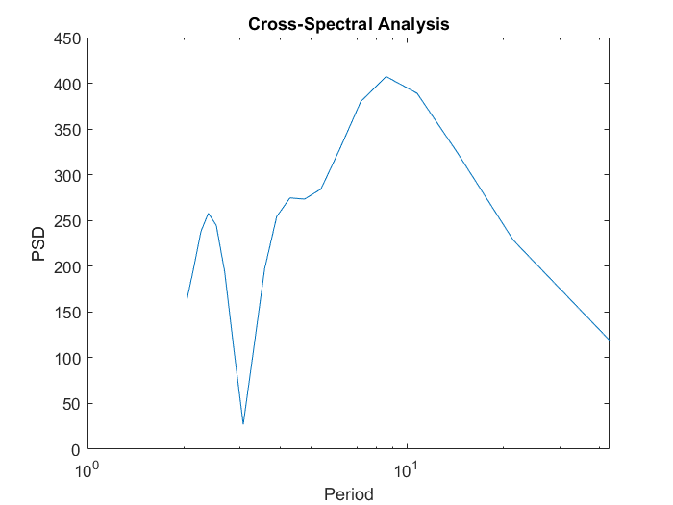
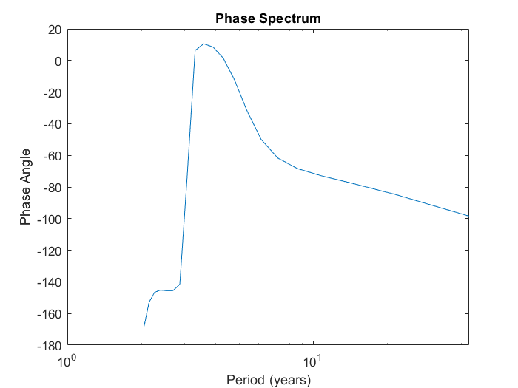
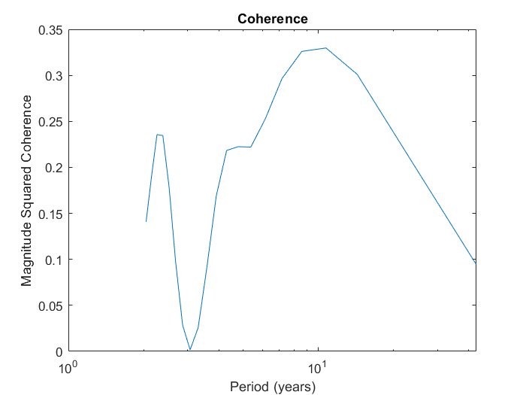
Cross-Spectral Analysis
Cross-spectral analysis gives a period of 8.6 years (τ=8.6 yr)
f=1/τ, Frequency: 0.1163
Lag: -68.3
Negative lag indicates the temperature response occurs after the SO₂ emissions
ΔT=-1.6 years
Coherence: 0.33

Slide 5
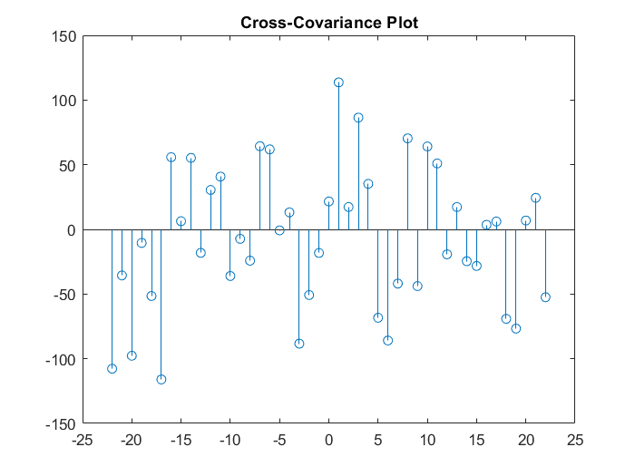
Cross Covariance
Cross-covariance measures the similarity between one dataset and lagged copies of a second dataset
The maximum negative covariance occurs at a period of 6 years

Slide 6
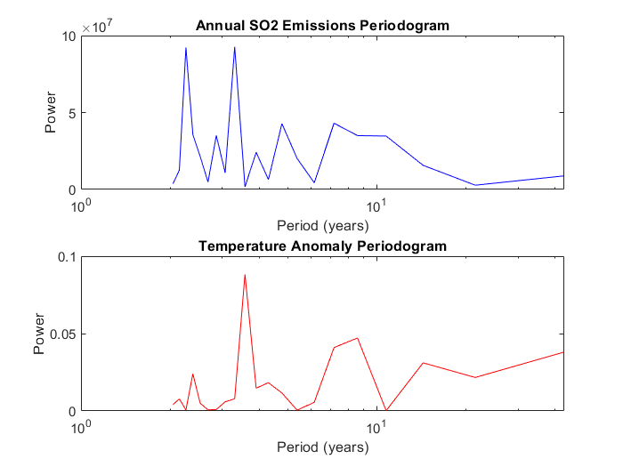
Periodogram

Slide 7
Conclusion
There is a slight correlation (coherence=0.33) between SO₂ emissions from volcanic eruptions and the subsequent decrease in global temperature with a time lag of 1-2 years
Other factors that contribute to changes in temperature anomaly (i.e. anthropogenic GHG emissions) may explain the low coherence

