Slide 1
How does Sea Surface Temperature impact Sea Level Rise?
Mark Rotolo
EAS 4480

Slide 2
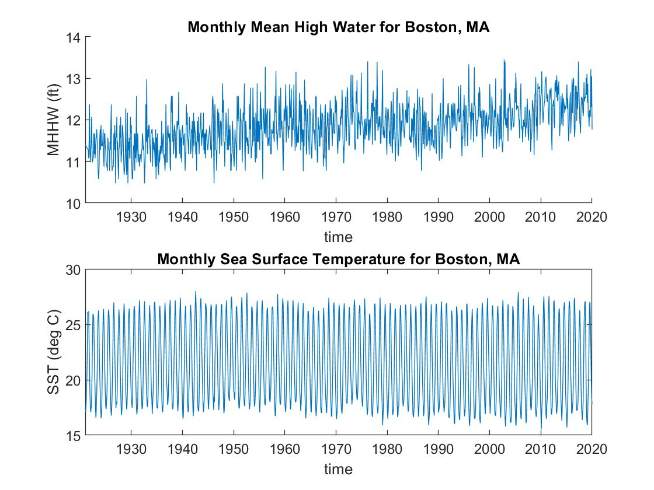
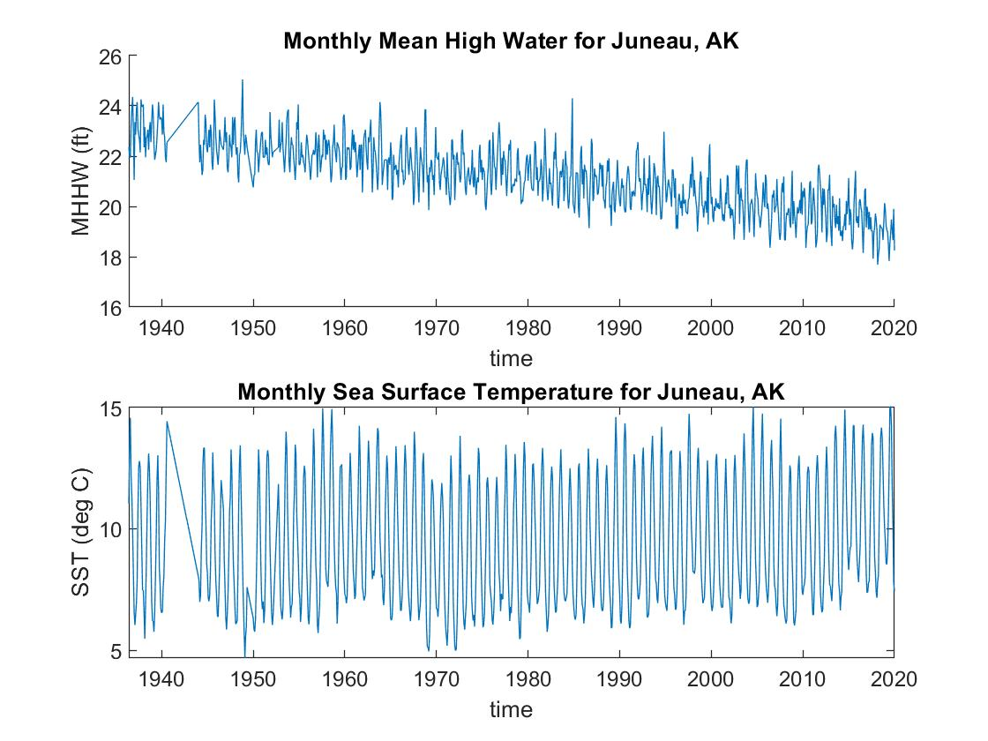
Intro and Data

Slide 3
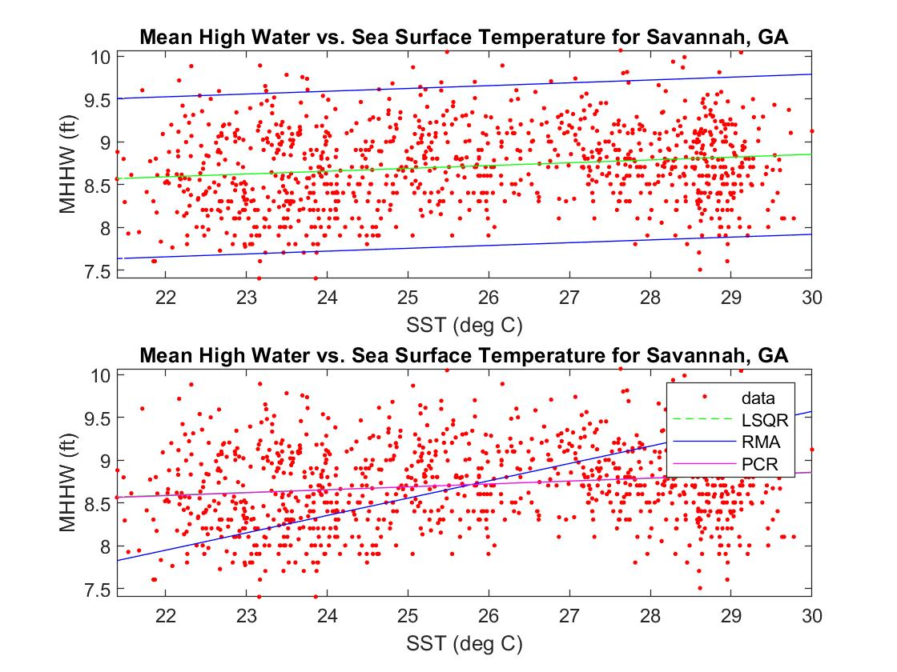
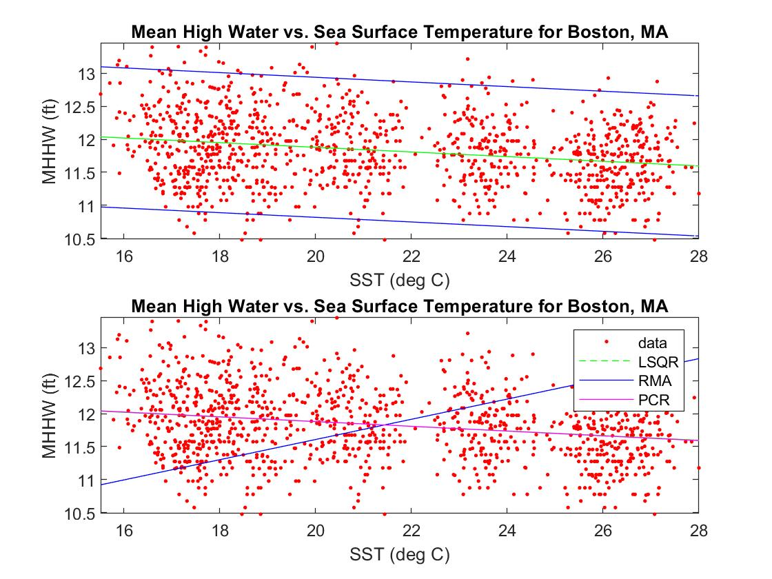
Regression Analysis

Slide 4
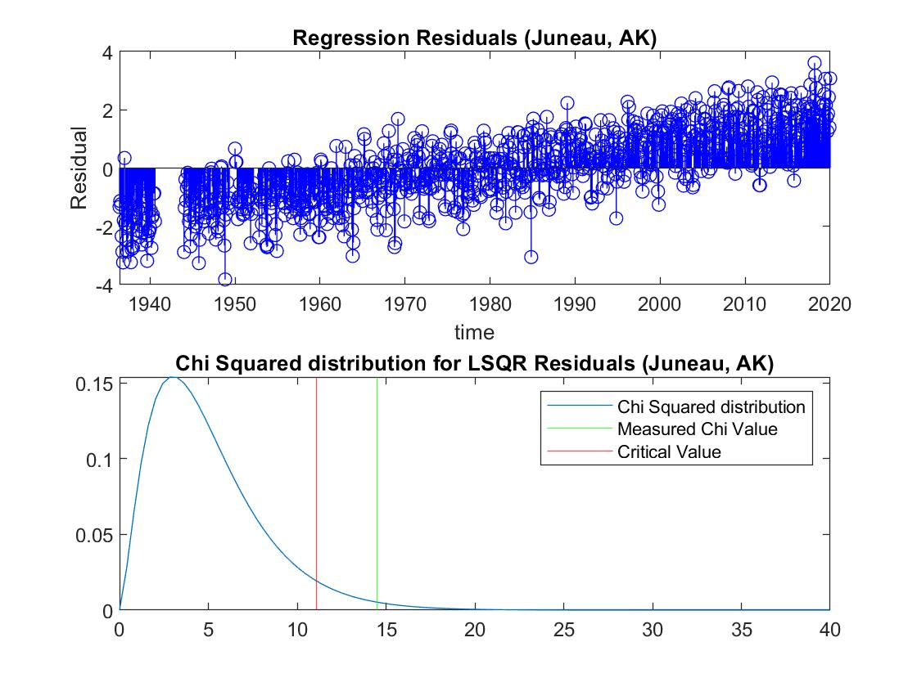
Error Analysis
Slope Confidence Interval
Savannah = [0.1009 0.2223]
Boston = [-0.3279 0.2573]
Alaska = [-1.0847 0.9130]
Hawaii = [0.3125 0.4077]

Slide 5
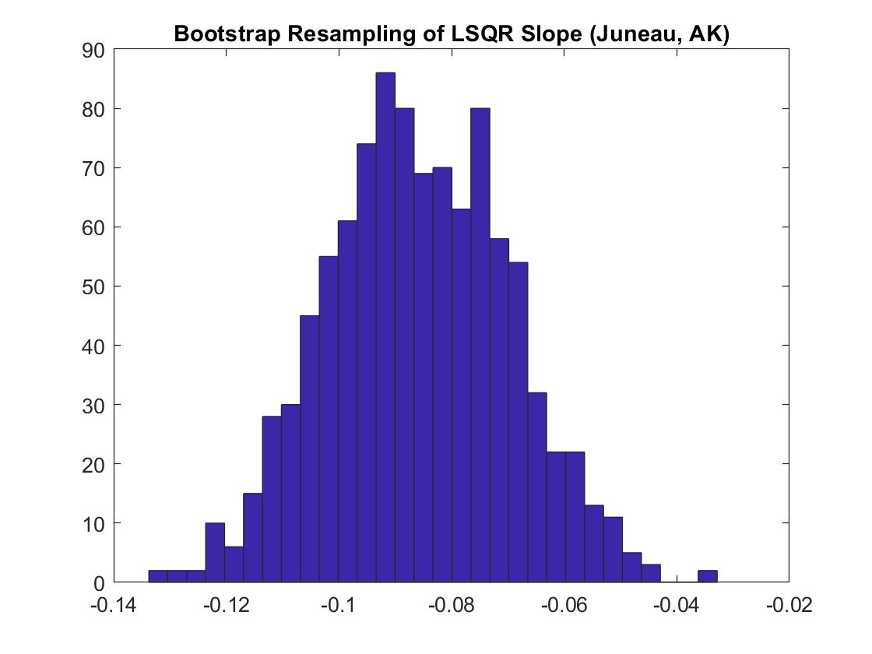
Bootstrap Resampling
Confidence Interval
Savannah = [0.0195 0.0452]
Boston = [-0.0437 -0.0266]
Alaska = [-0.1171 -0.0557]
Hawaii = [0.0894 0.1195]

Slide 6
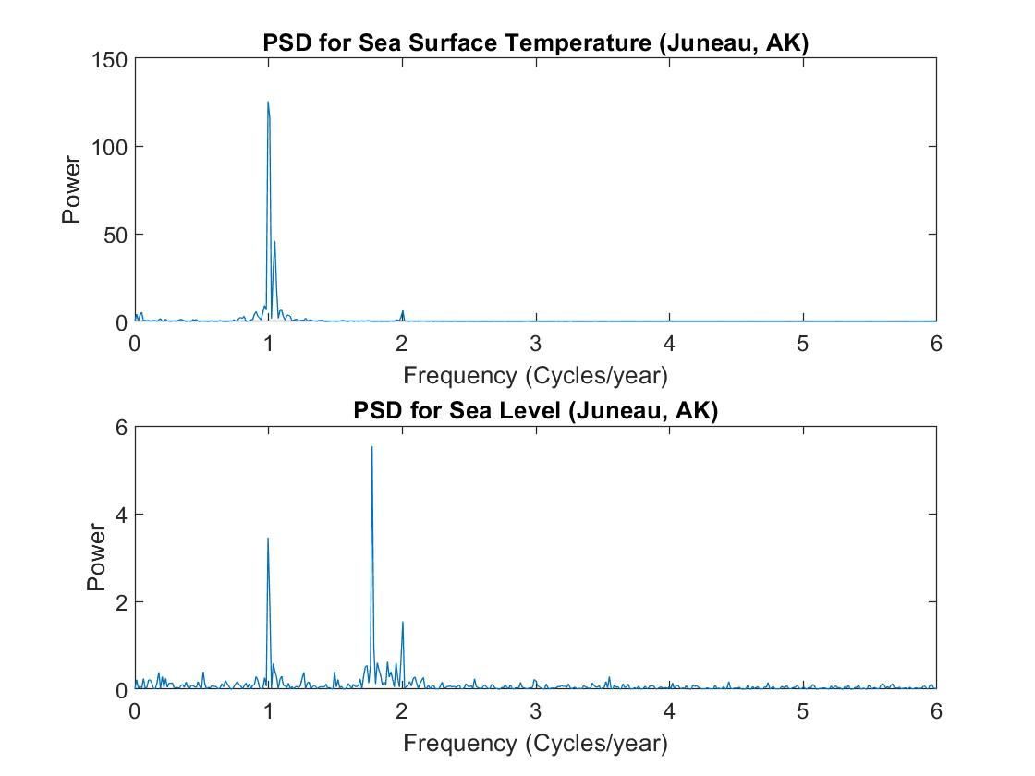
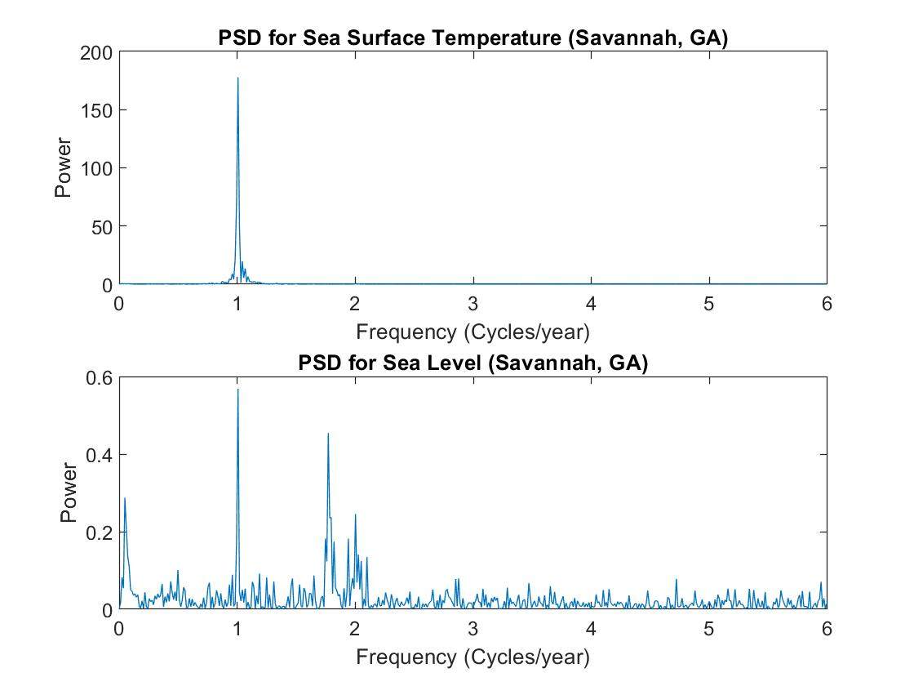
Time Series Analysis

Slide 7
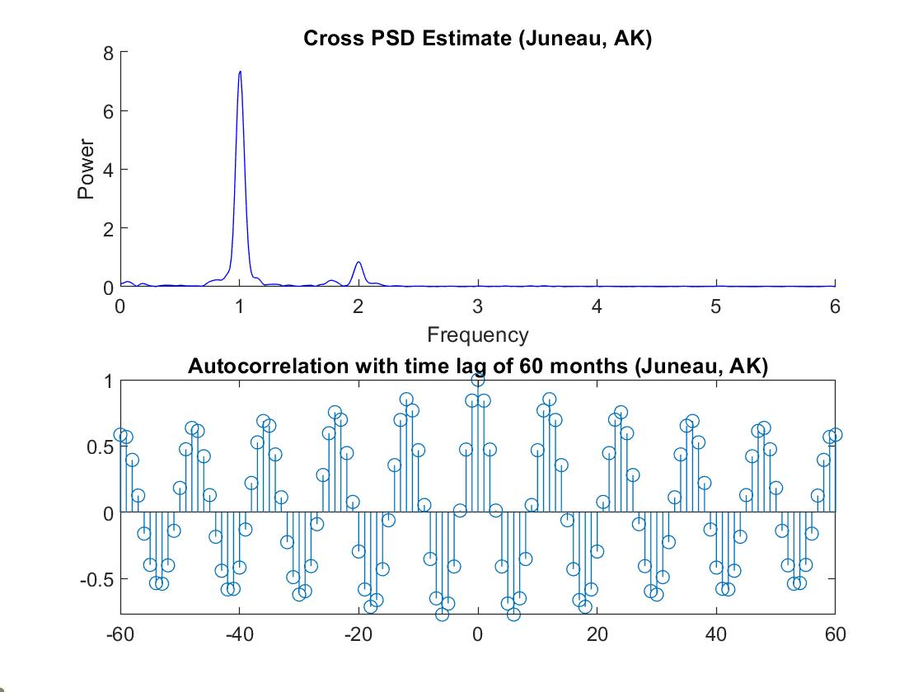
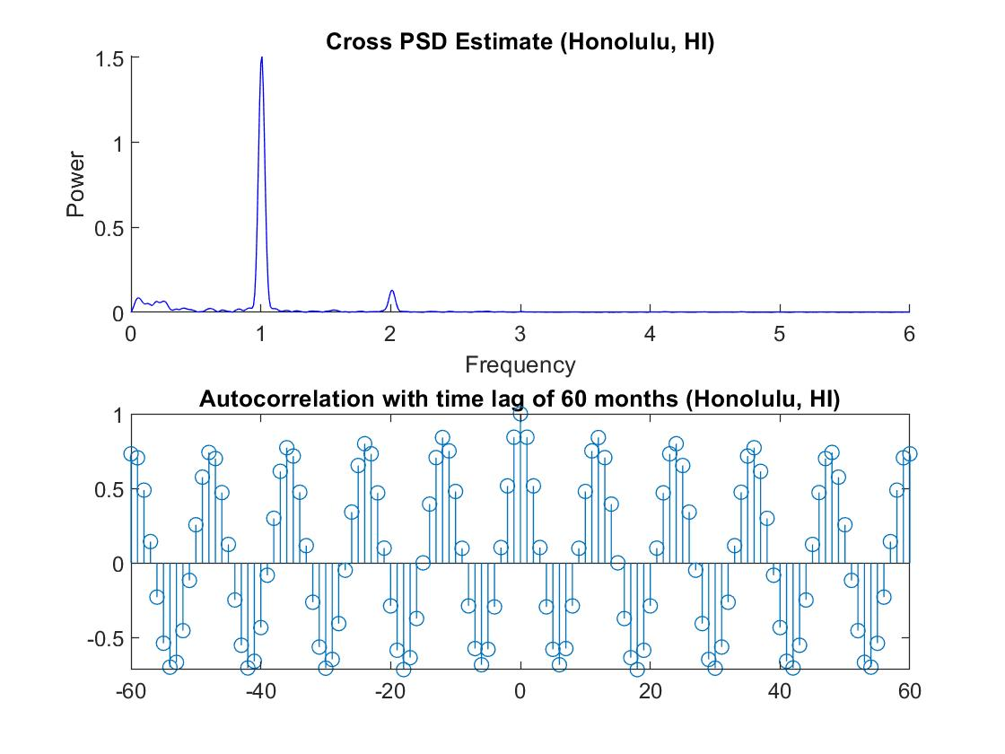
Cross-Spectral Analysis

Slide 8
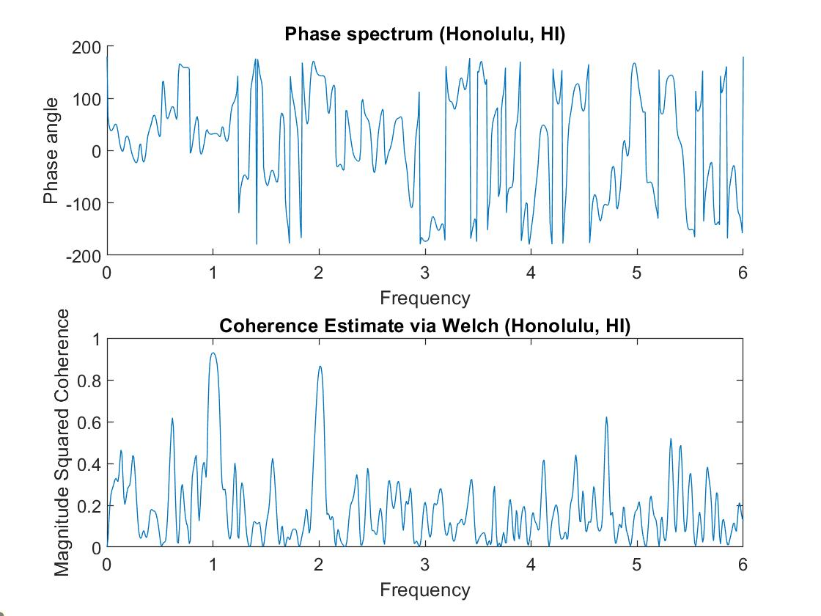
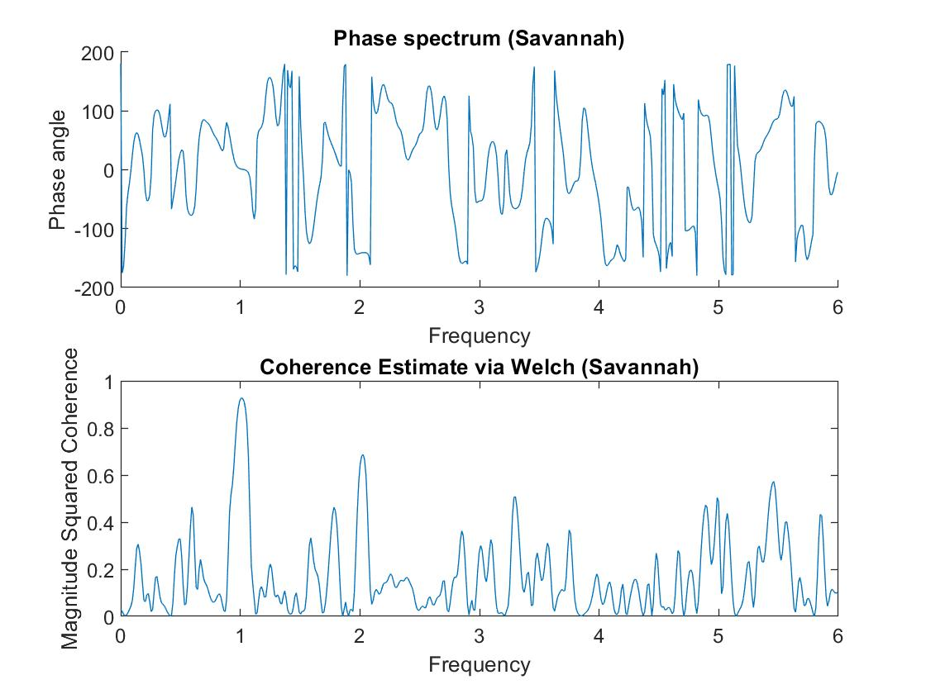
Phase Spectrum and Coherence

Slide 9
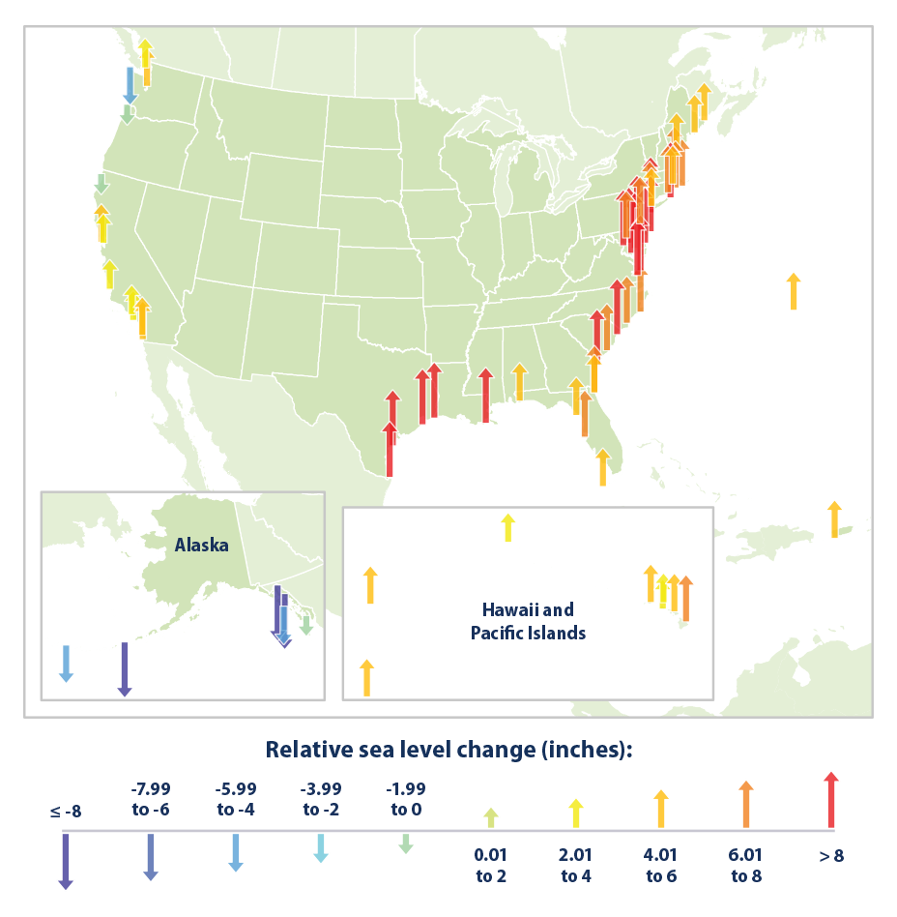
Conclusions
Low Correlation
Periodic Data
Many Factors Contributing to SLR

Slide 10
References
NOAA Tide Gauge Data: https://tidesandcurrents.noaa.gov/map/index.html?region=Georgia
NOAA Sea Surface Level Data: https://psl.noaa.gov/data/gridded/data.noaa.oisst.v2.html
Image: https://www.epa.gov/climate-indicators/climate-change-indicators-sea-level

