Slide 1
Comparison of linear and nonlinear regression of adsorption isotherms
EAS 4480
Paige Wise

Slide 2
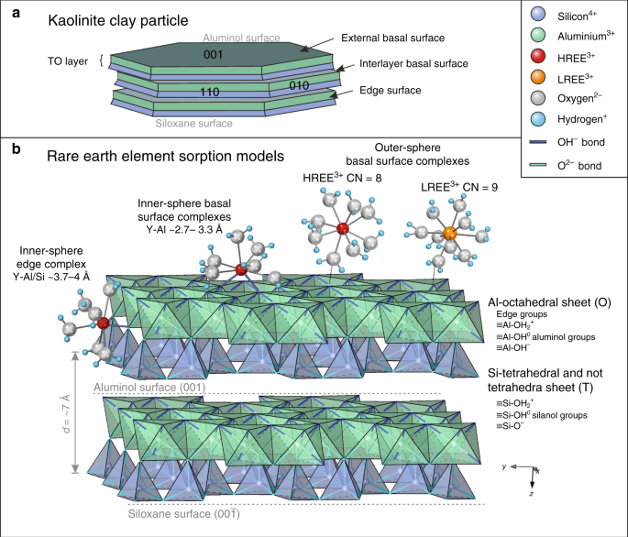
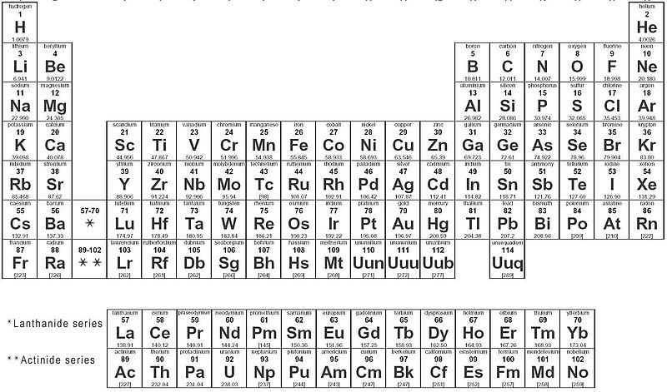
Rare earth element Adsorption
LREE
MREE
HREE
Figure 1: An adapted periodic table to visually display the rare earth metals and the light, middle, and heavy REEs. The categories of REEs are differentiated by atomic mass as the atomic numbers increase across the row. (CC-licensed).
Figure 2: (a) A model of kaolinite highlighting the alternating silicate tetrahedral and aluminum octahedral layers. (b) Hydrated rare earth ions are adsorbing to the surface of kaolinite (Borst et. al 2020)

Slide 3
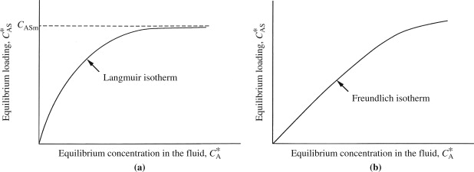
Langmuir vs Freundlich isotherms
Figure 3: (a) A graph depicts a Langmuir isotherm where an adsorption carrying capacity is highlighted with the dotted line. (b) A plotted Freundlich isotherm does not account for a carrying capacity which indicates infinite adsorption sites (Doran, 2013)
Freundlich Isotherm: $q=\frac{x}{m}=nKC$
Langmuir Isotherm: $q=\frac{x}{m}=\frac{bCNmax}{1+bC}$
Where q is the amount of adsorbate taken up during the adsorption and C is the equilibrium concentration of the solution

Slide 4
Objectives
Display Neodymium adsorption data as a Langmuir (non-linear regression) and Freundlich (linear regression)
Analyze the residuals to determine which regression is a better model for the data
Use cross-validation to assess the uncertainty of the regression lines

Slide 5
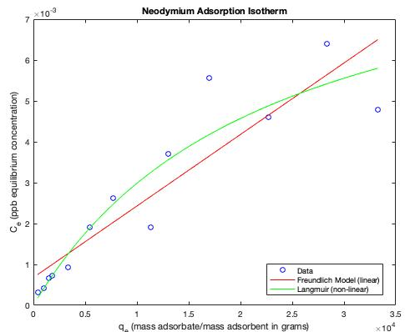
Regression

Slide 6
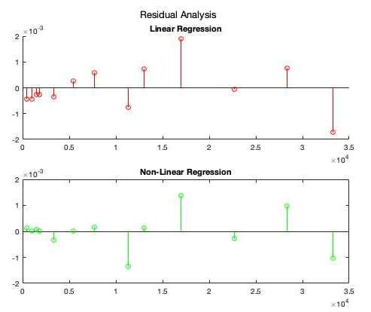
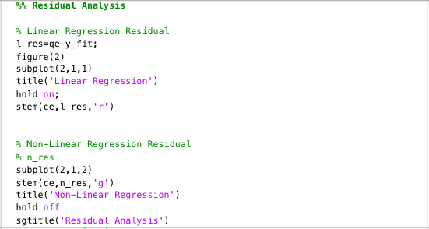
Residual Analysis
Mean of Linear Regression Residuals:
0.00065623
Mean of Non-Linear Regression Residuals:
0.00040148

Slide 7
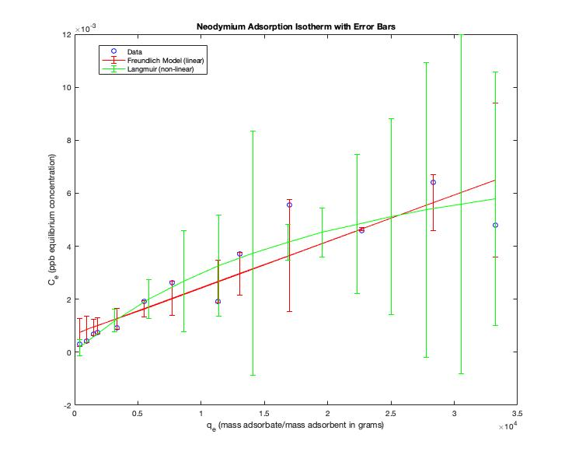
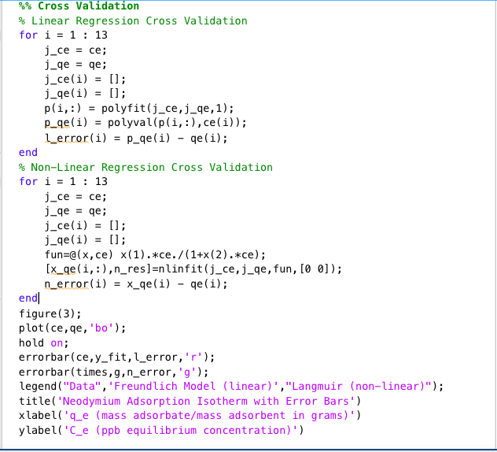
Uncertainty
Mean Linear Regression Error:
0.00082
Mean Non-Linear Regression Error:
0.0027

Slide 8
Conclusions
The Langmuir Isotherm fit the Nd adsorption data better than the Freundlich Isotherm
Smaller mean for the nonlinear residuals
Using cross-validation, it can be determined that though the Langmuir Isotherm fits better but does lead to a large range for errors
Smaller error mean suggests that the Freundlich is easier to calculate
Langmuir isotherms better predict adsorption behavior however in order to minimize error, a large data set would be better

Slide 9
Sources
Doran, Pauline M. 2013. “Chapter 11 - Unit Operations BT - Bioprocess Engineering Principles (Second Edition).” 445–595.
Jeppu, Gautham P., and T. Prabhakar Clement. 2012. “A Modified Langmuir-Freundlich Isotherm Model for Simulating PH- Dependent Adsorption Effects.” Journal of Contaminant Hydrology 129–130:46–53. doi: 10.1016/J.JCONHYD.2011.12.001.
Juan Luis, Fernández Martínez, Fernández Muñiz Zulima, and Breysse Denys. 2018. “The Uncertainty Analysis in Linear and Nonlinear Regression Revisited: Application to Concrete Strength Estimation.” Https://Doi.Org/10.1080/17415977.2018.1553969 27(12):1740–64. doi: 10.1080/17415977.2018.1553969.\
Osmari, Taynara Andrea, Roger Gallon, Marcio Schwaab, Elisa Barbosa-Coutinho, João Baptista Severo, and José Carlos Pinto. 2013. “Statistical Analysis of Linear and Non-Linear Regression for the Estimation of Adsorption Isotherm Parameters:” Http://Dx.Doi.Org/10.1260/0263-6174.31.5.433 31(5):433–58. doi: 10.1260/0263-6174.31.5.433.

