Slide 1
Analysis of air quality during COVID lockdown in Delhi, India
Presented by
Ritika Sridharan

Slide 2
Outline
Introduction + Motivation
Hypothesis
Data analysis results
Basic parameters
LS regression
Uncertainty analysis
Time-series analysis

Slide 3
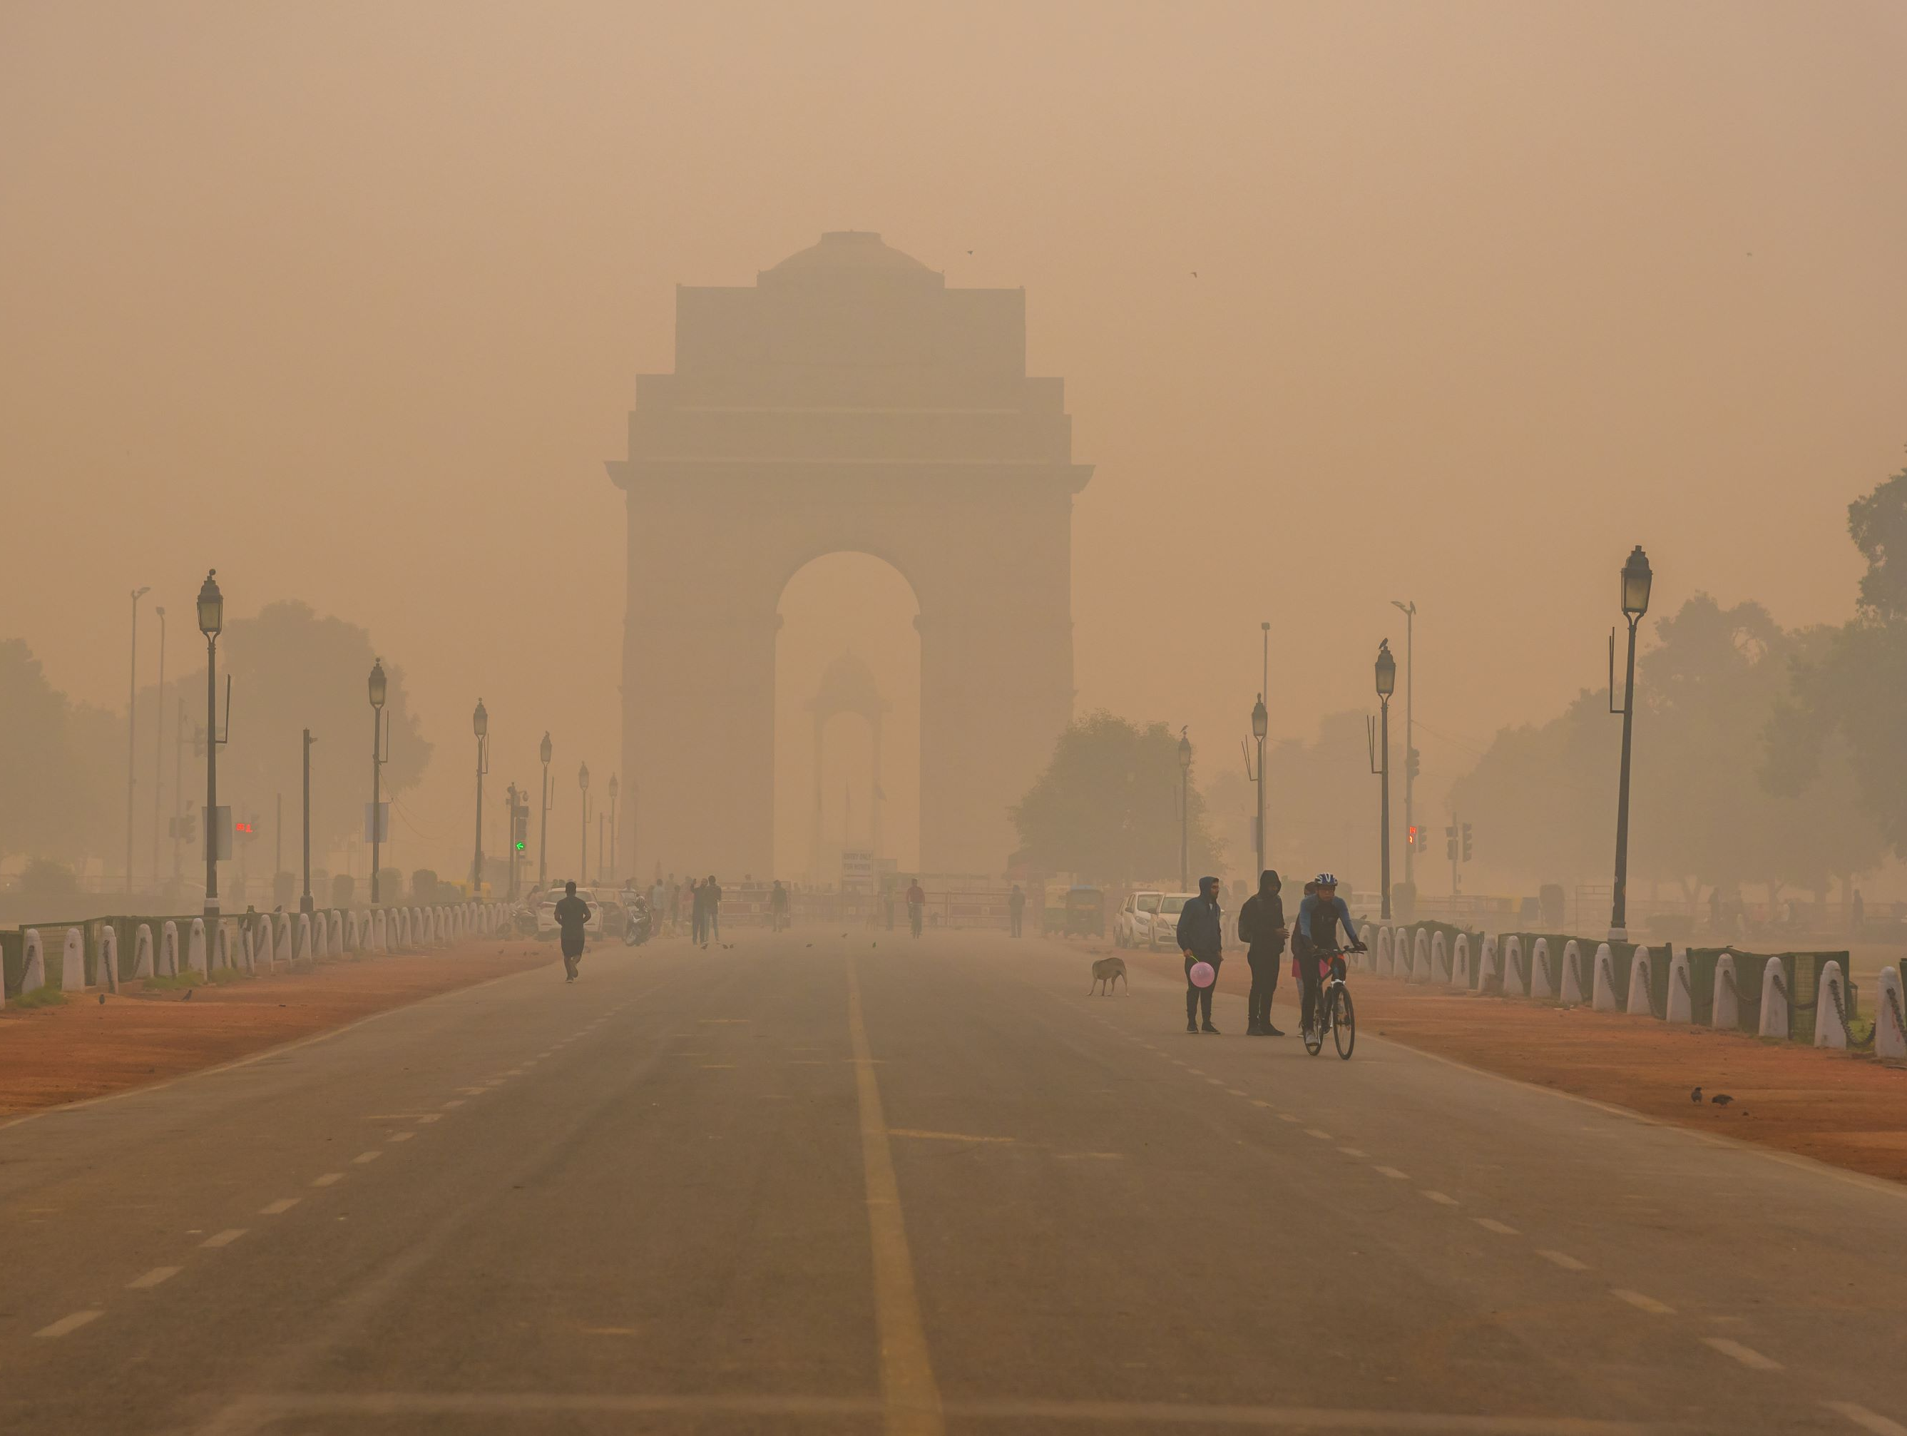
Introduction and Motivation
Delhi was the fourth most polluted city in the world in 2020
30% of Delhi residents have respiratory diseases ^{[1]}
Amid the COVID-19 pandemic, a nationwide lockdown was imposed in India
Lockdown period: 24th March to 31st May 2020 (in 3 phases)
The result of such studies can be used as guidance for regulatory bodies to impose restrictions and improve the air quality
Delhi, the world’s most air polluted capital fights back (brookings.edu)
^{[1]} Mahato, S., Pal, S., & Ghosh, K. G. (2020). Effect of lockdown amid COVID-19 pandemic on air quality of the megacity Delhi, India. Science of the total environment, 730, 139086.

Slide 4
Hypothesis
As COVID cases increase, people tend to stay at home and everything is virtual, so the pollution levels should reduce drastically
Better air quality
Are COVID and PM_{2.5} be inversely related?

Slide 5
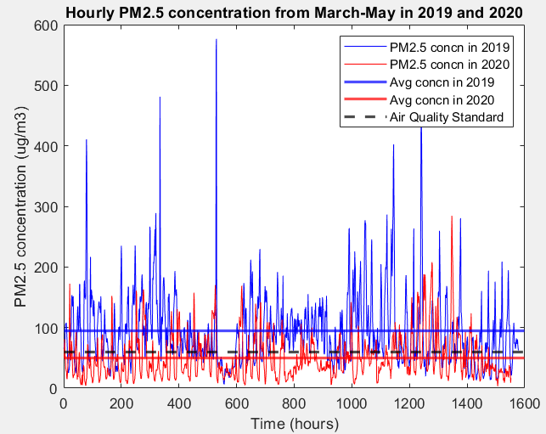
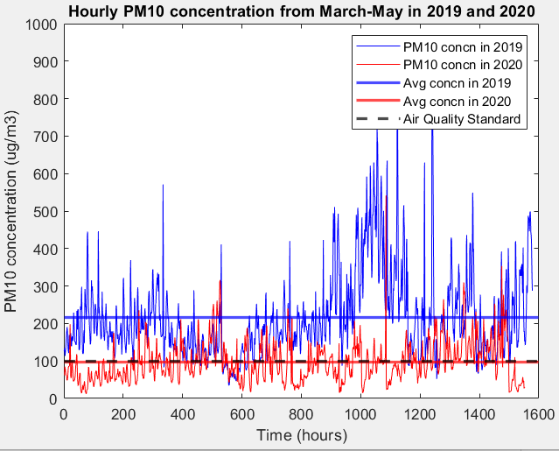
Data Analysis
1. Basic parameters

Slide 6
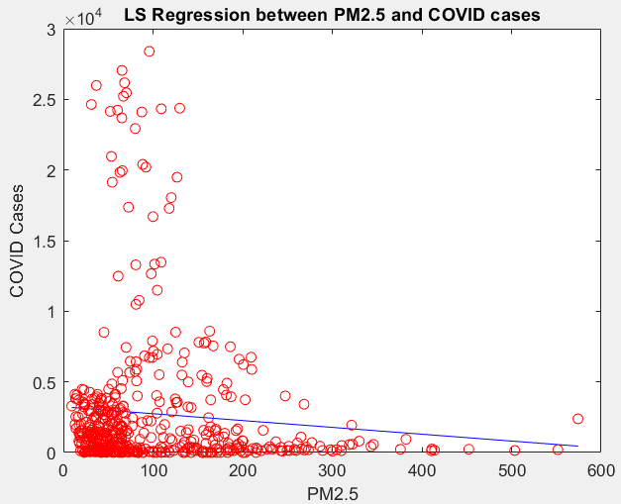
Data Analysis
2. Linear least-squares regression
Hypothesis: As COVID cases increase, PM2.5 concentration decreases due to lockdown implementations

Slide 7
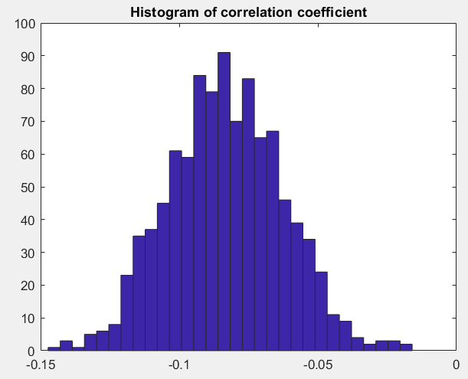
Data Analysis
3. Uncertainty analysis (Bootstrap)
Possible reasons for low correlation:
Things remained virtual for a long time, even after reduction in cases
Initial lockdown implemented with 70 cases, which led to reduction in pollution with no increase in cases

Slide 8
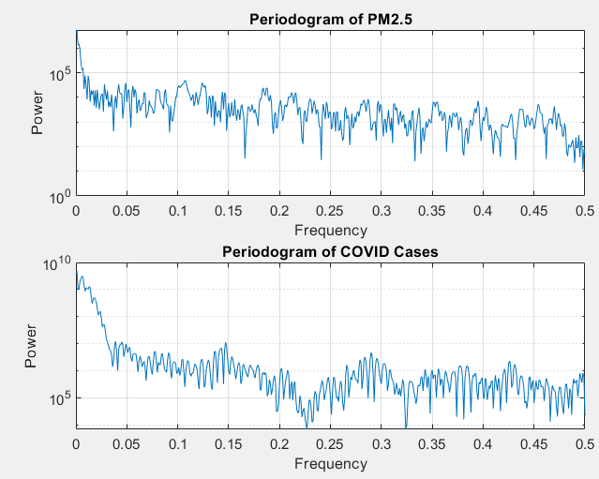
Data Analysis
4. Time-series Analysis – Periodogram
Time frame: 3/2/2020 – 8/11/2021

Slide 9
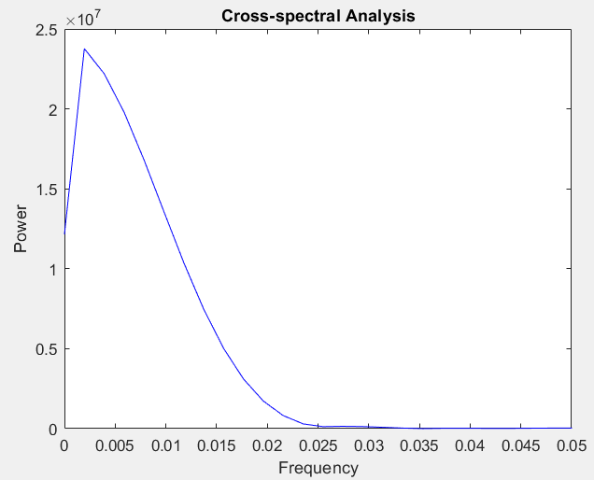
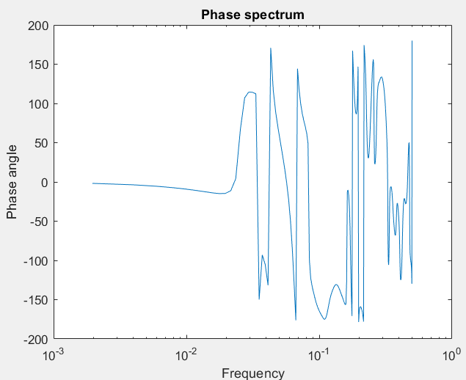
Data Analysis
5. Time-series Analysis – Cross-spectral analysis

Slide 10
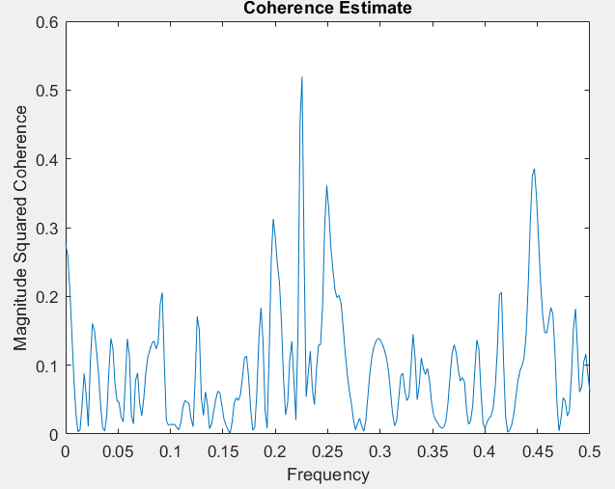
Data Analysis
5. Time-series Analysis – Coherence
Coherence value at a frequency of 0.01 = 0.029
No significant correlation

Slide 11
Thank You! Questions?

