Slide 1
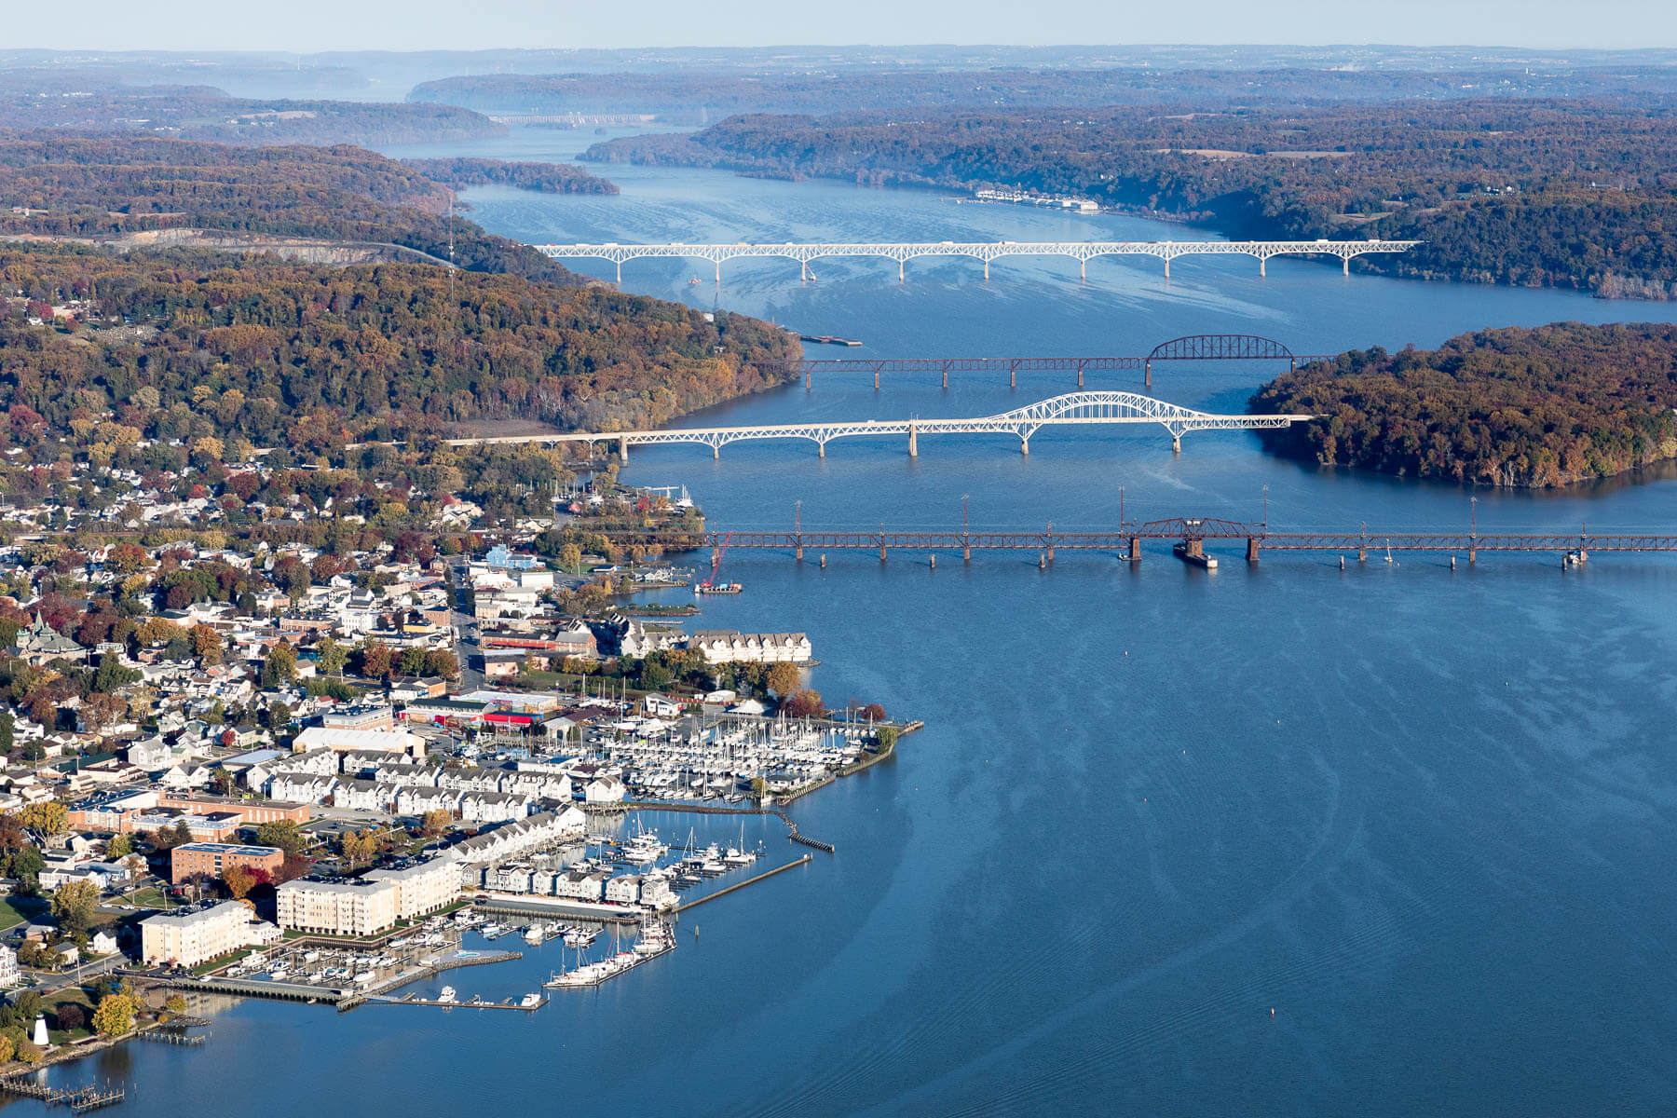
Relationship Between Dissolved Oxygen, Nitrogen, and Phosphorus Levels in the Chesapeake Bay
Sara Delawalla

Slide 2
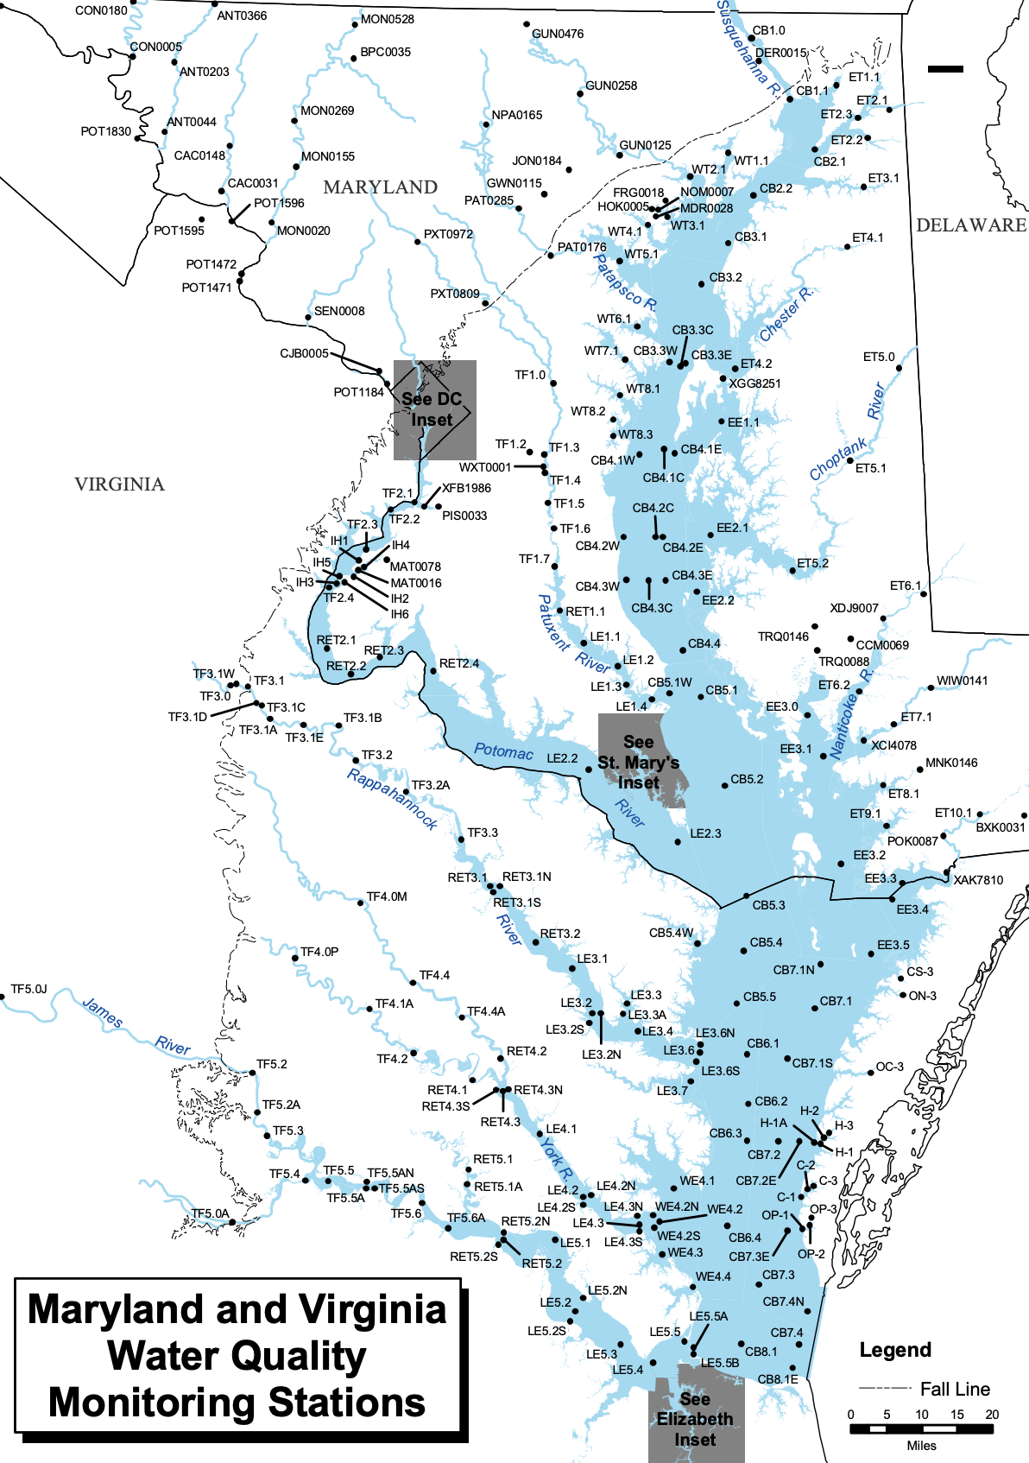
Monthly data from July 1984 to September 2021
Dissolved oxygen, total nitrogen, and total phosphorus recorded in mg/L
Question: What is the relationship between dissolved oxygen and nitrogen, and dissolved oxygen and phosphorus in the Chesapeake Bay? Does it reflect the Bay’s frequent hypoxic/anoxic events due to eutrophication?

Slide 3
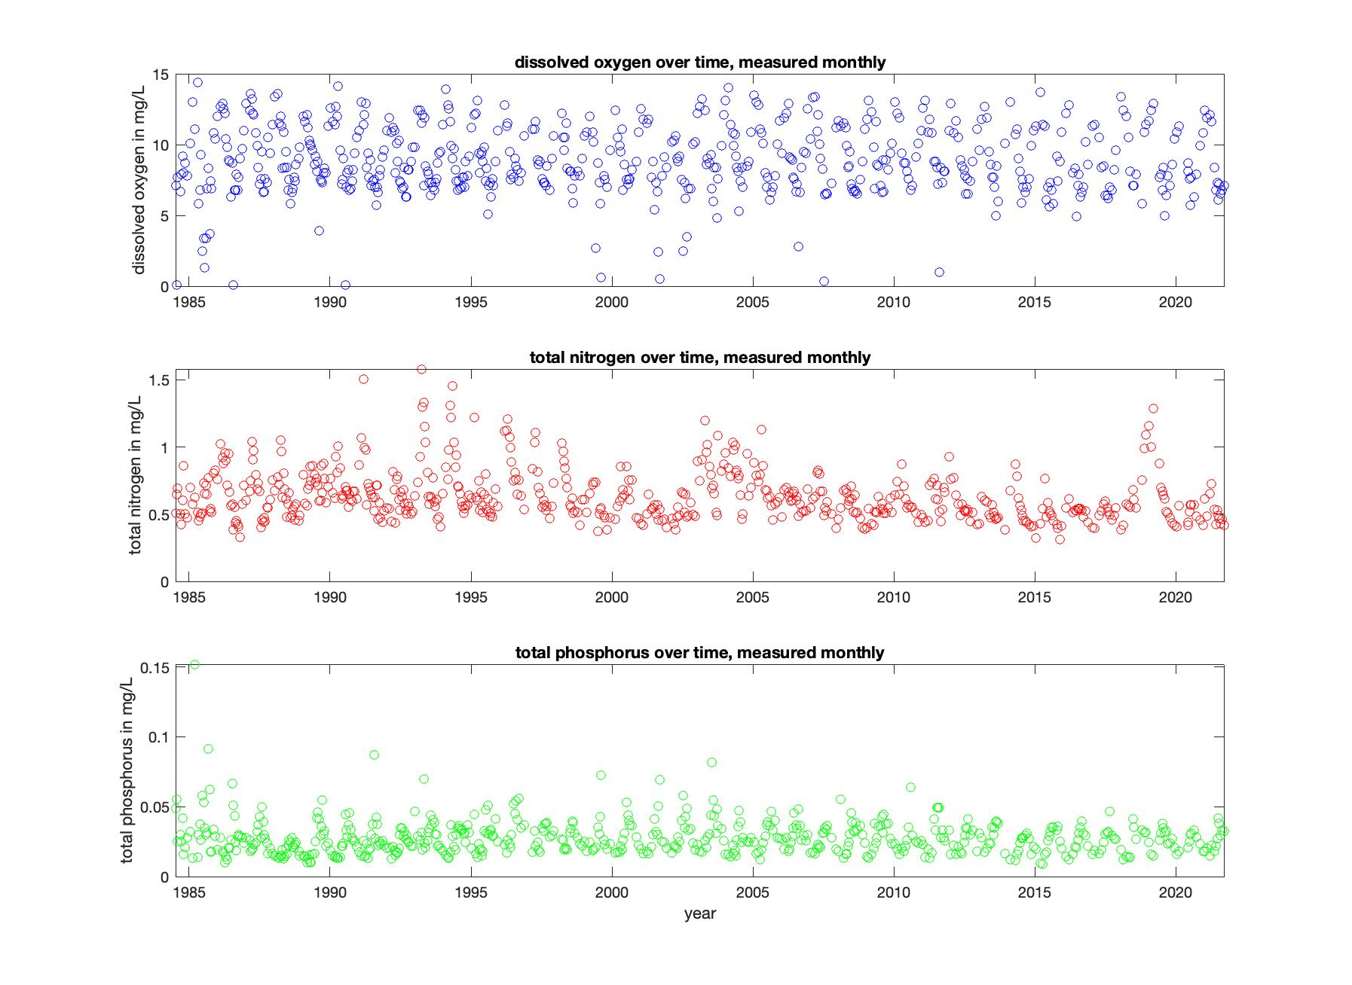

Slide 4
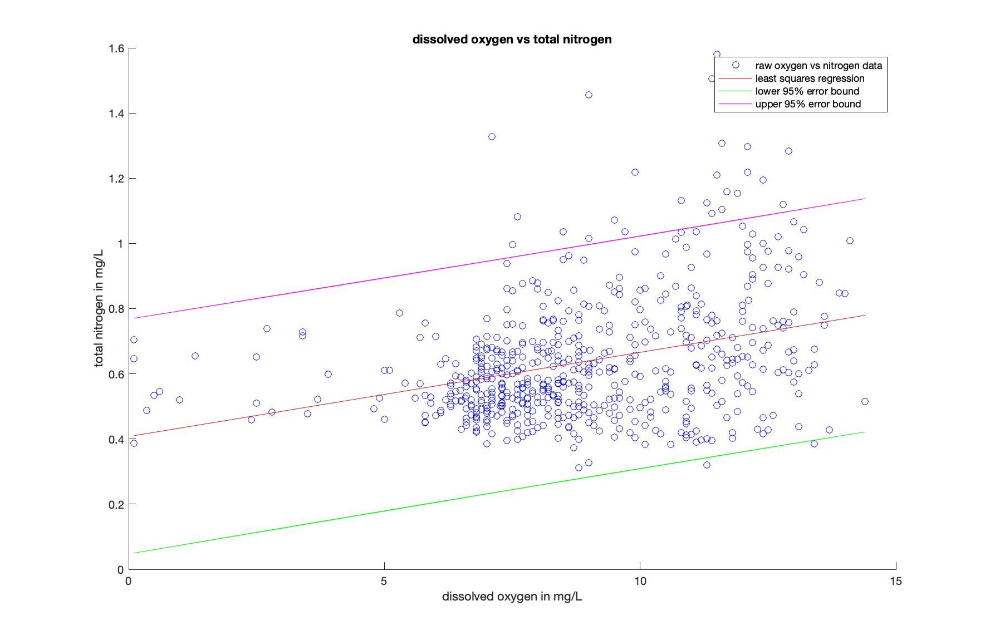
slope: 0.0258
slope error lower bound: -0.1184
slope error upper bound: 0.1701

Slide 5
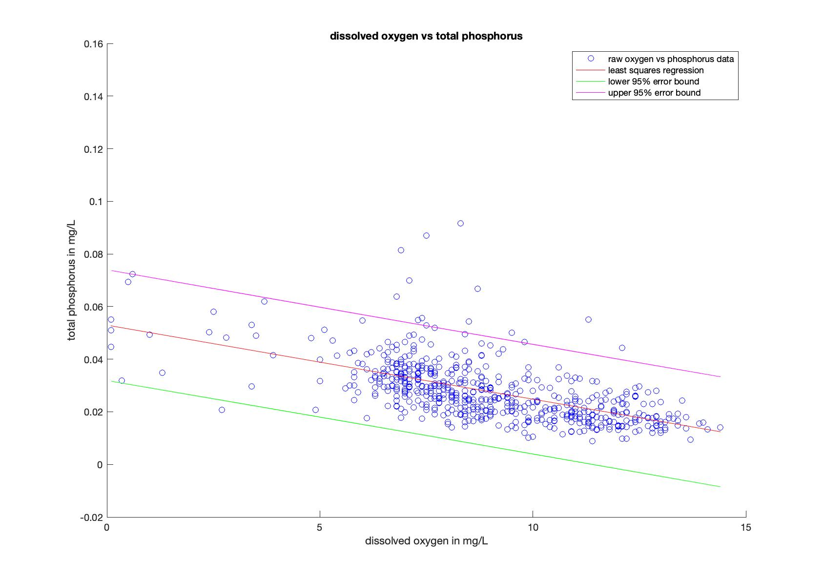
slope: -0.0028
slope error lower bound: -0.0112
slope error upper bound: 0.0056

Slide 6
Correlation coefficient
Dissolved oxygen vs nitrogen
r = 0.3322
pvalue = 1.2971e-16
r error lower bound = 0.2583
r error upper bound = 0.4022
Dissolved oxygen vs phosphorus
r = -0.5488
pvalue = 1.5096e-47
r error lower bound = -0.6029
r error upper bound = -0.4897

