Slide 1
Sea Level Rise and Rising Temperature in Washington, D.C.
Sophia Colosi
EAS 4480

Slide 2
Data Used
Sea Level Data from NOAA, collected from the tide gauge in Washington, DC on the Potomac River
Temperature data from The National Weather Service

Slide 3
Null Hypothesis
There is a correlation between sea level rise and global warming, or rising temperatures.

Slide 4
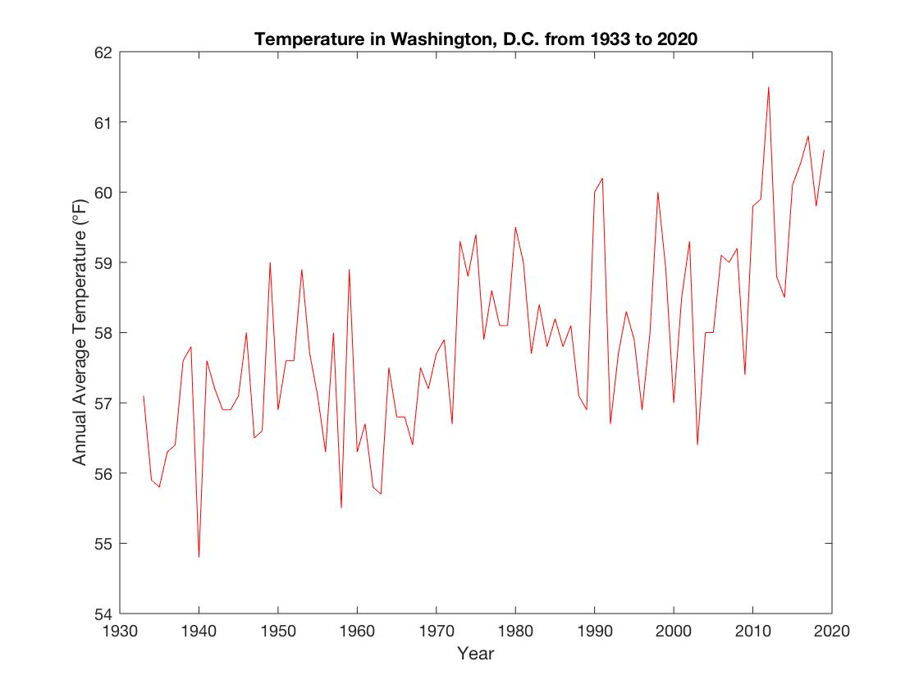
Raw data

Slide 5
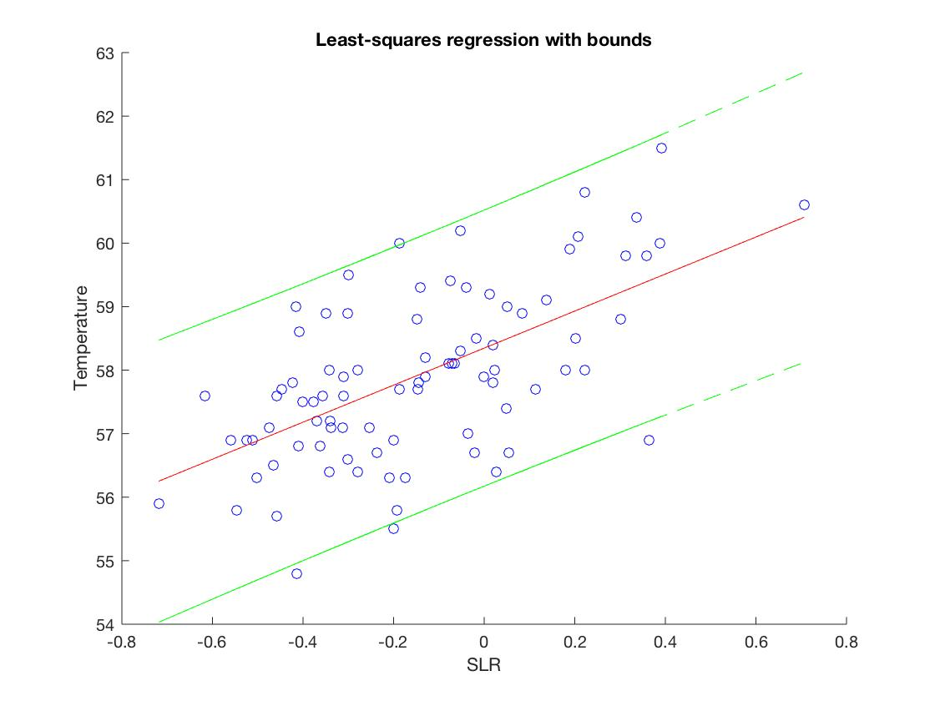
Least-Squares Regression
Slope: 2.915
CI of Slope: [-3.5302, 9.3607]
Correlation Coefficient: 0.6033
CI of Coefficient: [0.4499, 0.7222]

Slide 6
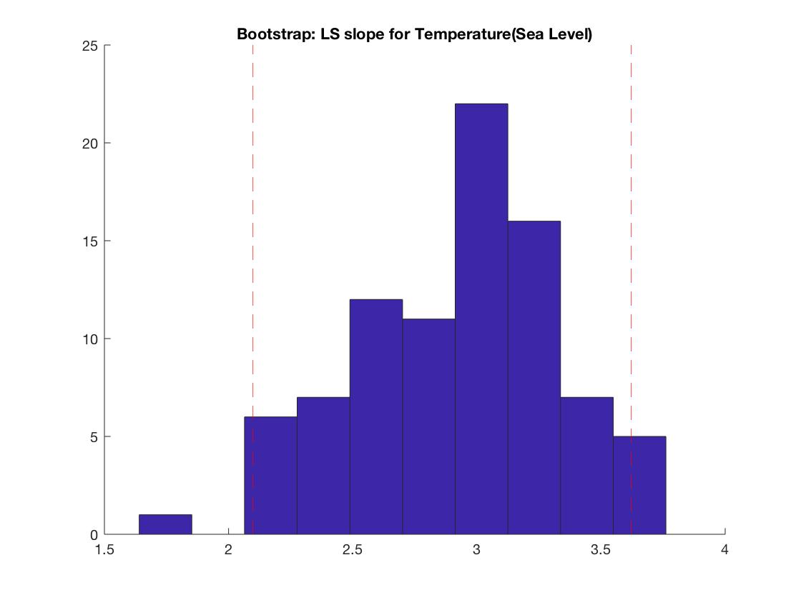
Bootstrap LS regression
CI = [2.0981, 3.6216]
Mean: 2.946
Stdev: 0.355

Slide 7
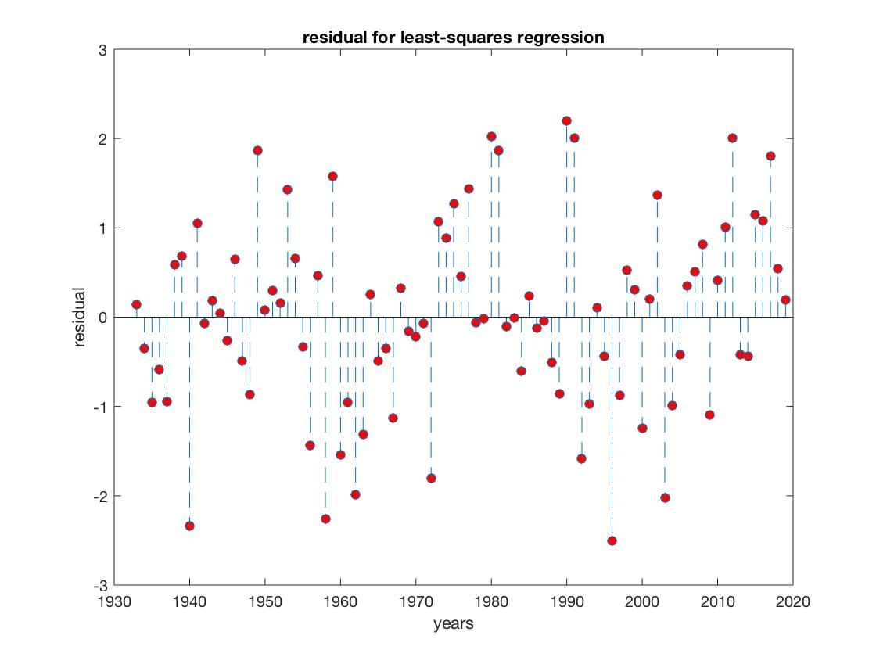
Residual Analysis
Chi2 Test:
Critical Chi2 Value = 14.0671
Residual Chi2 Value = 10.4391
The null hypothesis is that the residual of the least-squares regression is normally distributed. Because the critical chi 2 value is greater than the residual chi 2 value, we fail to reject the null hypothesis. We can conclude that the residual is normally distributed.

Slide 8
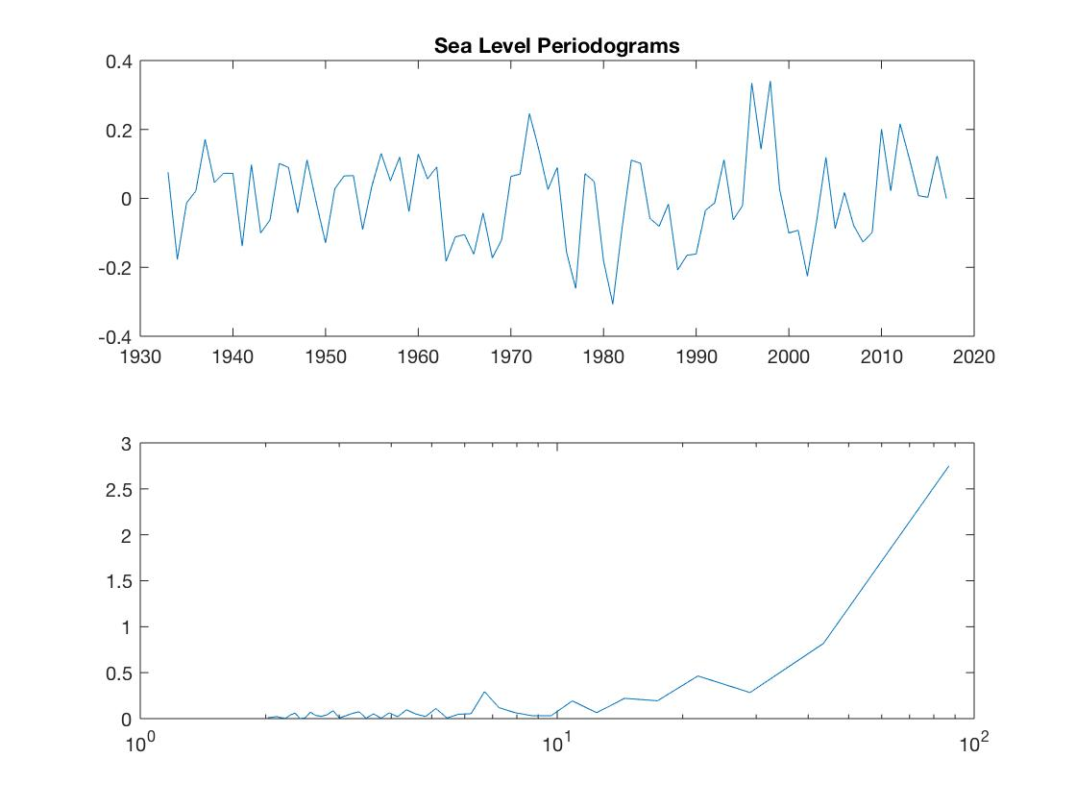
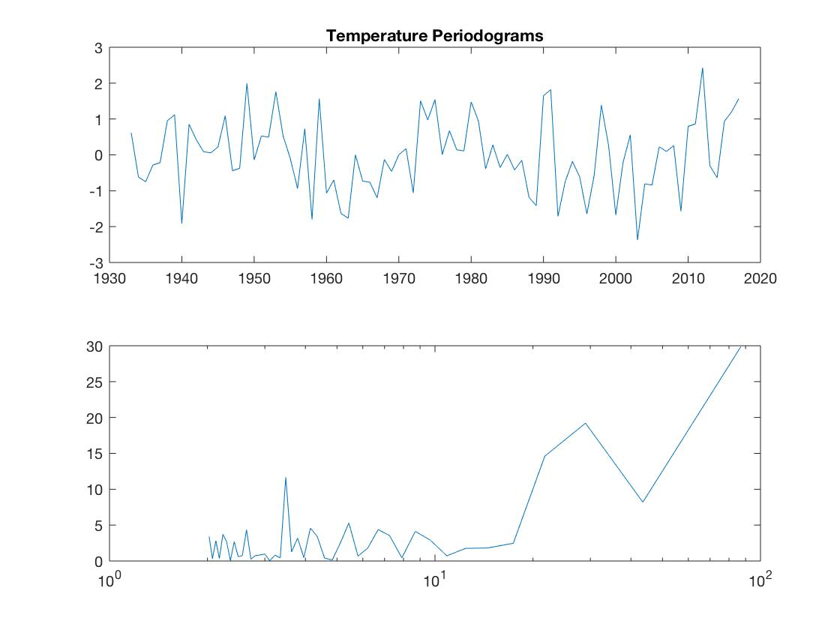
Periodicity
7 year cycle for sea level, 2 peaks for temp at 11 years and 30 years

Slide 9
CPSD
~ 30, 40 years

Slide 10
Conclusions
Fail to reject null hypothesis: There is a significant correlation between Sea Level and Atmospheric Temperature.
The datasets are normally distributed.
Slow response of Sea Level to Warming temperatures (30-40 years)
No correlation in frequency space
Localized vs global
Rising temperatures vs global warming from emissions

