Slide 1
COVID-19 wastewater surveillance
EAS 4480
Sudarshan surange

Slide 2
Project Motivation
CDC launched the national wastewater surveillance system
Aimed to monitor covid concentration across the country
Prediction of covid outbreak
Supplements existing testing methods
Source: CDC
Source: CNN news
Notes:
The CDC launched NWSS in December 2020. This system was aimed to sample and monitor the covid virus concentration across the country and predict any outbreak in the society. By collaborating with the local municipal WWTP, laboratories and counties health officials, the sampling was stared in all localized WWTP of major counties. By constantly monitoring this concentration, the health officials can be notified of any increase in the levels and preventive measures can be taken to prevent any outbreak.
In addition to the regular covid testing, this analysis helps in providing a robust and sustainable Covid-19 surveillance system. This overcomes the issue of accessibility to healthcare centers and availability of tests.

Slide 3
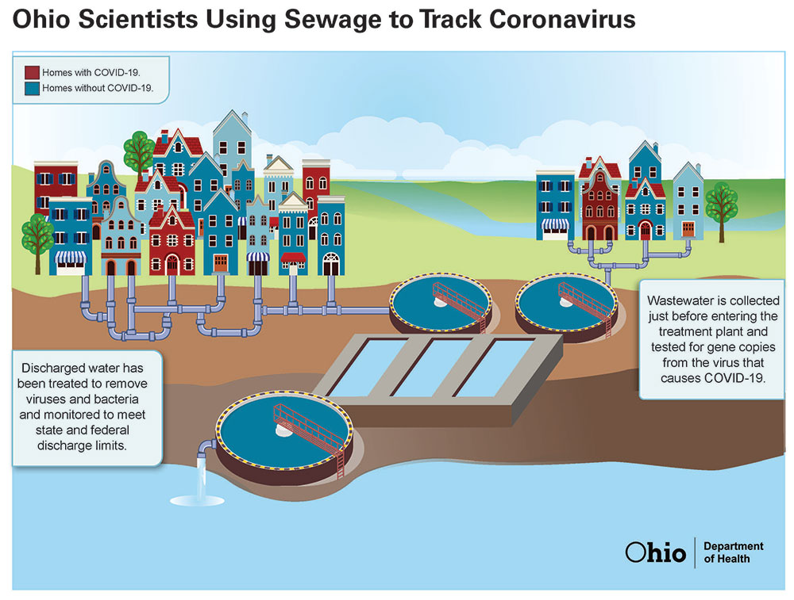
Data Sources
2 data sources:
Centers for disease control and prevention:
National wastewater surveillance system.
Contains the raw wastewater data from all of the major counties across Unites States.
California department of public health:
A network of wastewater facilities, laboratories, academic institutions and government testing centres
Source: Ohio DOH
Source: CNN news
Notes:
The data processing in this project includes interpolation of the concentration levels datasets as some datapoints were missing from the raw wastewater dataset.
The trendline of concentration data provides a more reliable way to predict and compare it with the covid cases rather than the daily data. To improve the quality of trendline, a 10 day rolling average is applied.
The data focused on in this project is taken from the Santa Clara county CA
A network of wastewater facilities, laboratories, academic institutions and government testing centres have collaborated to get daily samples of Sars-CoV2 virus concentration from the WWTP of all counties situated in California.

Slide 4
Hypothesis
The Covid-19 cases and the SARS-CoV2 concentration data are correlated.
This correlation is followed by some time lag between the two timeseries and from to the nature of this correlated data, covid outbreak can be predicted with the use of concentration data.

Slide 5
Data analysis
Time series plot with 10 day rolling average to get an estimate of the data trend.
Least squares regressions fit
Bootstrap correlation coefficient
Cross spectral analysis
Cross-correlation
Source: Ohio DOH

Slide 6
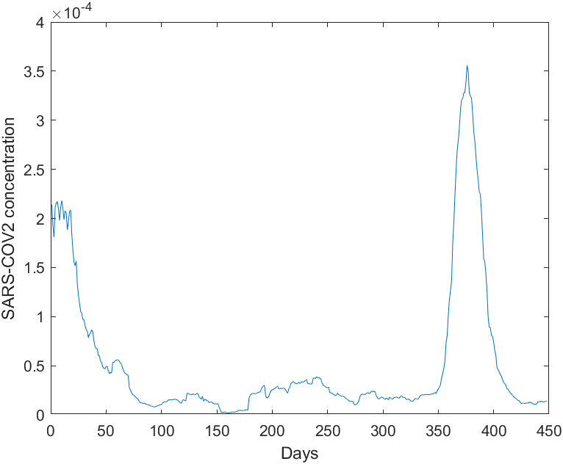
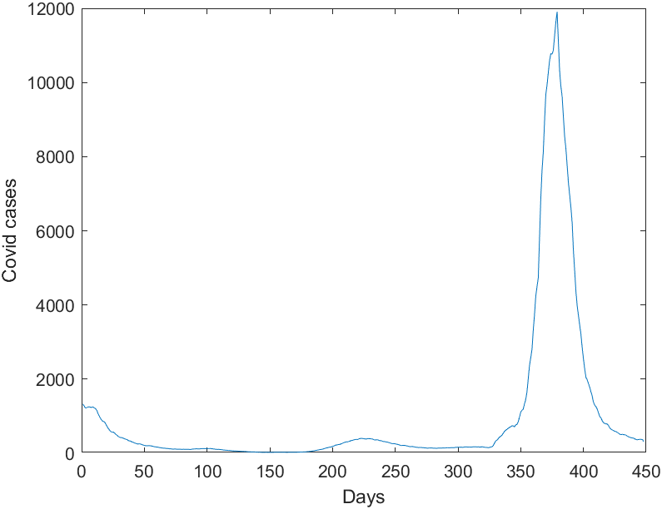
Time Series
This plot shows the time series of covid cases and SARS-COV2 virus concentration.
Time frame- 1st January 2021 to 24th March 2022

Slide 7
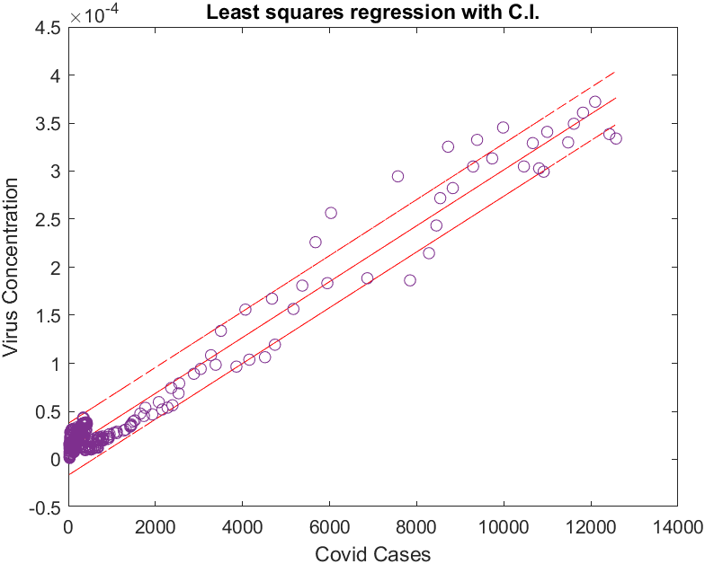
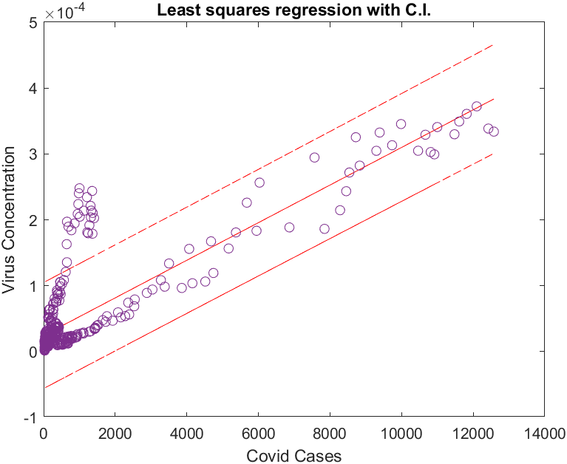
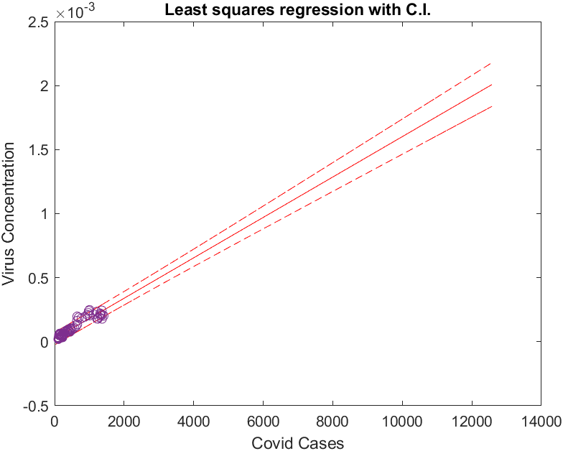
Least squares regression
Figure a: Data after the first peak (75 days)
Figure b: Data through the first peak (1st to 75Th day)
Hypothesis:
Due to change in sampling strategy adopted by the NWSS overtime
Due to the Omicron variant. Affects more people with fewer concentration doses
Figure a
Figure b
Notes:
This shows the best fit line from least squares regression. There are 2 diverging concentration data corresponding to the same covid cases. Figure a shows the data after 75th day while figure b data from 1st day until the 75th day. The surge ended at around 75th day.
This could be backed up by 2 hypothesis. 1) The sampling strategy of NWSS changes over time while optimizing the process. It required less concentration to reflect the same number of cases. 2) The omicron surge came into effect by the end of 2021. It could be possible that it affected the same number of people from a fewer concentration doses.

Slide 8
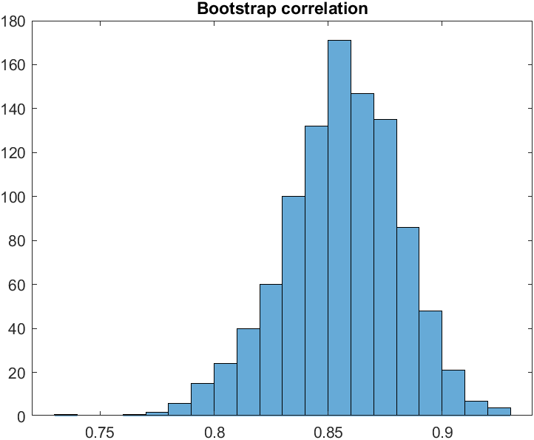
Bootstrap correlation
This is the uncertainty analysis model showing the bootstrap correlation coefficient histogram.
Resampled 1000 times
Mean correlation coefficient of 0.8489
This signifies a good correlation between the two datasets

Slide 9
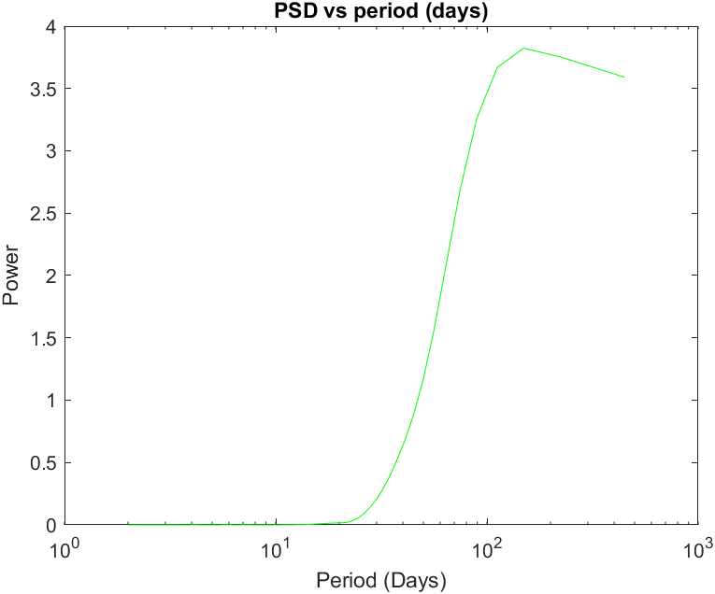
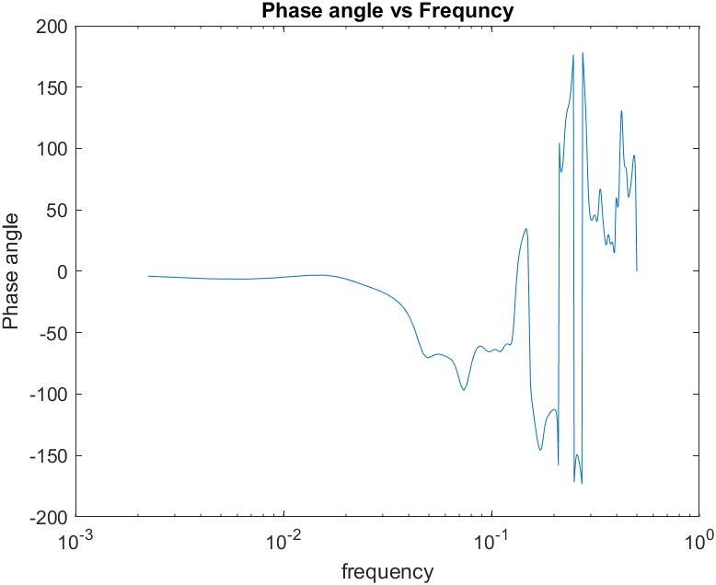
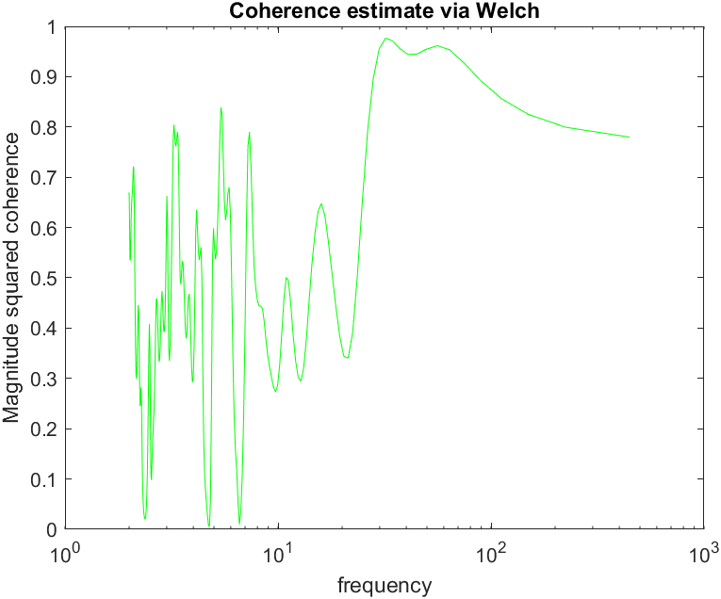
Cross spectral analysis
The cross spectral analysis does not give results. Due to the higher number of cases from the omicron variant, it suppresses the rest of the peaks making them just white noise.
Notes:
This data is not periodic.
Due to higher power spectral density at the end, it suppresses rest of the peaks making the data as white noise. (i.e. giving out a constant psd).
No phase lag could be determined because of this. Also the coherence proves to be inconclusive.

Slide 10
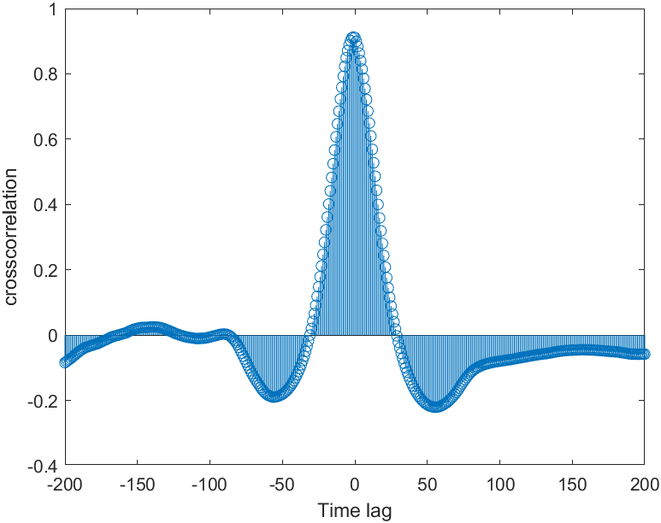
Cross-correlation
This is not a periodic function
A correlation of 0.912 is found at time lag of -1 unit.
This signifies that both of the time series data are well correlated at almost no time lag
It can be implemented that the virus concentration measured at WWTP is a fast indicator of localised covid cases

Slide 11
Conclusion
Strong correlation is found between covid cases and virus concentration
Cross spectral analysis proves to be futile due to high power spectral density towards the end
Highly correlated without showing any time lag
Concentration is a fast reflector of covid cases

Slide 12
Thank You

Slide 13
References
1) California Department of health,’ www.cdph.ca.gov’.
2) Centers for disease control and prevention,’ www.cdc.gov,.
3) National wastewater surveillance system, ’www.cdc.gov/nwss’.

