Slide 1
Can we equitably increase access to electricity while reducing greenhouse gas emissions?
Thiago Esslinger
20 April 2022
EAS 4480

Slide 2
How to go about answering this question:
Correlation between access to electricity and…
Greenhouse gas emissions (kt CO2 equivalent)
Electricity Production from Fossil Fuels (%)
Electricity Production from Renewable Sources (%)
For …
World data
7 countries with highly developed economies (G7)
7 countries with developing economies
And is there a trend in the data?
Notes:
*data for energy consumption NOT in % was behind paywall, thus this data was used in the analysis

Slide 3
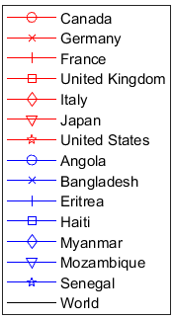
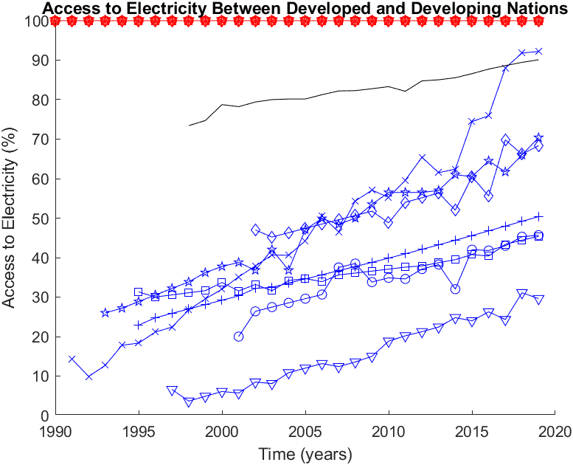
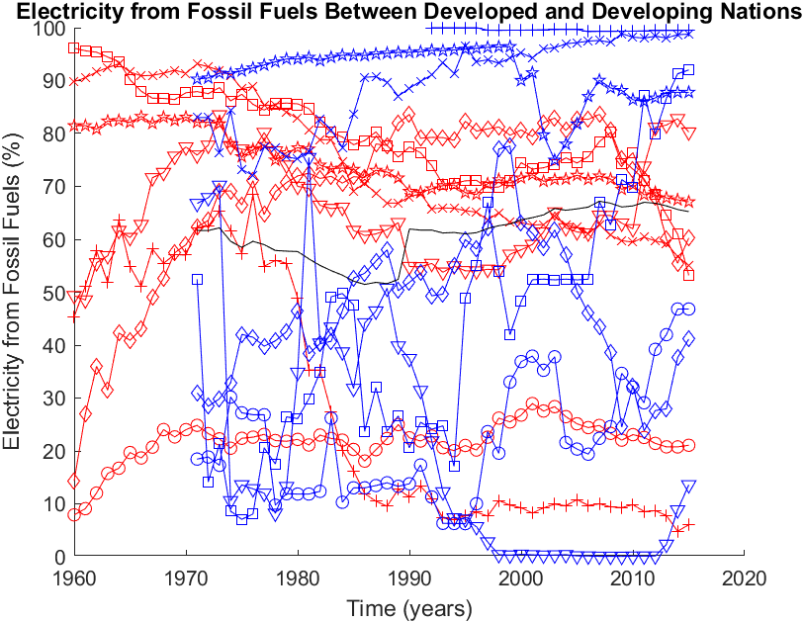
Preliminary Data

Slide 4
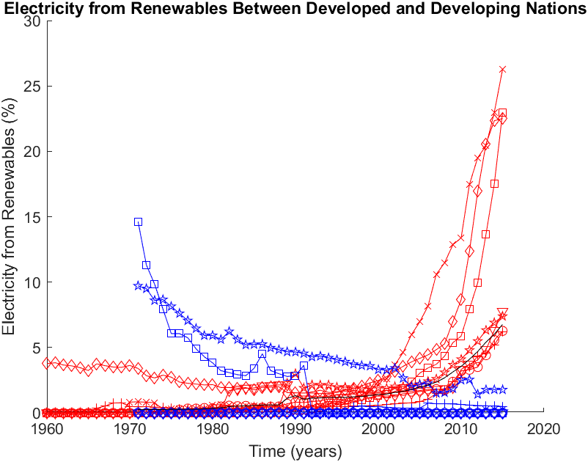
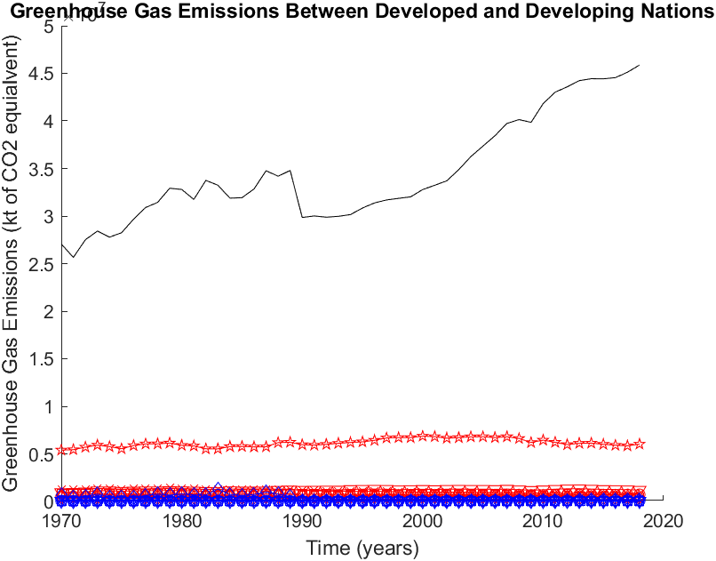
Preliminary Data
Notes:
*note y-axis for renewables is zoomed in (not out of 100)
*note different units for these GHGs (not in %)!

Slide 5
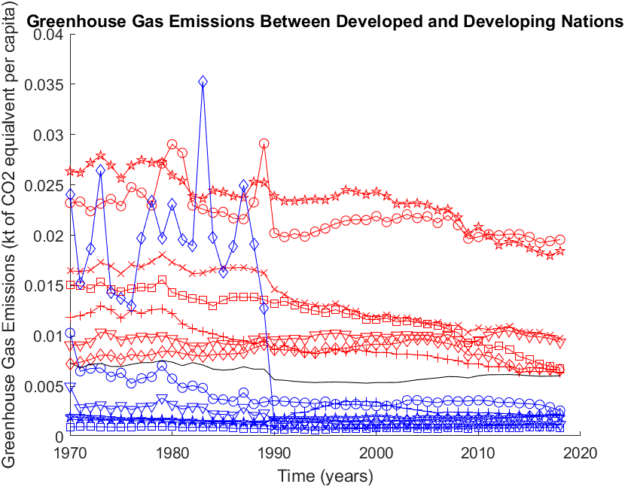
Preliminary Data
Notes:
Switched GHGs to per capita use (again, still not %).
*note per capita emissions of developed countries are all above global per capita global average

Slide 6
Let’s compute the correlation!
Notes:
*correlation was not computed between countries, as groupings were chosen solely to select countries to test; if differences between the groups of countries arose for their correlations between variables, then we have an interesting story…
*because correlation occurred between multiple variables and some countries included had noticeably poor record-keeping, the common time period only included 2002-2015 (14 years)

Slide 7
Correlation of variables
Access to Electricity vs. Electricity from Fossil Fuels
Country | r | p | r_low | r_high
World | 0.191431 | 0.512084 | -0.37749 | 0.655438
Canada | NaN | NaN | NaN | NaN
Germany | NaN | NaN | NaN | NaN
France | NaN | NaN | NaN | NaN
U.K. | NaN | NaN | NaN | NaN
Italy | NaN | NaN | NaN | NaN
Japan | NaN | NaN | NaN | NaN
U.S.A. | NaN | NaN | NaN | NaN
Angola | 0.295147 | 0.305631 | -0.27915 | 0.713926
Bangladesh | 0.873979 | 4.38E-05 | 0.640329 | 0.959584
Eritrea | -0.32897 | 2.51E-01 | -0.73181 | 0.244244
Haiti | 0.938488 | 6.84E-07 | 0.812474 | 0.980724
Myanmar | -0.67583 | 7.98E-03 | -0.88799 | -0.22645
Mozambique | 0.632917 | 1.51E-02 | 0.15408 | 0.871003
Senegal | 0.75957 | 1.62E-03 | 0.383576 | 0.919557
Access to Electricity vs. Electricity from Renewables
Country | r | p | r_low | r_high
World | 0.957761 | 7.48E-08 | 0.868553 | 0.986853
Canada | NaN | NaN | NaN | NaN
Germany | NaN | NaN | NaN | NaN
France | NaN | NaN | NaN | NaN
U.K. | NaN | NaN | NaN | NaN
Italy | NaN | NaN | NaN | NaN
Japan | NaN | NaN | NaN | NaN
U.S.A. | NaN | NaN | NaN | NaN
Angola | NaN | NaN | NaN | NaN
Bangladesh | 0.633471 | 0.015007 | 0.154982 | 0.871226
Eritrea | 0.328966 | 0.250784 | -0.24424 | 0.731813
Haiti | NaN | NaN | NaN | NaN
Myanmar | NaN | NaN | NaN | NaN
Mozambique | NaN | NaN | NaN | NaN
Senegal | -0.49868 | 0.069506 | -0.81391 | 0.043375
Access to Electricity vs. GHG Emissions
Country | r | p | r_low | r_high
World | 0.93236 | 1.19E-06 | 0.795119 | 0.978757
Canada | NaN | NaN | NaN | NaN
Germany | NaN | NaN | NaN | NaN
France | NaN | NaN | NaN | NaN
U.K. | NaN | NaN | NaN | NaN
Italy | NaN | NaN | NaN | NaN
Japan | NaN | NaN | NaN | NaN
U.S.A. | NaN | NaN | NaN | NaN
Angola | -0.05081 | 0.863046 | -0.56613 | 0.493062
Bangladesh | 0.966184 | 2.01E-08 | 0.8938 | 0.989506
Eritrea | -0.89237 | 1.77E-05 | -0.96571 | -0.68713
Haiti | 0.667564 | 0.00909 | 0.212115 | 0.884764
Myanmar | 0.804589 | 0.00052 | 0.478117 | 0.935714
Mozambique | -0.48411 | 0.079412 | -0.80732 | 0.06253
Senegal | 0.532868 | 0.049768 | 0.003191 | 0.829051

Slide 8
Correlation of variables
Electricity from Fossil Fuels vs. from Renewables
Country | r | p | r_low | r_high
World | 0.056085 | 0.84897 | -0.48905 | 0.569711
Canada | -0.78293 | 0.000929 | -0.92801 | -0.43168
Germany | -0.91578 | 4.29E-06 | -0.97339 | -0.74926
France | -0.85312 | 0.000105 | -0.95254 | -0.58928
U.K. | -0.938 | 7.17E-07 | -0.98057 | -0.81108
Italy | -0.97979 | 9.43E-10 | -0.99376 | -0.93556
Japan | 0.872308 | 4.73E-05 | 0.636163 | 0.959024
U.S.A. | -0.95413 | 1.22E-07 | -0.9857 | -0.85781
Angola | NaN | NaN | NaN | NaN
Bangladesh | 0.486492 | 0.077729 | -0.05943 | 0.808404
Eritrea | -1 | 0 | -1 | -1
Haiti | NaN | NaN | NaN | NaN
Myanmar | NaN | NaN | NaN | NaN
Mozambique | NaN | NaN | NaN | NaN
Senegal | -0.62131 | 0.017709 | -0.86631 | -0.13534
Electricity from Fossil Fuels vs. GHG Emissions
Country | r | p | r_low | r_high
World | 0.421357 | 0.133489 | -0.14067 | 0.778003
Canada | 0.877509 | 3.73E-05 | 0.649179 | 0.960767
Germany | 0.836913 | 0.000189 | 0.551008 | 0.946985
France | 0.825276 | 0.000279 | 0.524255 | 0.942958
U.K. | 0.773078 | 0.001185 | 0.411139 | 0.924462
Italy | 0.97149 | 7.29E-09 | 0.909942 | 0.991169
Japan | 0.564268 | 0.035556 | 0.048084 | 0.842586
U.S.A. | 0.935076 | 9.39E-07 | 0.802784 | 0.97963
Angola | -0.49378 | 0.072735 | -0.8117 | 0.049865
Bangladesh | 0.841742 | 0.00016 | 0.562285 | 0.948646
Eritrea | 0.515825 | 0.059016 | -0.02031 | 0.821556
Haiti | 0.789144 | 0.000792 | 0.444806 | 0.930232
Myanmar | -0.57182 | 0.032641 | -0.84579 | -0.0592
Mozambique | 0.065397 | 0.824225 | -0.4819 | 0.57599
Senegal | 0.603652 | 0.022265 | 0.107505 | 0.859081
Electricity from Renewables vs. GHG Emissions
Country | r | p | r_low | r_high
World | 0.913782 | 4.91E-06 | 0.743842 | 0.972743
Canada | -0.7292 | 0.003084 | -0.90834 | -0.32395
Germany | -0.85231 | 0.000108 | -0.95226 | -0.58734
France | -0.9663 | 1.97E-08 | -0.98954 | -0.89416
U.K. | -0.9043 | 9.00E-06 | -0.96964 | -0.71842
Italy | -0.95487 | 1.11E-07 | -0.98594 | -0.86
Japan | 0.296013 | 0.304147 | -0.27827 | 0.714391
U.S.A. | -0.9524 | 1.52E-07 | -0.98516 | -0.85272
Angola | NaN | NaN | NaN | NaN
Bangladesh | 0.701632 | 0.005163 | 0.272494 | 0.897935
Eritrea | -0.51582 | 0.059016 | -0.82156 | 0.020314
Haiti | NaN | NaN | NaN | NaN
Myanmar | NaN | NaN | NaN | NaN
Mozambique | NaN | NaN | NaN | NaN
Senegal | -0.28111 | 0.330261 | -0.70634 | 0.293198

Slide 9
What are the correlations?
Access to electricity is strongly correlated to electricity production from fossil fuels and to greenhouse gas emissions for developing countries and the world

Slide 10
What are the correlations?
Access to electricity is strongly correlated to electricity production from fossil fuels and to greenhouse gas emissions for developing countries and the world
Electricity production from fossil fuels and from renewables is strongly correlated for G7 countries, but not for the world

Slide 11
What are the correlations?
Access to electricity is strongly correlated to electricity production from fossil fuels and to greenhouse gas emissions for developing countries and the world
Electricity production from fossil fuels and from renewables is strongly correlated for G7 countries, but not for the world
Electricity production from fossil fuels and renewables are both strongly correlated with GHG emissions for G7 countries

Slide 12
What are the correlations?
Access to electricity is strongly correlated to electricity production from fossil fuels and to greenhouse gas emissions for developing countries and the world
Electricity production from fossil fuels and from renewables is strongly correlated for G7 countries, but not for the world
Electricity production from fossil fuels and renewables are both strongly correlated with GHG emissions for G7 countries
Electricity production from fossil fuels and GHG emissions is strongly correlated for most developing countries, but that is not the case for electricity production from renewables

Slide 13
Why are the correlations so?
Increasing access to electricity increases demand on electricity production (mostly based on fossil fuels)
This increases GHG emissions

Slide 14
Why are the correlations so?
Increasing access to electricity increases demand on electricity production (mostly based on fossil fuels)
This increases GHG emissions
G7 countries’ electricity production from renewables has increased, but not nearly enough to effectively reduce GHG emissions

Slide 15
Why are the correlations so?
Increasing access to electricity increases demand on electricity production (mostly based on fossil fuels)
This increases GHG emissions
G7 countries’ electricity production from renewables has increased, but not nearly enough to effectively reduce GHG emissions
This data does not account for population growth which increases overall electricity production and GHG emissions
Values are in % and per capita

Slide 16
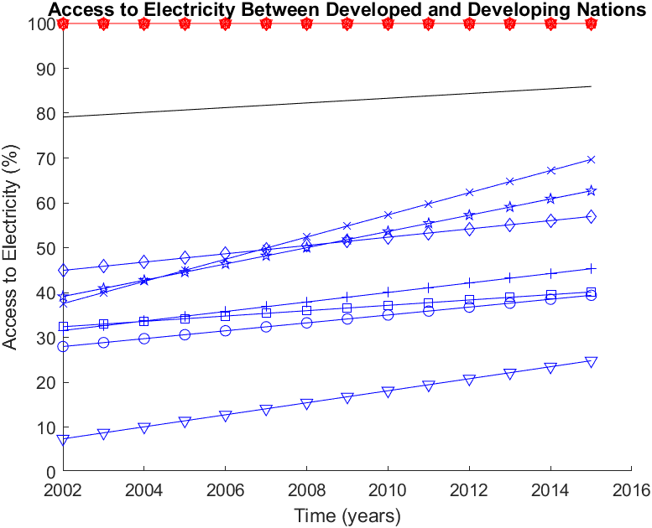
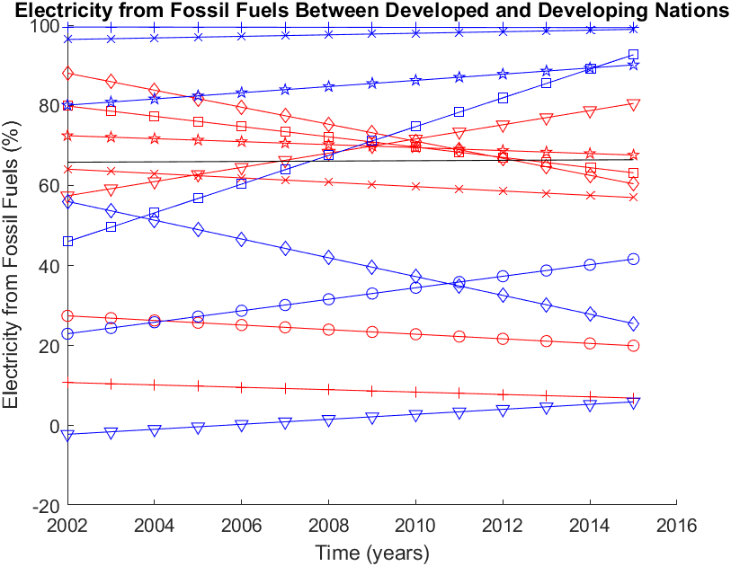
Least-squares regression of variables
Notes:
*bootstrap method was used to determine the uncertainty in slopes (not included due to visual crowding in slide)
*LS regression here was used for visual determination of any trends

Slide 17
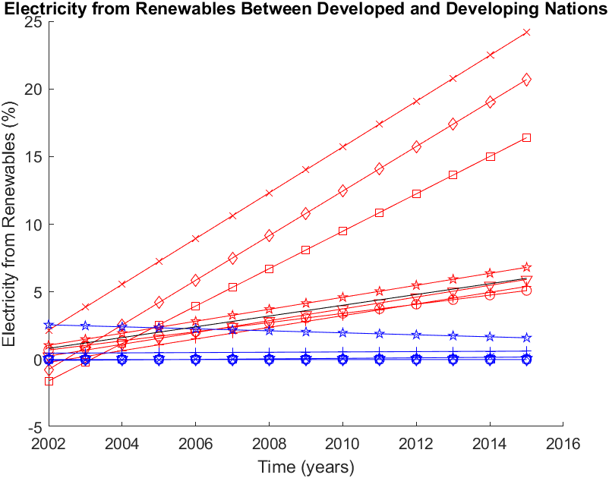
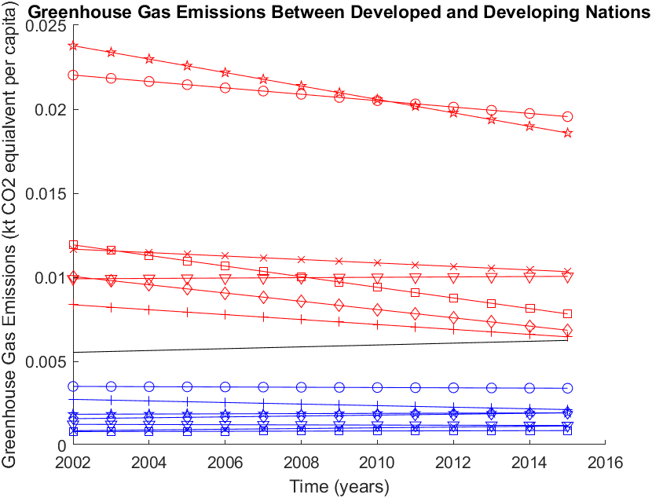
Least-squares regression of variables

Slide 18
Can we equitably increase access to electricity while reducing greenhouse gas emissions?

Slide 19
Can we equitably increase access to electricity while reducing greenhouse gas emissions?
Yes, but so far we have not…

Slide 20
Can we equitably increase access to electricity while reducing greenhouse gas emissions?
Yes, but so far we have not…
Developing countries cannot be expected to reduce fossil fuel use when developed countries have the capacity to do so, and don’t act accordingly.

