Slide 1
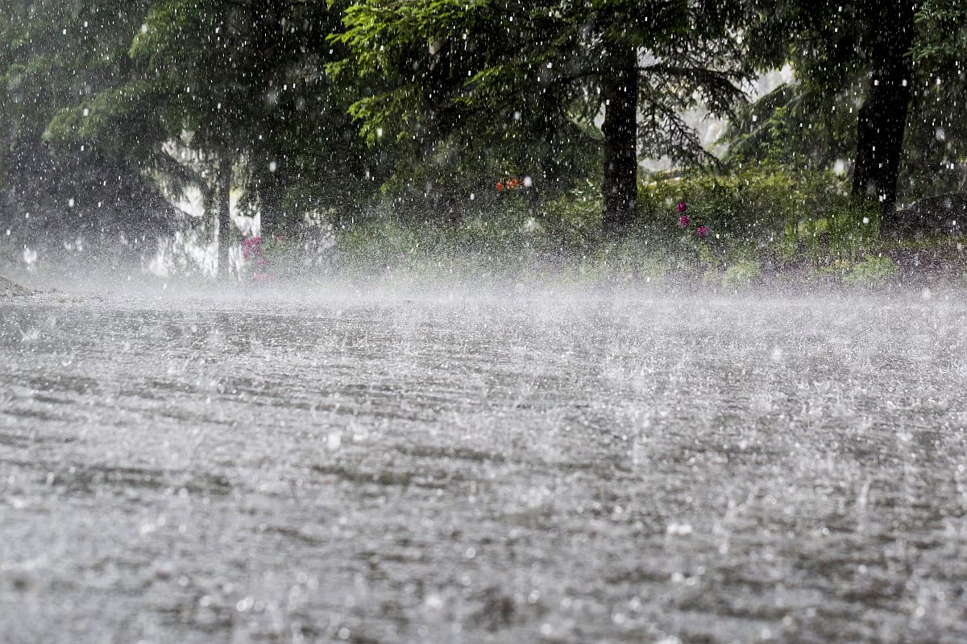
Analysis of Longest Instrumental Rainfall Series of the Indian Regions (1848-2006)
Yamini Kulkarni
EAS-4480

Slide 2
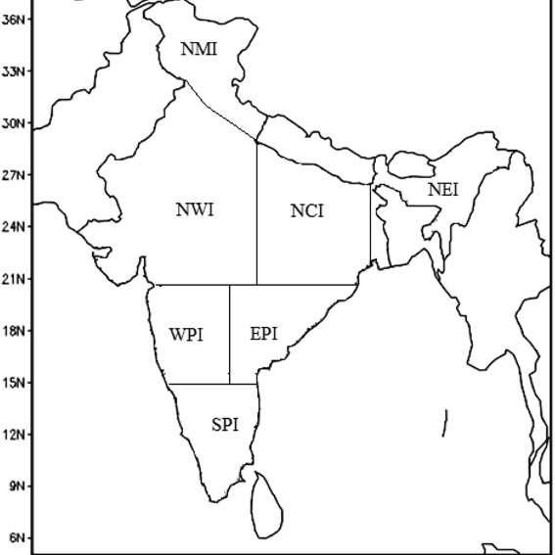
Introduction
Long period rainfall data is important for climate studies
Helps in identifying wind patterns, seasonal variations
Monthly averaged, seasonal and annual rainfall series of seven homogeneous zones and the whole India have been developed from well spread network of 316 raingauge stations
The series is constructed by applying theoretically vindicated objective method
Out of seven regions four are considered here
North Mountainous India (NM)
North West India (NWI)
North Central India (NCI)
North East India (NEI)
West Peninsular India (WPI)
East Peninsular India (EPI)
South Peninsular India (SPI)
Whole India (AI)

Slide 3
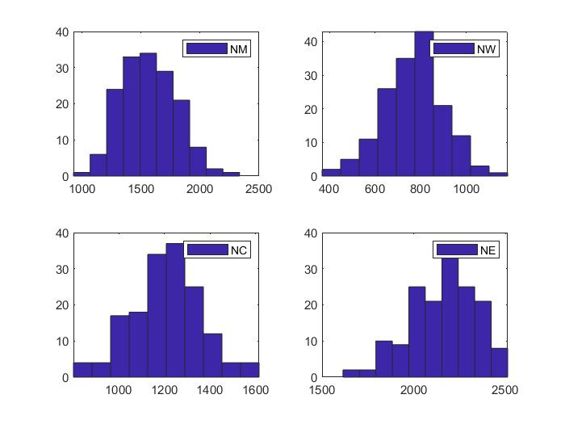
Methods and Hypothesis
Expecting fluctuations in amount of precipitation for the period of 158 years.
All regions are correlated with each other in terms of the rainfall
Statistical Analysis Performed: Histogram, Hist, Timeseries Analysis, Boxplot, Student’s t Distribution, Correlation, Least Squares Regression, Periodogram

Slide 4
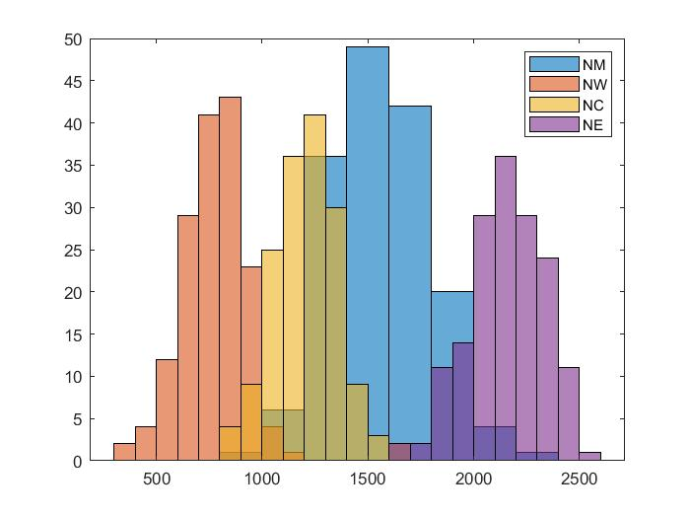
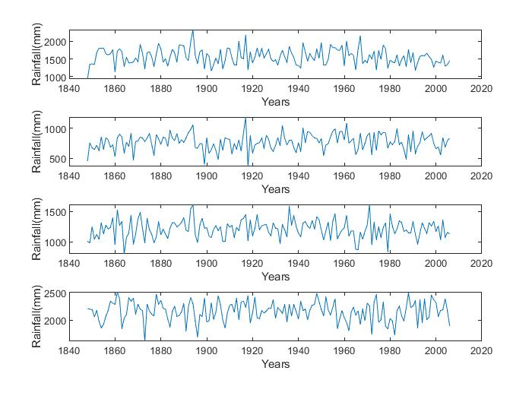
Histogram Distribution and Trend Analysis of the Annual Rainfall

Slide 5
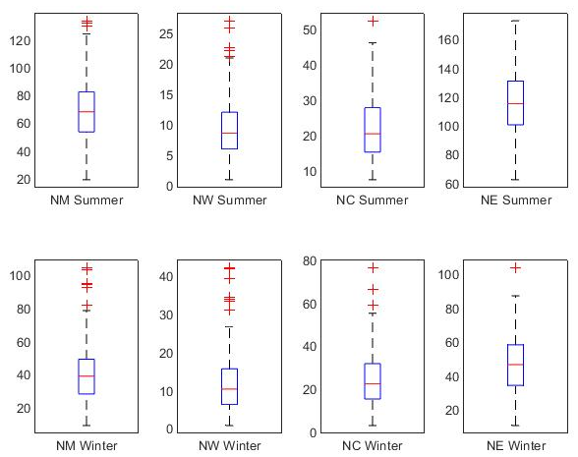
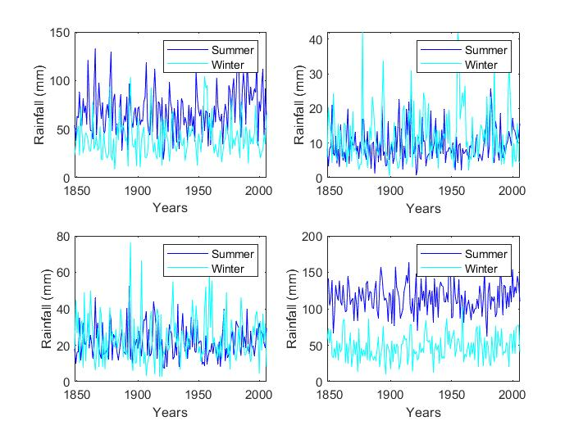
Box Plot Comparison f - Summer and Winter Averaged Data
Summer Fluctuations: 1840s–early 1890s increase, 1890s–1900s sudden decrease, 1900s–early 1960s increase and 1960s onwards decrease
Winter Fluctuations: From early years up to about 1910 with largely decreasing
rainfall trends and a slight increasing trend thereafter

Slide 6
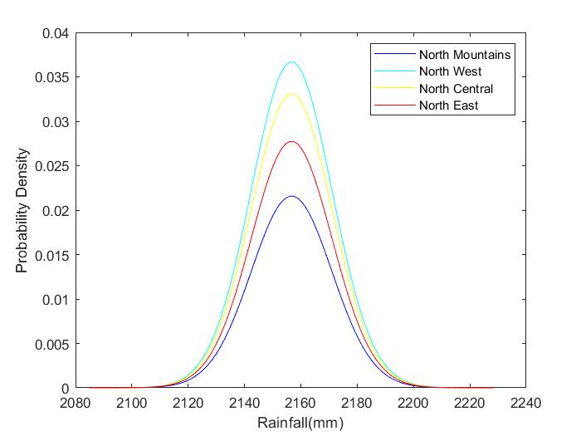
The t - Test
Regions | tcalc | tcrit | h
NM-NW | 37.1723 | 1.9675 | 1
NM-NC | 16.2079 | 1.9675 | 1
NM-NE | 25.2724 | 1.9675 | 1
Null hypothesis can be rejected

Slide 7
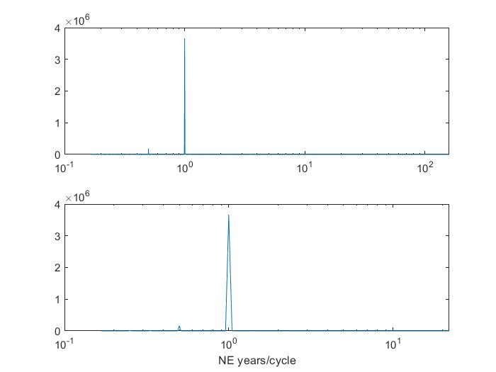
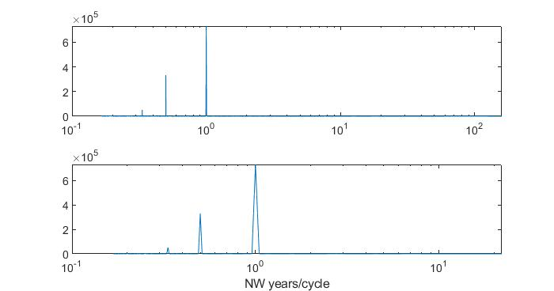
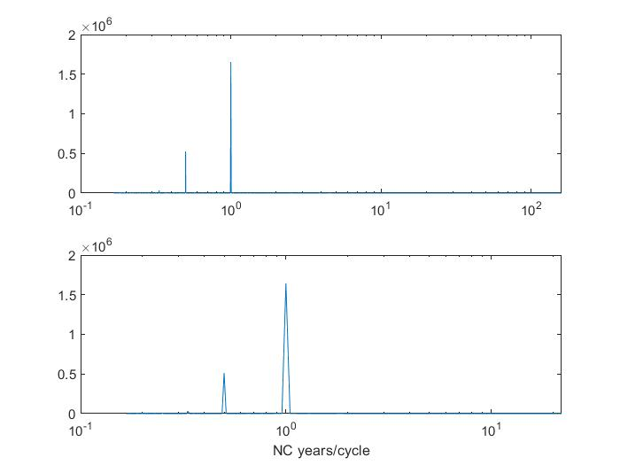
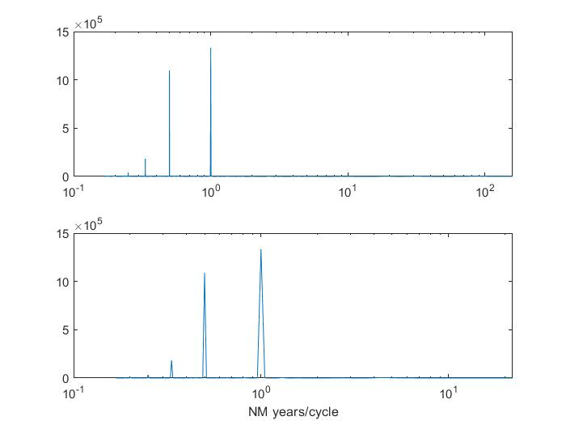
Periodogram

Slide 8
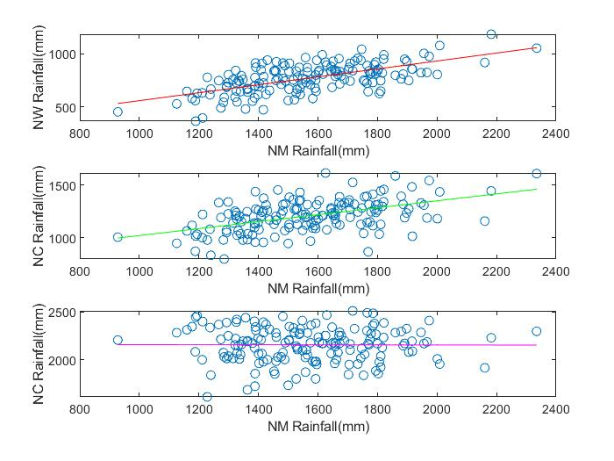
Correlation and Regression Analysis of the Regions as per Annual Rainfall
Regions | Correlation(r) | L.S. Regression Slope
NM-NW | 0.6312 | 0.3714
NM-NC | 0.5040 | 0.3288
NM-NE | -0.0041 | -0.0001

Slide 9
Conclusion
Three zones, North Mountainous, North West and North CentraI can be cosidered together as a contiguous monsoon area of India while the North East is not correlated with these regions
In the summer and winter monsoon rainfall fluctuations of NM, NW and NE show similar increasing/decreasing trend while NE region trend is somewhat different
Can be receiving rainfall from other sources

