Slide 1
An Analysis into Bird Migration Patterns
William Boynton

Slide 2
Motivation
As wildlife and their food sources are being threatened by expansion, how do they react?
Have birds been forced to survive the environment we have created in cities like New York or Miami? Or are they being pushed back through expansion?
How are their migratory habits affected?
What is the answer to these w.r.t. time, comparing data between 1980s-90s to now.

Slide 3
Hypothesis
HYP: Birds will end up distanced from major cities.
ALT HYP: Birds will end up distanced from most major cities, but will find themselves near smaller populations and towns.

Slide 4
Data
Not much, what’s out there is jumbled or in .png files
Found one data source that has been reliable:
Cornell Lab’s Project Feederwatch (9 mil+ entries)
Lat/Lon and counts of bird surveys across the US.
Had to clean the data: null values, invalid surveys, etc.
Filtered the data down into the times when birds will have finished their migration (looking at where they ended up).
After Spring Migration, they are in the North (months: [4, 9]).
After Fall Migration, they are in the South (months: [11, 12], [1, 2]).
Filtered the data further by state for each settling time.

Slide 5
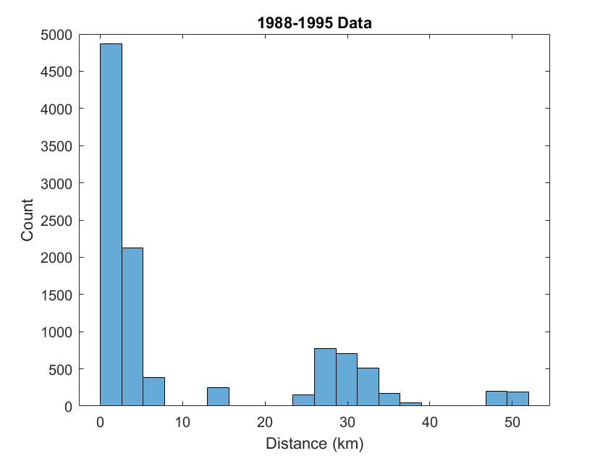
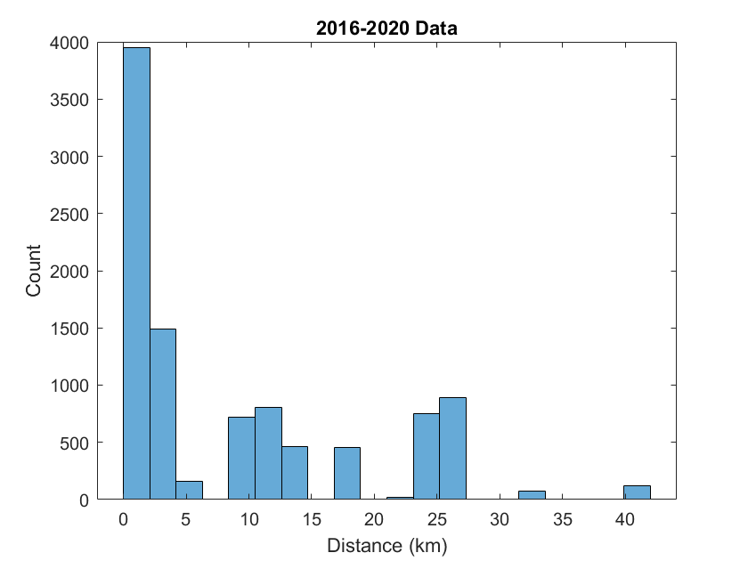
Histograms
Focused on Mississippi, 1988-1995 & 2016-2020
Found the minimum Euclidean distances of bird surveys from a list of the 85 largest population centers (by population).
Created a histogram to find the most common values.
20 bins: peak between 0-2.5km from cities
The 2000s data showed fewer bird counts than the 1980s data.
Error in data continuity: Fewer people making observations in 2000s closer to cities, more making observations in small towns and parks.

Slide 6
Statistical Values
Calculations of the mean/median/standard deviation show the distribution of the data.
A lower mean distance means the peak of the distribution has shifted to include a greater number of closer distances.
A lower STD shows a smaller variance in the data, and a higher probability of birds occurring closer to the mean.
Data YR | Mean (km) | Median (km) | STD (km)
2020 | 1.8763 | 1.8817 | 1.1341
1985 | 2.2177 | 1.8792 | 1.5763

Slide 7
Linear Regression
Next, I grouped the data into counts of birds by distance to perform a linear regression
After performing a polyfit on the data and plotting it (2020 on x, 1995 on y), the results showed a decent fit between the data, until further inspection.
The original trend shows a good fit for all data.
2-sigma removed takes away the 15km+ distances. The City Skirt trend further removes the “in-city” points.
Further from city center (<10km), 2020 data shows a decrease in the trendline (i.e. shorter avg distances).
>10km can be seen as extraneous points close to other cities, and not meaningful for this analysis.

Slide 8
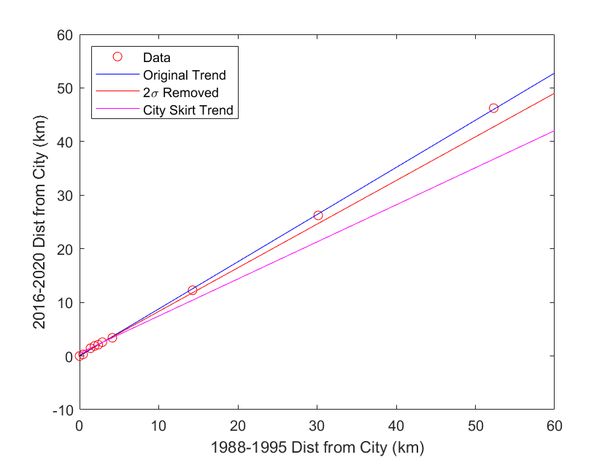
Linear Regression
Data | Slope | Y-intercept
Original | 1.1934 | -0.5566
2 Sigma Removed | 1.1039 | -0.2590
City Skirt Trend | 0.8810 | 0.0520
Test | Value
Correlation Coeff | 0.9865
Confidence Interval | [0.8046, 0.9992]
Significance | 0.0019

Slide 9
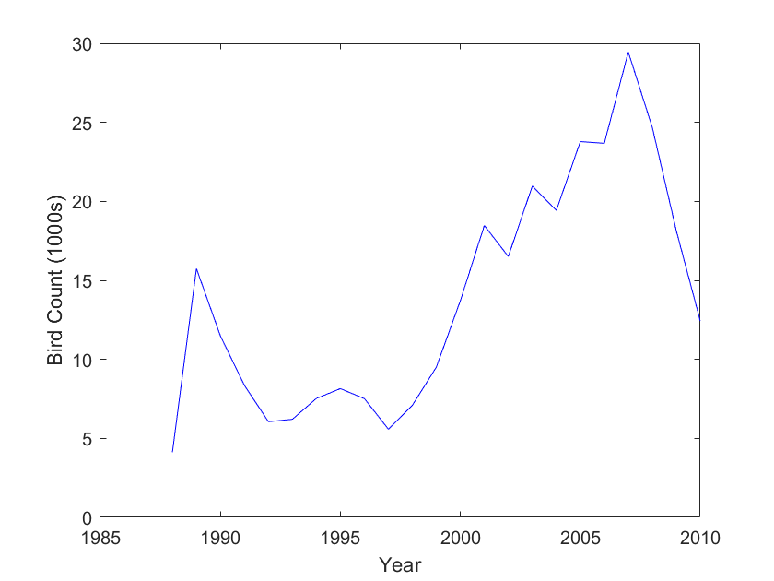
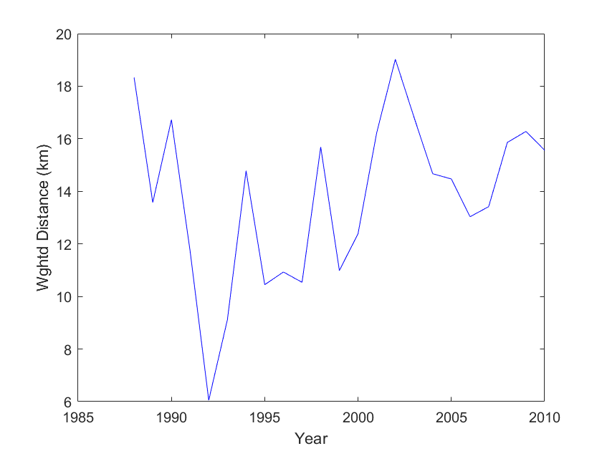
Time Series Analysis
Number of Birds is dictated by the number of observers.
Strictly looking at bird count per year is not enough
Instead, look at distance weighted by bird count.
Data shows inaccuracies.

Slide 10
Items to Look into Before Report
How does the effect of rapid expansion (i.e. Atlanta) change the behavior of birds?
1
Can I include a side-analysis on park and nature preserve centers?
2
Apply the data I have to QGIS to perform a by-zone analysis
3

Slide 11
Error
How did new city development affect the way data was collected?
New city and development disrupts wildlife in area, observation inaccuracies
How did city expansion, development, and events affect the behavior of the birds at the time of observation?
Was there a fire? Or development that occurred in that region over a specific time?
Human Error is a huge factor
Missed observations, incorrect record keeping, limited region of observation.
Poorly maintained datasets
Excluding around 200+ smaller towns and areas and doesn’t consider the existence of natural parks and nature preserves, so the data in the >10km range might be different in real life.
Not much variety of publicly sourced data.

Slide 12
Conclusions
City growth and development has had a major impact on birds over the years.
Studies show that urban development has led to a decline in avian population given reduced homeland area for the wildlife.
These results show that the bird population has had to adapt to the new environment we forced onto it.
Birds have adapted to move towards cities and urbanized areas for food and shelter.

